Slide 1

Metrocar Analysis
Notes:
valuable insights
and potential issues

Slide 2
Metrocar Analysis
User Funnel
Funnel stage with lowest conversion rate
Possible reason
Average spending
Most engaged platform
Age range most users
User distribution
Notes:
explain what will be discussed

Slide 3
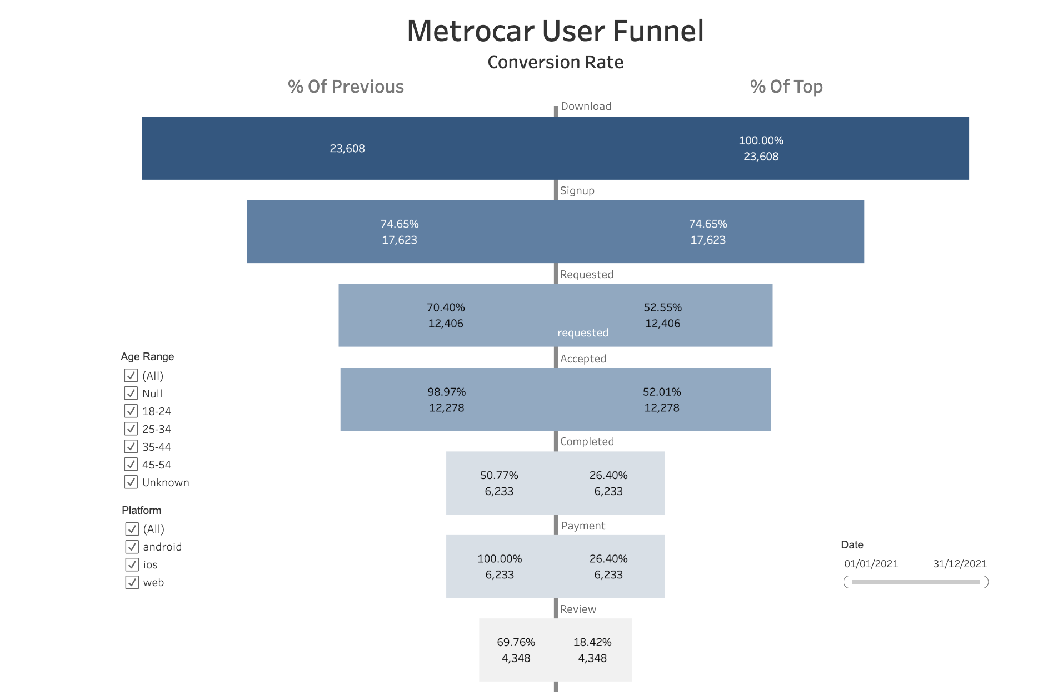
Notes:
explain the steps
cancellation equally distributed
no affect on destination

Slide 4
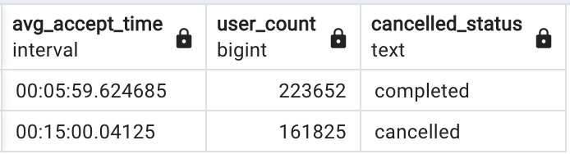
Notes:
potential issue
more data to investigate further

Slide 5
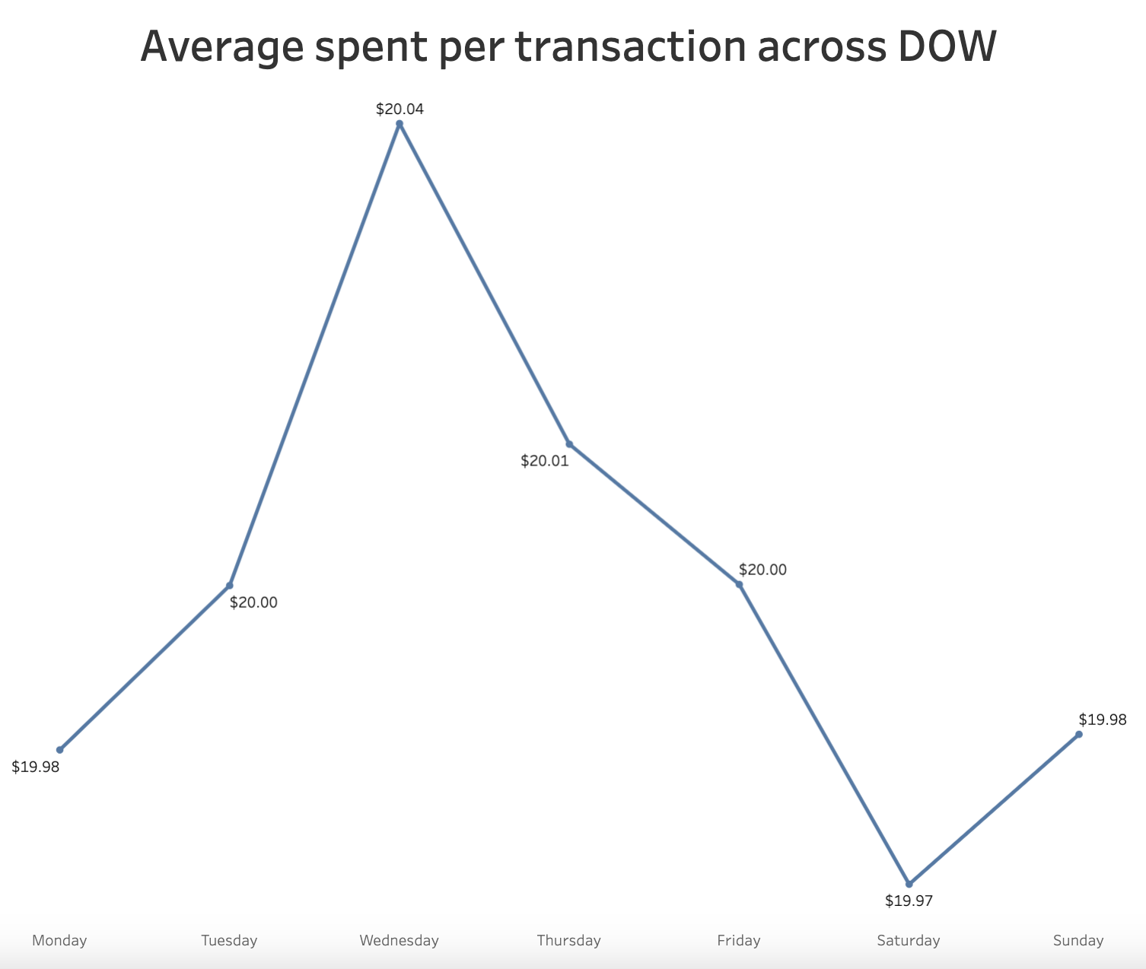
Notes:
average spending across all trips is in the region of $20

Slide 6
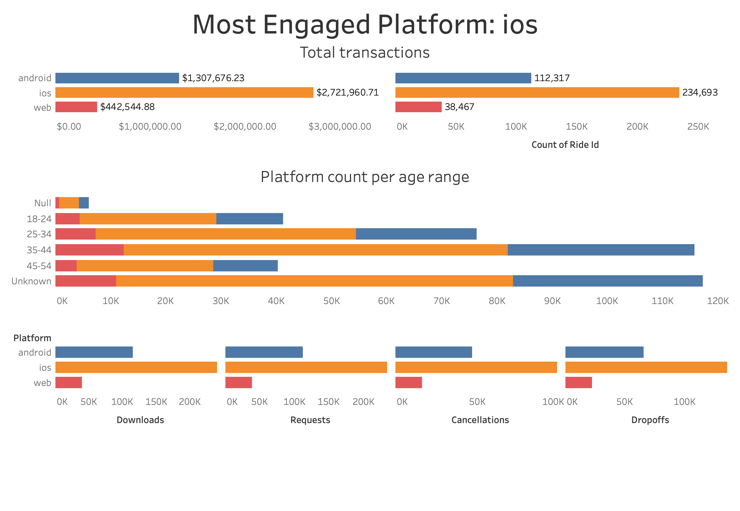
Notes:
most spent on ios
because

Slide 7
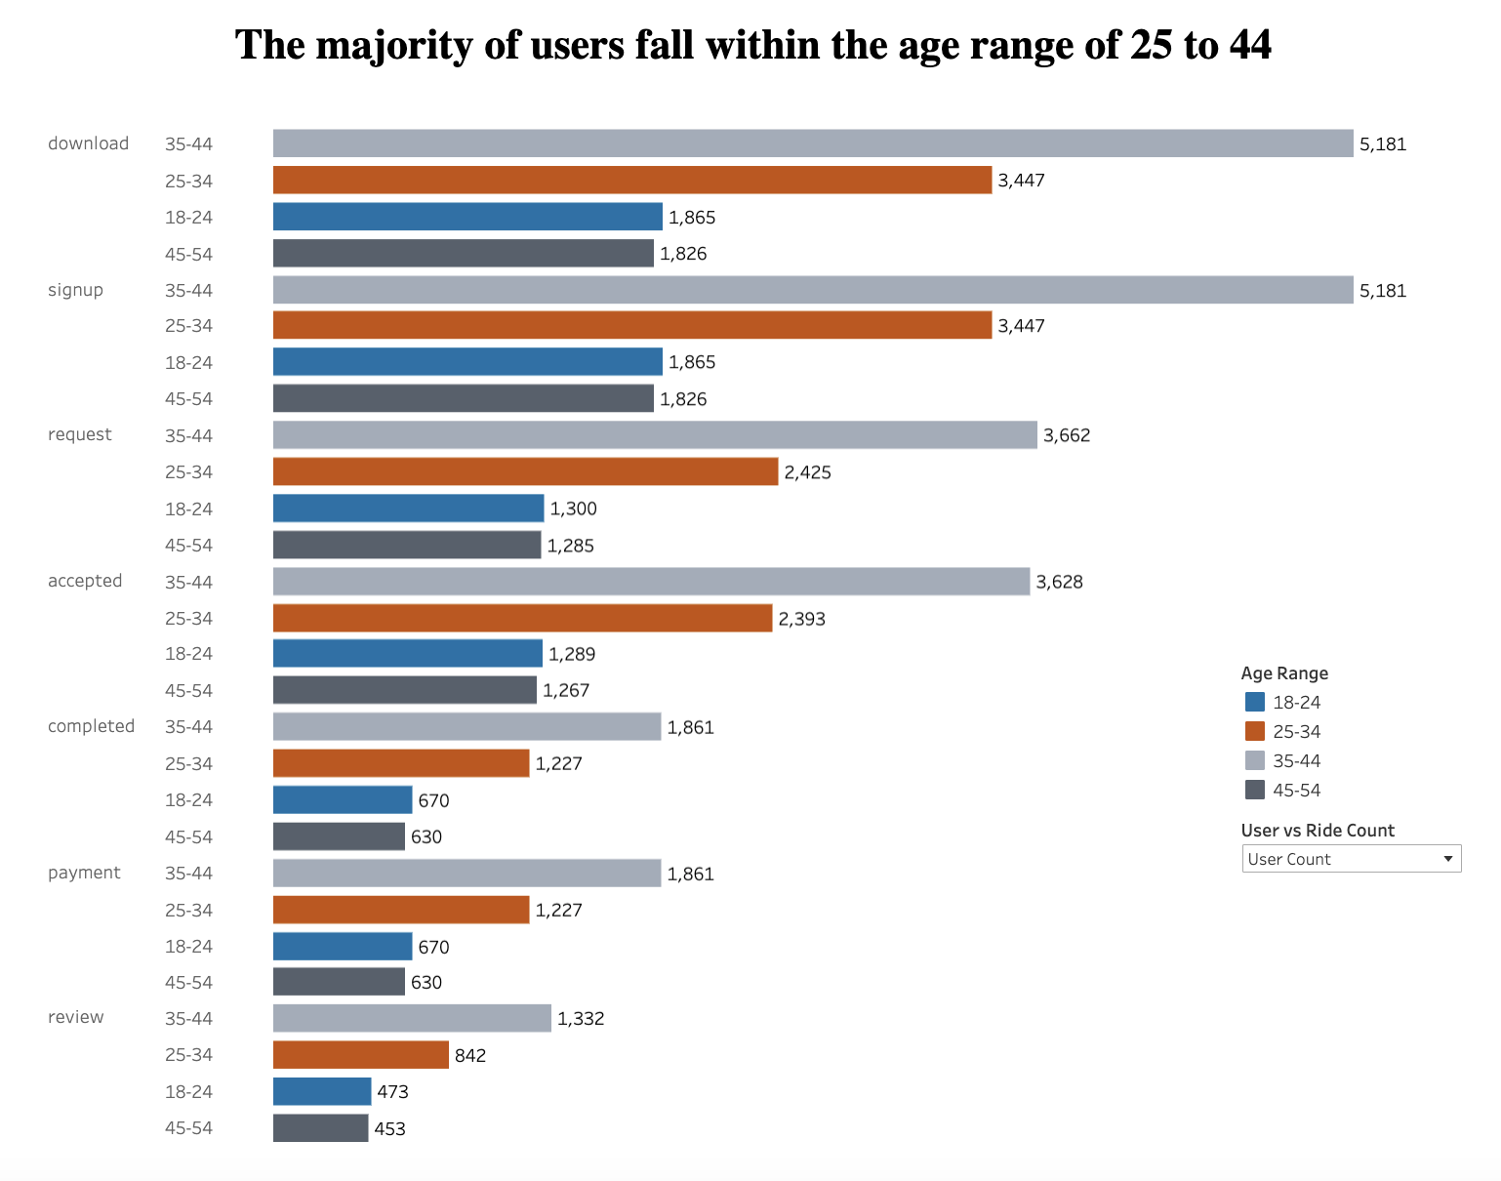
Notes:
considerably users are
in the age brackets of 35-45 and 25-34

Slide 8
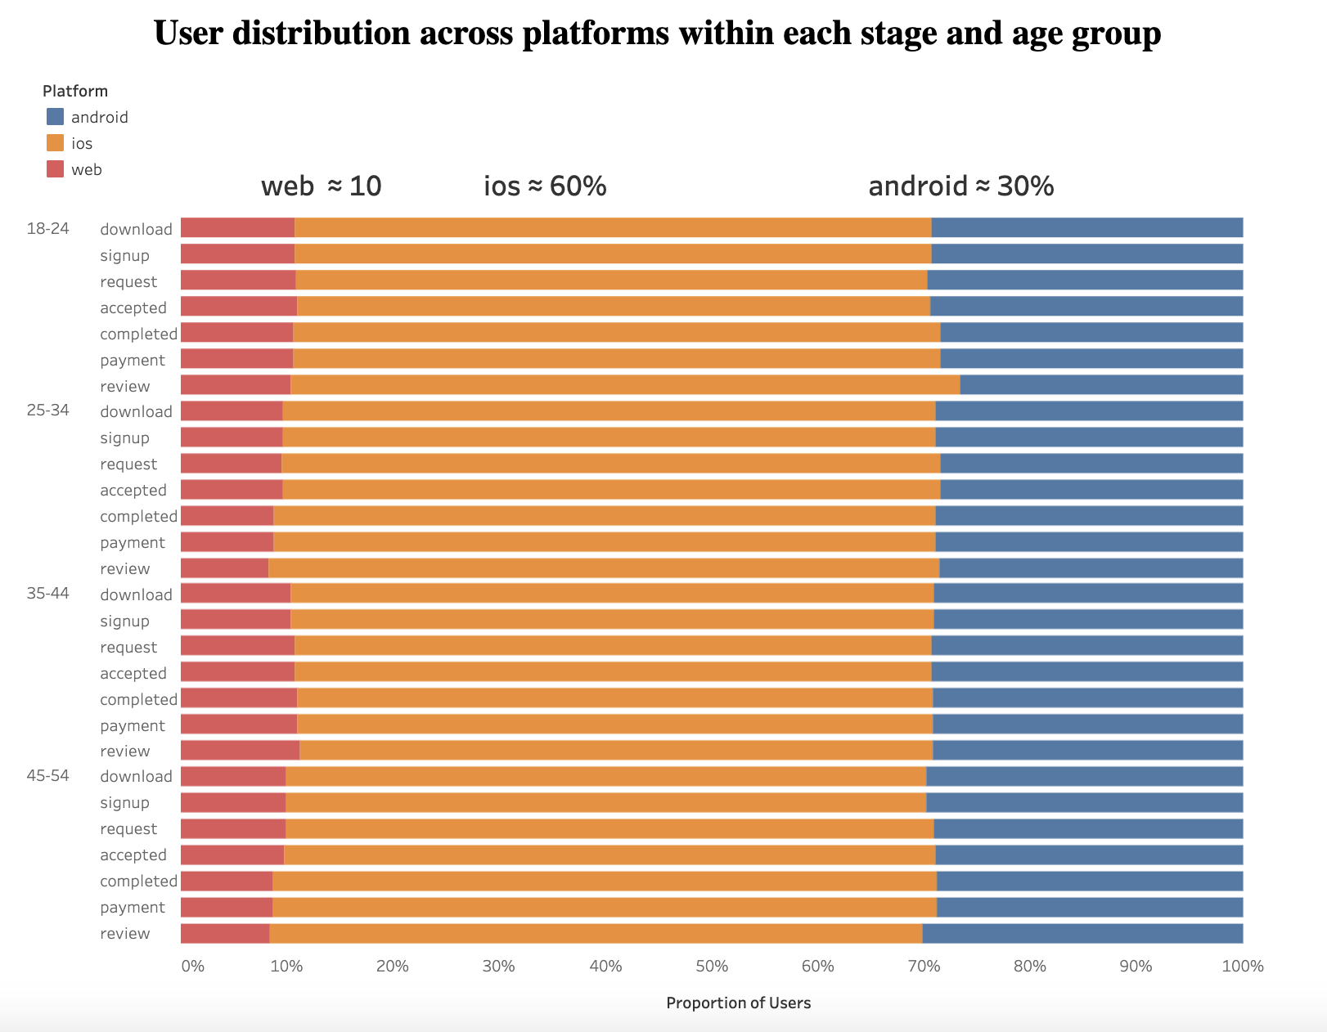
Notes:
repeating pattern across all age groups and stages of the funnel

Slide 9
Recommendation
With a conversion rate of 50% from ride acceptance to completion, further investigation can provide greater insights into the underlying causes. We should cut waiting time by bringing in more drivers. It is important to note that the majority of our customer base comprises individuals aged 25 to 44 who use iOS. It is advisable for us to concentrate our efforts on encouraging this demographic to increase their platform usage and spending.
Notes:
conversion rate
accepting to completion is only 50
majority of users are 25-44

