Slide 1
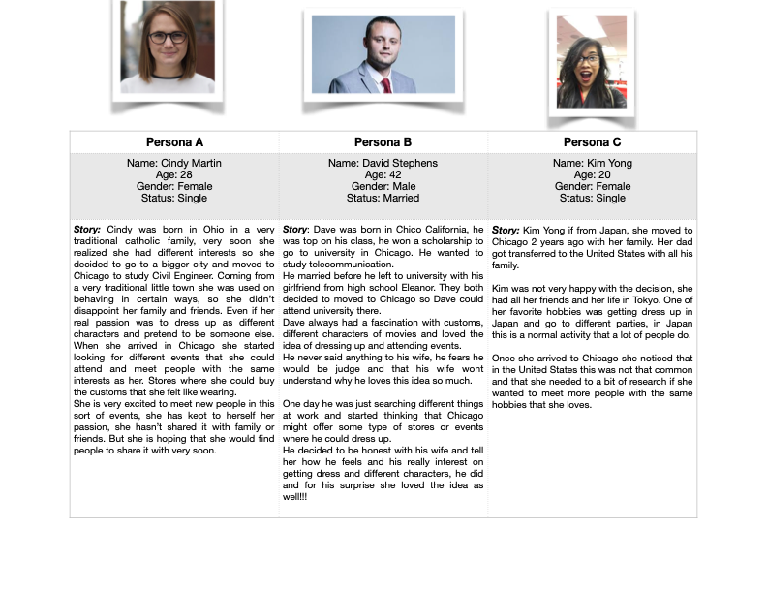
Personas
People in Wonderland Event and Costume Shop
Ana Lorena Castellanos

Slide 2
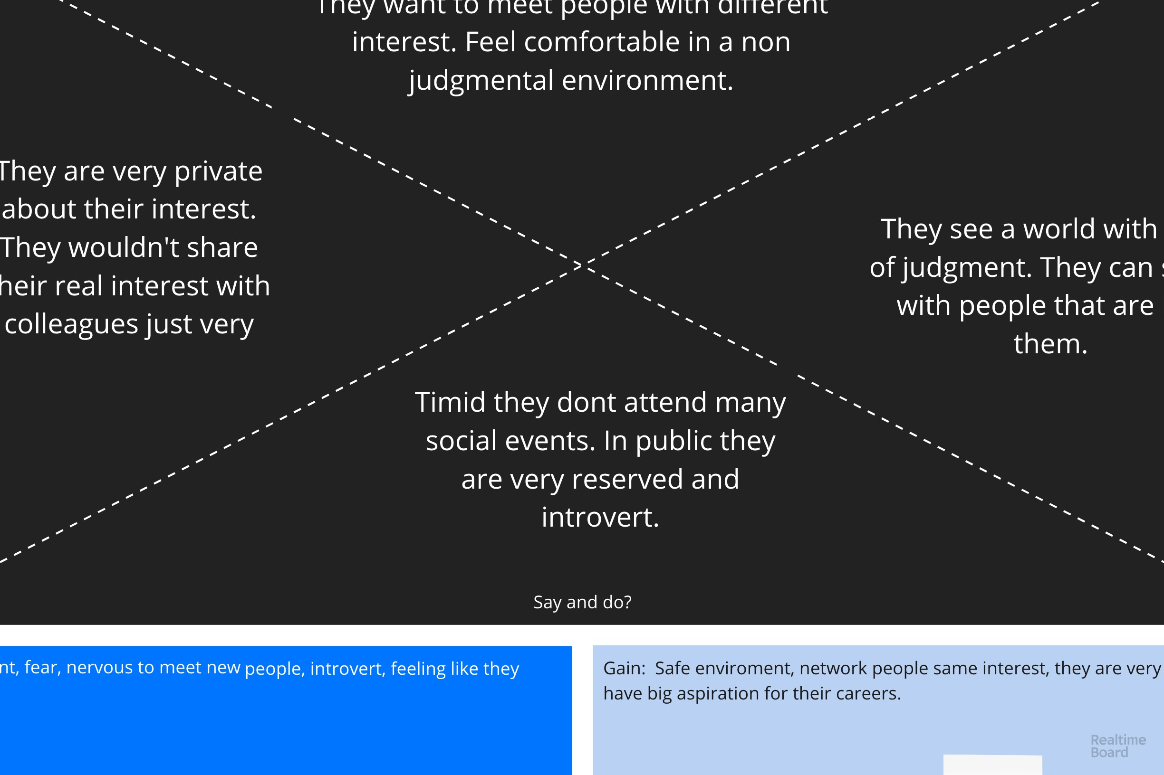
Empathy Map
People in Wonderland Event and Costume Shop
Ana Lorena Castellanos

