Slide 1
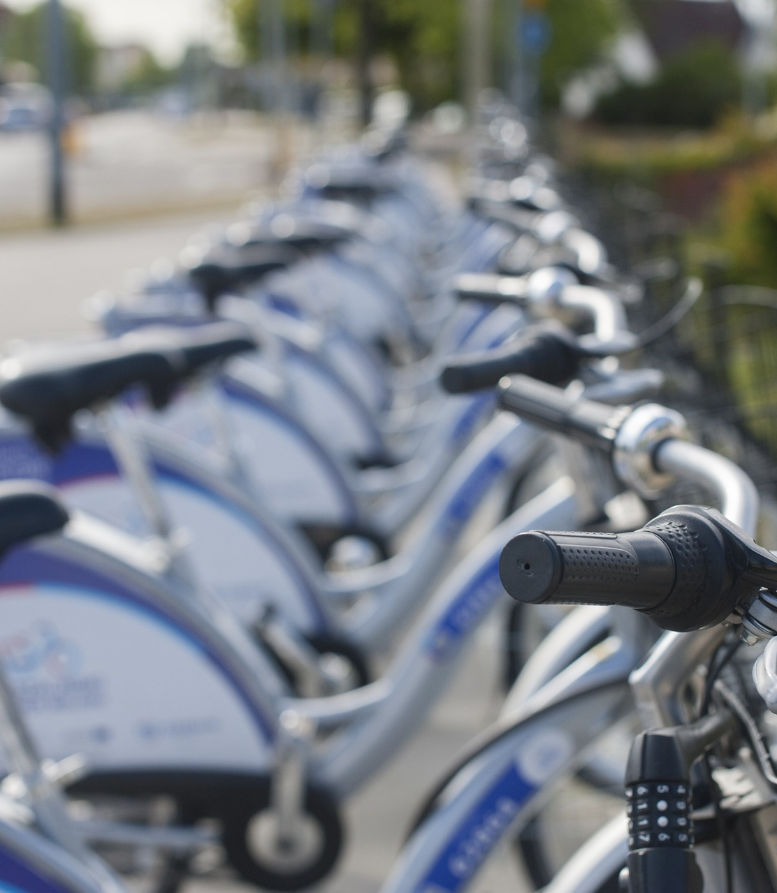


Cyclistic Rider Trends
analusis.dev

Slide 2
Agenda
Business Task
Analysis
Potential Cause Findings
Summary
Action Plan

Slide 3

Business Task
How do member and casual riders use Cyclistic bikes differently?
Analyze rider data from the last 12 months to identify trends in usage between member and casual riders.

Slide 4
Analysis

Slide 5
Analysis Limitations
Removal of PII
Docked Rides
Utilization Capacity
The data set was rightfully pre-filtered of PII. Unfortunately, this does impact trend studies as we are unable to analyze whether casual riders were repeat or unique customers.
Docked rides were excluded from charted analysis due to lack of information regarding their usage.
Data regarding bike availability and capacity utilization is not available. It is possible that usage between rider types could be influenced by reservation programs or lack of bike availability.

Slide 6
Total Number of Rides and Average Duration
Member Rides
Avg. Member Duration
3,463,689
00:12:34
Total Rides
5,828,546
Casual Rides
Avg. Casual Duration
2,364,587
00:28:56

Slide 7
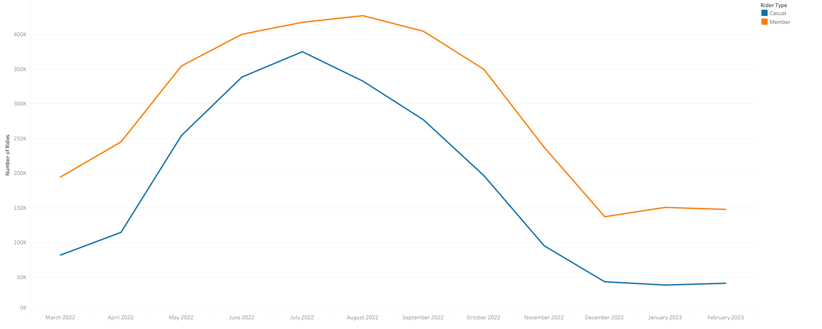
Trend – Number of Rides by Rider Type
Notes:
Analyzing data over the last 12 months reveals that member riders consistently use the ride program more than casual riders.

Slide 8
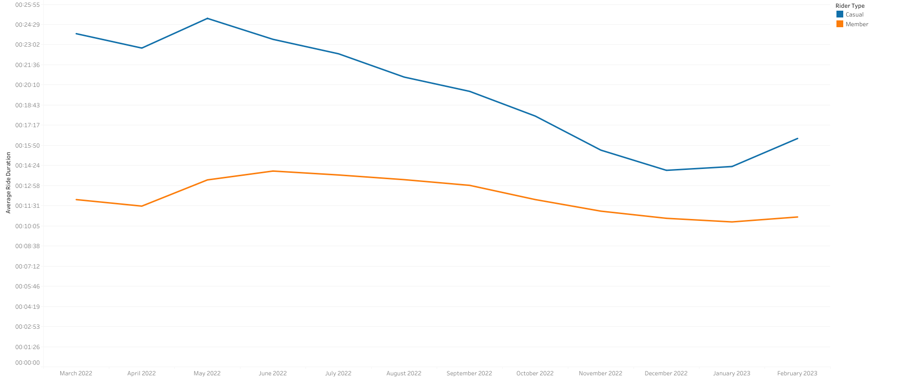
Trend – Duration of Rides by Rider Type
Notes:
However, an interesting trend was noted in the duration of rides. Casual riders were noted to utilize bikes for durations as much as twice that of member riders.

Slide 9
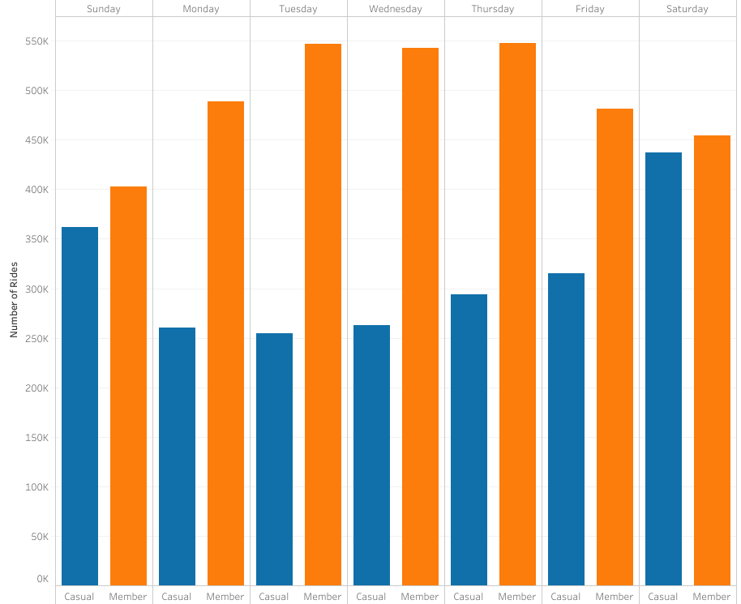
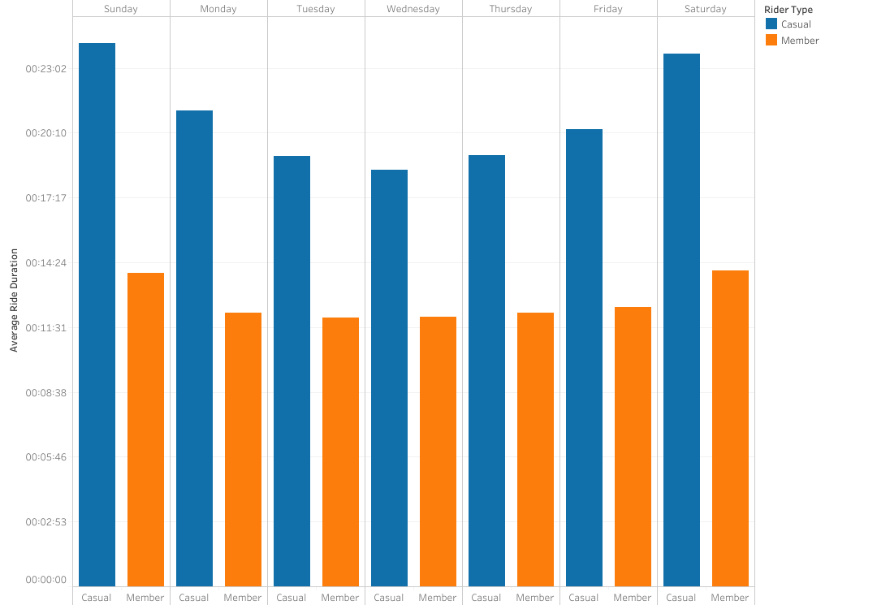
Weekday Differences
Notes:
Differences in usage during different days of the were analyzed. Member riders continued to show more overall rides while casual riders were noted to have greater trip durations. Increases in duration were noted during weekends, with more significant increases for casual riders.

Slide 10
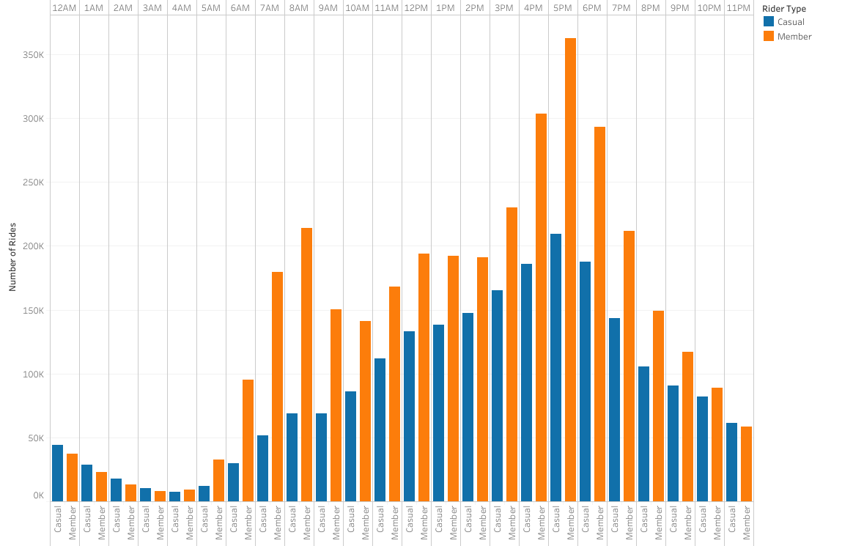
Number of Rides by the Hour
Notes:
The number of trips started by hour of day were analyzed. Member riders were noted to have peak usage around the 6am-8am and 4pm-6pm times. Casual riders saw more utilization during the late to early morning hours of 11pm to 3am. Casual riders also have an increasing utilization throughout the day, without multiple defined peaks as seen with member riders. The data seems to suggest that member riders may use the service on a user-defined schedule that could be related to work instead of leisure.

Slide 11
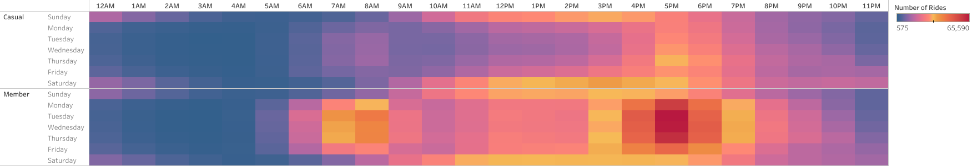
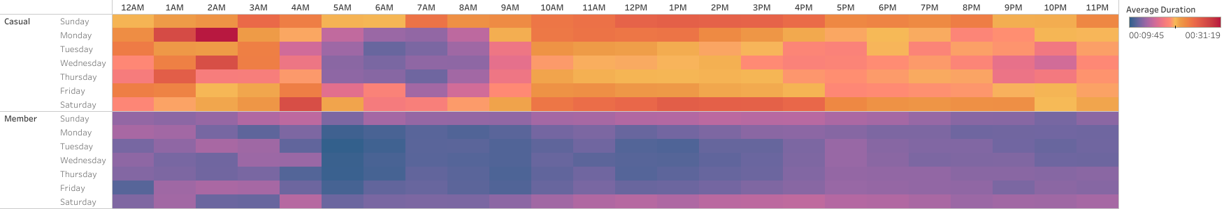
Number and Duration of Rides by the Hour and Weekday
Notes:
Heatmap plotting of the number of rides and average ride durations were also charted. Members appear to utilize services in the morning with significant increase in the afternoon. Weekends appear to have more distributed usage throughout the day, while weekdays see defined time periods of heavier utilization. Casual members, on the other hand, appear to utilize the service moreso on the weekends, with moderate activity during weekday afternoons to late evening.
Duration of rides shows fairly consistent usage from member users, with increased duration for member riders seeming to occur throughout the day but less so in the morning hours.

Slide 12
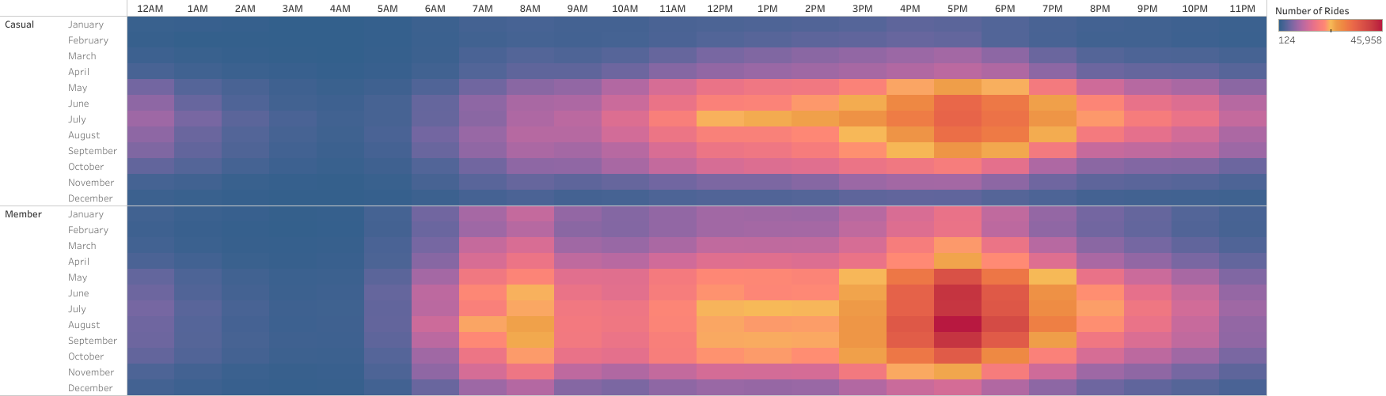
Number of Rides by the Hour and Month
Notes:
Comparison of usage by month seems to reveal that members utilize bike services on a fairly regular period throughout the year, with slight declines noted in the winter months. Casual riders appear to primarily utilize the bike service during warmer time periods, approximately May through October.

Slide 13
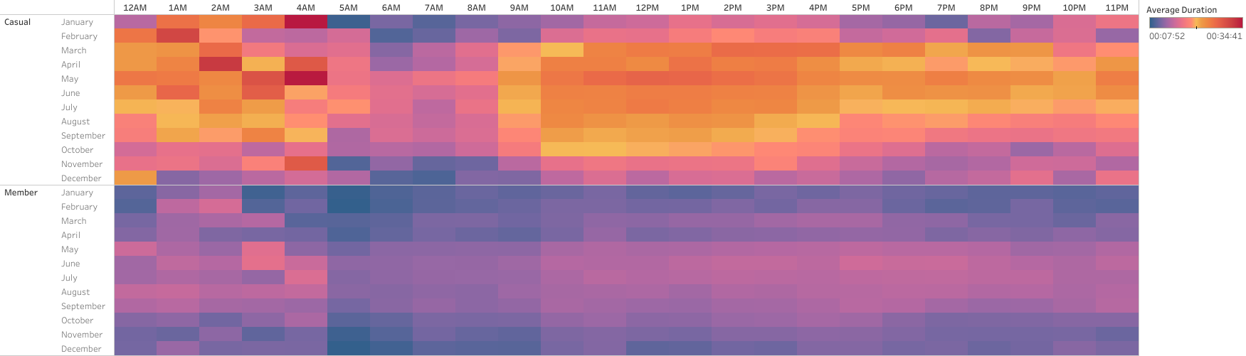
Duration of Rides by the Hour and Month
Notes:
Viewing duration trends from month to month seems to suggest similar patterns between member and casual riders. While casual riders still have a higher average trip duration, both appear to have shorter durations during winter months.

Slide 14
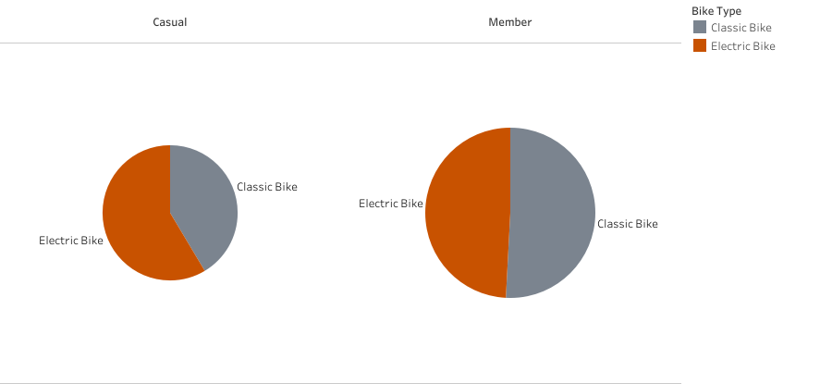
Bike Type Utilization
Notes:
Viewing duration trends from month to month seems to suggest similar patterns between member and casual riders. While casual riders still have a higher average trip duration, both appear to have shorter durations during winter months.

Slide 15
Potential Cause Findings
Member Riders May Utilize a Schedule
Member riders appear to utilize bike services during specific hours of the day
Casual Riders May Utilize Bikes for Leisure
Casual riders have increased utilization during weekends compared to weekdays.
Bike Type Utilization
While member riders are nearly even between usage of bike types, casual riders appear to favor electric bikes.

Slide 16
Summary
Member Riders
Casual Riders
More overall rides
Increased usage during specific hours of the day
More usage throughout the year
Increased duration of rides
Higher weekend utilization
More commonly used during warmer months

Slide 17
Action Plan
Conduct Further Analysis
Continue to work with the data collection team to capture utilization data
While some trends are discoverable with the current data set, more information could provide further insight into program usage
Consider Rider Surveys
Consider creating a quick and simple survey to collect information regarding why users utilize the service
Implement and Reassess
Consider implementation of weekend subscriptions to convert casual riders who may utilize the program for weekend leisure but rely on different modes of weekday transportation
Consider implementation of summer passes
Consider implementation of a reservation system should it not currently exist

Slide 18

Appendix
Coursera Google Data Analytics
Divvy Data Source
This case study was created as a result of course assignment during the Coursera Google Data Analytics learning program.
The data belongs to and originated from Divvy. The data is provided according to the Divvy Data License Agreement. This case study is not affiliated with, endorsed by, or sponsored by Divvy or the Chicago DOT.

Slide 19




Thank you

