Slide 1
Welcome’s You
Into the Project-6_Next-Hikes.ppt
Pharmaceutical Sales prediction across multiple stores
By- MOHD ZEESHAN
20-SEP-2024

Slide 2
Abstract:
The pharmaceutical industry relies heavily on accurate sales forecasting to ensure optimal inventory management, reduce waste, and meet customer demands across various locations. This project focuses on developing a predictive model for pharmaceutical sales across multiple stores, leveraging historical sales data, store-specific features, and external factors such as holidays and promotions. By employing machine learning techniques, the model aims to predict future sales with high accuracy, enabling better decision-making for inventory allocation and promotion strategies.
The analysis begins with extensive exploratory data analysis (EDA) to identify key patterns and relationships within the data. Feature engineering is performed to extract meaningful variables that contribute to the predictive power of the model. Various machine learning algorithms, including linear regression, decision trees, and ensemble methods like random forests, are evaluated to determine the most effective approach for sales prediction.
To ensure the model's robustness, hyper parameter tuning and cross-validation techniques are applied. The final model is deployed through a user-friendly web application, allowing store managers to input relevant data and receive real-time sales forecasts. This tool not only aids in managing day-to-day operations but also supports strategic planning by providing insights into sales trends and the impact of promotions.

Slide 3
Content:
Introduction
Objectives
Methods
Results
Conclusions
Chapter - 1
Introduction
In the pharmaceutical retail industry, accurate sales forecasting is critical for maintaining the delicate balance between supply and demand. Ensuring that stores are adequately stocked to meet customer needs while minimizing overstock and waste is a complex challenge, especially when dealing with multiple locations with varying customer bases and purchasing patterns. As the industry continues to grow, so does the need for more sophisticated and reliable methods to predict sales trends and optimize inventory management.
This project aims to develop a predictive model for pharmaceutical sales across multiple stores, utilizing historical sales data, store-specific features, and external factors such as promotions, holidays, and regional demographics. Traditional sales forecasting methods often fall short in accounting for the multitude of variables that influence consumer behavior in the pharmaceutical sector.

Slide 4
Chapter - 2
Objectives
To develop an accurate predictive model for pharmaceutical sales across multiple stores using historical sales data and store-specific features.
To enhance inventory management and reduce wastage by forecasting sales trends and optimizing stock levels. To evaluate the impact of external factors such as promotions and holidays on sales and incorporate these into the predictive model.
1.Data Collection: The data used in this project was collected from various sources to ensure a comprehensive understanding of pharmaceutical sales patterns across multiple stores. The primary dataset consists of historical sales data obtained directly from the internal databases of a major pharmaceutical retail chain. This dataset includes detailed information on daily sales figures, store locations, product categories, and customer demographics

Slide 5
2.Data Cleaning: Ensuring the quality of data by handling missing values, removing duplicates, and correcting inconsistencies.
3.Exploratory Data Analysis (EDA): Analyzing the dataset to identify key features, uncover patterns, and visualize trends that impact sales prediction.
4.Model Development and Evaluation: Building, training, and evaluating several machine learning models, including sklearn, gradient boosting regressor and random forest regressor to identify the best-performing model.
5.Model Deployment: Developing a web application using Deep learning with Sklearn pipelines to make the prediction model accessible for customer sales prediction.

Slide 6
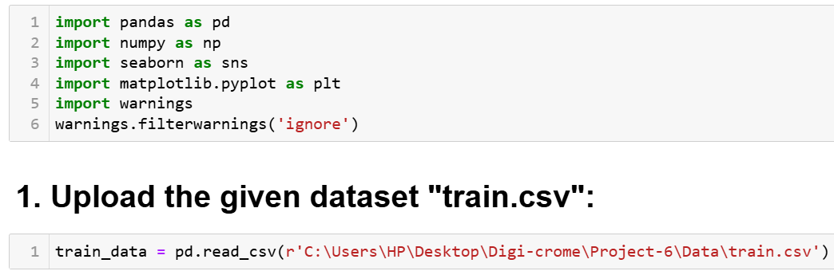
Chapter - 3
Methods
Task 1 - Exploration of customer purchasing behavior :
(i). Loading the Data:
To load the train, test and store dataset into a Pandas DataFrame, Load the dataset provided in a CSV or Excel format into a Pandas DataFrame to facilitate easy manipulation and analysis. Using Python Pandas Library.

Slide 7
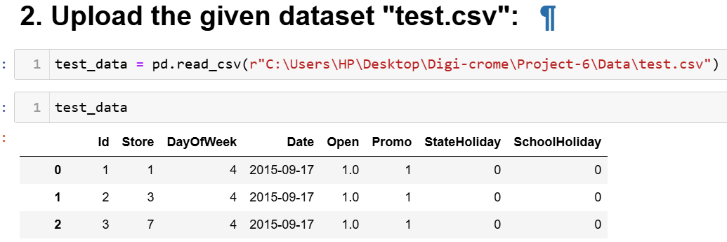
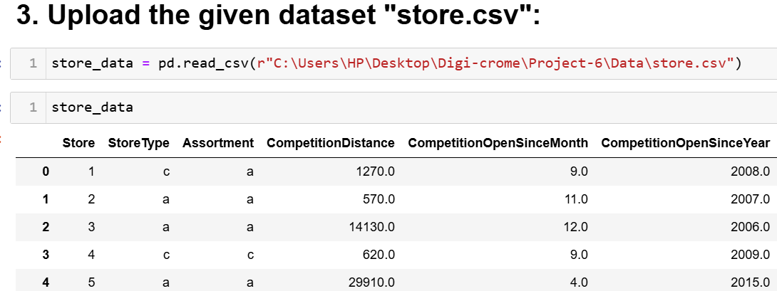

Slide 8
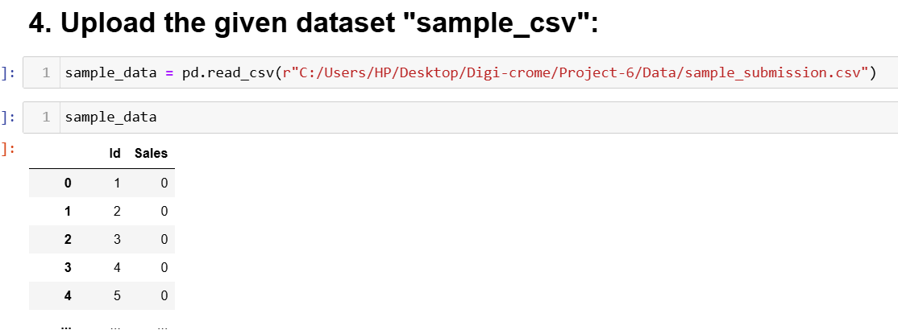

Slide 9
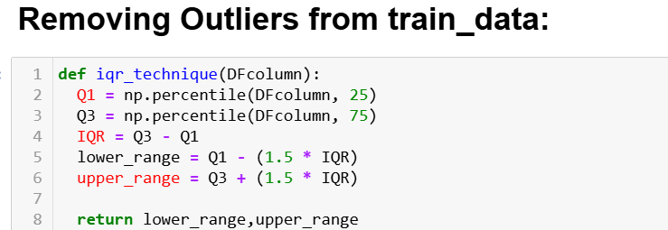
(ii). Cleaning the Data:
Cleaning the data is an essential step in the data analysis process, particularly for Pharmaceutical Sales data. It involves preparing the dataset by addressing missing values, removing duplicate entries, checking and detection outliers. This ensures that the data is accurate and reliable for further analysis.
Removing outliers Values:
Summarize the implications of removing outliers on data analysis, emphasizing the importance of careful consideration in the process.

Slide 10
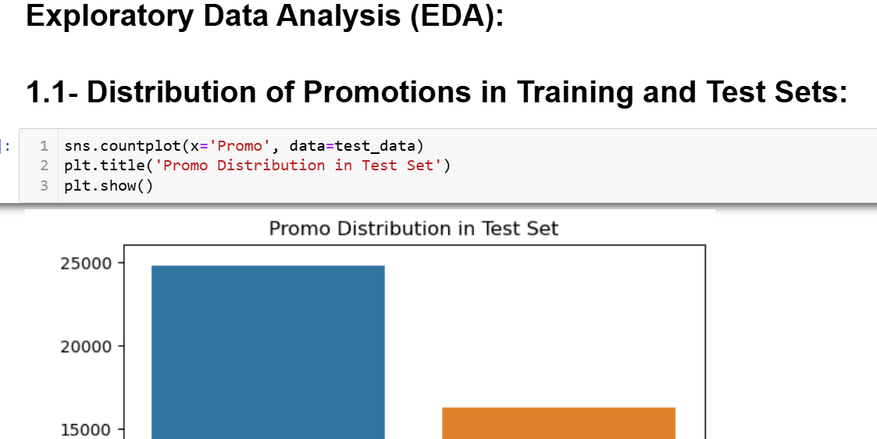

Slide 11
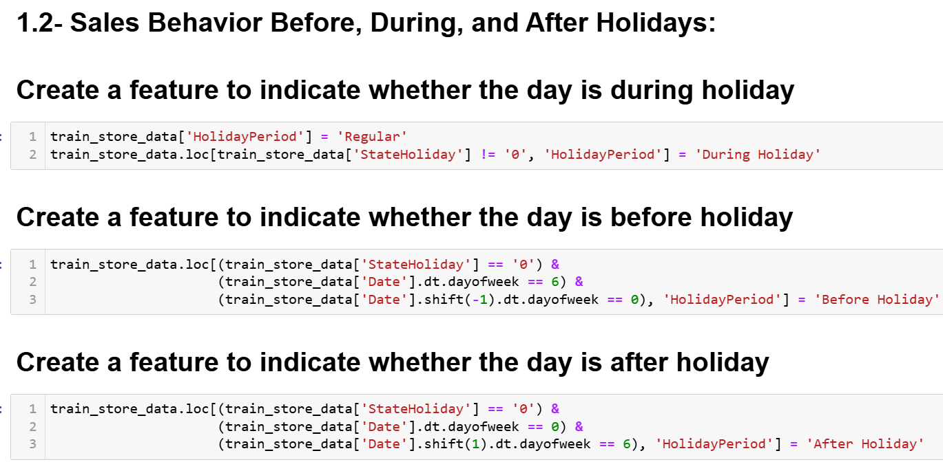

Slide 12
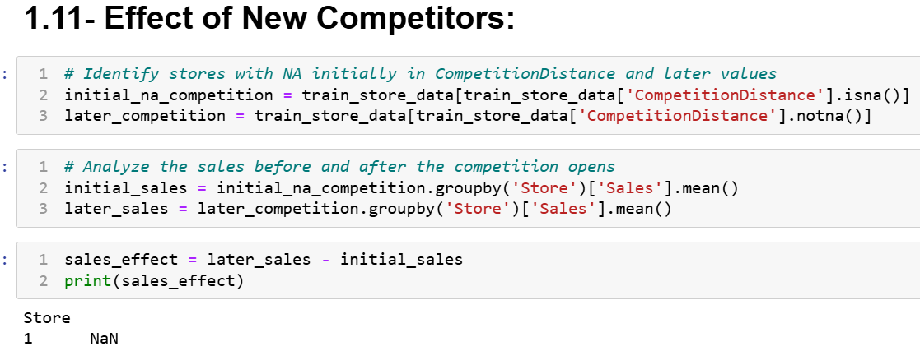
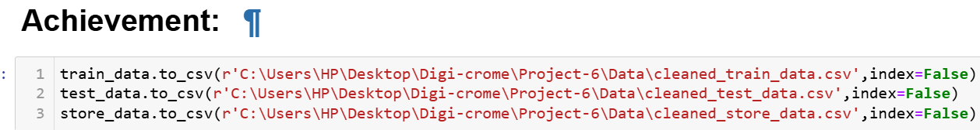

Slide 13
Task 2- Prediction of store sales:
Prediction of sales is the central task in this challenge. We have to predict daily sales in various stores. This will help the company plan ahead of time
Preprocessing:
It is important to process the data into a format where it can be fed to a machine learning model. This typically means converting all non-numeric columns to numeric, handling NaNvalues and generating new features from already existing features.

Slide 14
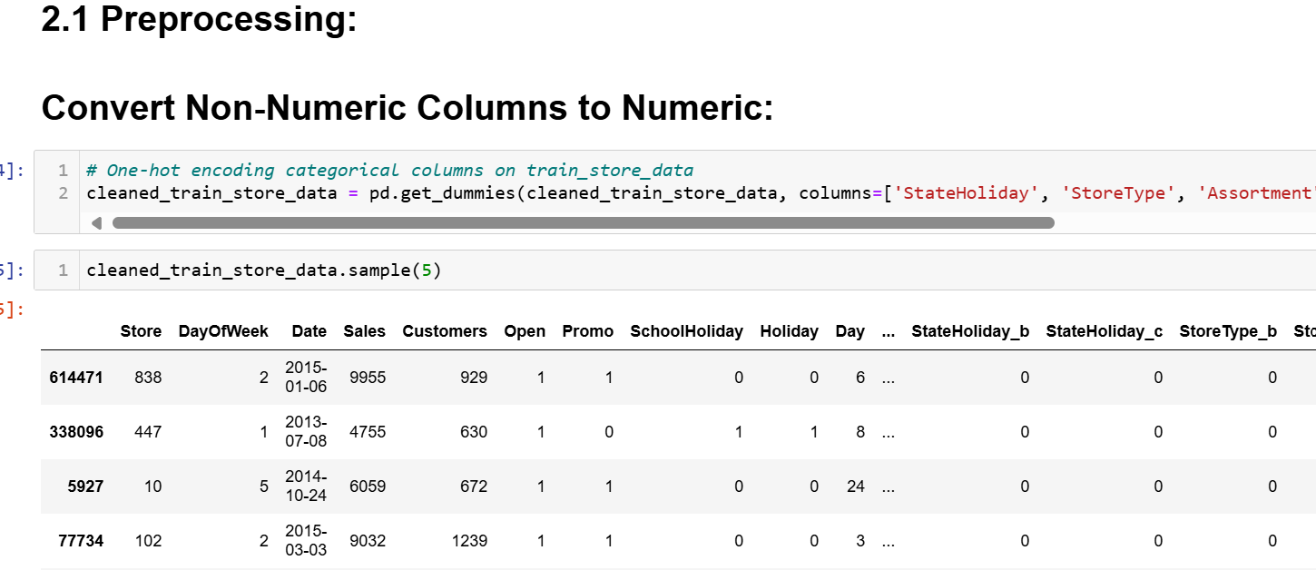

Slide 15
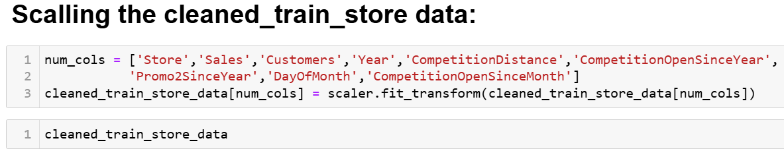
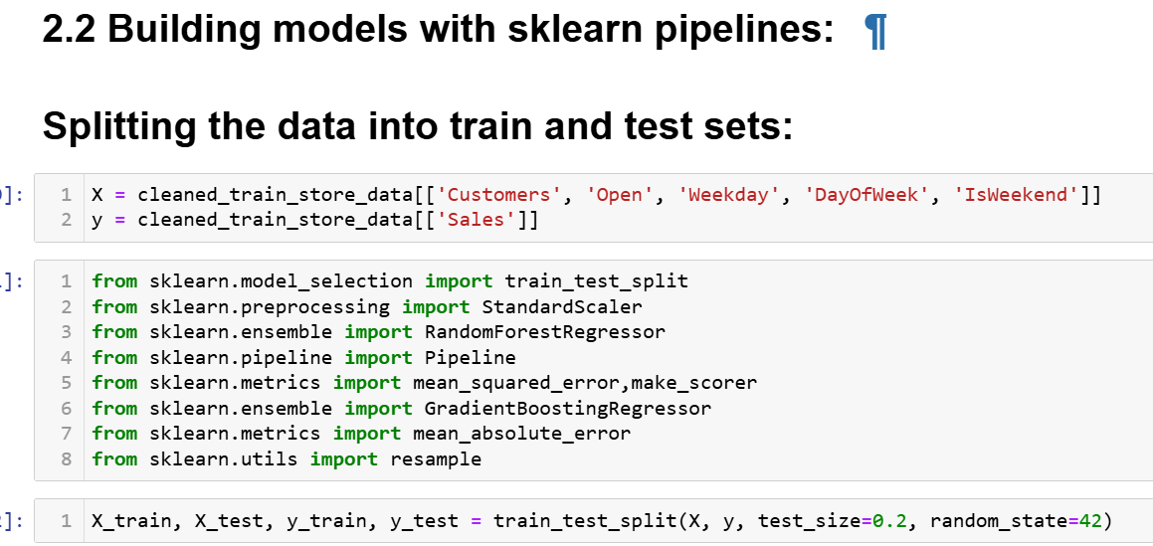

Slide 16
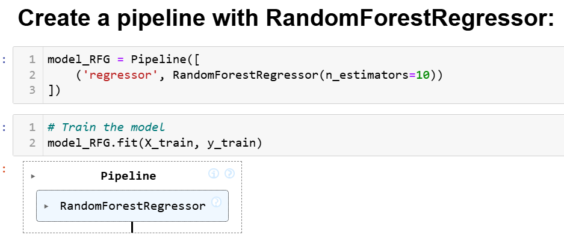
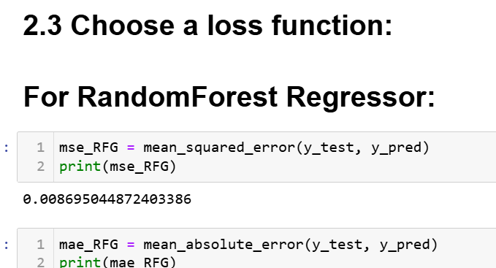

Slide 17
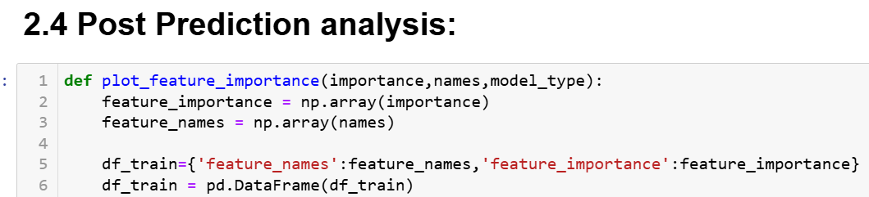
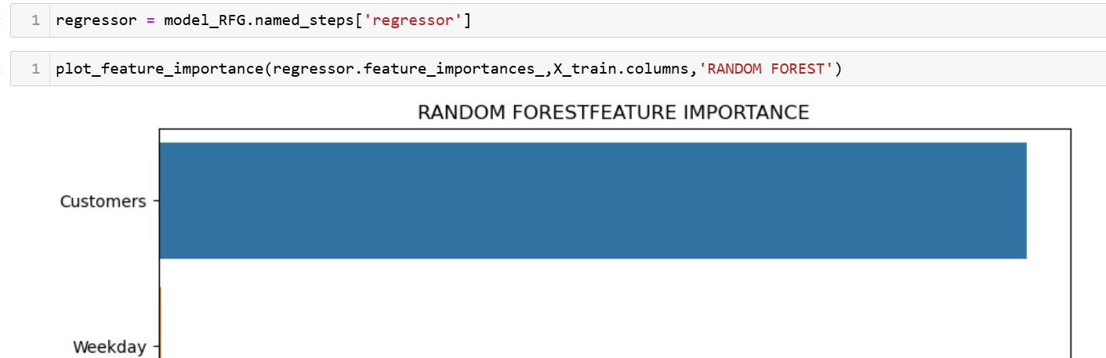

Slide 18
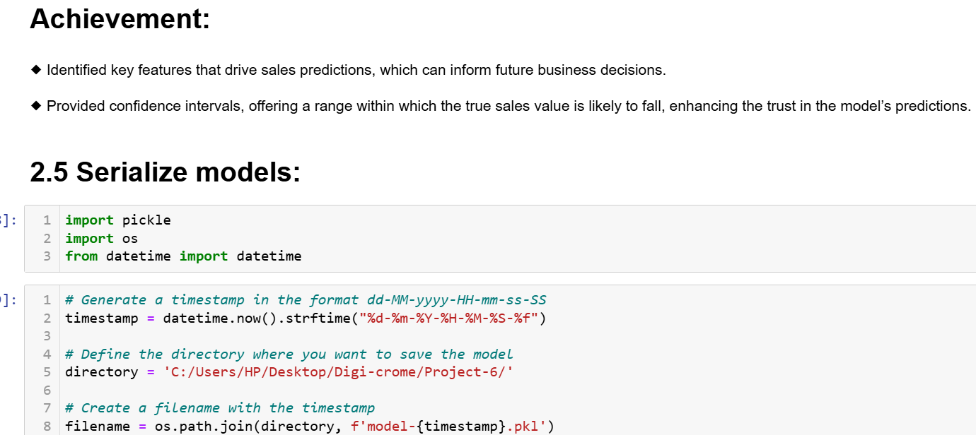

Slide 19
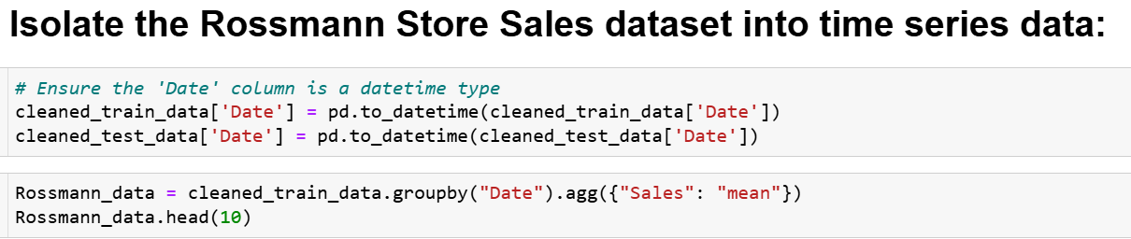
Building model with deep learning
Deep Learning techniques can be used to predict various outcomes including but not limited to future sales. Our task is to create a deep learning model of the Long Short Term Memorywhich is a type of Recurrent Neural Network. We can use either Tensorflow or Pytorch libraries for model building, it should comfortably run in google colab.

Slide 20
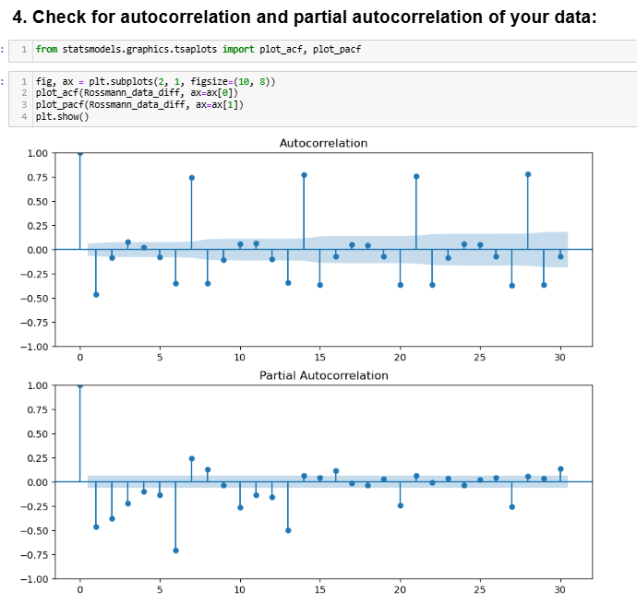

Slide 21
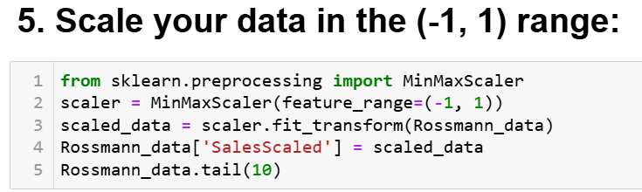
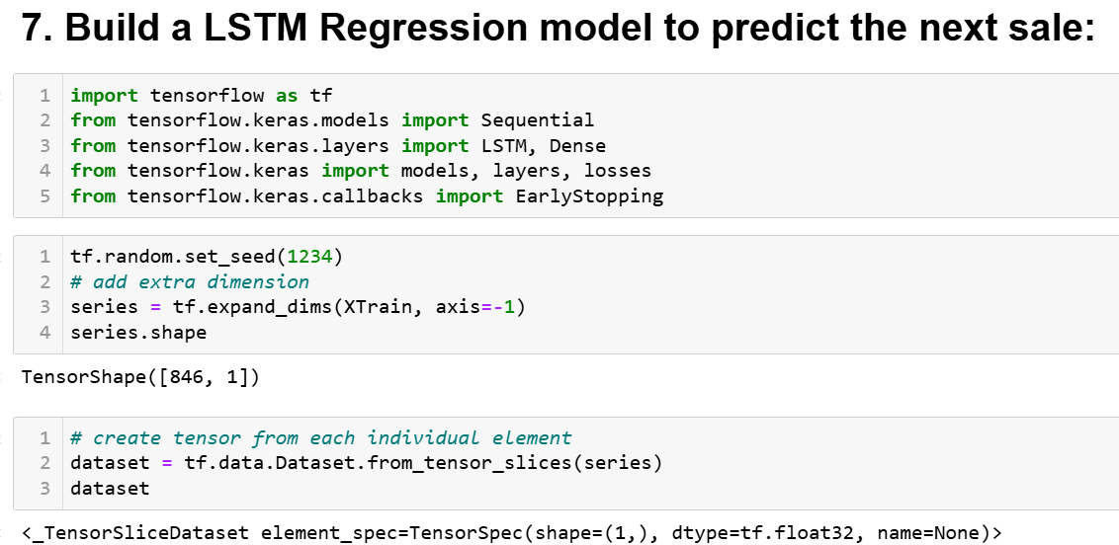

Slide 22
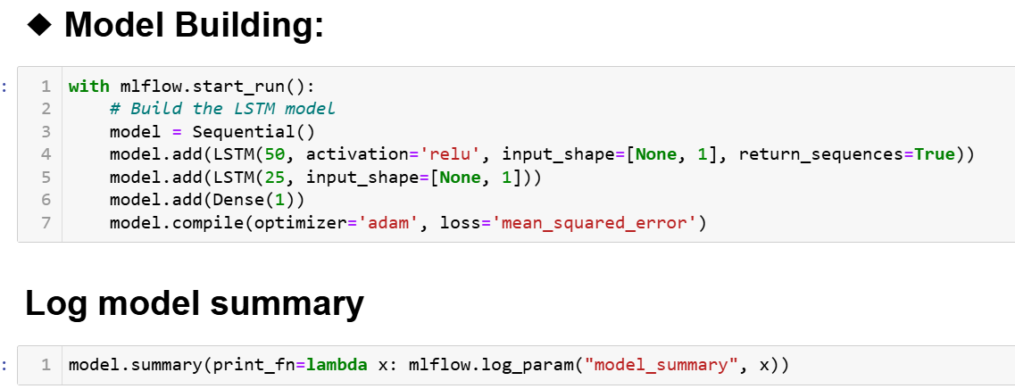

Slide 23
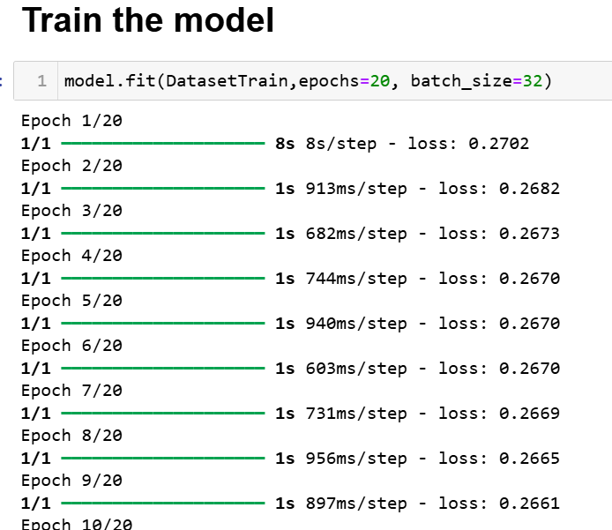

Slide 24
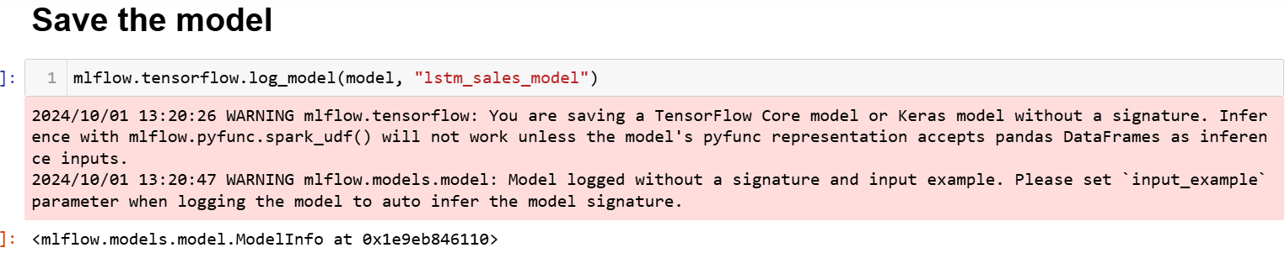

Slide 25
Task 3- Serving predictions on a web interface:
In this project, we have to use Flask platforms to design, and build a backend to make inference using our trained model and input parameters collected through a frontend interface. Our dashboard should provide an easy way for a user (in this case managers of the stores) to enter required input parameters, and output the predicted sales amount and customer numbers.
Finally our dashboard show a plot that shows the predicted sales amount and number of customers. It also allow the user to download the prediction in the form of a csv table.

Slide 26
Chapter - 4
Results
Limitations:
Data Quality: Inconsistent or missing values, especially in promotional or competition data, may impact model accuracy.
External Factors: The model doesn't account for unexpected events (e.g., economic shifts, natural disasters) that could affect sales.
Feature Scope: Some relevant features, like local events or customer demographics, are not included due to data unavailability.
Model Complexity: Random Forest and LSTM models can be computationally intensive, impacting real-time scalability.

Slide 27
Recommendations:
Feature Expansion: Include additional data, such as regional economic indicators or customer demographics, to improve predictive power.
Event Impact: Integrate data on special events or holidays to better capture sales spikes or drops.
Extended Predictive Window: Consider strategies like transfer learning to extend forecast accuracy beyond six weeks.

Slide 28
Chapter - 5
Conclusions
Exploratory Analysis Insights: The analysis highlighted key factors impacting sales, such as promotions, holidays, assortment types, and competitor proximity. These insights revealed patterns like the effect of promotions on customer behavior, weekend vs. weekday sales, and seasonal trends in purchasing, which are crucial for understanding customer dynamics.
Data Processing and Feature Engineering: Through comprehensive preprocessing, the data was cleaned, missing values were handled, and relevant features were engineered. Extracting features from date columns (e.g., holidays, month periods) improved the model’s ability to capture sales patterns effectively.
Model Development: A two-step modeling approach was used: first with tree-based models, particularly the Random Forest Regressor, for its interpretability and handling of complex data relationships. Then, an LSTM model was introduced to capture temporal dependencies in sales, offering insights into sales trends and seasonality.

Slide 29
Business Impact: This project offers a strong foundation for data-driven decision-making. By accurately predicting sales, the model can support better inventory planning, resource allocation, and promotion timing, helping the company respond more effectively to demand fluctuations.
Future Directions: Extending the predictive window, refining time-based features, and exploring advanced modeling techniques will allow for a broader range of applications and further strengthen sales forecasting capabilities.
Final Remarks: In summary, this project demonstrates the practical application of machine learning in sales forecasting. The insights and predictions gained from the model have the potential to enhance the company’s operational efficiency, optimize resources, and improve customer satisfaction through timely and informed decision-making.

Slide 30


