Slide 1
Welcome’s You
Into the Project-5_Next-Hikes.ppt
User Analytics in the Telecommunication Industry - Overview
By- MOHD ZEESHAN
20-AUG-2024

Slide 2
Abstract:
User analytics in the telecommunication industry has become increasingly vital for understanding customer behavior, optimizing services, and driving business growth. This study aims to explore the patterns and trends in user activity by analyzing extensive datasets, including Call Detail Records (CDR) and data sessions Detail Records (xDR). We employed advanced data analysis techniques using Python libraries such as pandas for data cleaning and handling, and machine learning models for predictive insights.
Our analysis focused on identifying key factors influencing user behavior, including call duration, frequency of data usage, and application preferences. Additionally, we implemented geospatial analysis to map user activity across different regions, providing insights into regional variations in service demand. The study revealed significant trends, such as the increasing popularity of streaming services and the impact of social media usage on network performance.
The findings from this research offer valuable insights for telecommunication companies to enhance their service offerings, tailor marketing strategies, and improve network infrastructure. By leveraging user analytics, companies can make data-driven decisions that cater to the evolving needs of their customers, ultimately leading to improved customer satisfaction and business performance.

Slide 3
Content:
Introduction
Objectives
Methods
Results
Conclusions
Chapter - 1
Introduction
The telecommunication industry has undergone a transformative evolution over the past few decades, driven by rapid advancements in technology and the proliferation of mobile devices. In this dynamic landscape, user analytics has emerged as a critical tool for telecom companies to understand and cater to their customers' needs effectively. User analytics involves the systematic analysis of customer data, providing insights into user behavior, preferences, and usage patterns.
The importance of user analytics in the telecommunication industry cannot be overstated. By leveraging data analytics, telecom companies can enhance customer satisfaction through personalized services, optimize their marketing strategies to target specific user segments, and improve network performance by anticipating and addressing potential issues. Furthermore, user analytics helps in identifying trends and patterns that can inform strategic business decisions, driving growth and competitiveness in a highly saturated market.

Slide 4
Chapter - 2
Objectives
The primary objective of this research is to leverage user analytics to gain comprehensive insights into customer behavior and usage patterns in the telecommunication industry. This will aid telecom companies in optimizing their services and enhancing customer satisfaction. The specific objectives of this study are:
1.Data Collection: The data collection process is a critical component of our research on user analytics in the telecommunication industry, enabling us to gather comprehensive insights into customer behavior and usage patterns. The following subsections detail the sources, types, methods, and tools used in this study.
2.Data Cleaning and Preprocessing: Ensuring the quality of data by handling missing values, removing duplicates, and correcting inconsistencies.

Slide 5
3.Exploratory Data Analysis (EDA): Analyzing the dataset to identify key features, uncover patterns, and visualize trends that impact house prices.
4.Feature Engineering: Creating new features based on domain knowledge and statistical methods to enhance the predictive power of the model.
5.Model Development and Evaluation: Building, training, and evaluating several machine learning models, including linear regression, decision trees, and random forests, to identify the best-performing model.
6.Model Deployment: Developing a user-friendly web application using Streamlit to make the prediction model accessible for user behaviour estimation.

Slide 6
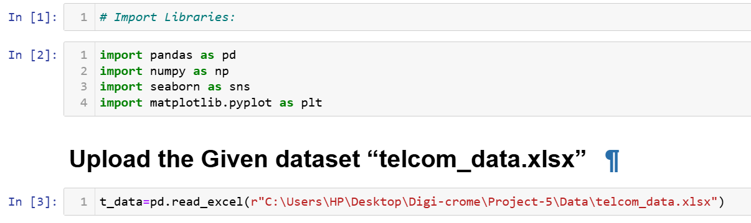
Chapter - 3
Methods
(i). Loading the Data:
To load the real estate pricing dataset into a Pandas DataFrame, Load the dataset provided in a CSV or Excel format into a Pandas DataFrame to facilitate easy manipulation and analysis. Using Python Pandas Library.

Slide 7
(ii). Cleaning the Data:
Cleaning the data is an essential step in the data analysis process, particularly for User Analytics in the Telecommunication Industry - Overview. It involves preparing the dataset by addressing missing values, removing duplicate entries, and fixing any anomalies or inconsistencies. This ensures that the data is accurate and reliable for further analysis.
Handling Missing Values:
Missing values can occur due to various reasons such as data entry errors or incomplete records. To handle missing values, you can:
Use isnull() method to identify missing values in the dataset.
Use fillna() method to replace missing values with appropriate values, such as the mean, median, or mode of the column.
Alternatively, you can use the dropna() method to remove rows with missing values if they are not critical for your analysis.

Slide 8
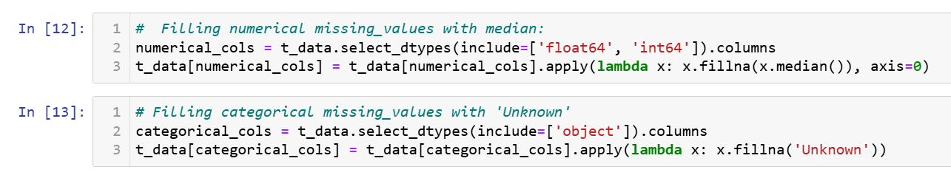
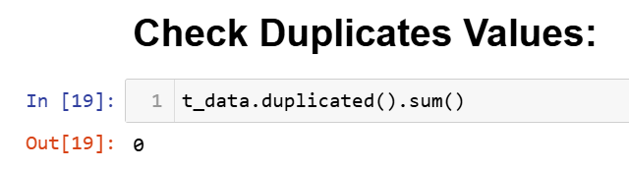
Removing Duplicates:
Duplicate entries can skew the analysis results. To remove duplicates, you can:
Use the duplicated() method to identify duplicate rows in the dataset.
Use the drop_duplicated() method to remove duplicate rows and keep only unique entries.

Slide 9
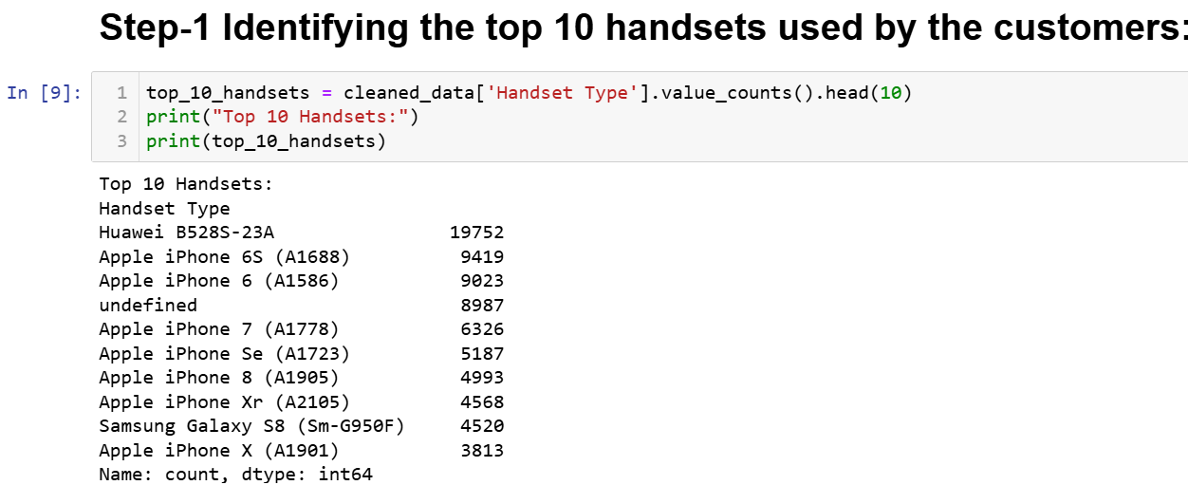
Task 1 - User Overview Analysis:
Identify the top_10 Handsets

Slide 10
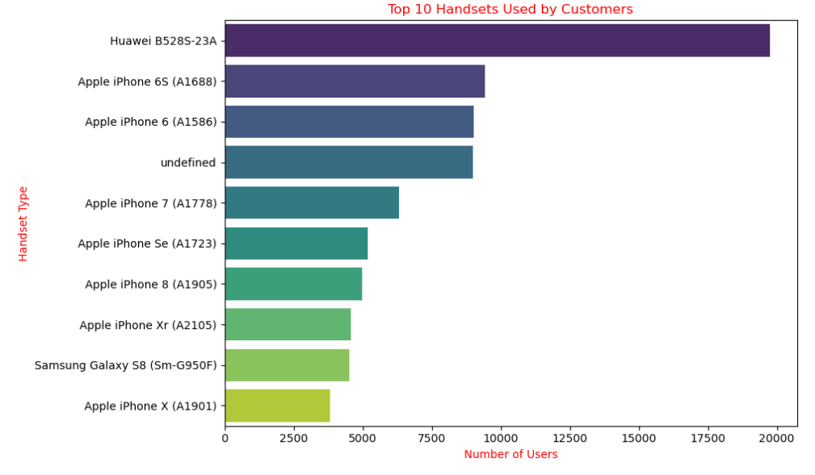
Visualization

Slide 11
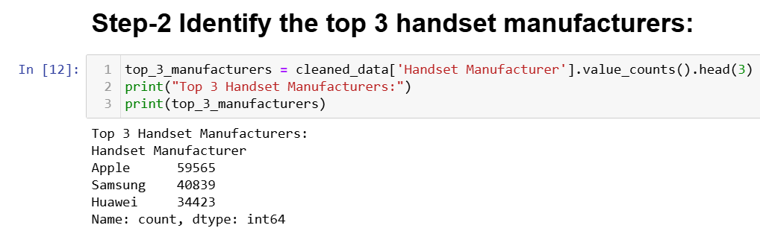
Identify the top_3 Handsets

Slide 12
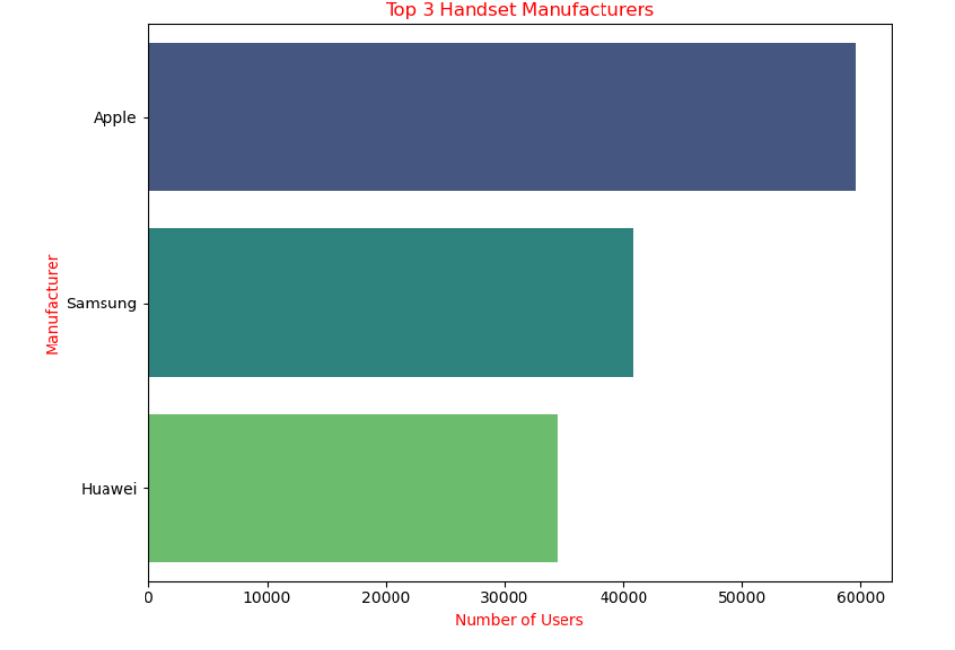
Visualization

Slide 13
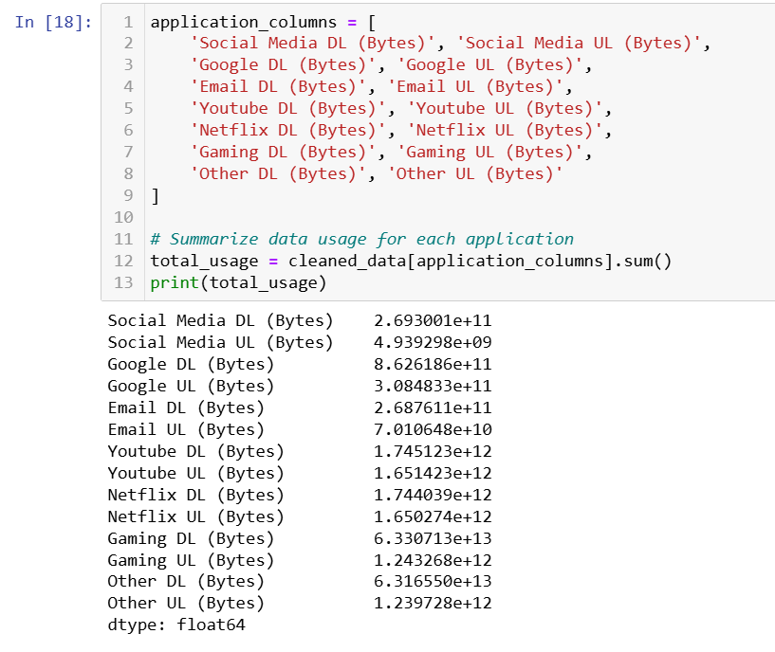
Summing the data usage for each application

Slide 14
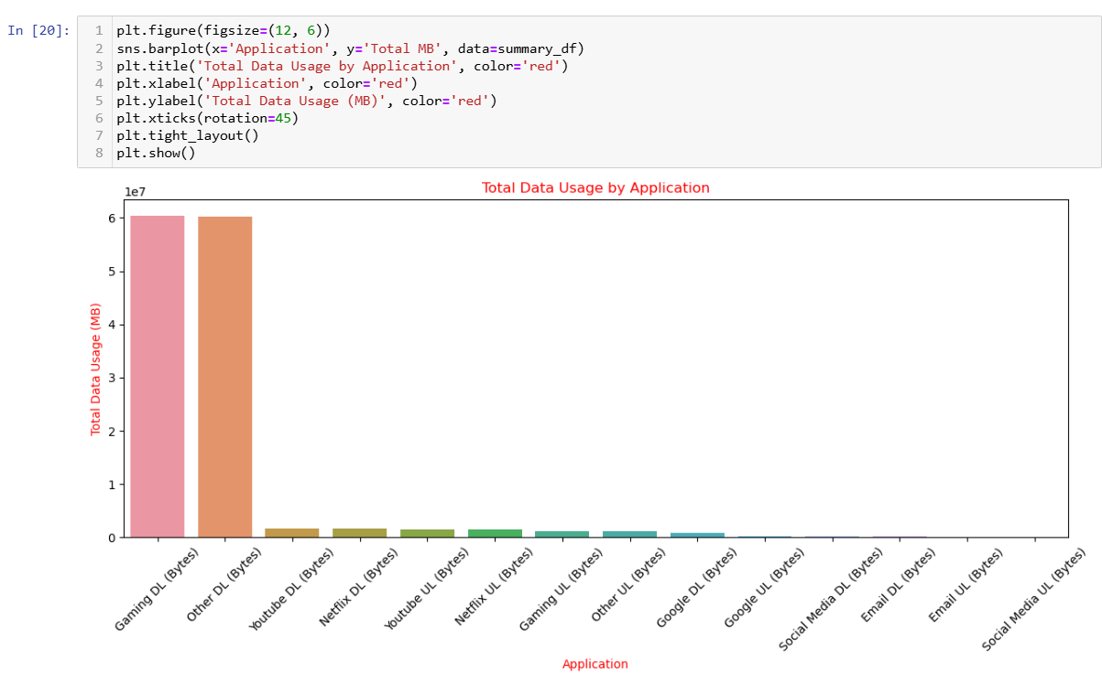
Visualization

Slide 15
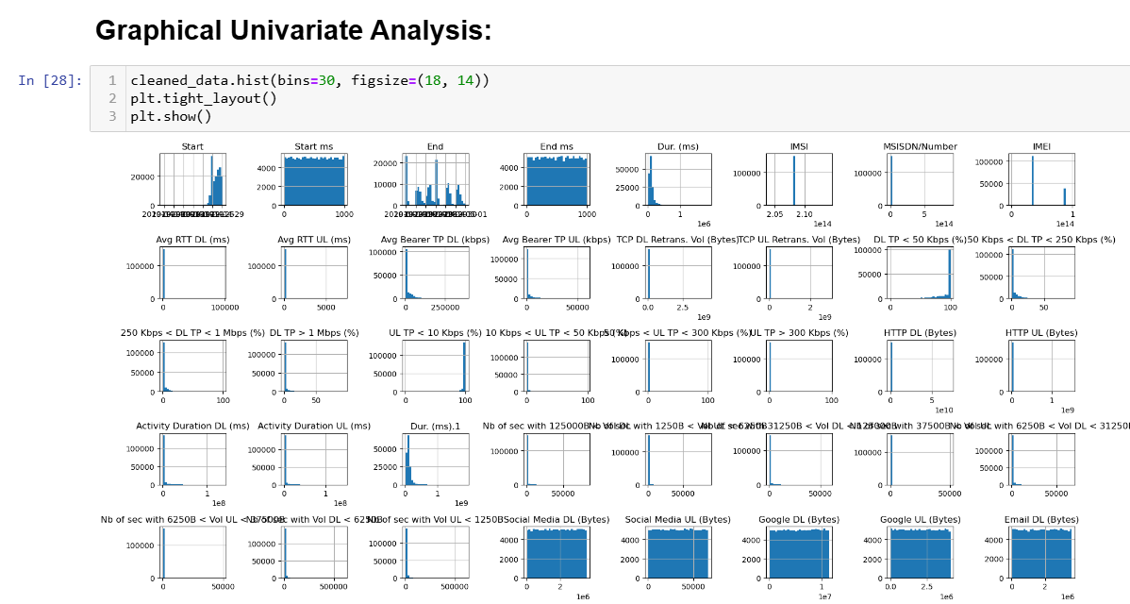

Slide 16
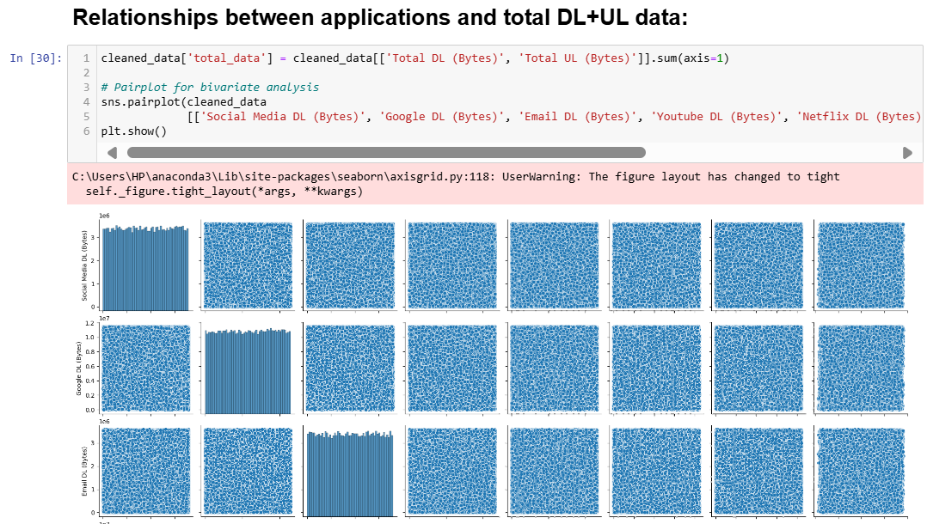
Bivariate Analysis :

Slide 17
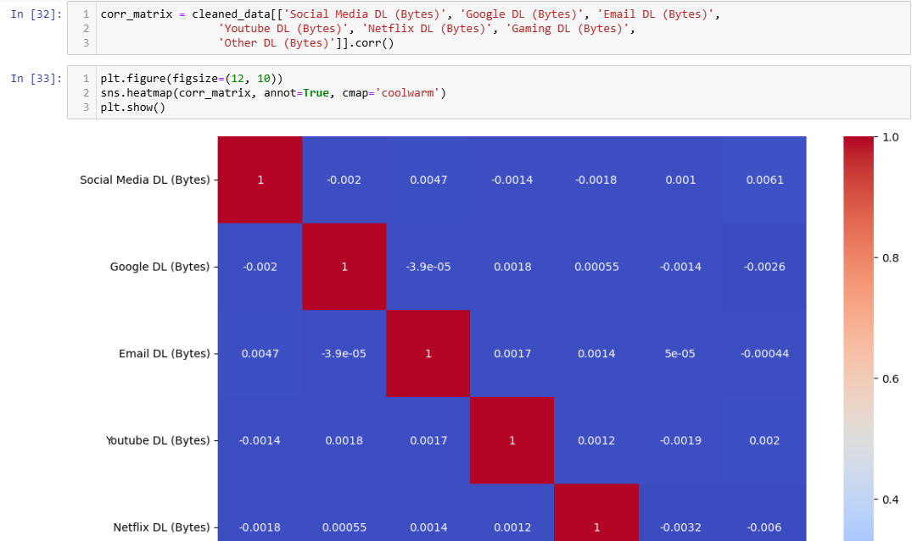
Correlation Analysis:

Slide 18
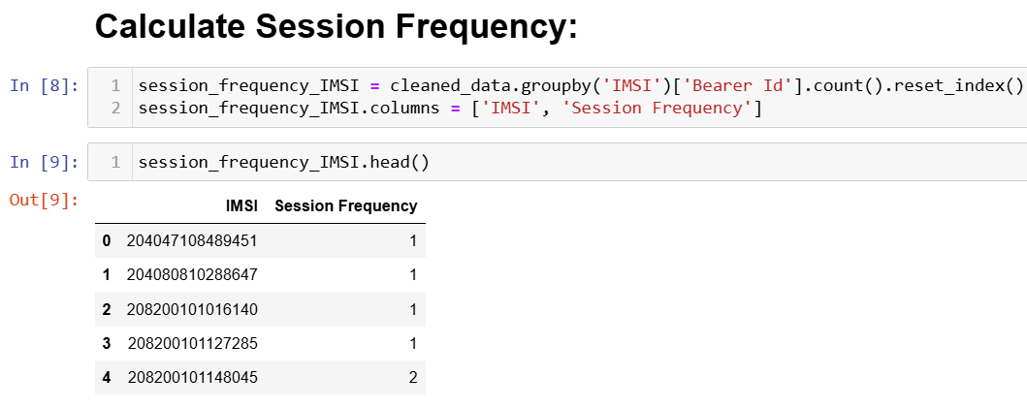
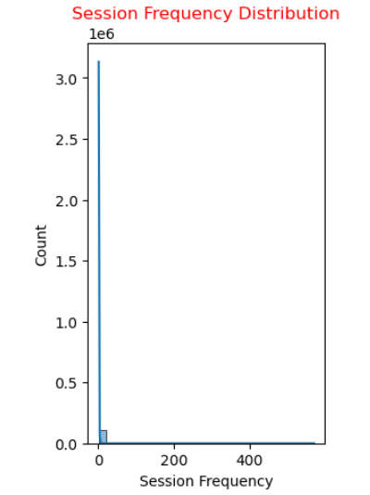
Task 2 - User Engagement Analysis

Slide 19
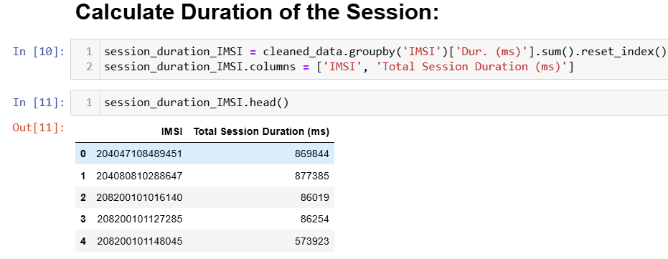
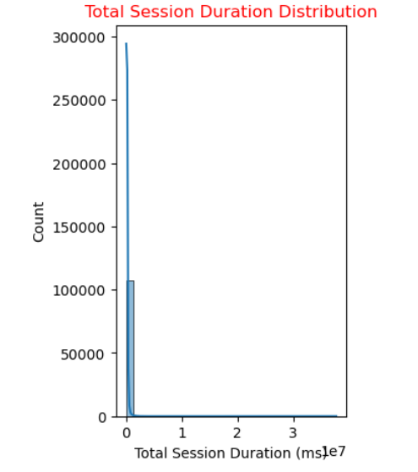

Slide 20
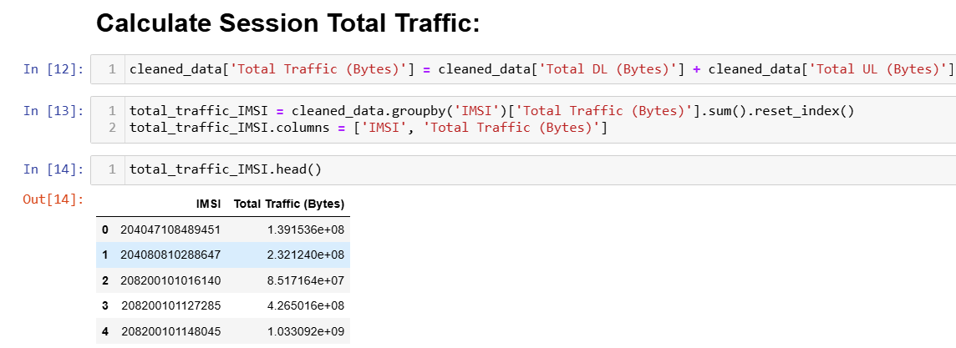
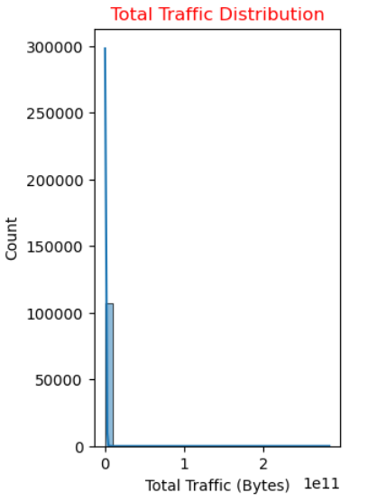

Slide 21
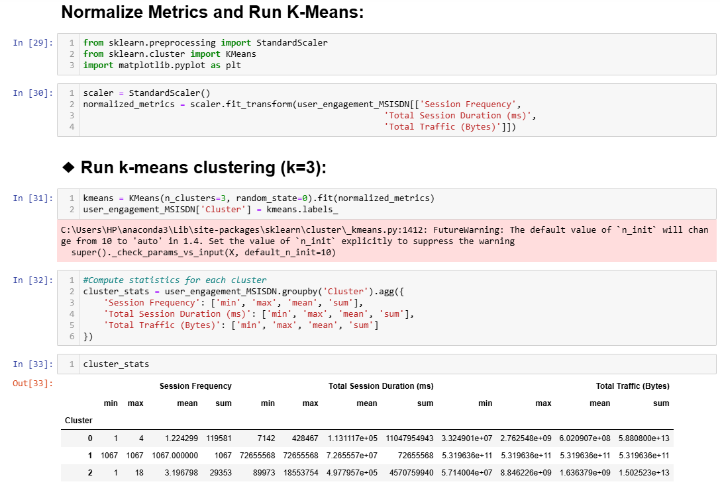

Slide 22
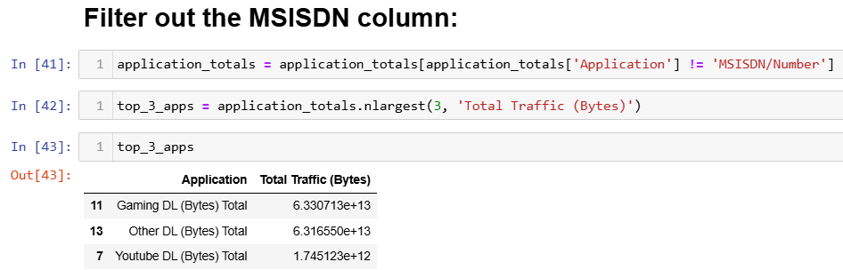

Slide 23
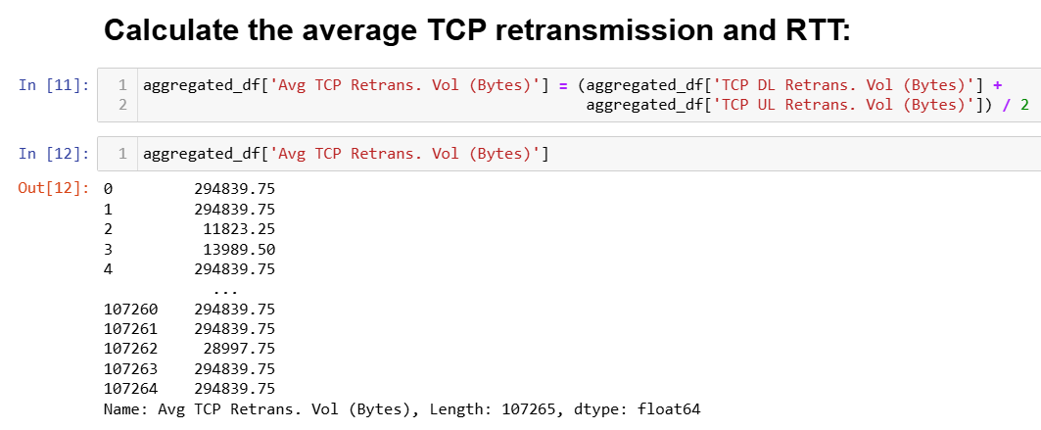
Task 3 - Experience Analytics

Slide 24
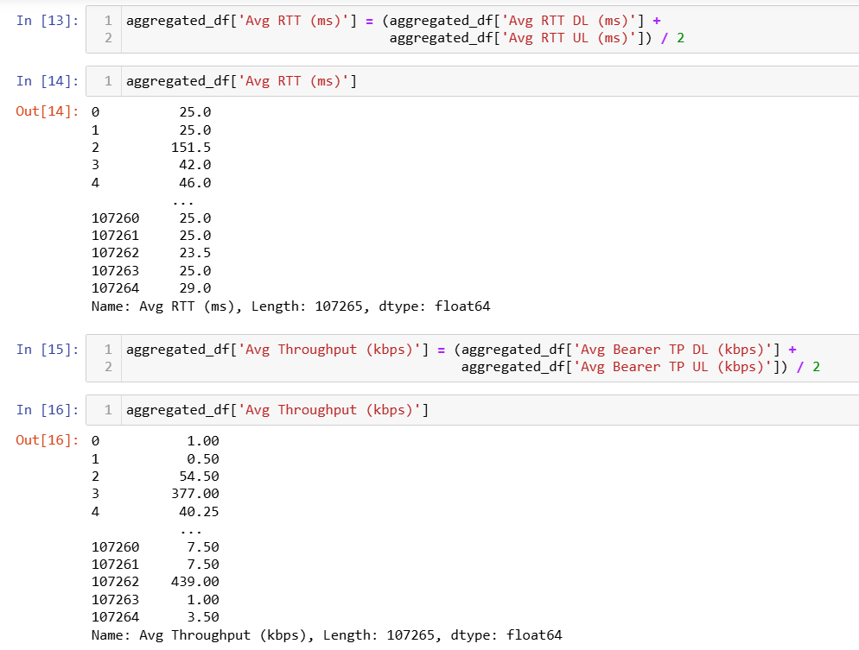

Slide 25
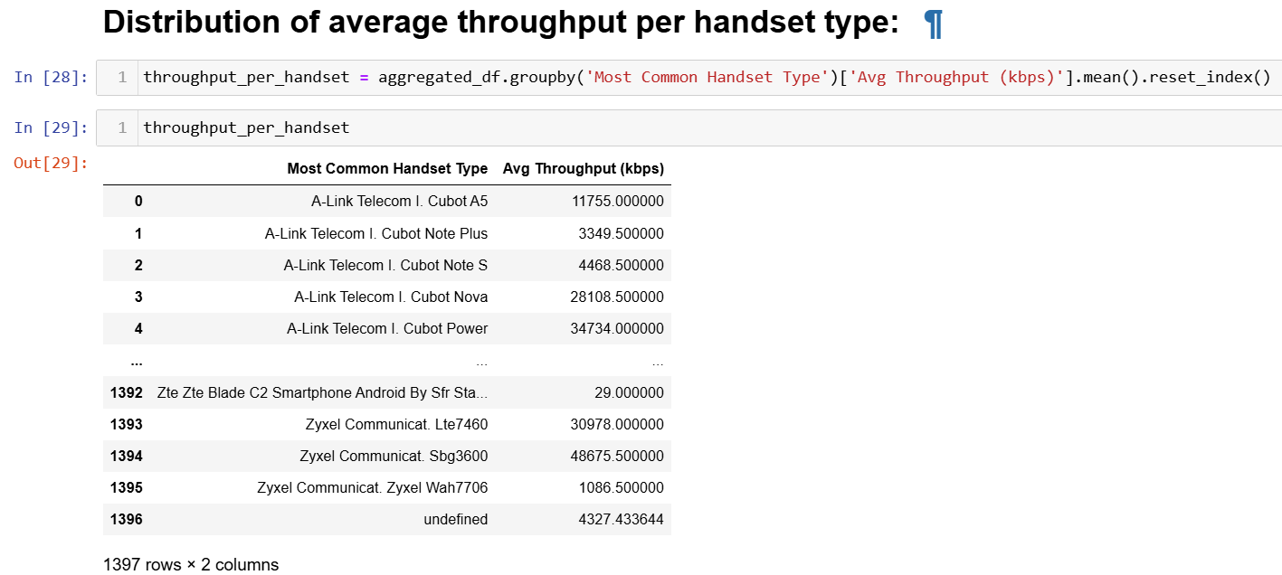

Slide 26
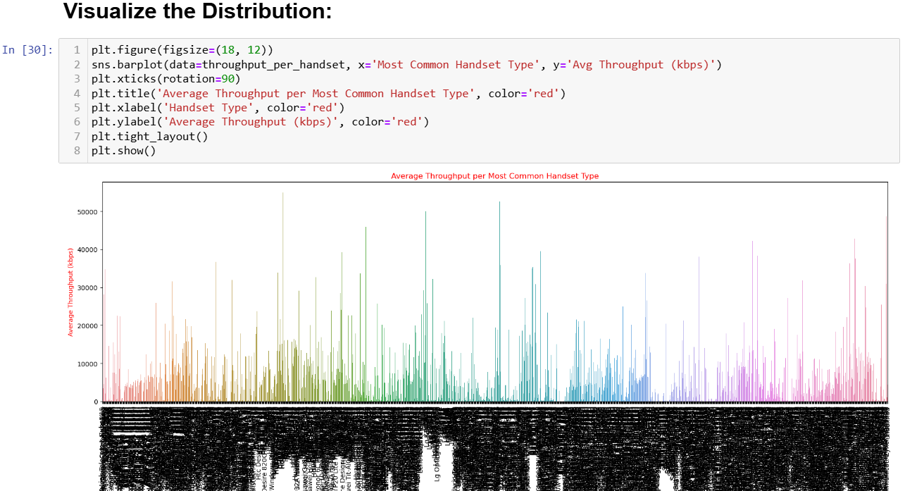
Visualization

Slide 27
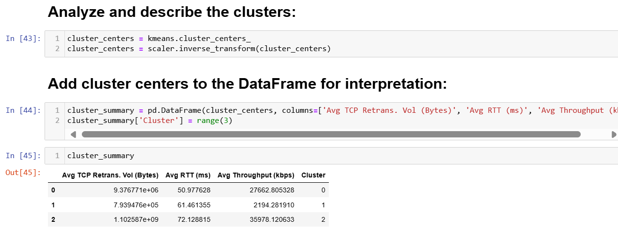

Slide 28
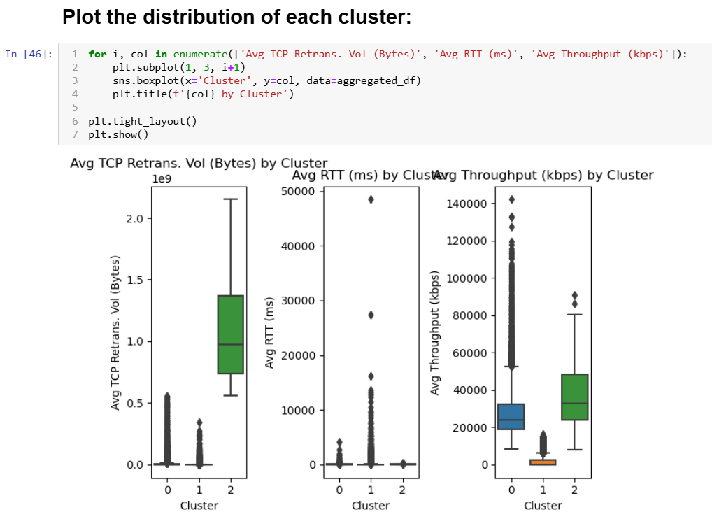

Slide 29
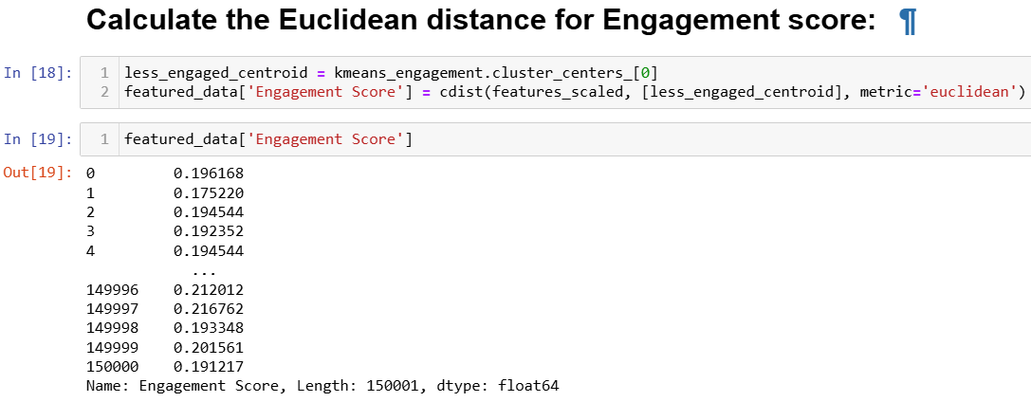
Task 4 - Satisfaction Analysis
Perform Euclidean Distance

Slide 30
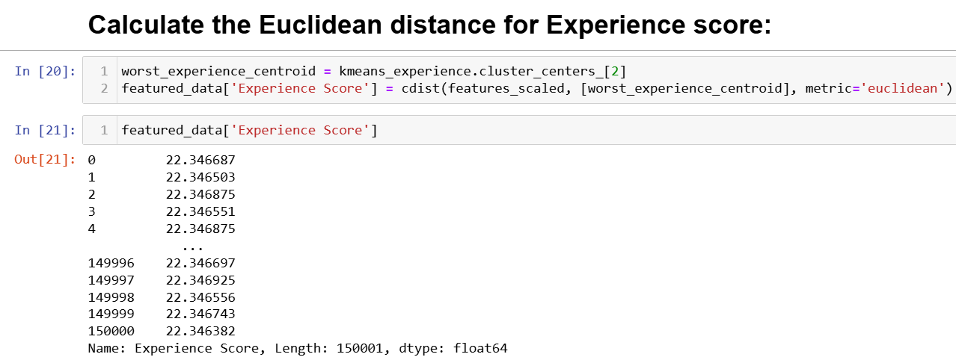

Slide 31
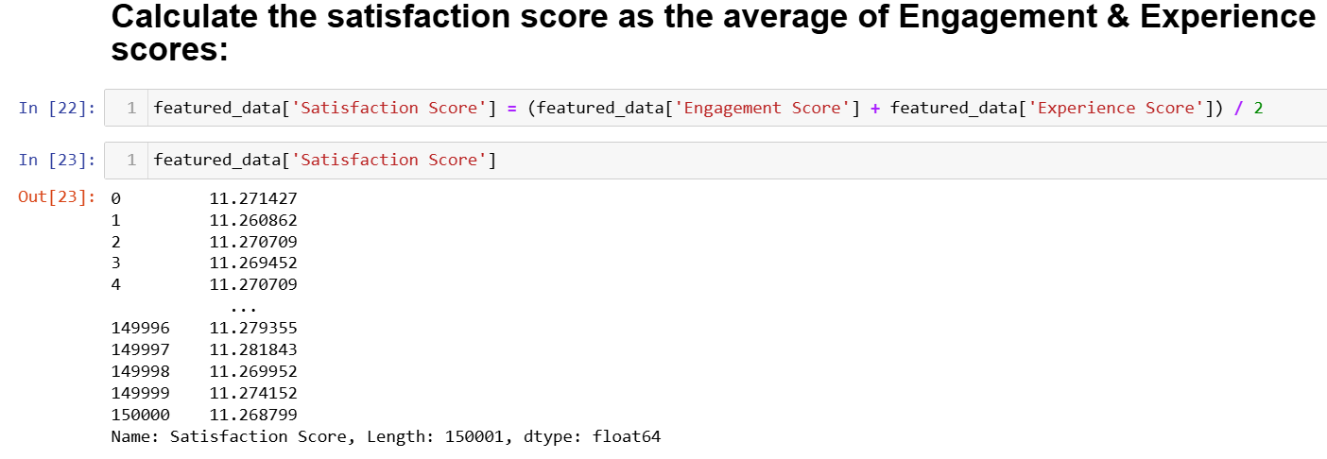

Slide 32
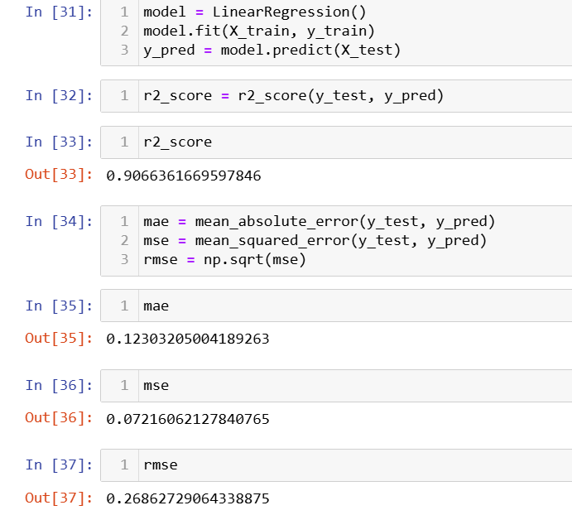
Initialize the Linear-regression-model

Slide 33
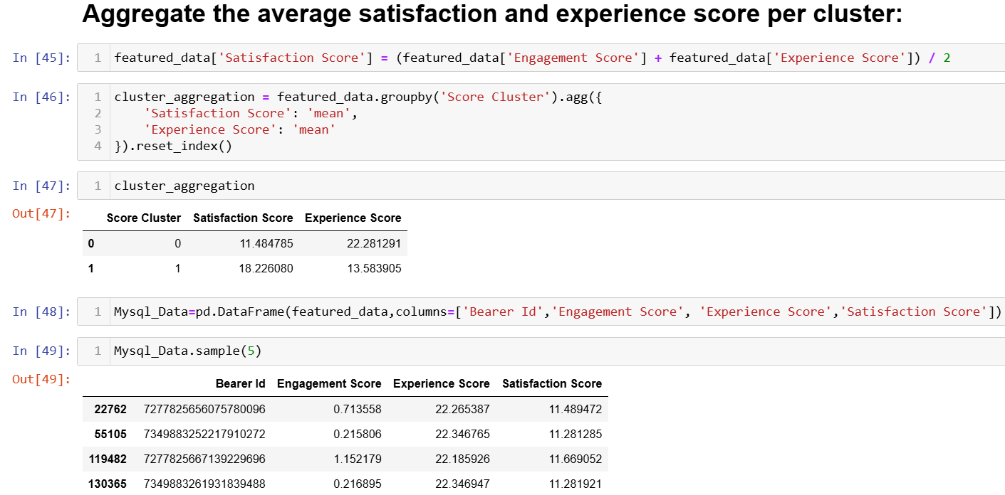

Slide 34
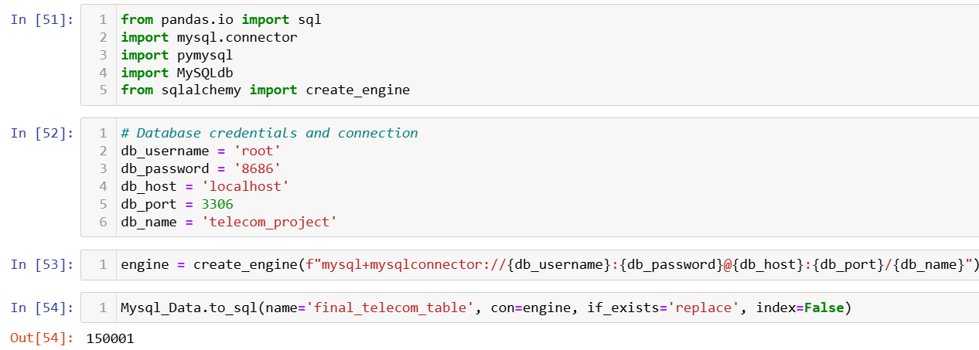
Connect MySql database:

Slide 35
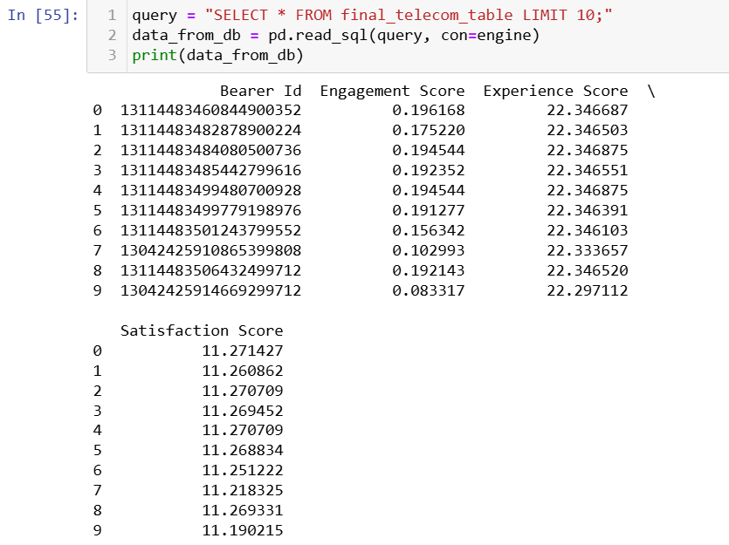

Slide 36
Chapter - 4
Results
Limitations:
Some of the columns in the datasets have large percentages of missing values, thus cannot be analysis.
The data has no timestamp. It might contain old records which might give a false overview of the current situation.
The analysis is focused only on the user leaving out potential insights that could be obtained from other aspects like handsets-analysis.
The call detail record (voice channel) is ignored and more focus is put on data sessions detail record.

Slide 37
Recommendations:
The company has some weaknesses and strengths based on the analysis. It is worth buying with some changes to be made:
● The handset types should be stocked depending on their number of users.
● More gaming handsets should be introduced given that majority of traffic is as a result of games.
● More features should be added to the existing gaming apps to increase sessions traffic.
● Handsets with a wide variety of applications should be introduced to in order to capture the attention of less
engaged users.

Slide 38
Chapter - 5
Conclusions
After conducting an extensive analysis of TellCo’s user data, we have identified several key insights and opportunities for growth:
User Overview:
The top 10 handsets and top 3 manufacturers dominate the market. Marketing strategies should target these popular devices to maximize reach.
The aggregated user behavior data highlights significant usage patterns across various applications, providing a clear picture of customer preferences.
User Engagement:
High engagement metrics were observed for users frequently accessing social media, YouTube, and Netflix. Enhancing network resources for these applications could improve user satisfaction and retention.
K-means clustering revealed distinct user segments based on engagement levels, allowing for targeted marketing and resource allocation.

Slide 39
User Experience:
Average throughput and TCP retransmission rates vary across handset types, indicating potential areas for network optimization.
Clustering users based on experience metrics identified groups with specific needs and challenges, guiding network improvement efforts.
User Satisfaction:
Combining engagement and experience scores provided a comprehensive satisfaction score. The regression model accurately predicted user satisfaction, aiding in proactive service improvements.
Clustering satisfaction scores identified distinct user groups, enabling tailored customer service strategies.

Slide 40


