Slide 1
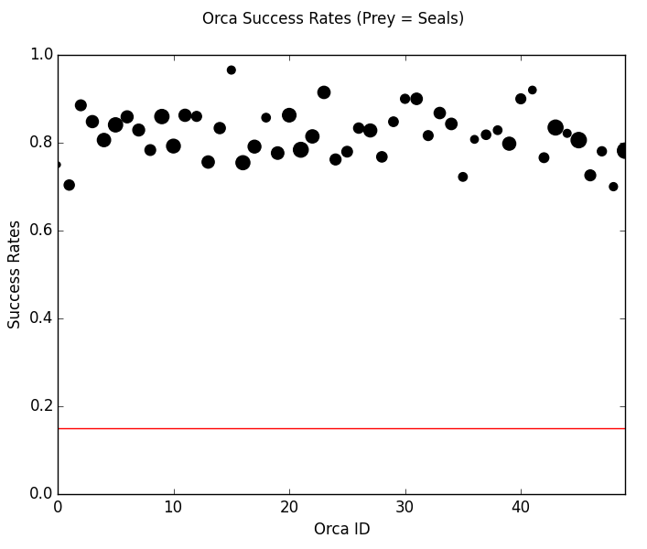
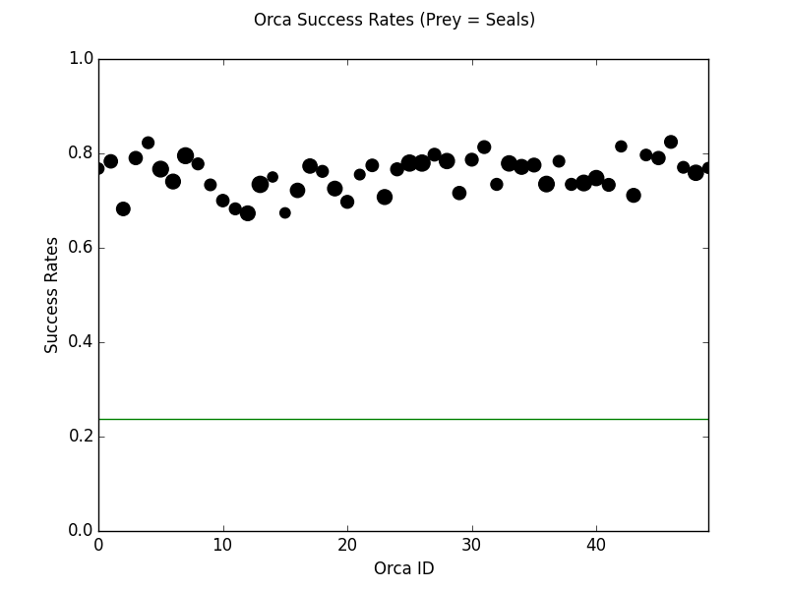
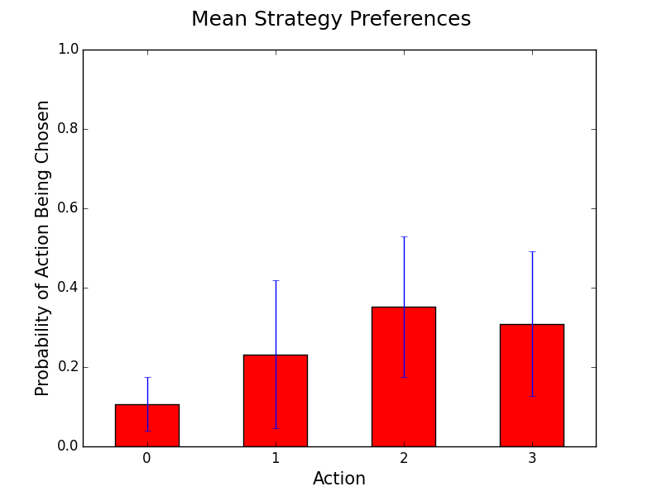
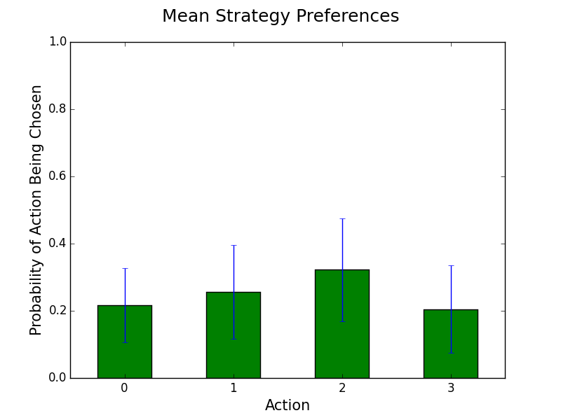
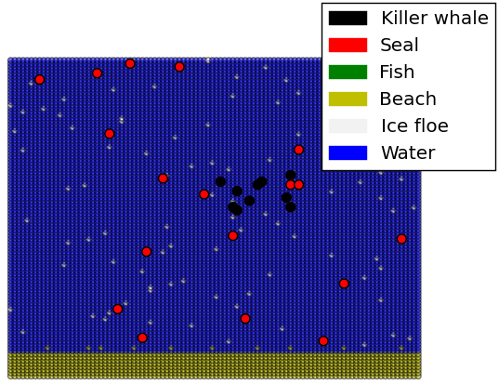
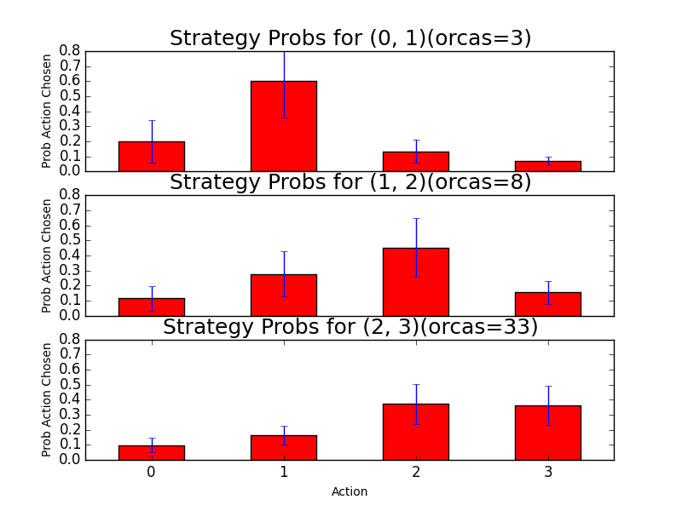
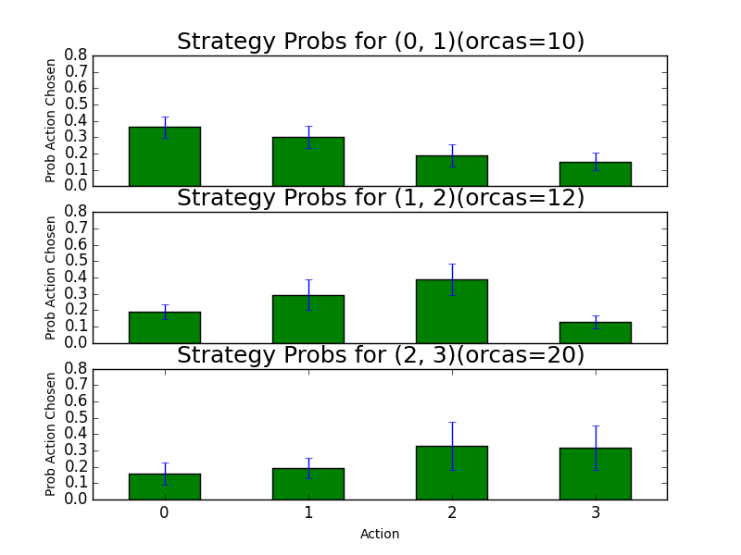
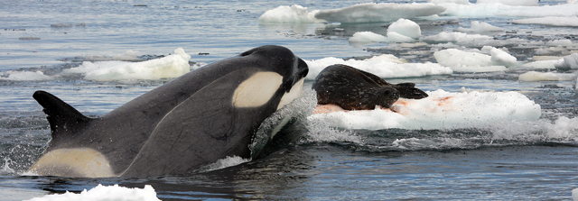
Killer Whale Hunting Strategies
Ana Lise Smith
CX 4230
Conceptual Model
Implementation
Results
Task
Learning Setup
Seals
Fish
Reproduce killer whale hunting behavior
Hunting behavior tied with communication behavior
Mammals → Be Quiet, Fish → Chatter
Training instances: Tuples of actions
Labels: 1 for successful attack, -1 for failed attack
Learning model: Naïve Bayes
Baselines
Killer Whales (Orcas)
Naïve Bayes
Naive because it assumes features are mutually independent
Based on Bayes’ theorem
Produces a MLE for each label given an instance
Move towards nearest prey with probability inversely proportional to distance
Limited detection range = 10 units
If no nearby prey, killer whale moves towards other orcas
Moves randomly otherwise if no other orcas and no fish
Four options for attacking with varying probabilities of success:
Learning Cycle
Action | Success % | Success % (w/ chatter) | Success % (w/ chatter, seal)
Action 0 (Chatter) | 0.0001 | 0.0001 | 0.0001
Action 1 | 25.0 | 50.0 | 5.0
Action 2 | 25.0 | 80.0 | 5.0
Action 3 | 25.0 | 25.0 | 5.0
For first 25 attacks, uniformly choose actions at random
Train on a feature set of 25 previous action tuples
Choose next action according to belief probabilities
Action Preferences
Strategies
MLE of last attack action × all possible actions
MLE of all combinations of actions
Next action chosen from distribution base on above
Prey: Seals and Fish
Move randomly when unbothered
Actively moves away from nearby orcas
Limited detection range = 5 units
Attacks on seals less successful in presence of noise
Attacks on fish more successful in presence of noise
Snazzy Visuals
Environment
Mostly uniform as far as action success is concerned
Some obstacles (e.g., ice floes, beach shallows)
Both orcas and prey must go around obstacles
References
Hunter, J. D. (2007). Matplotlib: A 2D graphics environment. Computing in science and engineering, 9(3), 90-95.
Pedregosa, F., Varoquaux, G., Gramfort, A., Michel, V., Thirion, B., Grisel, O., ... & Duchesnay, É. (2011). Scikit-learn: Machine learning in Python. The Journal of Machine Learning Research, 12, 2825-2830.
Whitney B. Musser, Ann E. Bowles, Dawn M. Grebner, and Jessica L. Crance. Differences in acoustic features of vocalizations produced by killer whales cross-socialized with bottlenose dolphins. The Journal of the Acoustical Society of America, 2014 DOI: 10.1121/1.4893906.
Mock, K. J. and J. W. Testa. 2007. An agent-based model of predator-prey relationships between transient killer whales and other marine mammals, University of Alaska Anchorage, Anchorage, AK, May 31, 2007, Available online at http://www.math.uaa.alaska.edu/~orca/.
Riesch, R. and V.B. Deecke. 2011. Whistle communication in mammal-eating killer whales (Orcinus orca): further evidence for acoustic divergence between ecotypes. Behavioral Ecology and Sociobiology, 65(7), 1377-1387.
Notes:
References
1. Hunter, J. D. (2007). Matplotlib: A 2D graphics environment. Computing in science and engineering, 9(3), 90-95.
2. Pedregosa, F., Varoquaux, G., Gramfort, A., Michel, V., Thirion, B., Grisel, O., ... & Duchesnay, É. (2011). Scikit-learn: Machine learning in Python. The Journal of Machine Learning Research, 12, 2825-2830.
3. Whitney B. Musser, Ann E. Bowles, Dawn M. Grebner, and Jessica L. Crance. Differences in acoustic features of vocalizations produced by killer whales cross-socialized with bottlenose dolphins. The Journal of the Acoustical Society of America, 2014 DOI: 10.1121/1.4893906.
4. Mock, K. J. and J. W. Testa. 2007. An agent-based model of predator-prey relationships between transient killer whales and other marine mammals, University of Alaska Anchorage, Anchorage, AK, May 31, 2007, Available online at http://www.math.uaa.alaska.edu/~orca/.
5. Riesch, R. and V.B. Deecke. 2011. Whistle communication in mammal-eating killer whales (Orcinus orca): further evidence for acoustic divergence between ecotypes. Behavioral Ecology and Sociobiology, 65(7), 1377-1387.

