Slide 1

Penguin Dataset Analysis

Slide 2
Overview
The analysis is performed based on factors like body mass and length to identify the relationship between the parameters, along with the distribution of penguins based on location and to identify the population of the penguins based on gender for a given timeline.

Slide 3
Objectives
Query 1
Query 2
Query 3
What is the relationship between the body mass and flipper length of a penguin ?
What is the distribution of penguins among the three islands?
What is the population distribution of the penguins based on gender?

Slide 4
Understanding the data

Slide 5
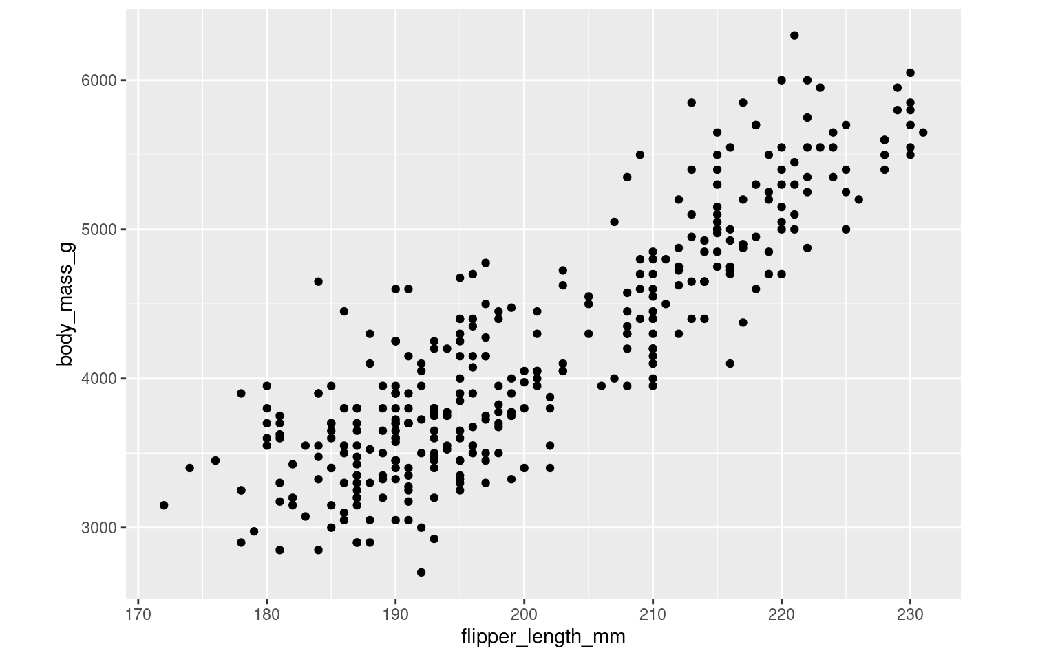
It can be inferred from the graph that the body mass is directly proportional to the flipper length of the penguin.

Slide 6
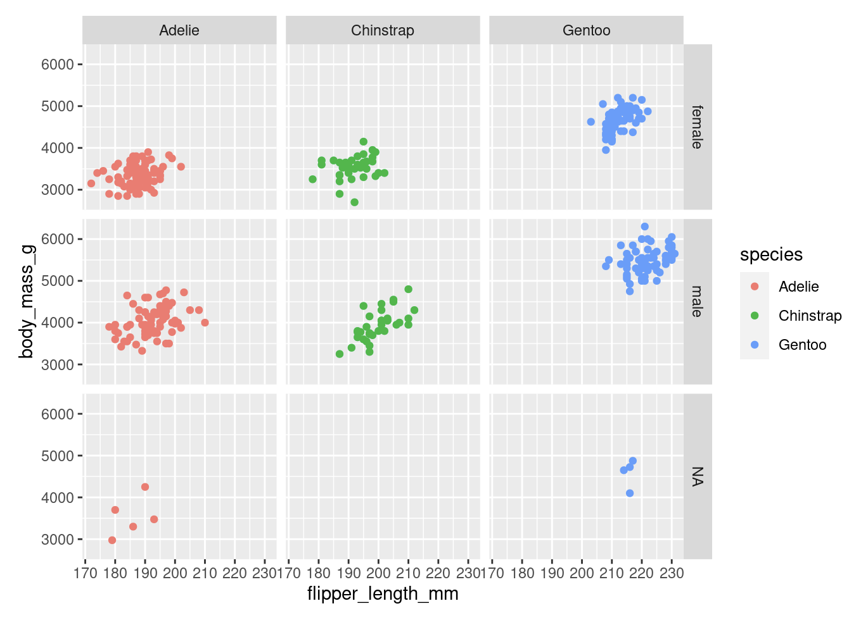
Further, Gentoo species have higher body mass irrespective of gender than the other two kinds of penguin species. Hence Gentoo species have longer flipper length among all.

Slide 7
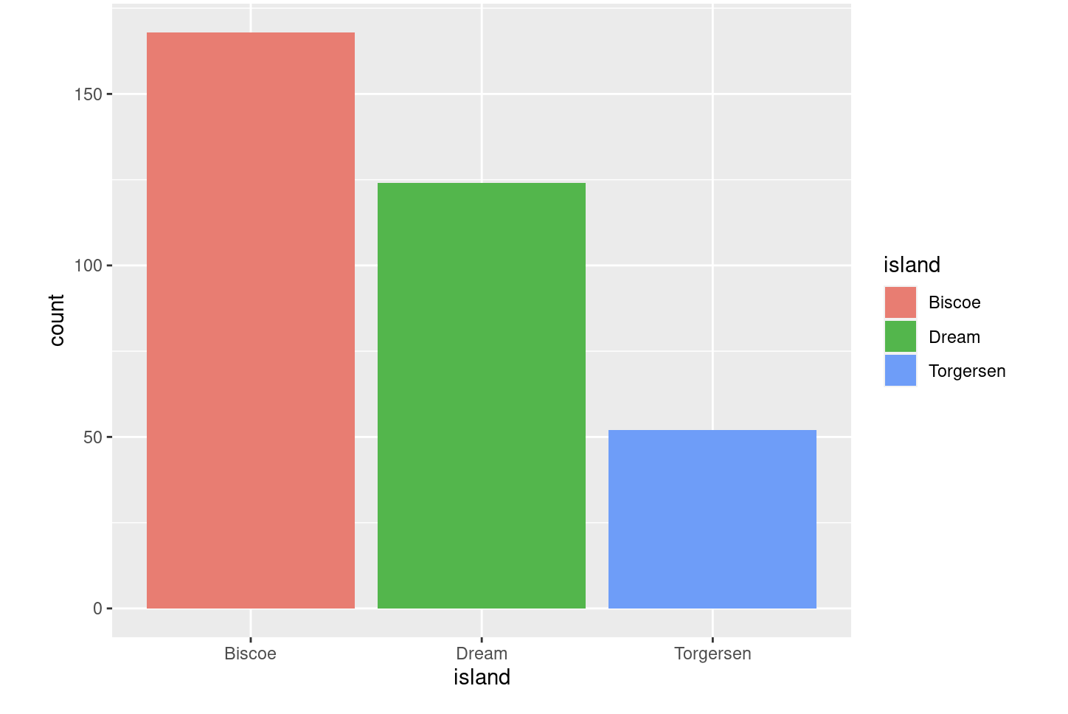
It can be inferred from the graph that the island of Biscoe has the highest population of penguins among the three, followed by the Dream and Torgersen islands.

Slide 8
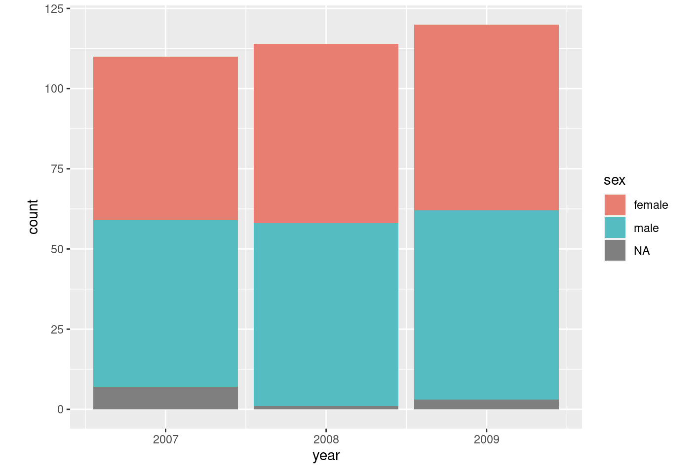
It can be observed from the graph that the overall population of the penguins has increased over the years by maintaining an indistinguible balance between both the genders.

Slide 9
Conclusion
Flipper length of the species increases with body mass.
Gentoo species have higher body mass irrespective of gender and hence tend to have longer flipper length.
It can also be inferred that Adelie species have lower body mass than the rest of the species.
Most number of penguins can be found in Biscoe Island followed by Dream Island.
Over the years, population of the penguins have gradually increased in all the islands.

Slide 10

Thank You
Jithesh Yemi Reddy
Aspiring Business Analyst

