Slide 1

Airbnb Analysis - New York

Slide 2

Overview
The analysis is performed based on various parameters to determine what types of rooms the customers prefer the most along with the location and plan a strategy accordingly to increase the occupancy of the room.

Slide 3
Objectives
What type of room do people prefer the most?
Question 1
What price range do most people prefer based on the location?
Question 2
What is the minimum number of nights spent in the location?
Question 3
Quotes for illustration purposes only

Slide 4
Understanding the data

Slide 5
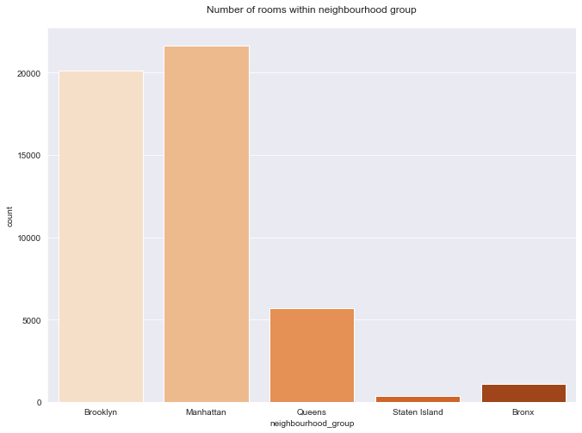
It can be inferred from the graph that Manhattan has the most number of Airbnb’s compared to the rest of the neighborhood.

Slide 6
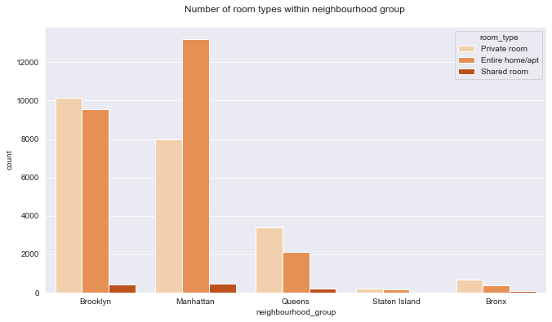
Furthermore, Manhattan has the most number of entire home / apartments followed by Brooklyn.

Slide 7
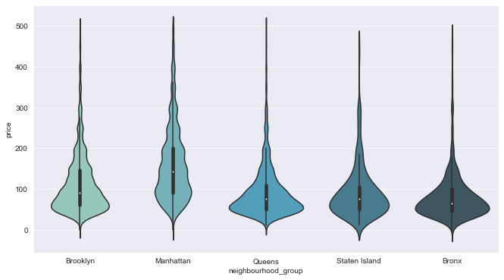
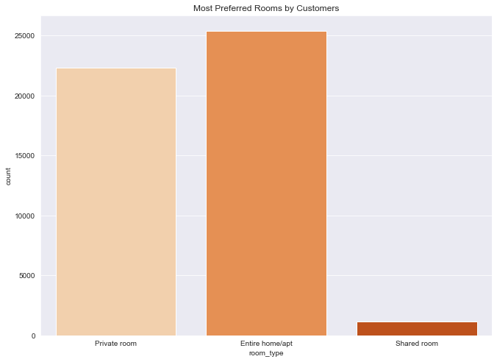
Preferred Room
From the analysis it is evident that most people prefer entire home / apartments. Since most number of the Airbnb's that are available in Manhattan and Brooklyn are entire home/ apartments, many people prefer to stay in these locations.

Slide 8
Price
Most of Airbnb’s in Brooklyn are priced in the range of 50- 100 and in Manhattan they are priced around 80-150. Queens, Stalin Island and Bronx neighborhoods also have many Airbnb's in the range of 50-100 .

Slide 9
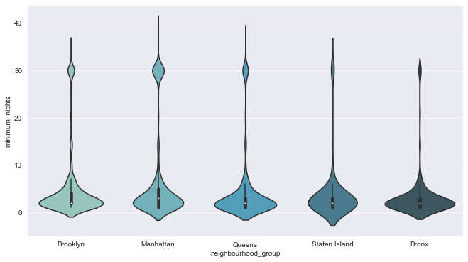
Duration
Most of people tend to stay between 2-5 days in Brooklyn and Bronx followed by Queens and Manhattan.
People stay longer in Manhattan followed by Bronx for a period of over 28- 33 days.

Slide 10
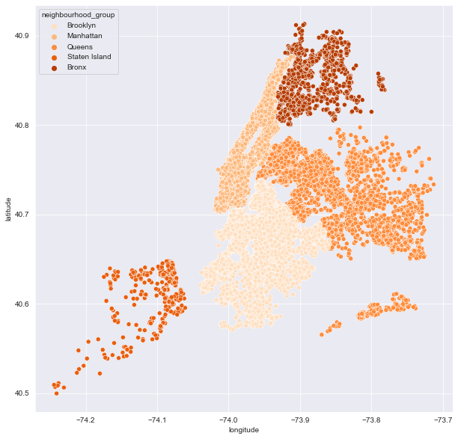


DEMOGRAPHIC REPRESENTATION OF NEIGHBOURHOODS

Slide 11
Solution
Increase the Number of apartments and private rooms in all the locations
Ensure to Incorporate more Airbnb’s in the price of 50-100$ in Manhattan and Brooklyn
R
Airbnb’s should be ready to host at least two sets of guests per week as the avg stay is 2-5 days
Quotes for illustration purposes only

Slide 12

THANK YOU
Jithesh Yemi Reddy
Aspiring Business Analyst

