Slide 1

Customer Analysis

Slide 2
Overview
The analysis is performed based on parameters such as Age, Gender, Annual Income and Spending Score of the customers so as to determine the “Target Customers” by using clustering technique and plan a strategy accordingly.

Slide 3
Project Objectives
Question 1
Question 2
Question 3
Should we focus more on the Female Clothing rather than the Male Clothing ?
Which age group of customers should we target to start our marketing strategy ?
How does the Annual Income and Spending score play a factor in the shopping practice of a customer ?

Slide 4
Understanding the data

Slide 5
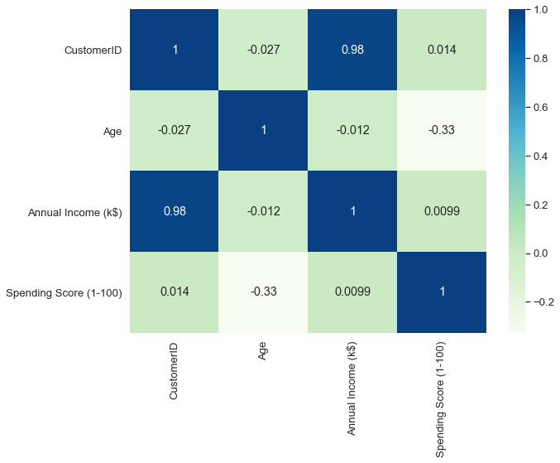
Correlation
It is clear from this correlation table that the older customers have less income and therefore spend less money.

Slide 6
Male vs Female Customers
110
52
90
49
Mean spending amount
Count of people
Female
Male
Female
Male
Though the number of female customers are more than male customers , the mean spending amount of both the genders are almost the same.

Slide 7

Target audience

Slide 8
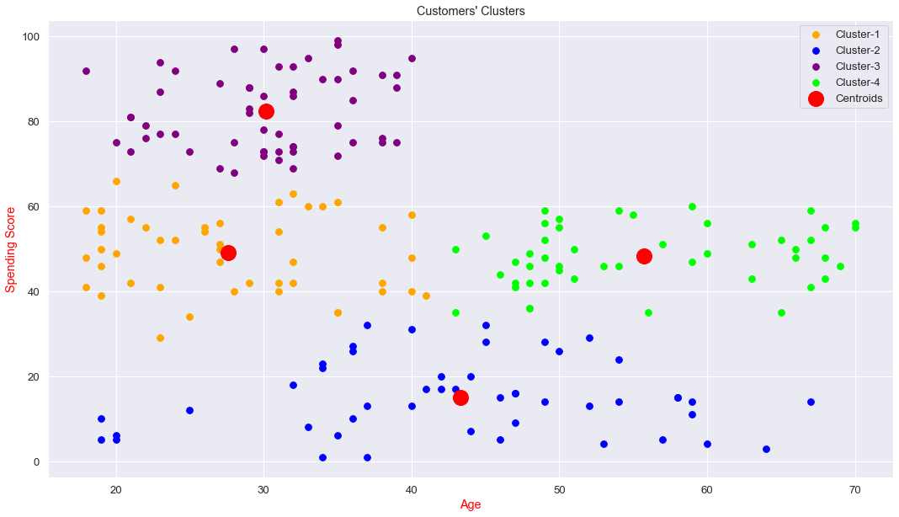
Age vs Spending
People between the age 20-40 have made more purchases. Therefore, we can make our target customers more specific.

Slide 9
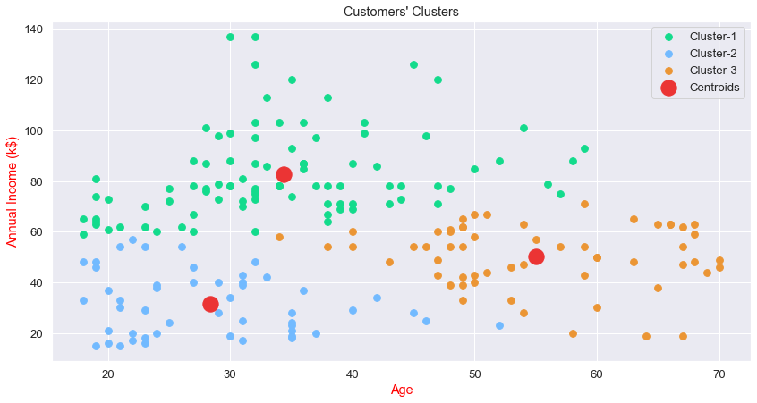
Age vs Income
People between the age 30-50 have more annual income. Hence, we can target customers in this range.

Slide 10
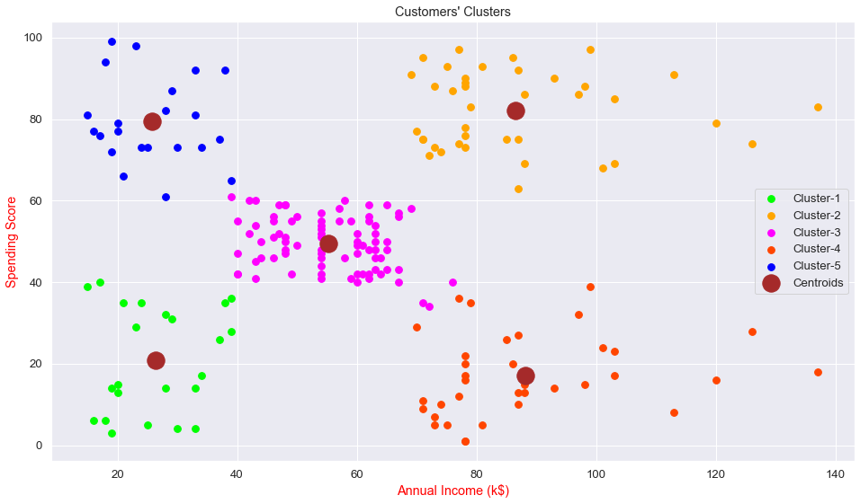
Income vs Spending
Cluster groups 2 and 5 can be targeted directly , meanwhile cluster 3 has more number of customers who have a spending score of 40-70K. If we can make shopping attractive for the cluster-3 customers, we can expect more profit.

Slide 11
Market trends
It is very clear that there is no big difference between male and female customers, so a gender based audience should not be chosen.
Customers aged between 30-40 have higher income and tend to spend more.
Customers aged between 20-30 also spend significant amount on purchase even though their annual income is less than others.
Majority of the customers have their annual income in the range of 40 - 75K. Hence, by making the shopping experience attractive for customers belonging in this range can bring more profits to the company.

Slide 12
Proposed Strategies
Strategy 1
Running special campaigns (social media) for customers between the age of 20 -40
Strategy 2
Offering special discounts to the customers who have annual income between 40 - 70k
Strategy 3
Increase the quality of service to target high income customers while retaining the existing

Slide 13

Thank You
Jithesh Yemi Reddy
Aspiring Business Analyst

