Slide 1

Medical Cost Analysis using Excel
Data Analytics Project
By: Muneeza

Slide 2
Project Overview
Objective: The aim of this project is to understand what factors have the biggest influence on medical costs and identify patterns that explain why some individuals end up paying more than others.
Dataset: The analysis is based on 1,338 records, including details such as age, BMI, number of dependents, smoking status, region, and medical charges.
Tools Used: The entire study was carried out in Excel, using pivot tables, charts, KPI cards, and an interactive dashboard to explore and visualize the data.
Goal: The main goal is to uncover key health and cost trends that can help explain medical expenditure and highlight high-risk groups.

Slide 3
Basic Statistics Summary
The average age is around 39, which means most people in this dataset fall into the middle-aged group.
The average BMI is roughly 30.7, suggesting that many individuals are in the overweight range.
The average medical charges come out to about ₹13,270, but there is a lot of variation from person to person.
Since the median charges are lower than the average, it shows that a few people have very high medical bills, which pushes the average up.
Basic Statistics Summary
Metric | Value
Average Age | 39.21
Median Age | 39.00
StdDev Age | 14.05
Average BMI | 30.66
Median BMI | 30.40
StdDev BMI | 6.10
Average Charges | 13270.42
Median Charges | 9382.03
StdDev Charges | 12110.01

Slide 4
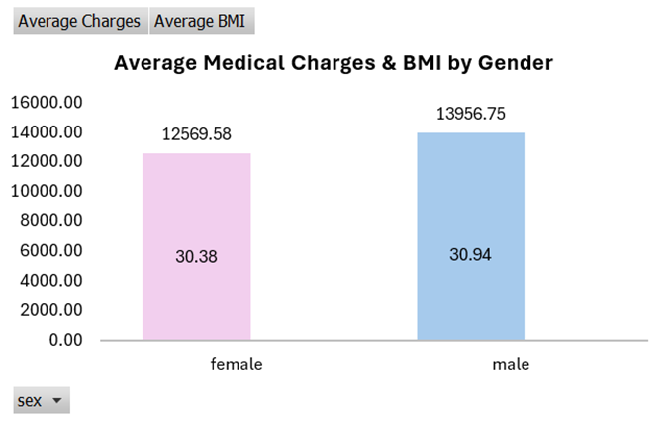
Gender Analysis
On average, males tend to spend more on medical charges than females. Male beneficiaries have average charges of about ₹13,956, while females are around ₹12,570. This means men are spending roughly 11% more.
When we look at BMI, males also show a slightly higher average BMI (30.94) compared to females (30.38). The difference isn’t huge, but it does suggest that men in this dataset are marginally heavier on average.
Overall, gender does play a role, but the impact is moderate rather than extreme. Both costs and BMI differ between men and women, but not drastically.

Slide 5
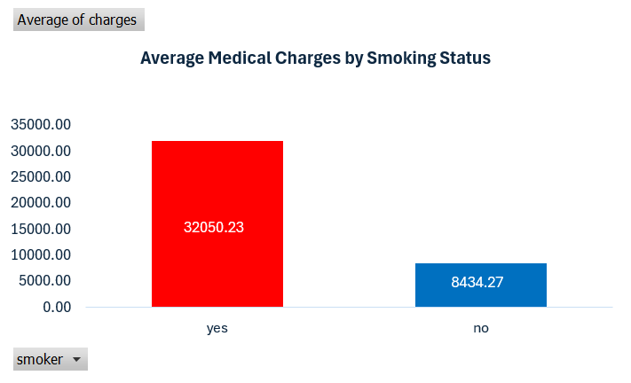
Smoking Impact
The difference in medical spending between smokers and non-smokers is huge. Smokers spend around ₹32,050 on average, while non-smokers spend roughly ₹8,434.
This means smokers are paying almost four times more than non-smokers, making smoking one of the strongest factors driving up medical costs in the entire dataset.
The numbers clearly show that smoking has a major financial impact, with significantly higher healthcare expenses for individuals who smoke.

Slide 6
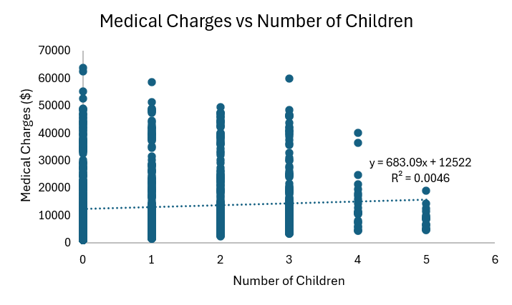
Dependents vs Charges
The correlation between the number of dependents and medical charges is extremely low (around 0.07), which means there is almost no direct relationship between the two.
In other words, having more children doesn’t necessarily lead to higher medical expenses. The costs remain fairly scattered across all family sizes.
The trendline on the chart is almost flat, reinforcing that larger families do not automatically translate into higher medical bills in this dataset.

Slide 7
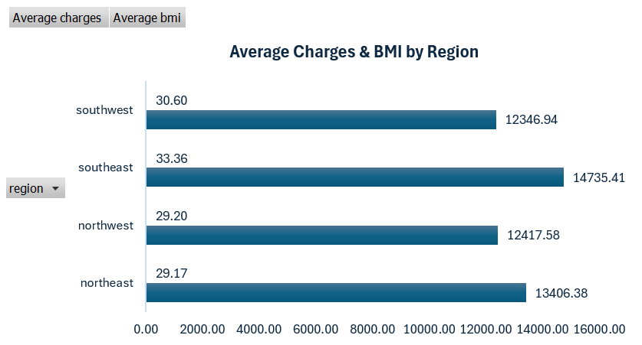
Regional Analysis
The Southeast region stands out with the highest average medical charges, around ₹14,735, which makes it the most expensive region in terms of healthcare costs.
The Southeast also shows the highest average BMI (33.36), noticeably higher than the other regions. This suggests that people in this region may have a higher prevalence of weight-related health issues.
When we put both metrics together, the Southeast clearly appears to be the most health-risk-prone region, as higher BMI often leads to higher medical spending.
The other regions—Northeast, Northwest, and Southwest—show lower and relatively similar averages, indicating more stable health and cost patterns compared to the Southeast.

Slide 8
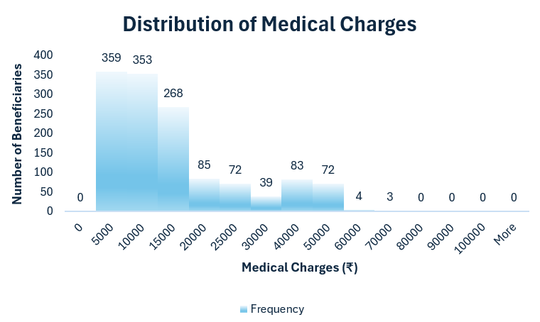
Cost Distribution
Most people fall in the ₹5,000–₹10,000 medical charge range, making it the most common bracket in the dataset.
As the cost increases, the number of beneficiaries drops sharply. Charges above ₹30,000 are quite rare, and only a small handful reach the very high-cost levels.
The shape of the distribution shows that the data is right-skewed — meaning a majority of people have relatively lower medical expenses, while a few individuals have very high costs that stretch the tail of the graph.

Slide 9
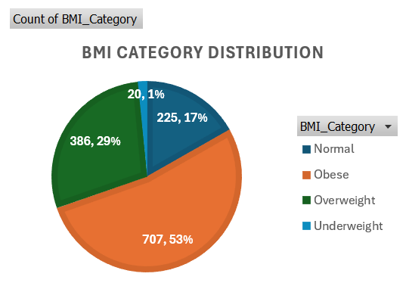
BMI Classification
A large portion of the population falls under the Obese category (53%), making it the biggest BMI group in the dataset.
The next major segment is Overweight individuals (29%), followed by those with Normal BMI (17%).
Only a very small group (1%) is classified as Underweight.
Overall, the fact that more than 80% of the people are either overweight or obese highlights a significant health-risk pattern in the dataset. This could also explain higher medical expenses in certain groups.

Slide 10
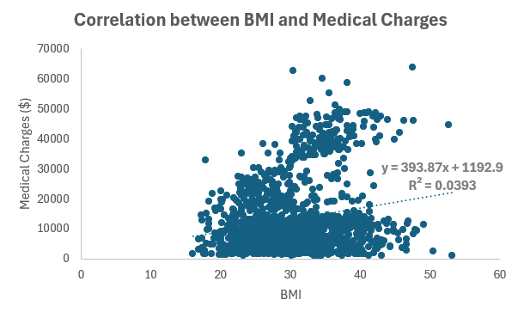
BMI vs Charges Correlation
The correlation between BMI and medical charges is around 0.20, which indicates a weak positive relationship. In simple terms, higher BMI is linked to higher medical costs, but the connection isn’t very strong.
The scatter plot shows a lot of spread, meaning people with similar BMI values can still have very different medical expenses. This suggests that BMI alone doesn’t fully explain the variations in medical costs.
Other factors—especially smoking status and in some cases regional differences—seem to have a much stronger influence on healthcare spending than BMI does.

Slide 11
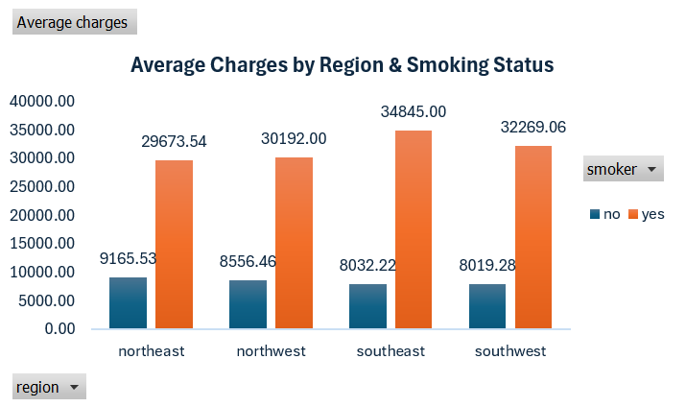
Smoking × Region
Across every region, smokers consistently have much higher medical charges compared to non-smokers. The pattern is strong and very clear in the chart.
Among all regions, the Southeast shows the highest average medical cost for smokers, at around ₹34,845. This suggests that smoking-related health issues may be more severe or more expensive to treat in this region.
Non-smokers, on the other hand, show lower and fairly stable costs across all regions, with only small differences between them.
Overall, the chart highlights that smoking dramatically increases medical expenses, and the effect becomes even more pronounced in certain regions—especially the Southeast.

Slide 12
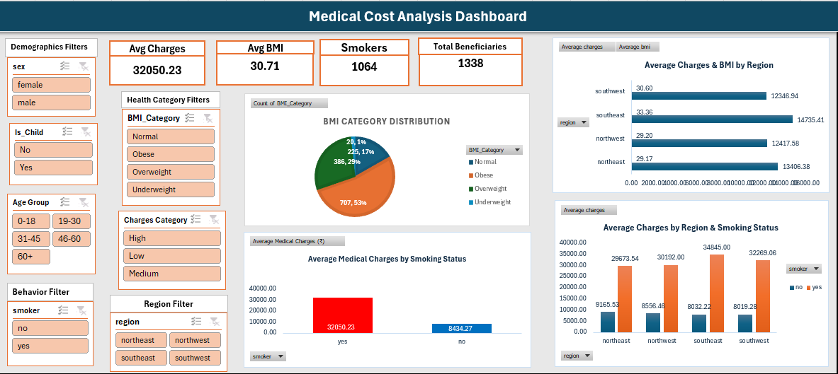
Dashboard Overview

Slide 13
Summary & Key Insights
The dashboard highlights three key metrics upfront: Average medical charges are ₹13,270, the average BMI is 30.66, and around 20% of the population are smokers. These values help set the overall context of the dataset.
One of the biggest insights is that smokers incur far higher medical expenses. On average, smokers pay ₹32,050, whereas non-smokers pay only ₹8,434 — roughly 4× difference, making smoking the strongest driver of medical costs.
Regional filters show that the Southeast region records the highest medical charges, with an average of ₹14,735, along with the highest BMI (33.36). This indicates that this region faces more health risks than others.
Looking at BMI categories, 53% of individuals fall into the obese group, followed by 29% overweight. This means more than 80% of the population is above the normal BMI range, which directly connects to higher medical spending.
Gender filters reveal that males have slightly higher medical charges (₹13,956) than females (₹12,569), and they also show a slightly higher average BMI (30.94 vs. 30.38).
Overall, the dashboard gives a clear picture of the major cost-driving patterns: smokers pay the most, the Southeast has the highest risk profile, and obese individuals form the most expensive BMI segment.

Slide 14
YouTube Video Link
🎬 Watch Full Explanation
Click here to open video
https://youtu.be/9wKx0TRduLo?si=3ARPhrtEfG3wytm0

Slide 15
Thank You
Presented by: Muneeza
Tool Used: Microsoft Excel
Project: Medical Cost Analysis

