Slide 1
Retail Sales Analysis – 2010–2011
Complete Project Presentation
Prepared by: Muneeza

Slide 2
Project Overview
Analyzed key sales patterns across products, customers, pricing levels, and regions.
Identified top-performing items and customer groups driving major revenue.
Studied monthly and seasonal trends to understand demand fluctuations.
Evaluated issues related to product returns and inconsistencies in pricing.
Built a unified dashboard to help decision-makers quickly interpret sales performance.

Slide 3
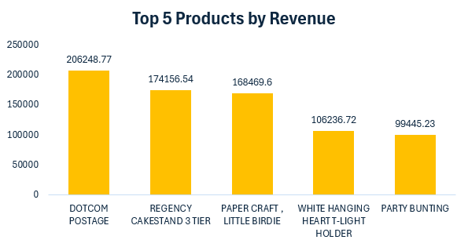
Sales Performance – Top Products
The top-selling products show consistently strong demand from customers.
High order volumes suggest frequent repeat purchases for these items.
Revenue contribution from these products highlights their importance in the catalog.
The distribution clearly shows a few bestsellers dominating overall sales performance.

Slide 4
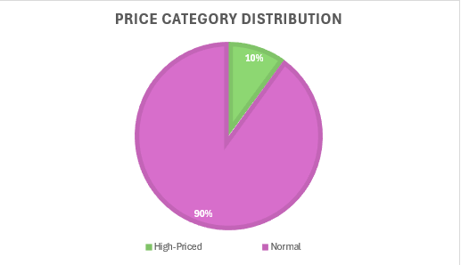
Pricing Analysis – High-Priced Products
The 90th-percentile threshold is used to classify premium-priced products.
Only about 10% of items fall under the high-priced segment.
These premium products contribute significantly to total revenue despite their smaller count.
The presence of high-value items indicates potential appeal to a more upscale customer base.

Slide 5
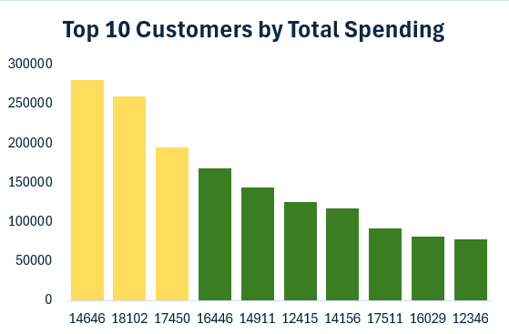
Customer Analysis – Top Spenders
A significant portion of revenue is concentrated among the top 10 customers, indicating a heavy reliance on a small group of high-value buyers.
These customers exhibit consistently high order frequency or large purchase volumes, positioning them as key accounts.
The sharp spending drop after the top three customers highlights a long-tail distribution, where many smaller buyers contribute marginally.
Retention efforts such as loyalty programs, exclusive discounts, or personalized communication could further strengthen this high-value group.

Slide 6
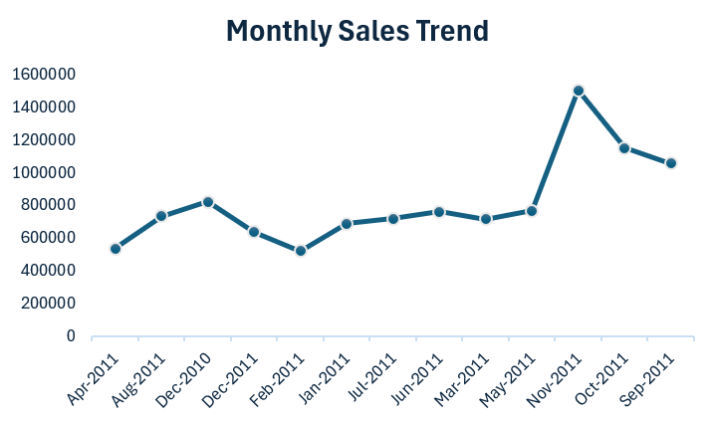
Temporal Sales Trend – Monthly Performance
November’s sharp sales spike indicates a strong festive season boost, likely tied to year-end shopping trends.
The February dip points to post-holiday slowdown, a common pattern across retail industries.
Mid-year months show stable and predictable demand, providing a reliable baseline for operational planning.
The overall upward movement across months reflects business expansion and growing customer engagement over time.

Slide 7
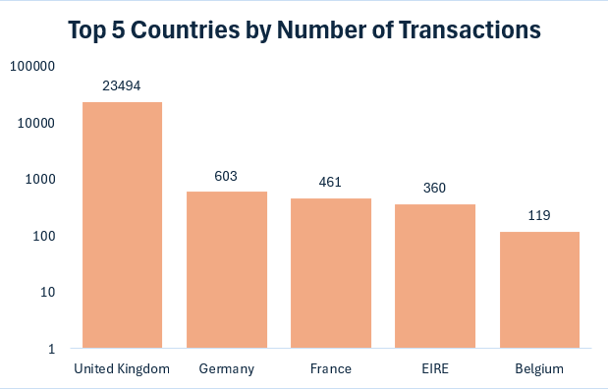
Geographical Insights – Top Countries
The UK clearly dominates sales activity, showing deep market penetration and strong brand presence in the region.
Other countries show much lower transaction volumes, highlighting untapped or under-served markets.
This imbalance indicates both a risk (dependency on one market) and an opportunity (scope for global expansion).
Strengthening marketing, product distribution, or partnerships in countries like Germany or France could diversify revenue streams.

Slide 8
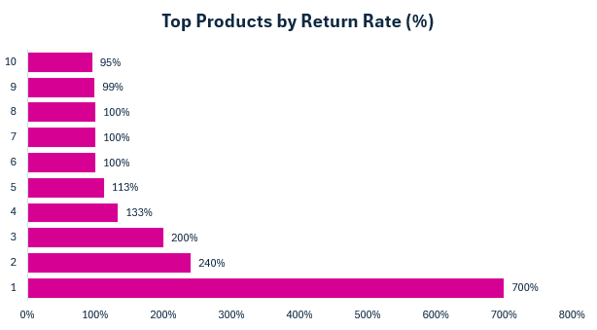
Product Return Rate – Key Issues
Exceptionally high return rates (100–700%) point to severe product issues — these may include incorrect listings, product mismatches, wrong shipments, or poor quality.
High-return items not only reduce profitability but also impact customer trust and operational efficiency.
A cluster of SKUs with consistently high returns suggests systemic issues rather than isolated events.
Immediate corrective action is needed, reviewing product descriptions, supplier consistency, logistics handling, and order accuracy.

Slide 9
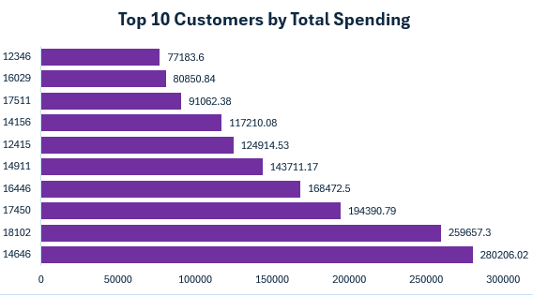
Customer Segmentation – High, Medium, Low
The majority of revenue is driven by a small group of high-tier customers, confirming a top-heavy revenue structure.
Medium-tier customers show considerable potential — with targeted engagement, they could transition into high-value buyers.
Lower-tier customers represent a large customer base but minimal contribution, indicating the need for broader marketing strategies or bundle offers.
Segmentation helps the business prioritize efforts: retention for high-tier, nurturing for medium-tier, and acquisition strategies for the broader market.

Slide 10
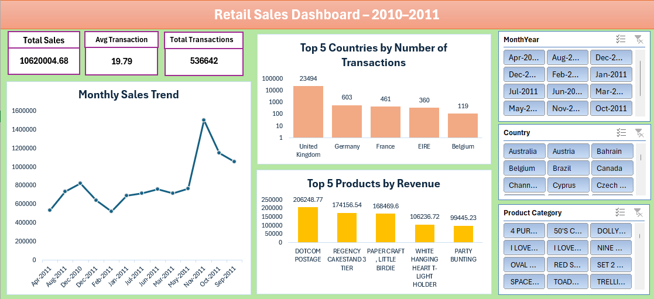
Overall Dashboard Insights
Sales, product performance, customer behaviour, and geographic trends are aligned, offering a cohesive view of how the business operates.
Seasonal spikes and dips reveal predictable cycles that can guide inventory planning and promotional strategies.
High-value customers continue to be the backbone of revenue, highlighting the importance of relationship management and retention.
High return rates and over-reliance on UK transactions are critical red flags that require organizational attention.
The dashboard provides a consolidated view that supports data-driven decision-making across departments.

Slide 11
Summary & Recommendations
The UK is currently the strongest revenue generator, with premium and top-selling items contributing major value.
Sales trends show clear seasonality, especially a strong November peak and February slump.
Revenue concentration among high-value customers presents both strength and vulnerability.
High product return rates highlight operational inefficiencies that could significantly impact customer satisfaction and profitability.
Recommendation: Prioritize high-value customer retention, address product return issues urgently through supplier and listing audits, and explore expanding into underperforming markets to reduce dependency on the UK.

Slide 12
End of Project – YouTube Explanation Link
• Complete walkthrough of dashboard and insights.
• Step-by-step explanation of each analysis sheet.
• Visual demonstration of key charts and KPIs.
🎬 Watch Full Explanation
Click here to open video
https://youtu.be/skvNYRAHqRc

