Slide 1
Credit Risk Analysis Using Power BI
Loan Default Risk – Dashboard & Insights
Prepared by Muneeza

Slide 2
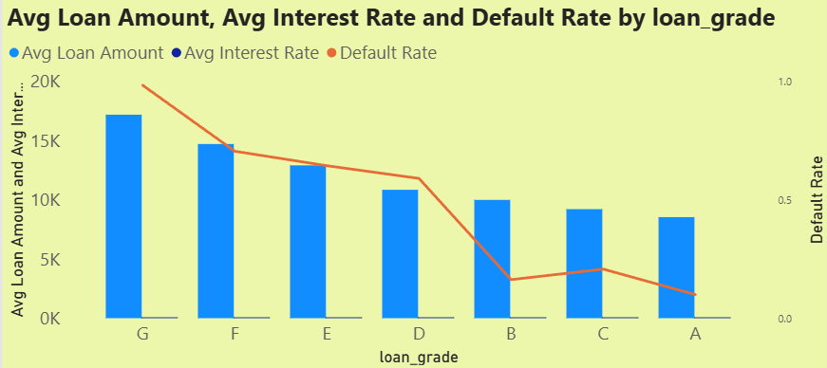
Loan Grade Analysis
This analysis compares average loan amount, interest rate, and default rate across loan grades.
Borrowers in lower grades (G, F, and E) tend to take higher loan amounts, even though their credit quality is weaker.
Interest rates gradually decrease from Grade G to Grade A, which clearly reflects improving borrower reliability and lower perceived risk.
Default rates are highest in grades G to E, showing that weaker credit profiles struggle more with repayment.
Grades A and B stand out as the safest segments, with lower loan amounts, lower interest rates, and minimal defaults.
Overall, this confirms that high loan amount combined with high interest rate significantly increases default risk, especially in lower grades.

Slide 3
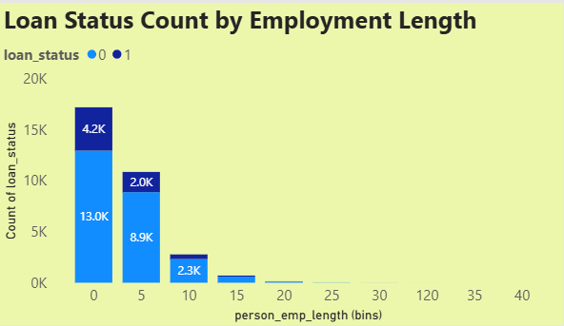
Employment Length Analysis
This Graph shows how employment stability impacts loan repayment behavior.
Borrowers with 0–5 years of employment form the largest applicant group, but they also contribute the highest number of defaults.
Individuals with less than 10 years of work experience show noticeably higher repayment risk, likely due to income instability.
As employment length increases, default rates decline steadily, indicating stronger financial discipline and stability.
Long-term employees are generally more reliable borrowers, with fewer defaults despite similar loan exposure.
This makes short employment duration a key risk indicator, especially when combined with other risk factors.

Slide 4
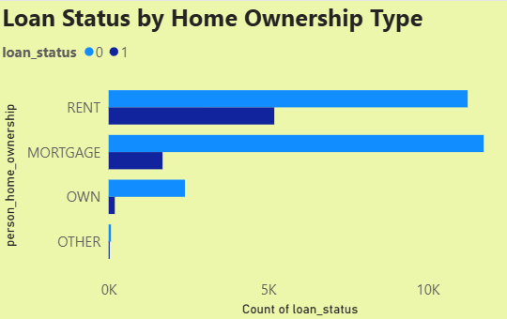
Home Ownership Risk Analysis
This analysis evaluates default behavior across different home ownership categories.
Renters show the highest number of defaults, making them the riskiest borrower group.
Borrowers with a mortgage perform better than renters, suggesting more financial responsibility and asset backing.
Customers who own their homes outright (OWN) show the lowest default rates, indicating the safest borrower profile.
The combination of renters with less than 10 years of employment emerges as the highest-risk segment.
On the other hand, home ownership plus stable employment strongly correlates with lower credit risk.

Slide 5
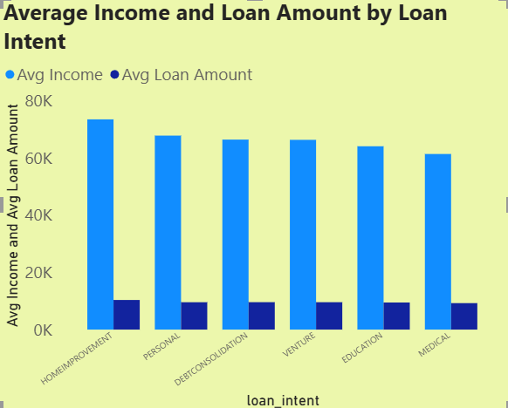
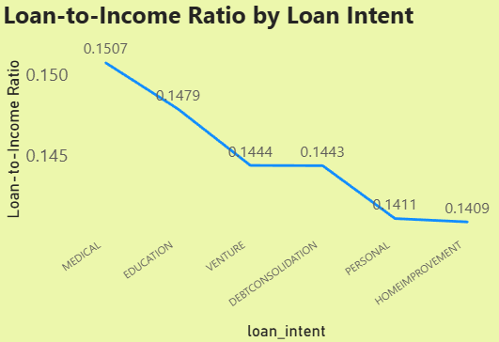
Loan Intent – Income & Amount
This slide compares average income and loan amount across different loan purposes.
Debt consolidation borrowers typically take the largest loan amounts, likely to manage multiple existing liabilities.
Medical and education loans show high loan-to-income ratios, indicating borrowers are stretching finances to meet urgent or long-term needs.
Personal and home improvement loans fall in a moderate range, suggesting relatively balanced borrowing behavior.
Venture loans show stable income with controlled borrowing, reflecting cautious financial planning.
High loan-to-income categories clearly require closer monitoring, as repayment pressure is higher.

Slide 6
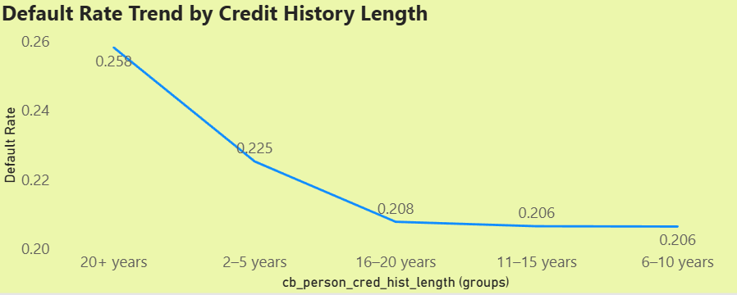
Credit History Length Analysis
This analysis focuses on how credit history duration impacts default risk.
Borrowers with 2–5 years of credit history show the highest default rates, highlighting limited repayment experience.
Default rates drop sharply between 6 and 20 years, indicating that experienced borrowers manage credit better.
The lowest default rates are observed in the 16–20 year group, representing mature and disciplined credit behavior.
A slight increase after 20 years is visible, likely due to smaller sample size, not actual higher risk.
Overall, longer credit history strongly correlates with lower credit risk.

Slide 7
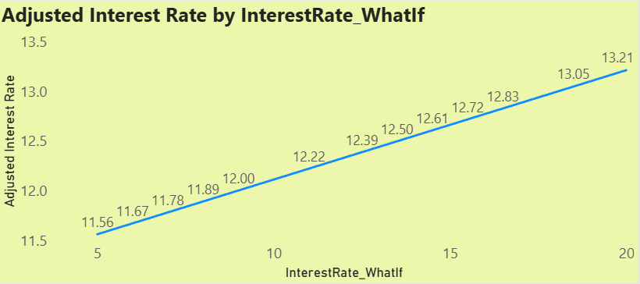
What-If Interest Rate Simulation
This simulation demonstrates how changes in interest rates affect borrower stress.
As the interest rate increases, the adjusted interest burden rises steadily, directly impacting monthly repayments.
Higher interest rates increase default probability, especially for already high-risk borrowers.
Lower rates significantly improve affordability and repayment capacity.
This scenario analysis helps understand how sensitive the portfolio is to rate changes.
It supports risk-based pricing decisions and better loan structuring.

Slide 8
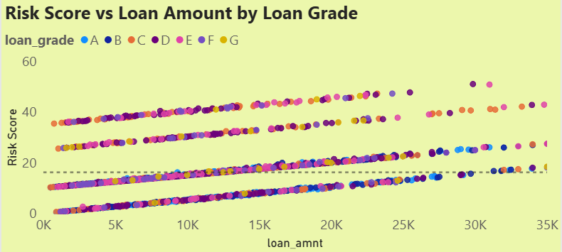
Risk Score vs Loan Amount
This scatter plot compares loan amounts with borrower risk scores across grades.
There is a clear upward trend: higher loan amounts generally correspond to higher risk scores.
Loan grades D to G cluster in the high-risk zone, showing both larger loan sizes and elevated risk.
Grades A and B remain concentrated in lower risk ranges, even with increasing loan amounts.
The average risk line helps quickly identify borrowers above acceptable risk thresholds.
This visualization is useful for risk segmentation and early warning identification.

Slide 9
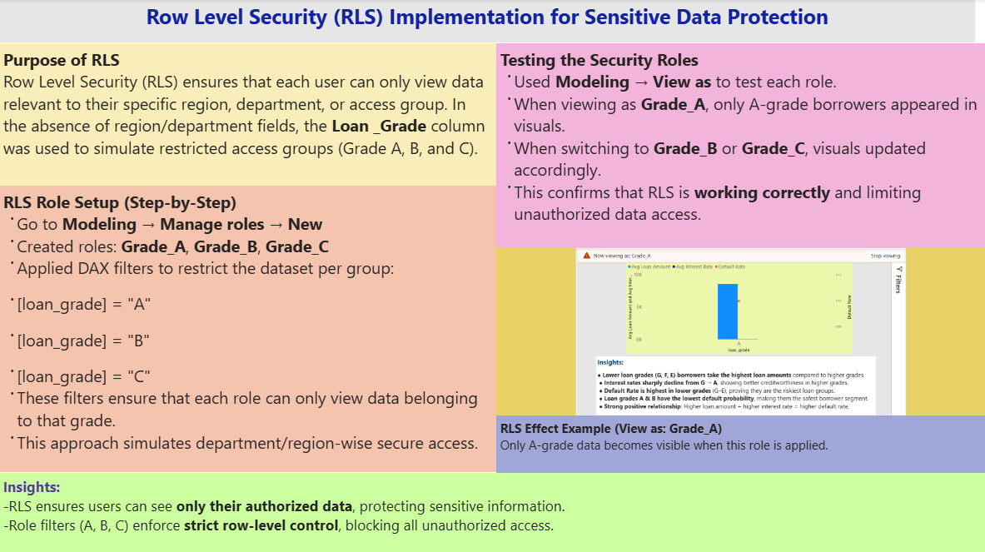
Row Level Security (RLS)
This slide explains how data security is implemented in the dashboard.
Row Level Security ensures users only see data relevant to their assigned role.
Separate roles were created for Grade A, Grade B, and Grade C, restricting access accordingly.
DAX filters enforce row-level restrictions, preventing unauthorized data exposure.
The ‘View As’ feature was used to test and validate each role’s access.
This setup ensures sensitive borrower information is protected, aligning with real-world enterprise security practices.

Slide 10
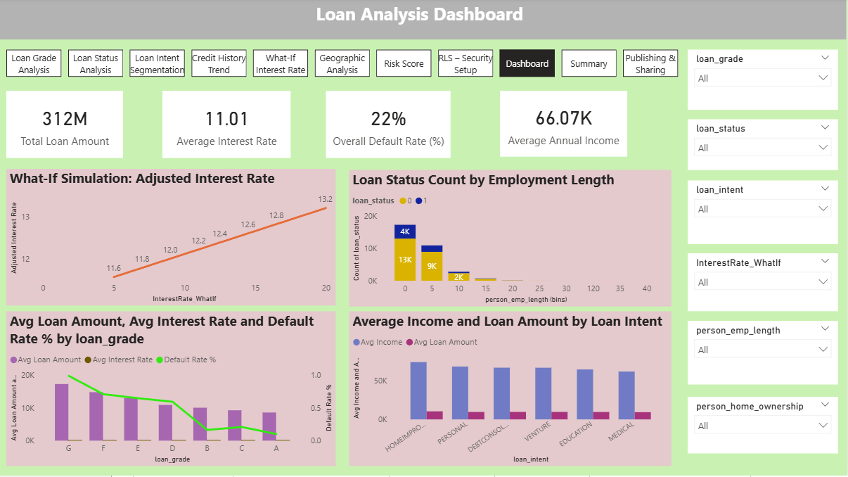
Dashboard Overview
This dashboard provides a comprehensive view of credit risk across multiple dimensions.
The loan portfolio totals approximately 312M, supported by a strong average income of 66K.
Employment length clearly influences default probability, especially for early-career borrowers.
Grades F and G consistently show the highest combined risk across metrics.
Medical and education loans indicate higher borrowing stress due to elevated loan-to-income ratios.
What-if analysis and segmentation features enable data-driven risk assessment and decision-making.
Overall, the dashboard allows stakeholders to identify risk quickly and act proactively.

Slide 11
⭐ Summary & Recommendations
Summary
Clear high-risk borrower groups have been identified.
Low loan grades and short employment history consistently show the highest defaults.
Renters and borrowers with medical or education loan intent carry higher risk.
Short credit history is strongly linked to weaker repayment behavior.
Recommendations
Apply stricter approval and monitoring for Grades F and G.
Prioritize borrowers with stable employment and longer credit history.
Closely monitor high loan-to-income cases, especially medical and education loans.
Use risk-based pricing and RLS controls to balance growth with safety.

Slide 12
Publishing & Sharing
Once the analysis and dashboard were finalized, the next step was to make the report accessible to others in a controlled and secure way.
The report was published from Power BI Desktop to the Power BI Service using the path Home → Publish → My Workspace, making it available online.
In the Power BI Service, a dashboard was created by pinning important visuals from the report. This helps stakeholders quickly view key KPIs without opening the full report.
The dashboard and report were shared with stakeholders using the Share option, either directly with specific people or through workspace-level access.
An App Workspace was used to support collaboration, allowing team members to view, comment, and manage different versions of the report.
Scheduled refresh was configured so that the data updates automatically at regular intervals, ensuring users always see the latest information.
Row Level Security (RLS) was applied to make sure each user can only view the data they are authorized to access, maintaining data privacy and governance.
Overall, this process ensures that insights are easily accessible, securely shared, and always up to date, which is critical in real business environments.

Slide 13
YouTube Video Link
🎬 Watch Full Explanation
Click here to open video
https://youtu.be/k_f0hc4jI7w

Slide 14
Thank You
Presented by: Muneeza
Tool Used: Power BI
Project: Credit Risk Analysis

