Slide 1
Madrid Analysis Project
Interactive Power BI Insights & Dashboard
Data Analytics Project
By: Muneeza

Slide 2
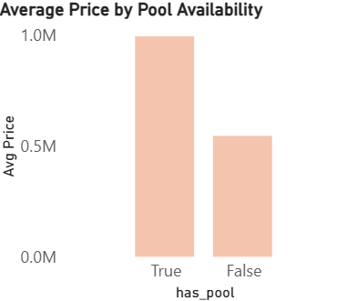
Price Analysis – Pool Availability
Properties that have a swimming pool are priced much higher on average compared to properties without a pool.
This clearly shows that a pool is treated as a premium feature and adds strong perceived value in the housing market.
Buyers seem willing to pay a significant premium for luxury and lifestyle amenities, not just basic living space.
The price gap between properties with and without a pool is substantial, indicating that pool availability can almost double the property value in certain markets.
From a seller’s perspective, adding or highlighting pool availability can be a strong pricing and marketing advantage.

Slide 3
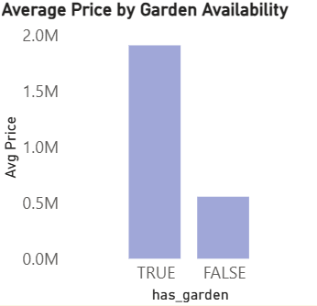
Price Analysis – Garden Availability
Properties with a garden are priced significantly higher on average compared to homes without a garden.
This indicates that buyers place strong value on open and green spaces, especially for relaxation, family use, and lifestyle comfort.
Garden availability increases a buyer’s willingness to pay, even when other property features remain similar.
The large price difference suggests that gardens are seen as a premium amenity, not just an optional add-on.
From a market perspective, properties with gardens tend to attract higher-income or lifestyle-focused buyers, leading to better pricing outcomes.

Slide 4
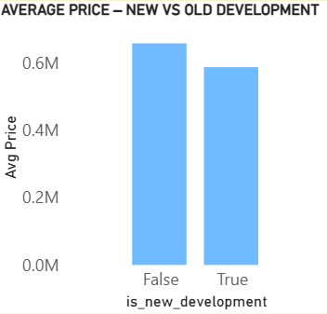
New vs Old Developments
New developments show a higher average property price compared to older constructions, indicating a clear market premium for newer projects.
Buyers are willing to pay more for modern architecture, better layouts, updated amenities, and improved infrastructure commonly associated with new developments.
This trend reflects a shift in buyer preference toward newly constructed properties, driven by lower maintenance costs and better long-term value.
Older developments, while still relevant, tend to be priced lower due to age, higher upkeep, and limited modern facilities.
Overall, the data suggests that new developments attract demand from premium and future-oriented buyers, positively impacting pricing.

Slide 5

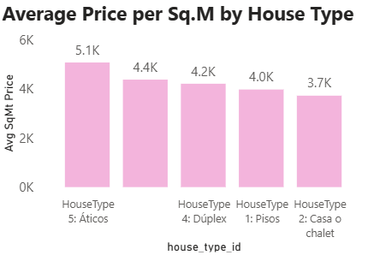
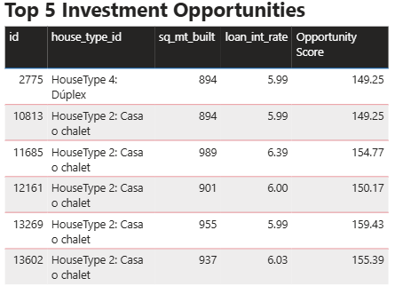
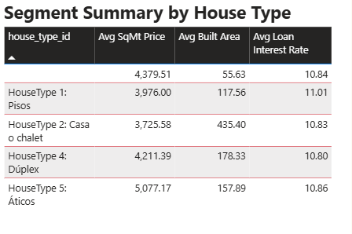
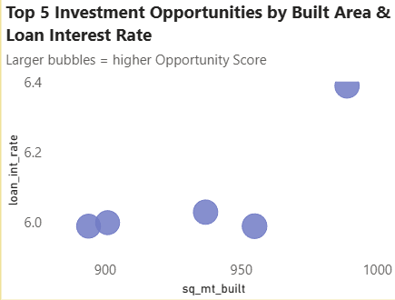
Segmentation & Top 5 Investment Opportunities
When we segment the data by house type, we can clearly see differences in pricing efficiency and investment potential.
House Type 2 (Casa o chalet) and House Type 5 (Áticos) stand out with the strongest overall market performance, driven by a good balance of price per square meter and demand.
Áticos show the highest average price per sq. meter, which indicates premium positioning and strong buyer willingness to pay for exclusivity and location advantages.
Casa o chalet dominates the Top 5 investment opportunities, suggesting that this category offers the best combination of built-up area, pricing, and interest rate stability.
The investment opportunity analysis shows that larger built areas paired with moderate loan interest rates generate higher opportunity scores, making them more attractive for long-term returns.
Rather than extremely low or high interest rates, properties with stable, mid-range rates appear to deliver better ROI when combined with spacious layouts.
Overall, the data highlights that property size and financing structure play a more critical role in returns than price alone, especially for investor-focused segments.

Slide 6
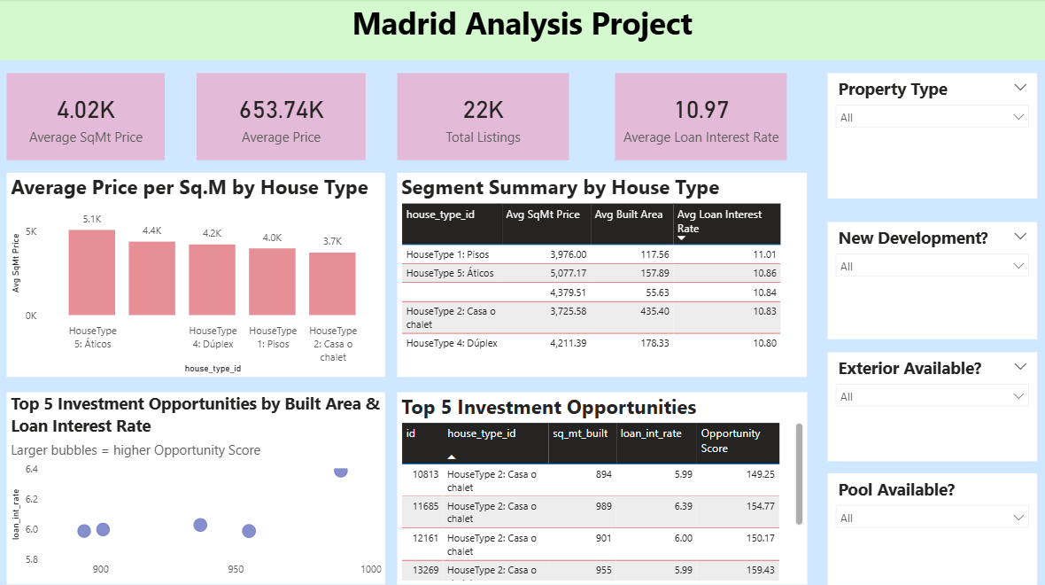
Interactive Dashboard Overview
This dashboard brings together all the key insights of the Madrid property market in one single, interactive view. Instead of looking at multiple static reports, stakeholders can explore the data dynamically and focus only on what matters to them.
At the top, the KPI cards provide an instant snapshot of the market. We can quickly see that the average price is around €653K, the average price per square meter is about €4.02K, there are 22,000 active listings, and the average loan interest rate stands close to 11%. These KPIs act as a health check for the market and immediately set the context before going into deeper analysis.
The dashboard is fully filter-driven, with slicers for Property Type, Pool availability, Garden availability, and New Development status. As soon as a user changes any of these filters, all charts and KPIs update instantly. This makes it very easy to compare scenarios, such as properties with a pool versus without a pool, or new developments versus older constructions.

Slide 7
The visuals in the dashboard cover multiple perspectives at once. We can see how price per square meter varies by house type, how different property segments compare in terms of built area and loan interest rate, and which listings stand out as top investment opportunities based on the opportunity score. This helps users connect pricing, property features, and investment potential in a single view.
Overall, this dashboard is designed for decision-making, not just reporting. It allows real-estate analysts, investors, and business stakeholders to explore trends, identify high-value segments, and evaluate investment opportunities quickly, without needing to manually analyze raw data.

Slide 8
Summary & Recommendations
To summarize the overall analysis, a few clear patterns stand out from the Madrid property data.
First, House Type 2 and House Type 5 consistently perform the best in terms of both pricing and return on investment. These property types strike a good balance between built area, demand, and affordability, making them attractive for buyers as well as investors.
Second, new developments clearly show stronger value growth compared to older properties. Buyers are willing to pay a premium for modern construction, better infrastructure, and updated amenities, which makes new developments a safer long-term investment.
Property features also play a major role in pricing. Homes with pools, gardens, or exterior spaces command significantly higher prices, reflecting strong buyer preference for comfort, lifestyle, and luxury. These features directly increase willingness to pay and improve resale value.
From an investment perspective, properties with larger built areas combined with relatively lower loan interest rates emerge as the best picks. They offer higher opportunity scores and better returns without proportionately increasing borrowing risk.
Based on these insights, the key recommendation is to focus on premium, feature-rich listings, especially new developments within high-performing house types. Targeting such properties can help investors maximize returns while minimizing risk in the current market conditions.

Slide 9





YouTube Video Link
🎬 Watch Full Explanation
Click here to open video
https://youtu.be/MvVBwHTf5j0

Slide 10
Thank You
Presented by: Muneeza
Tool Used: Power BI
Project: Madrid Analysis Project

