Slide 1
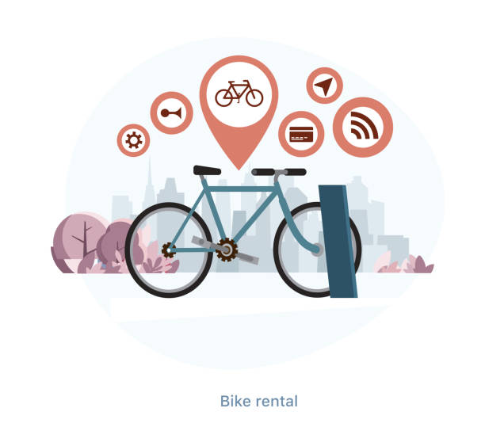
Transport For London
Cycle Rental Data Usage Analysis

Slide 2

Cycle Rental Behavioral Pattern Analysis
Renting cycles seems to be affected by climatic conditions, working days or weekends, social factors, etc.
Cycle rental pattern analysis during pre-pandemic(2019) and pandemic(2020-21).

Slide 3
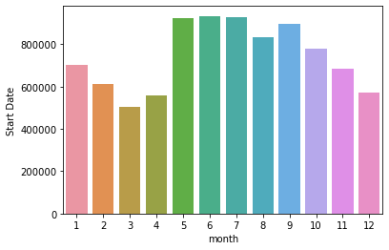
Cycle usage during pandemic lockdown (2020)
Cycle usage during Pandemic vs Post-pandemic
The usage of cycles during lockdown(Jan - Mar 2020) decreases as the government had advised not to socialize but the usage sharply rebounded by the month of May 2020.
There was a sharp drop in usage starting in the month of October till December 2020.

Slide 4
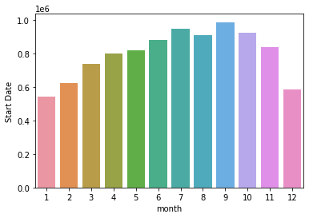
Cycle usage post-pandemic(2021)
Cycle usage during Pandemic vs Post-pandemic
The use of cycles is significantly high in the month of July-October owing to the climatic conditions in London.
During weekdays, usage of cycles was bimodal which was used by people for commuting to work.
During weekends, usage of cycles was unimodal which was for leisure activity or exercise with hire peaking in the mid-afternoon.

Slide 5
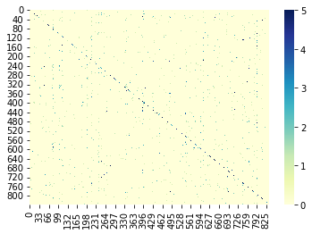
Cycle stations survey during pandemic
Cycle Stations Survey
Focus was on Central London(King’s cross & Waterloo) areas as these were the major docking stations.
Cycle stations survey after pandemic
Docking stations are scattered and central London is not the focus anymore.
However, some new docking stations were quite popular, particularly in areas around Hyde park and Hop Exchange, The Borough.

Slide 6
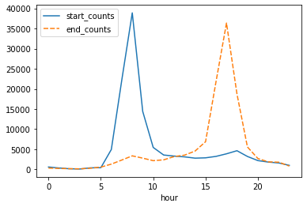
Cycle stations survey during pandemic
Cycle usage during the day
The morning hours from 7 AM till 9 AM is the peak period for usage of cycles from starting station. This justifies the activity as commuters uses cycle to the office.
The evening hours from 4 PM till 6 PM is the peak period for returning the cycles to ending station.

Slide 7


