Slide 1



Diwali Sales Analysis
Made By Shivam Kasaudhan
Date:- 26/02/2025

Slide 2
Introduction
This project examines the impact of the Diwali festival on sales trends. Diwali is one of the biggest shopping seasons, with customers making high volume purchases across various product categories. This analysis aims to:
Analyze top – selling products and categories.
Identify top States and Region on sales behavior.
Identify top customers by sales.
Provide data – driven insights to optimize future sales stratigies.

Slide 3

Dataset Overview
Total Rows: 11,251
Total Columns: 15Column
Names & Data Types:
User_ID:- Integer (Customer ID)
Cust_name:- Object (Customer Name)
Product_ID:- Object (Product Identifier)
Gender:- Object (Male/Female)
Age Group:- Object (Categorized Age Ranges)
Age:- Integer (Customer's Age)
Marital_Status:- Integer (0 = Single, 1 = Married)
State:- Object (Location of Purchase)
Zone:- Object (Region)
Occupation: Object (Customer’s Job Role)
Product_Category:- Object (Type of Product)
Orders: Integer (Number of Orders)
Amount: Float (Total Purchase Value)
Missing Values:
Amount: 12 missing values
Status: Entire column missing
unnamed1: Entire column missing

Slide 4
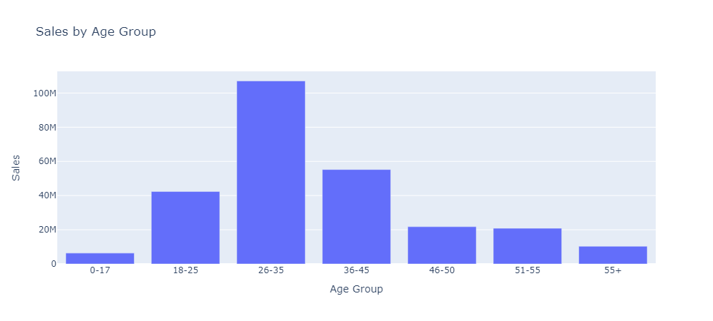
Summary
The 26-35 age group contributes the highest sales (>100M), making them the primary target audience.
The 18-25 and 36-45 age groups also show strong purchasing power, indicating potential for targeted promotions.
The 46+ age groups have lower sales, suggesting less engagement in Diwali shopping.
The 0-17 age group contributes the least, as purchases are likely made by parents.

Slide 5
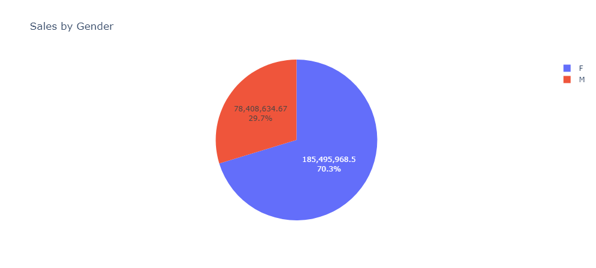
Summary
Females contribute 70.3% of total sales, indicating they are the primary buyers during Diwali.
Males contribute 29.7% of sales, showing a significantly lower spending pattern.
This suggests that marketing campaigns should target female shoppers more aggressively, focusing on popular product categories they prefer.

Slide 6
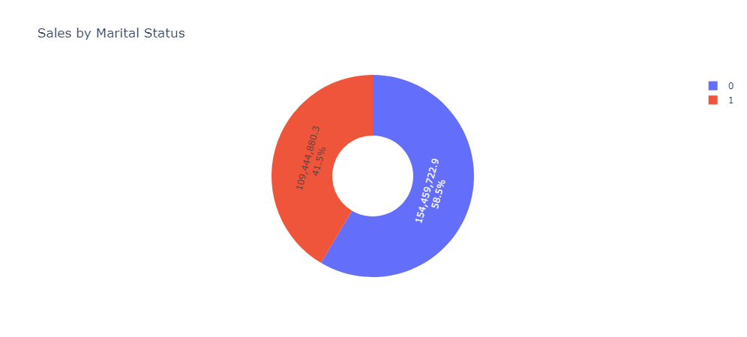
Summary
Unmarried customers contribute 58.5% of total sales, making them the dominant buyers.
Married customers account for 41.5% of sales, indicating a significant but lower spending pattern.
This suggests that unmarried individuals are more active in Diwali shopping, likely spending on personal and festive items.

Slide 7
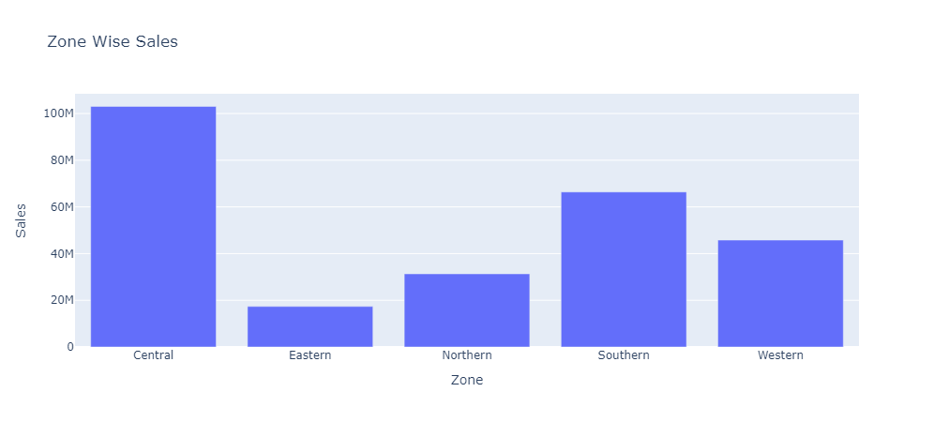
Summary
Central Zone dominates with the highest sales, indicating strong market presence.
Southern Zone follows, showing significant contributions to overall revenue.
Eastern Zone records the lowest sales, highlighting potential market gaps.

Slide 8
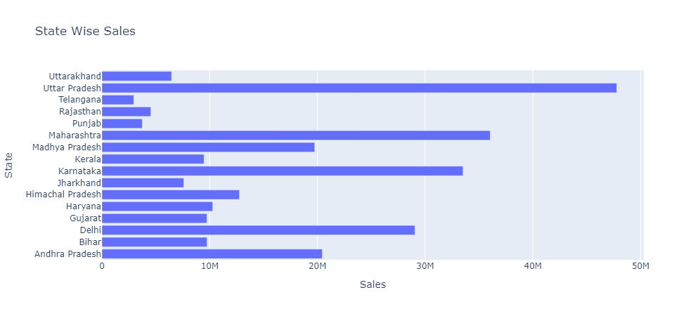
Summary
Uttar Pradesh leads in sales, making it the most significant market.
Maharashtra, Karnataka, and Andhra Pradesh also show strong sales, indicating high purchasing power.
States like Telangana, Punjab, and Jharkhand have lower sales, suggesting untapped potential.

Slide 9
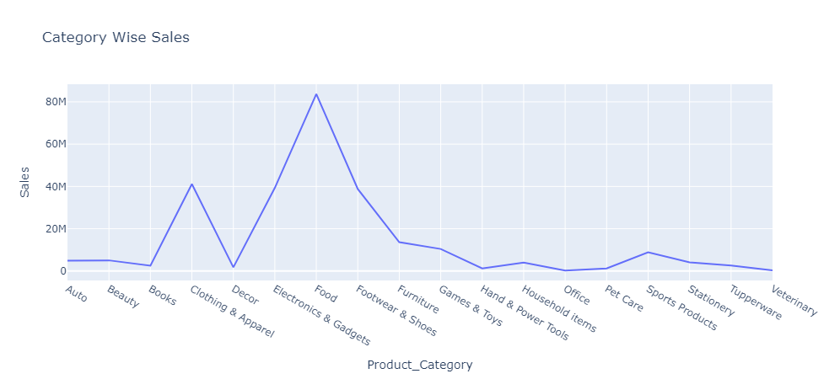
Summary
Electronics & Gadgets lead with the highest sales, reflecting strong consumer demand for tech products.
Clothing & Apparel and Food categories also perform well, making them key revenue drivers.
Lower sales in Auto, Beauty, and Veterinary products suggest a niche or underperforming market.

Slide 10
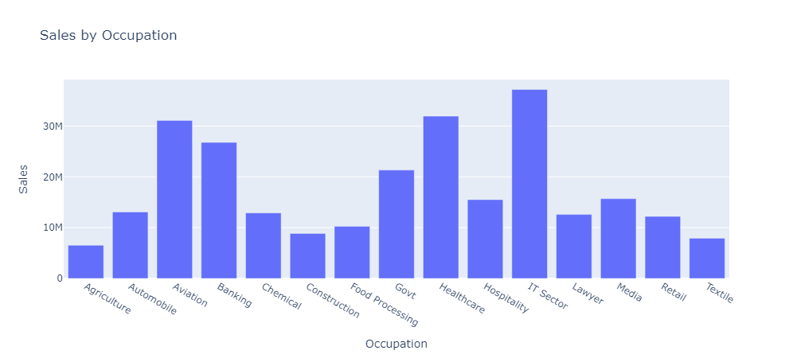
Summary
IT Sector leads with the highest sales, followed by Aviation and Government sectors.
Banking and Hospitality also show strong contributions, indicating good spending power.
Agriculture and Textile have the lowest sales, suggesting lower engagement in these industries.

Slide 11
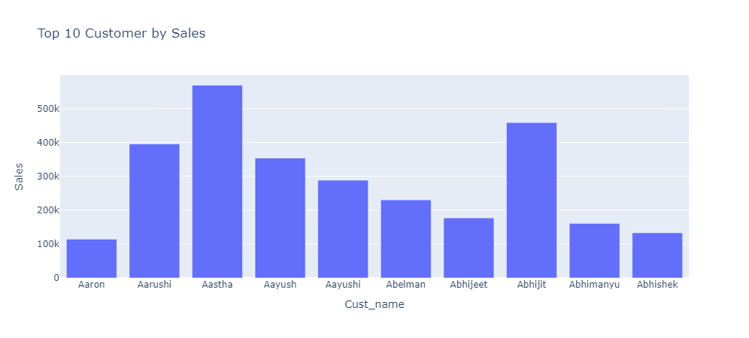
Summary
Aastha leads with the highest sales, followed by Abhijit and Aarushi.
Aayushi and Abelman also contribute significantly to overall sales.
Aaron, Abhijeet, Abhimanyu, and Abhishek have the lowest sales among the top 10.

