Slide 1
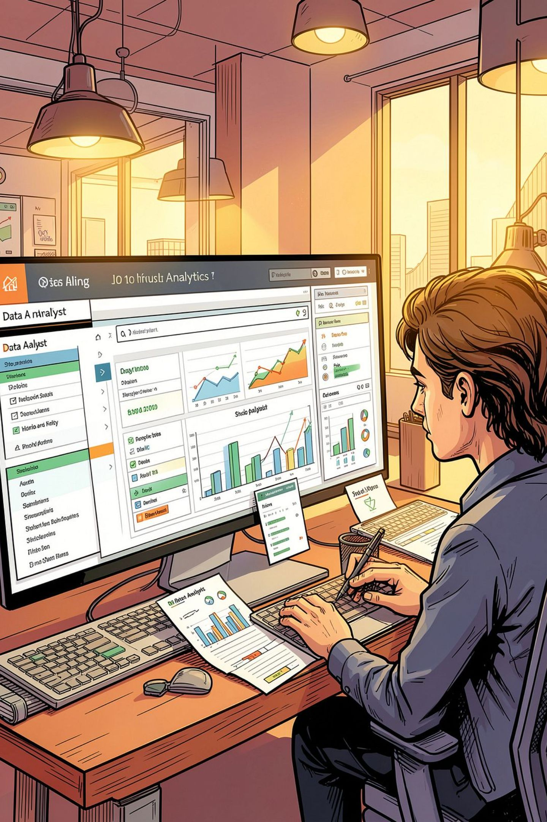
Customer Shopping Behavior Analysis
Uncovering spending patterns, customer segments, and product preferences from 3,900 transactions to guide strategic business decisions.

Slide 2
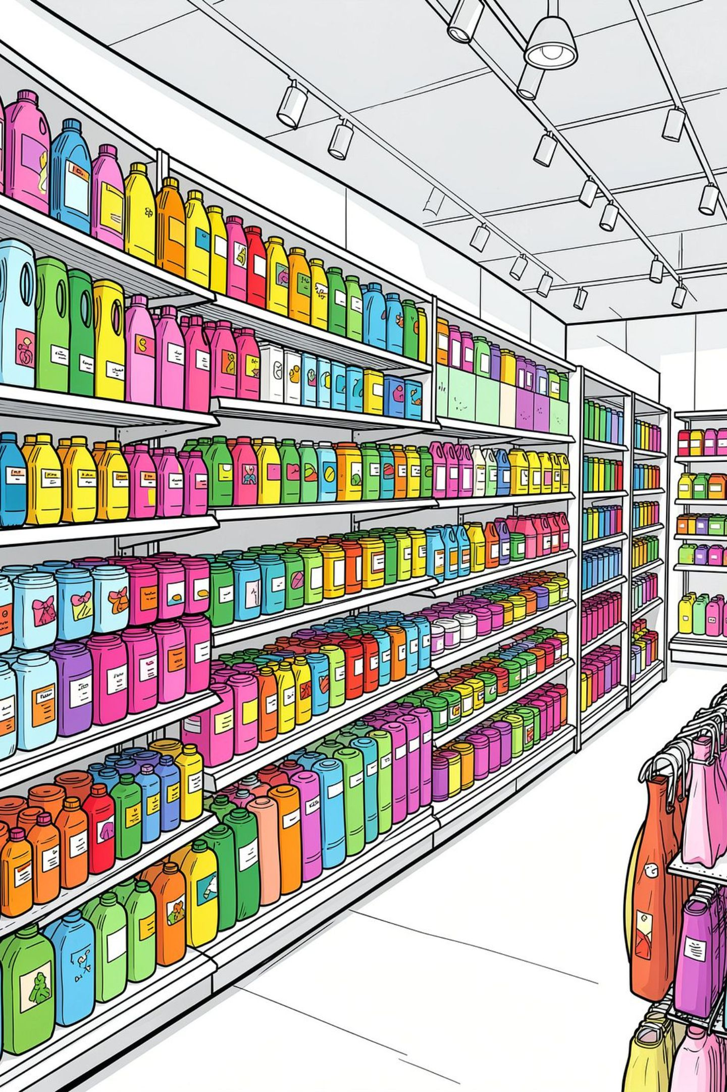
Dataset at a Glance
3,900
18
Purchase records
Columns
37
Missing values in Review Rating

Slide 3


Key Data Features
Demographics
Age, Gender, Location, Subscription Status
Purchase Details
Item, Category, Amount, Season, Size, Color
Behavior
Discount, Promo Code, Frequency, Rating, Shipping

Slide 4

Python: Data Preparation
Load & Explore
1
pandas import, .info(), .describe()
Clean
2
Median imputation for Review Rating; snake_case renaming
Engineer
3
Created age_group & purchase_frequency_days
Integrate
4
Loaded cleaned DataFrame into PostgreSQL

Slide 5

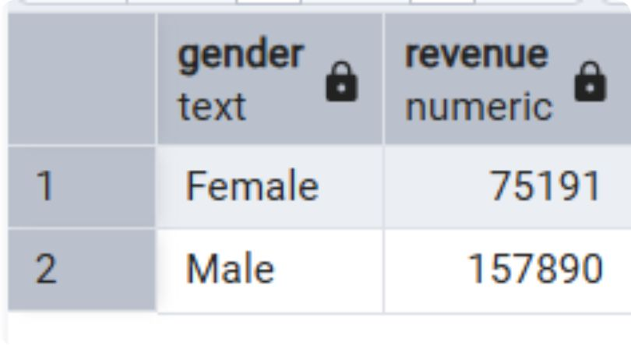

SQL Analysis: Revenue Insights
Revenue by Gender
Compared total revenue: male vs. female customers
High-Spending Discount Users
Customers using discounts but spending above average
Revenue by Age Group
Total revenue compared across customer age segments

Slide 6

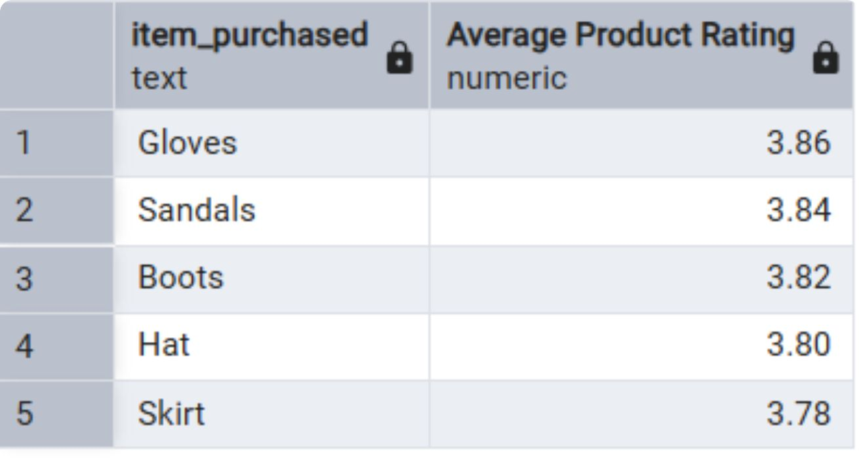

SQL Analysis: Products & Shipping
Top 5 Products by Rating
Highest average review ratings identified
Avg. Spend by Shipping Type
Compared spending across shipping methods
Top 3 Products per Category
Most purchased items within each category

Slide 7
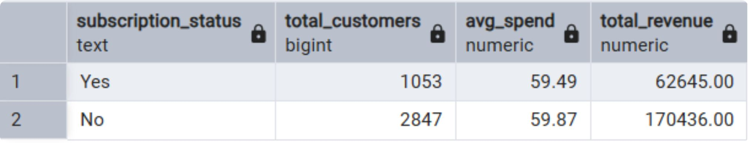
SQL Analysis: Customers & Subscriptions
Subscribers vs. Non-Subscribers
Average spend & total revenue by subscription status
Customer Segmentation
Classified as New, Returning, or Loyal by purchase history
Repeat Buyers & Subscriptions
Customers with >5 purchases — more likely to subscribe?

Slide 8
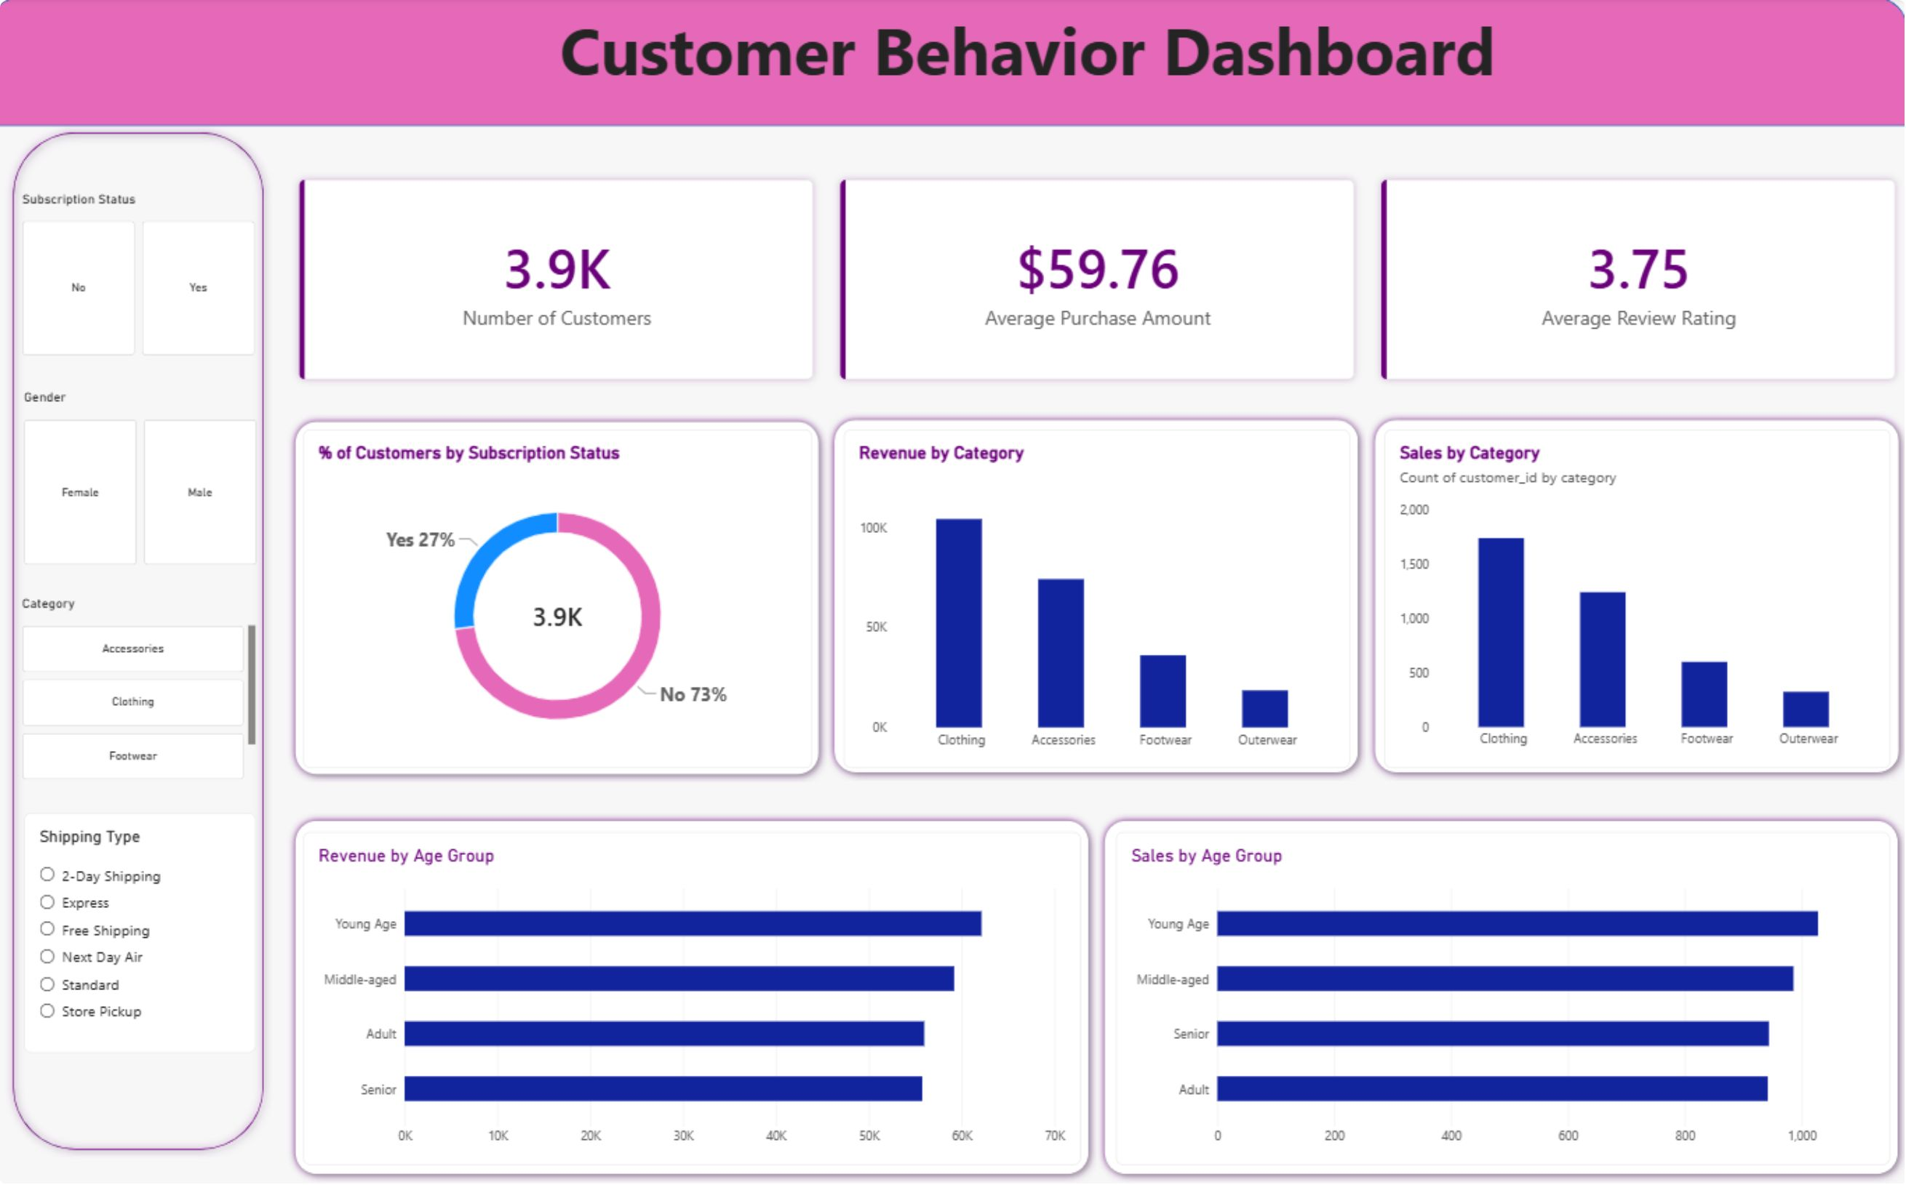
Power BI Dashboard
Interactive visual dashboard presenting all key insights — revenue, segments, products, and subscriptions — in one unified view.

Slide 9





Business Recommendations
Boost Subscriptions
Promote exclusive subscriber benefits
Loyalty Programs
Reward repeat buyers → Loyal segment
Review Discount Policy
Balance sales boosts with margin control
Targeted Marketing
Focus on high-revenue age groups & express-shipping users

Slide 10
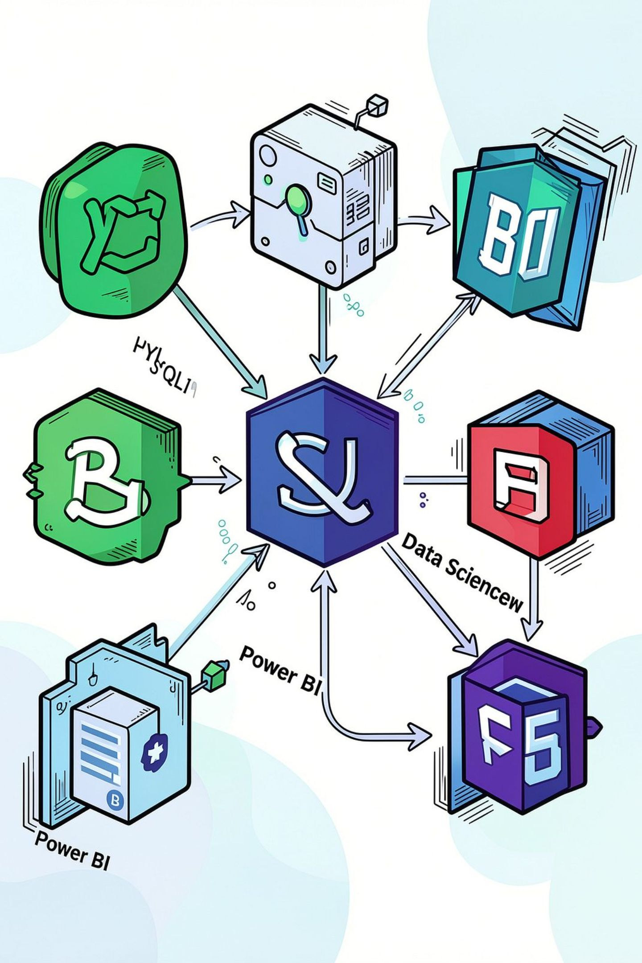
Conclusion
A structured end-to-end analysis — Python → PostgreSQL → Power BI — delivering actionable insights for segmentation, subscriptions, product promotion, and targeted marketing.

