Slide 1

Sprocket Central Pty Ltd
Data analytics approach
KPMG Lighthouse & Innovation Team – Oluwatosin Alebiosu [Junior Data Analyst]

Slide 2
Agenda
Introduction
Data Exploration
Model Development
Interpretation

Slide 3
Introduction
In this presentation, we’ll be discussing the methodologies and approach behind each of the 3 phases listed in the agenda, including activities involved in each.

Slide 4




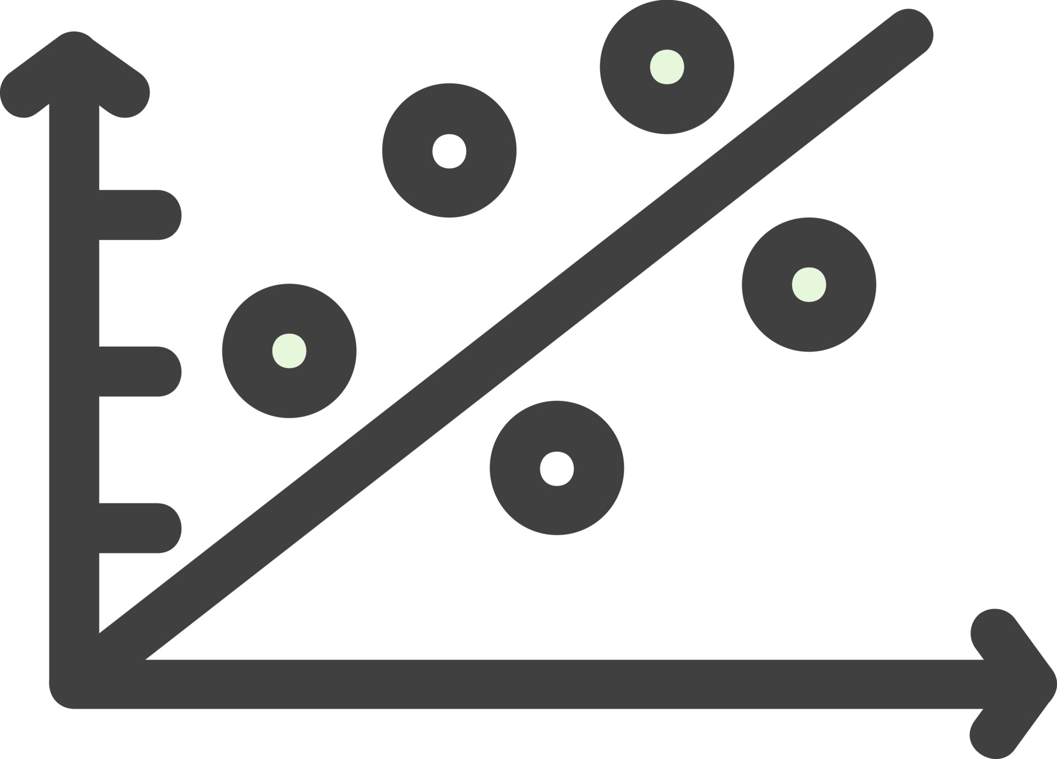
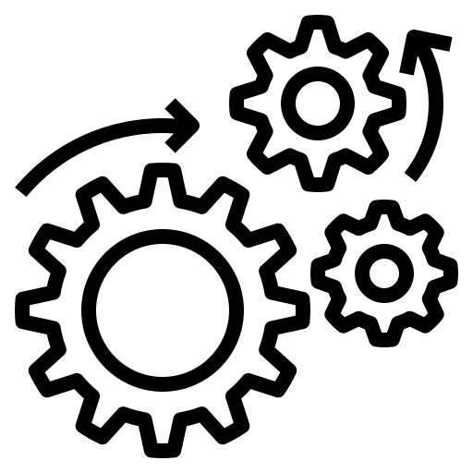



Data Exploration
Data exploration is pruning of data to remove unusable parts and identify potential relationships between different types of data.
Steps in data exploration:
Identifying the data types and the variable category.
Explore variables one by one. Method to perform uni-variate analysis will depend on whether the variable type is categorical or continuous.
Bi-variate Analysis finds out the relationship between two variables.
Missing data can reduce the power of a model or can lead to a biased model.
Outlier is an observation that appears far away and diverges from an overall pattern in a sample.
Feature engineering is the science & art of extracting more information from existing data.
Load Data-set.
Step 1: Variable Identification.
Step 2: Univariate Analysis.
Step 3:
Bi-variate Analysis.
Step 6: Feature Engineering.
Step 5:
Outlier
Detection.
Step 4:
Missing values treatment.
Insight.
Graphical representation of the steps for data exploration.
Notes:
i.e. are data in characters or numerical values.
i.e. In case of continuous variables, we need to understand the central tendency and spread of the variable. For categorical variables, we’ll use frequency table to understand distribution of each category. We can also read as percentage of values under each category.
i.e. Here, we look for association and disassociation between variables at a pre-defined significance level. We can perform bi-variate analysis for any combination of categorical and continuous variables. The combination can be: Categorical & Categorical, Categorical & Continuous and Continuous & Continuous.
i.e. this can lead to wrong prediction or classification.
i.e. Outliers tend to make your data skewed and reduces accuracy.
i.e. You are not adding any new data here, but you are actually making the data you already have more useful.

Slide 5
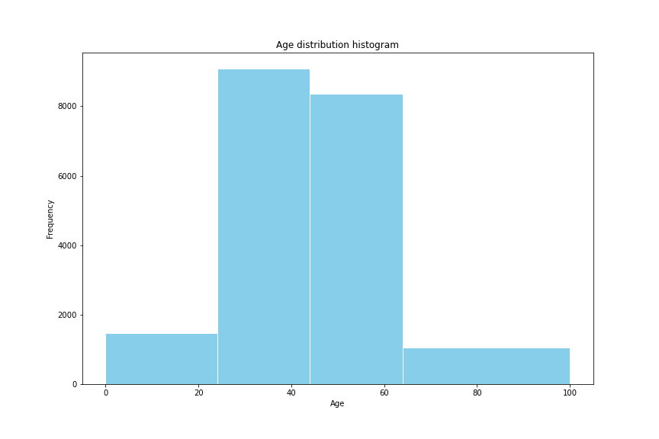
Model Development
Model development is the process of creating and testing statistical models to understand and make predictions about a given dataset.
D.O.B is converted to Age so as to be able to categorize the age brackets of bike riders.

Slide 6
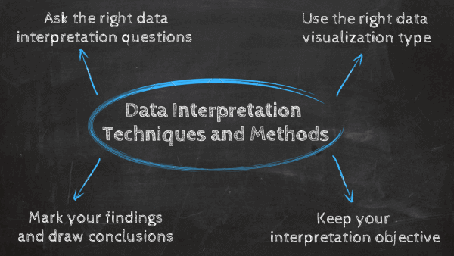
Interpretation
Data interpretation is the final step of data analysis where we turn results into a presentable format to gain clear and useful insights for business strategies.
We will be reporting the insightful findings in the form of a dashboard which will demonstrate the Customer Demographic , Target Customers, Top Selling Goods etc. to help the team to make appropriate business decisions.

Slide 7
Thank You.

