Slide 1
Data Science Advanced
Bank Fraud Classification Project
Marc-Vincent Müller, Kevin Widmann

Slide 2
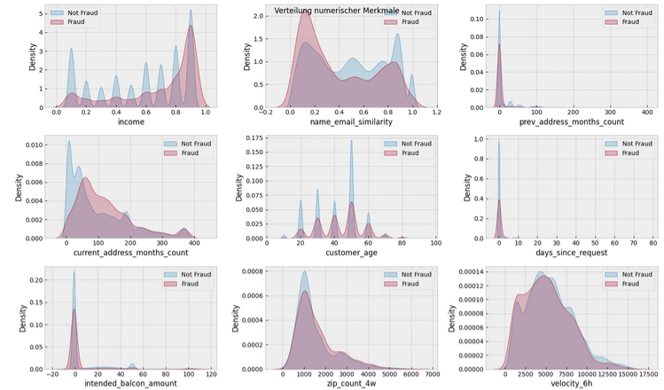
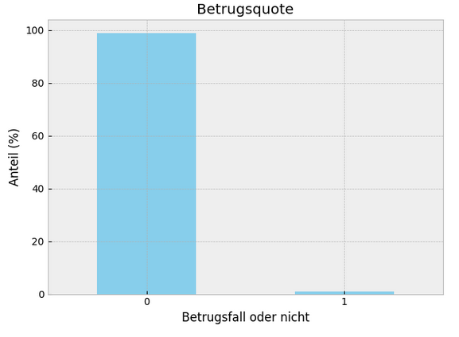

Data set & analysis
Data Science Advanced – Bank Fraud
Highly unevenly distributed data, increase of fraud with higher income and age

Slide 3
Steps
Data Science Advanced – Bank Fraud
Drop x1 and x2
Search missing values
Drop columns or refill values with imputation
One hot encoding of categorial features
Scaling all features
Feature selection (only log regression)
Define models
Data reduction to 10 % and train-test-split
Gridsearch (only log regression and decision trees) → Optimization Score:
ROC-AUC
Fit best model with best hyperparameters on all train data
Model evaluation → Precision-Recall-Curve: Threshold optimization on at least 75 % Recall on test data
Visualisation with Confusion Matrix
Comparison of results on train and test data
First optimization on ROC-AUC score, then threshold adjustment on at least 75 % Recall

Slide 4
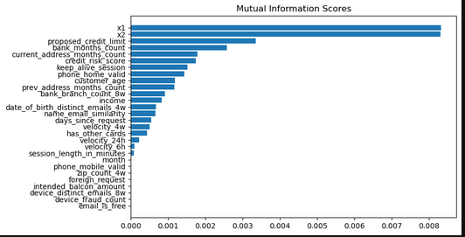
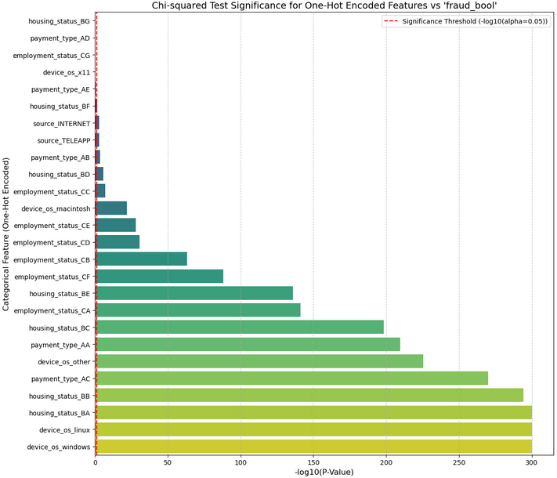
Data analysis - Feature selection
Data Science Advanced – Bank Fraud
Numeric features | Categorical features
- Perform mutual information test | Chi squared test with α = 0.5
Identify categorical features
Create new columns for each feature with value 0 or 1
x1 | 0.0083
x2 | 0.0083
proposed_credit_limit | 0.0033
bank_months_count | 0.0026
current_address_months_count | 0.0018
credit_risk_score | 0.0017
keep_alive_session | 0.0015
x1 and x2 should be considered

Slide 5
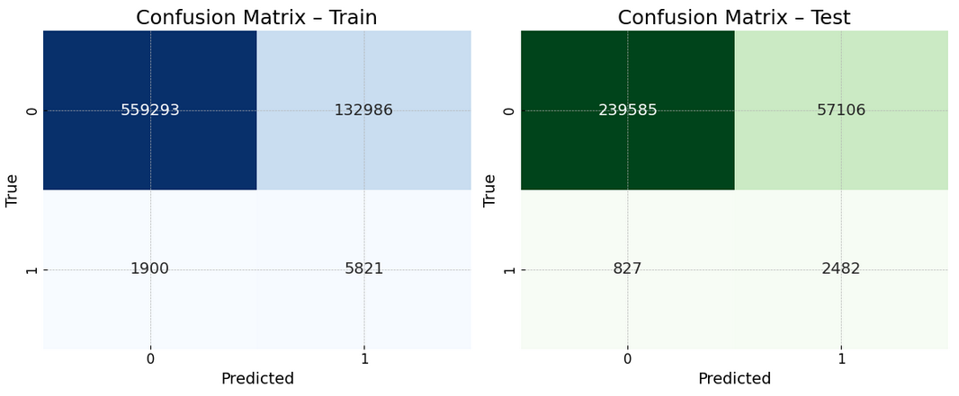
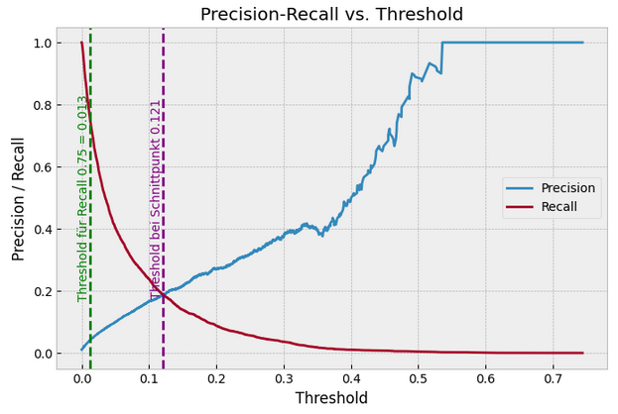
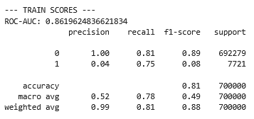
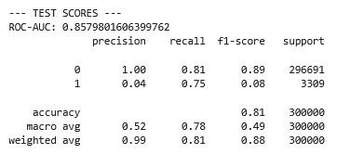

Model – Logistic Regression
Data Science Advanced – Bank Fraud
Without SMOTE, ridge regression, class weight: None, C: 3

Slide 6
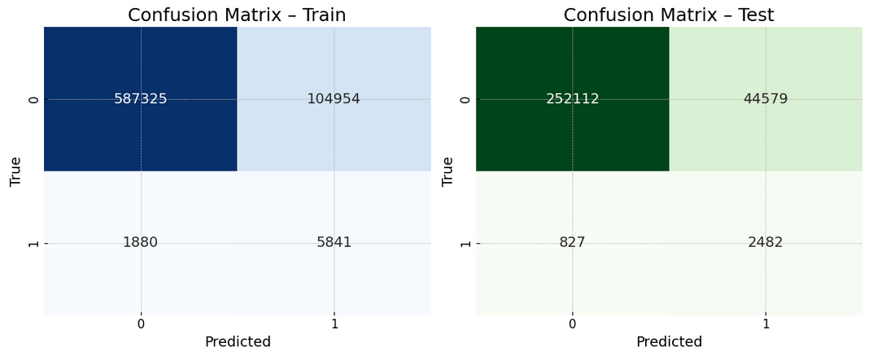
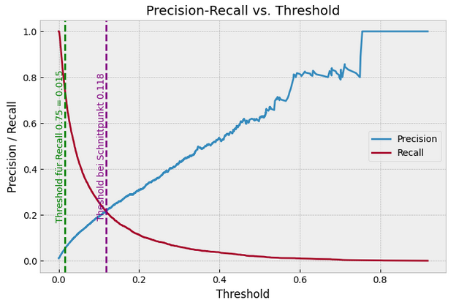
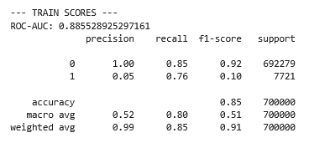
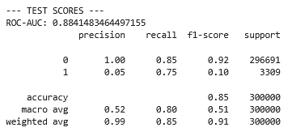

Model – Decision Tree
Data Science Advanced – Bank Fraud
Best tree: LightGBM, max depth: 3, n estimators: 300, num leaves: 3, scale pos weight: 1, learning rate: 1

Slide 7
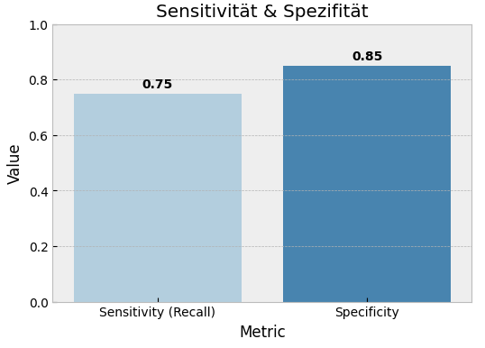
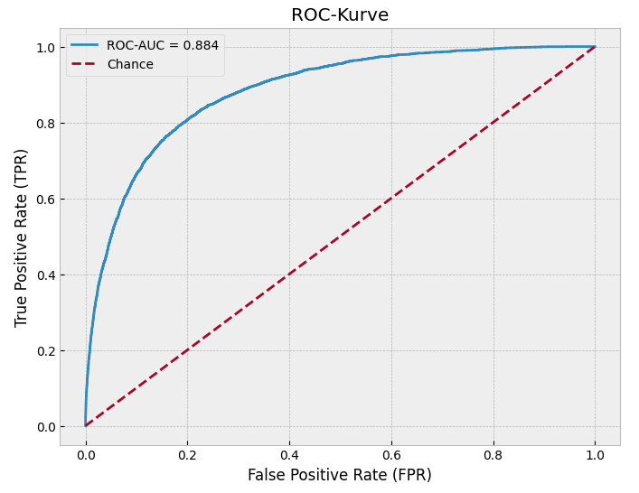
Model – Decision Tree
Data Science Advanced – Bank Fraud
Best tree: LightGBM, max depth: 3, n estimators: 300, num leaves: 3, scale pos weight: 1, learning rate: 1

Slide 8
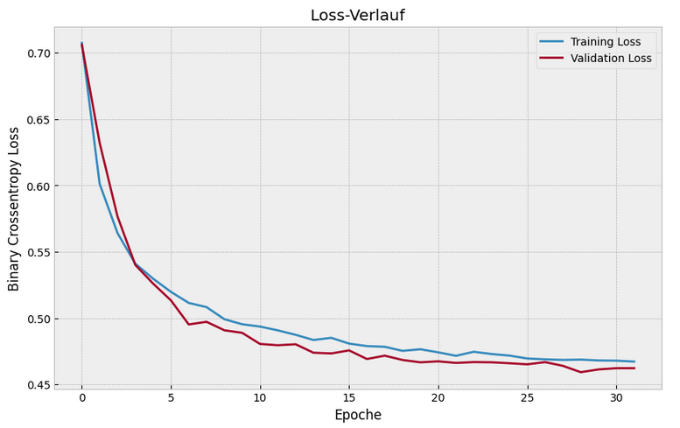
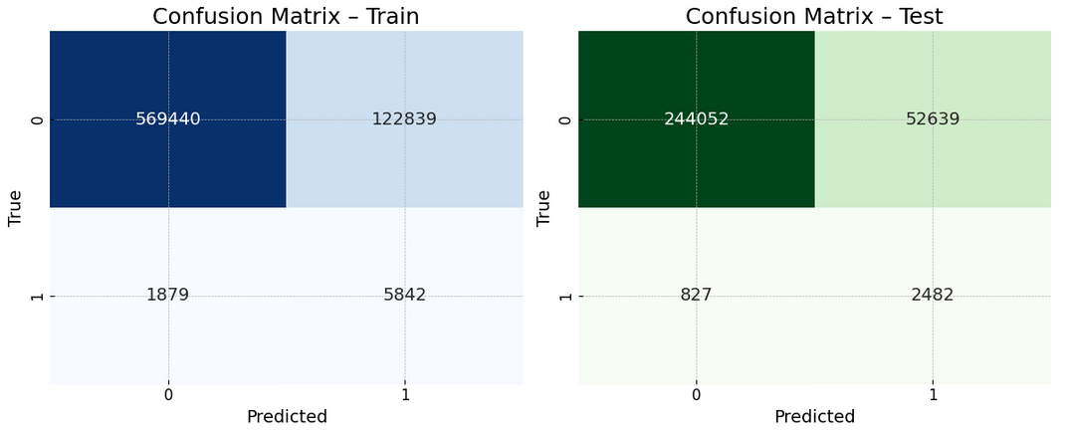
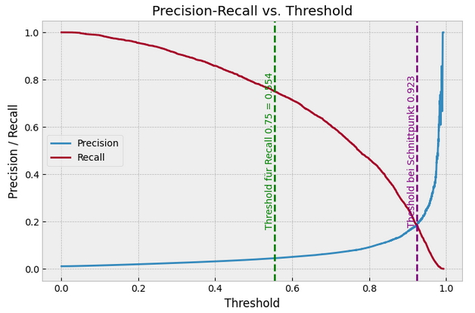
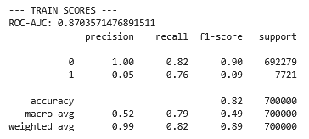
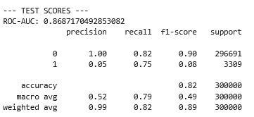
Model – Neural Network
Data Science Advanced – Bank Fraud
2 intermediate layers, ReLU activation , regularisation: Dropout against overfitting, early stopping

Slide 9
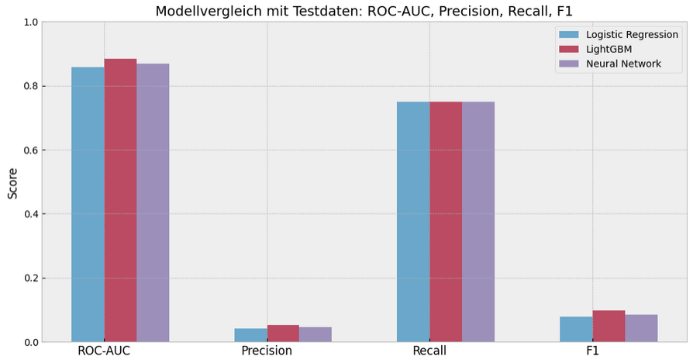
Model – Comparison and summary
Data Science Advanced – Bank Fraud
Very similar scores regardless of the model, best results with LightGBM, difficult fraud detection due to uneven distrubtion, Additional features required to improve model (for example x1 and x2)

Slide 10
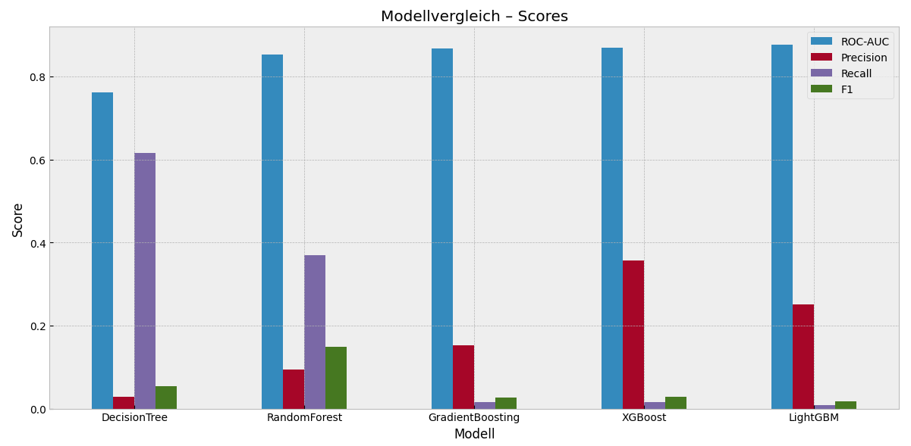
Model – Comparison and summary
Data Science Advanced – Bank Fraud

