Slide 1
Data Science Advanced
Bank Fraud Classification Project
Marc-Vincent Müller
12.12.2025

Slide 2
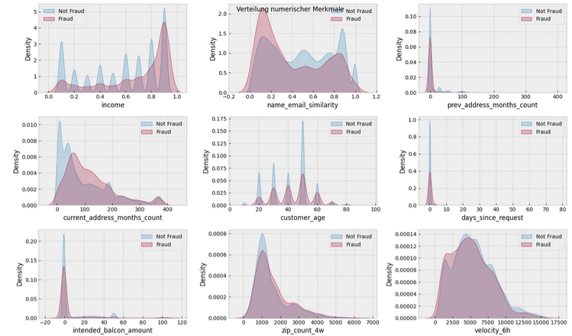
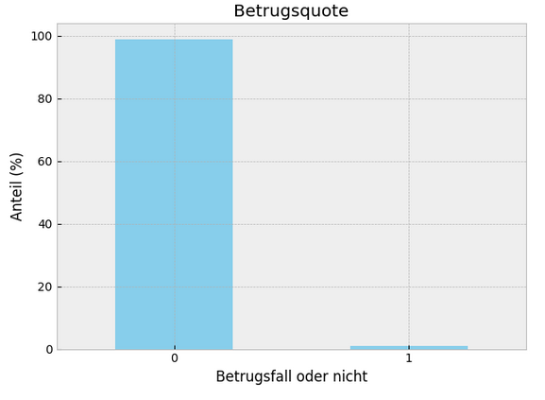

Data Science Advanced – Bank Fraud
Data set & analysis
Highly unevenly distributed data, increase of fraud with higher income
Marc-Vincent Müller | Data Science Advanced - Bank Fraud Classification Project | 12.12.2025 2

Slide 3
Data Science Advanced – Bank Fraud
Steps
Drop x1 and x2
Search missing values
Drop columns or refill values with imputation
One hot encoding of categorial features
Scaling all features
Feature selection (only log regression)
Define models
Data reduction to 10 % and train-test-split
Gridsearch (only log regression and decision trees) → Optimization Score:
ROC-AUC
Fit best model with best hyperparameters on all train data
Model evaluation → Precision-Recall-Curve: Threshold optimization on at least 75 % Recall on test data
Visualisation with Confusion Matrix
Comparison of results on train and test data
First optimization on ROC-AUC score, then threshold adjustment on at least 75 % Recall
Marc-Vincent Müller | Data Science Advanced - Bank Fraud Classification Project | 12.12.2025 3

Slide 4
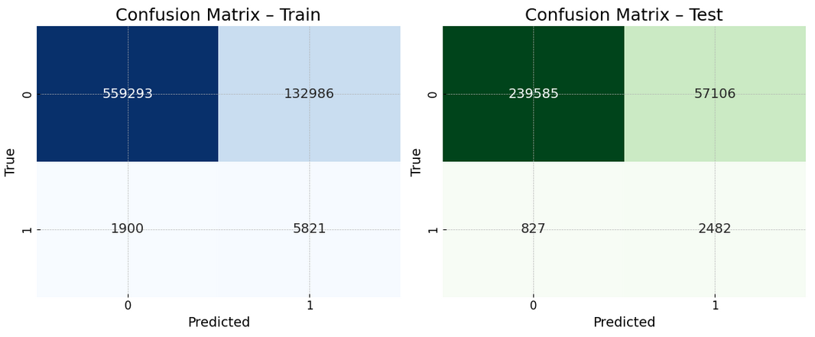
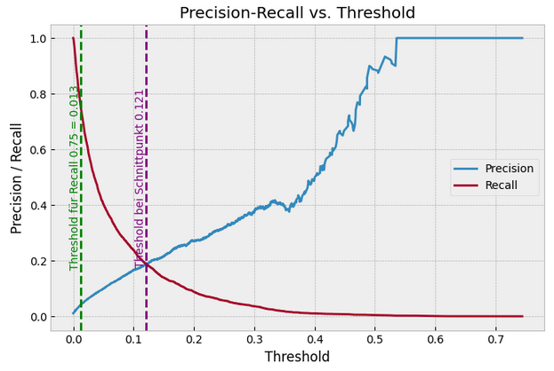
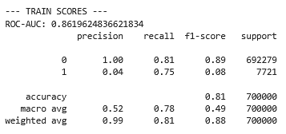
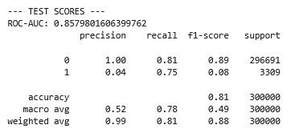

Data Science Advanced – Bank Fraud
Model – Logistic Regression
Without SMOTE, ridge regression, class weight: None, C: 3
Marc-Vincent Müller | Data Science Advanced - Bank Fraud Classification Project | 12.12.2025 4

Slide 5
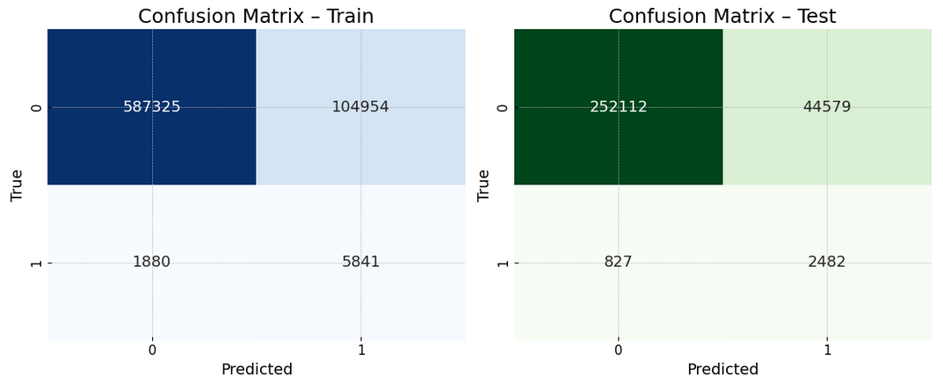
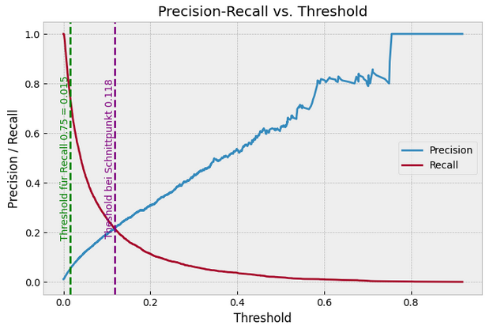
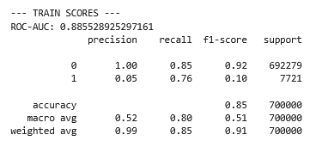
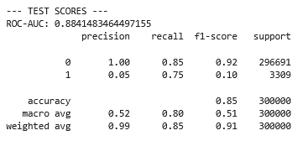

Data Science Advanced – Bank Fraud
Model – Decision Tree
Best tree: LightGBM, max depth: 3, n estimators: 300, num leaves: 3, scale pos weight: 1, learning rate: 1
Marc-Vincent Müller | Data Science Advanced - Bank Fraud Classification Project | 12.12.2025 5

Slide 6
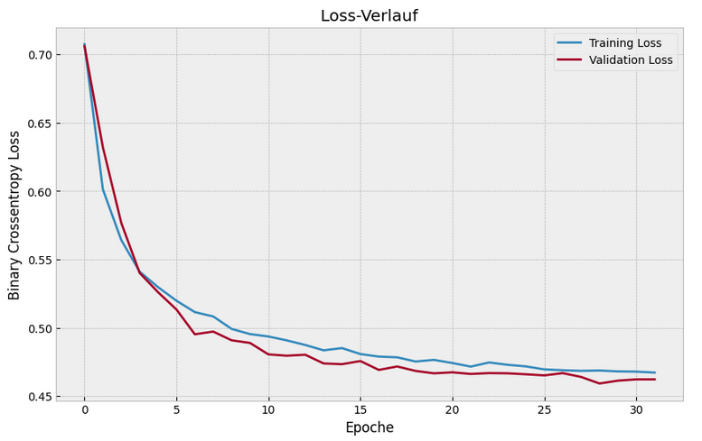
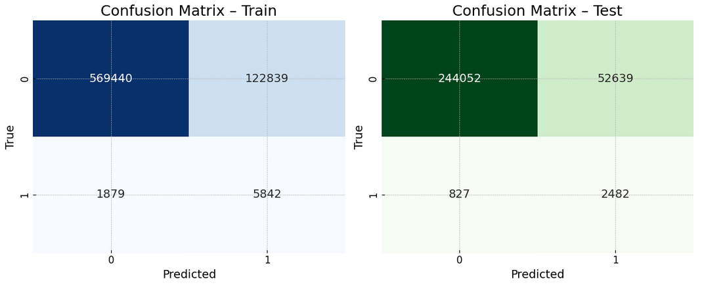
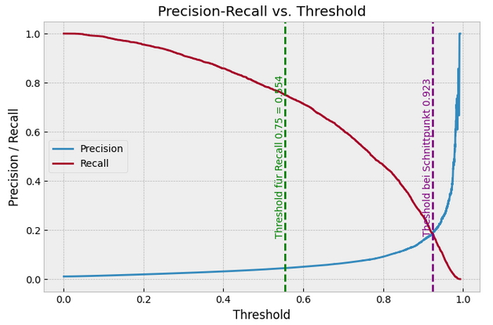
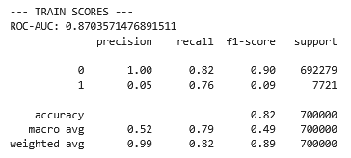
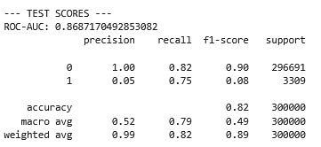
Data Science Advanced – Bank Fraud
Model – Neural Network
2 intermediate layers, ReLU activation , regularisation: Dropout against overfitting, early stopping
Marc-Vincent Müller | Data Science Advanced - Bank Fraud Classification Project | 12.12.2025 6

Slide 7
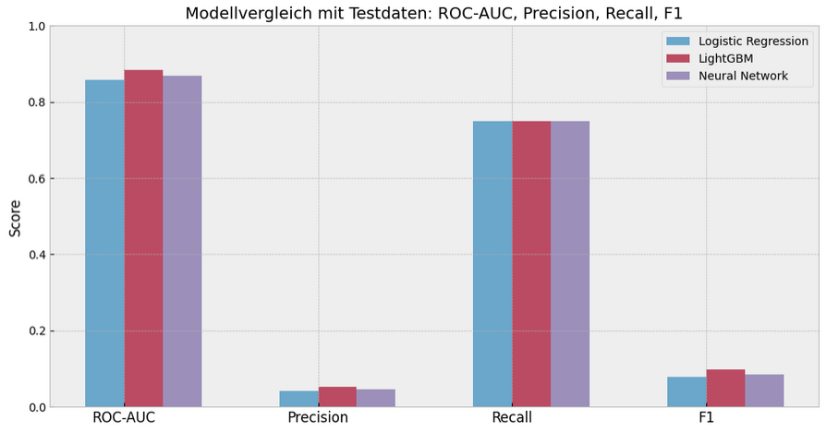
Data Science Advanced – Bank Fraud
Model – Comparison and summary
Very similar scores regardless of the model, best results with LightGBM, difficult fraud detection due to uneven distrubtion, Additional features required to improve model (for example x1 and x2)
Marc-Vincent Müller | Data Science Advanced - Bank Fraud Classification Project | 12.12.2025 7

