Slide 1
CJA Segment Cleanup
Automated duplicate and near-duplicate analysis for Adobe CJA segments
eClerx Digital

Slide 2
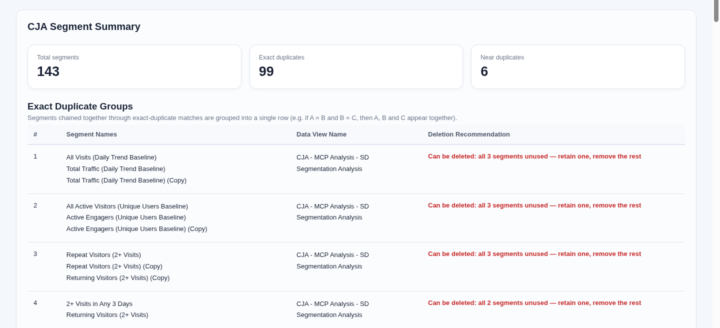
Accelerator name: CJA Segment Cleanup
Automated duplicate and near-duplicate analysis for Adobe CJA
Business Overview/Challenge
The eClerx Solution
Segments grow across teams and Data Views
Manual comparison takes time and varies by reviewer
Names alone do not show matching logic
Usage evidence is needed before cleanup
Technology Stack
Python and Flask
Adobe CJA Data Views, Segments and Projects APIs
OAuth Server-to-Server authentication
Local browser dashboard
Key Capabilities
Exact and near-duplicate detection
Definition normalisation and similarity score
Usage-aware groups and recommendations
Search, pagination and CSV or Excel export
Deployment
Business Outcomes
Runs on a local desktop or server
Read-only Adobe CJA API access
Credentials stay in the environment file
Faster review
Automatic comparison replaces manual definition checks
Safer decisions
Usage counts support retain or retire review
Clear governance
Grouped findings and exports provide an audit trail

Slide 3
Current State of Architecture
CJA Segment Cleanup Python Application
1
Show Data Views
Flask loads the complete accessible Data View list.
CJA Segment Cleanup
Browser UI
Show Data Views, choose scope and generate report
2
Select the scope
Choose one Data View or All Data Views and set the threshold.
Flask Service
Secure credentials, cache control and report request handling
Adobe CJA API
/data/dataviews
/segments
/projects
OAuth Server-to-Server
Read-only requests
3
Fetch live data
Read segments and workspace project references from CJA.
4
Compare definitions
Normalise logic, calculate similarity and list differences.
CJA Data Access
Data Views | Segments | Workspace Projects
5
Build duplicate groups
Combine connected matches and apply usage-aware guidance.
Comparison and Usage Engine
Definition normalisation, similarity score, differences and usage map
6
Review and export
Search the report or download CSV and Excel files.
Grouped Cleanup Report
Exact groups, near-duplicate groups, recommendations and exports

Slide 4
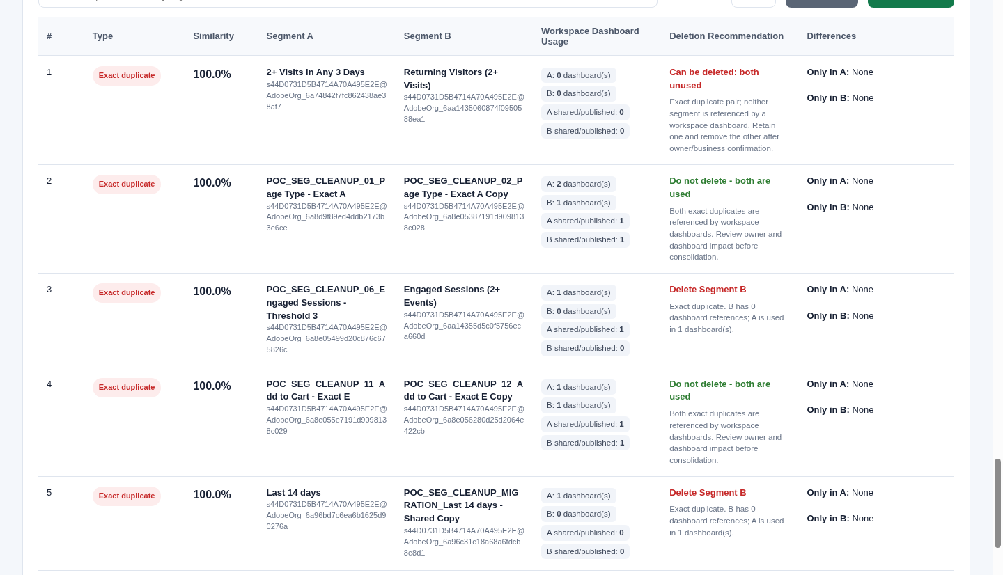
Demo
Select a Data View, generate the report and review grouped findings
1
Show Data Views
Load the full accessible list from CJA.
2
Choose the scope
Select one Data View or analyse all views.
3
Generate the report
Review exact and near-duplicate groups with usage.
4
Search and export
Use detailed tables or download CSV and Excel.

