Slide 1
CJA Segment Cleanup
Automated duplicate and near-duplicate analysis for Adobe CJA segments
eClerx Digital

Slide 2
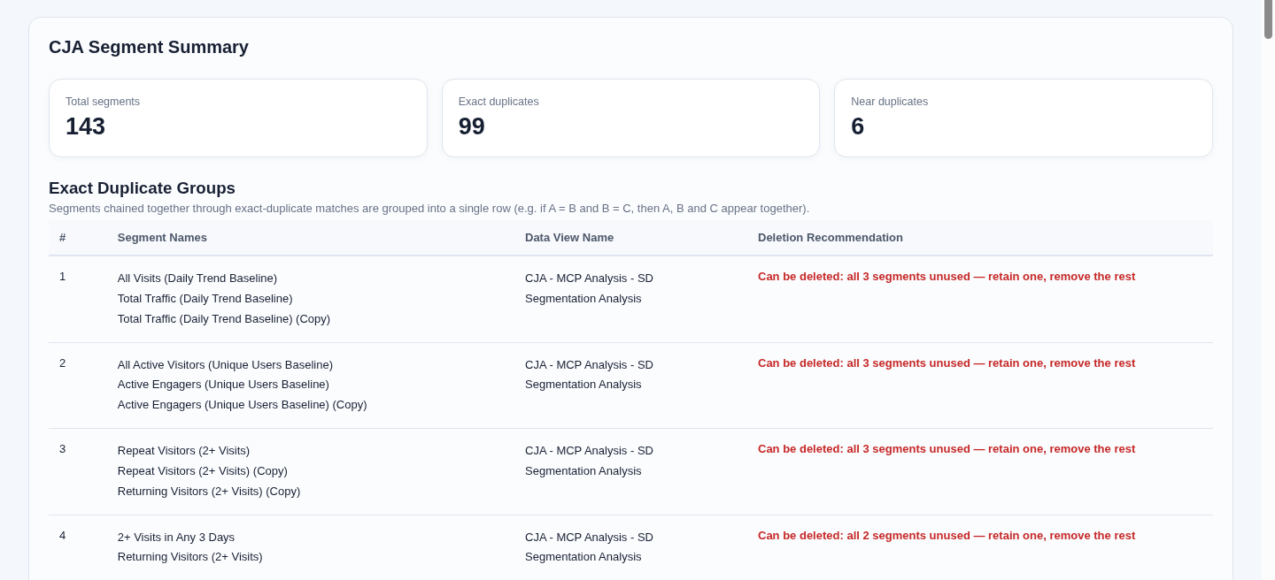
Accelerator name: CJA Segment Cleanup
Automated duplicate and near-duplicate analysis for Adobe CJA
Business Overview/Challenge
The eClerx Solution
Segments grow across teams and Data Views
Manual comparison takes time and varies by reviewer
Names alone do not show matching logic
Usage evidence is needed before cleanup
Technology Stack
Python and Flask
Adobe CJA Data Views, Segments and Projects APIs
OAuth Server-to-Server authentication
Local browser dashboard
Key Capabilities
Exact and near-duplicate detection
Definition normalisation and similarity score
Usage-aware groups and recommendations
Search, pagination and CSV or Excel export
Deployment
Business Outcomes
Runs on a local desktop or server
Read-only Adobe CJA API access
Credentials stay in the environment file
Faster review
Automatic comparison replaces manual definition checks
Safer decisions
Usage counts support retain or retire review
Clear governance
Grouped findings and exports provide an audit trail

Slide 3
Accelerator name: CJA Segment Cleanup
Concept flow and similarity classification
Business Overview/Challenge
The eClerx Solution
Segments grow across teams and Data Views
Manual comparison takes time and varies by reviewer
Names alone do not show matching logic
Usage evidence is needed before cleanup
Segment Fetcher
Reads CJA segment definitions
Definition Normalizer
Canonicalises definition JSON
Similarity Engine
Calculates Jaccard score and differences
Classification Engine
Exact Duplicate / Near Duplicate / Review Required
Technology Stack
Python and Flask
Adobe CJA Data Views, Segments and Projects APIs
OAuth Server-to-Server authentication
Local browser dashboard
Comparison result | Score or rule | Classification
Normalised definitions match | 100% | Exact Duplicate
High token overlap with no critical rule difference | 85% to 99.9% | Near Duplicate
Numeric threshold, operator or logic differs | Rule override | Review Required
Key Capabilities
Exact and near-duplicate detection
Jaccard similarity with field-level differences
Business-rule checks for numeric thresholds
Search, pagination and CSV or Excel export
Jaccard score = shared definition tokens divided by all unique definition tokens. Business-rule differences override the score.
Deployment
Business Outcomes
Runs on a local desktop or server
Credentials stay in the environment file
Faster review
Pairwise scoring replaces manual definition checks
Safer decisions
Rule differences remain visible before cleanup
Clear governance
Each pair keeps its score, differences and recommendation

Slide 4
High Level Architecture
CJA Segment Cleanup Python Application
POST API call to CJA
GET API call / response
Internal data flow
CJA Segment Cleanup Tool
Trigger: "Run segment cleanup scan" (scheduled or on-demand)
Adobe CJA API
/data/dataviews
/segments
/projects
OAuth Server-to-Server
Scoped read-only access
Backend
POST API call to CJA
GET API call / response
Segment Fetcher
GET /segments
Definitions, tags and compatibility
Definition Normalizer
Canonicalises and tokenises definition JSON
Similarity Engine
Jaccard score and field-level differences
Classification Engine
Exact Duplicate / Near Duplicate / Review Required
Output
HTML Dashboard Generator
Summary cards, cleanup overview, detailed findings and per-pair recommendation

Slide 5
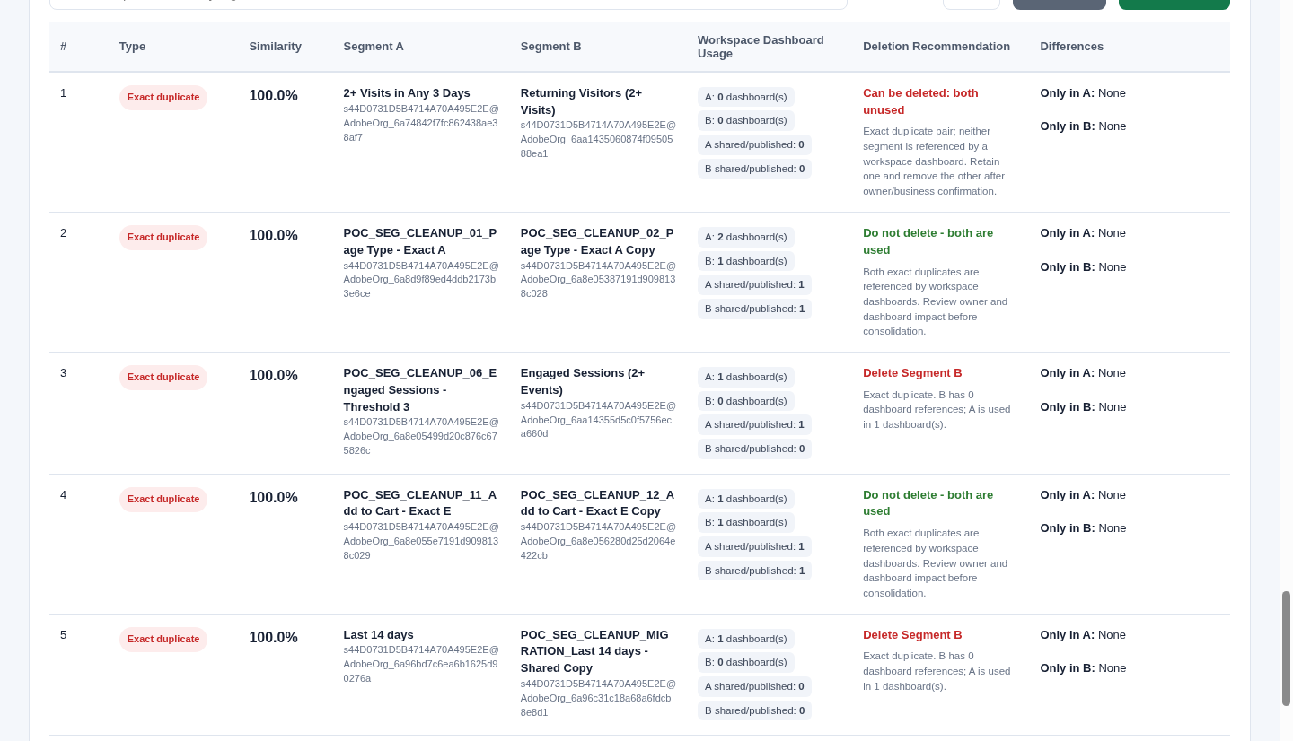
Demo
Select a Data View, generate the report and review grouped findings
1
Show Data Views
Load the full accessible list from CJA.
2
Choose the scope
Select one Data View or analyse all views.
3
Generate the report
Review exact and near-duplicate groups with usage.
4
Search and export
Use detailed tables or download CSV and Excel.
Read-only review. Any segment retirement still needs business-owner confirmation.

