Slide 1
Setup Jupyter on AWS (Amazon Web Services) EC2 (Elastic Compute Cloud) instance

Slide 2

Amazon Web Serices (AWS)
Amazon Web Services (AWS) is a subsidiary of Amazon that provides on-demand cloud computing platforms to individuals, companies and governments, on a paid subscription basis. The technology allows subscribers to have at their disposal a virtual cluster of computers, available all the time, through the Internet.
The AWS technology is implemented at server farms throughout the world, and maintained by the Amazon subsidiary. Fees are based on a combination of usage, the hardware/OS/software/networking features chosen by the subscriber, required availability, redundancy, security, and service options.
In 2019, AWS comprised more than 150 services spanning a wide range including computing, storage, networking, database, analytics, application services, deployment, management, mobile, developer tools, and tools for the Internet of Things. The most popular include Amazon Elastic Compute Cloud (EC2) and Amazon Simple Storage Service (S3).
AWS owns a dominant 34% of all cloud (IaaS, PaaS) while the next three competitors Microsoft, Google, and IBM have 11%, 8%, 6% respectively.

Slide 3

AWS EC2
Amazon Elastic Compute Cloud (EC2) forms a central part of Amazon.com's cloud-computing platform, Amazon Web Services (AWS), by allowing users to rent virtual computers on which to run their own computer applications. Users can boot an Amazon Machine Image (AMI) to configure a virtual machine, which Amazon calls an "instance". A user can create, launch, and terminate server-instances as needed, paying by the second for active servers – hence the term "elastic". EC2 provides users with control over the geographical location of instances that allows for latency optimization and high levels of redundancy.
Following Instance Types:
General Purpose: A1, T3, T2, M5, M5a, M4, T3
Compute Optimized: C5, C5n, C4
Memory Optimized: R5, R5a, R4, X1e, X1, High Memory, z1
Accelerated Computing: P3, P2, G3, F1
Storage Optimized: H1, I3, D2
Following paying method for instance were offered:
On-demand: pay by the hour without commitment.
Reserved: rent instances with one-time payment receiving discounts on the hourly charge.
Spot: bid-based service: runs the jobs only if the spot price is below the bid specified by bidder.

Slide 4


Python & Anaconda
Python is an interpreted, high-level, general-purpose programming language. Created by Guido van Rossum and first released in 1991, Python has come to become one of the most widely used programming languages worldwide (after Java and C) and the most used for machine learning/ A.I.
Available in two versions, Python 2.X and Python3.X, the community is moving towards Python3.X since support for 2.X will stop after 2020.
Anaconda is a free and open-source distribution of the Python and R programming languages for scientific computing (data science, machine learning applications, large-scale data processing, predictive analytics, etc.), that aims to simplify package management and deployment. Package versions are managed by the package management system conda. The Anaconda distribution includes more than 1400 popular data-science packages suitable for Windows, Linux, and MacOS.
The default installation of Anaconda2 includes Python 2.7 and Anaconda3 includes Python 3.7. However, you can create new environments that include any version of Python packaged with conda.

Slide 5

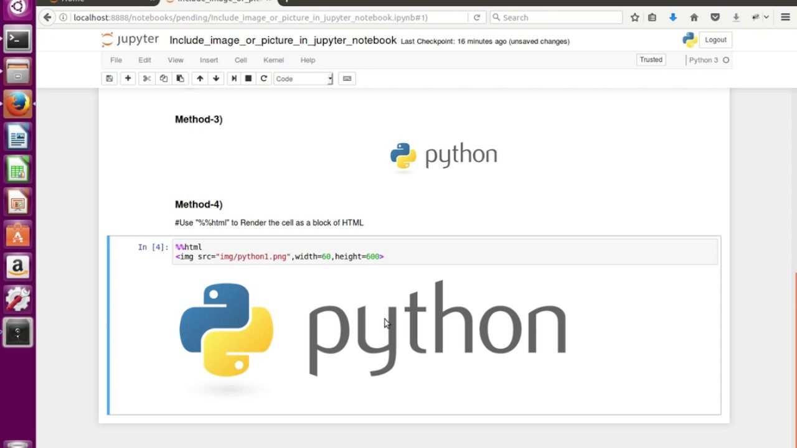
Jupyter & Setup Process
Jupyter Notebook (formerly IPython Notebooks) is a web-based interactive computational environment for creating Jupyter notebooks documents. The "notebook" term can colloquially make reference to many different entities, mainly the Jupyter web application, Jupyter Python web server, or Jupyter document format depending on context. A Jupyter Notebook document is a JSON document, following a versioned schema, and containing an ordered list of input/output cells which can contain code, text (using Markdown), mathematics, plots and rich media, usually ending with the ".ipynb" extension.
To set up Jupyter on an AWS EC2 instance:
Create an AWS Account (if don’t have already)
Create, launch, and connect an EC2 instance (preferably a free tier one for this tutorial)
Download & install Anaconda (can also activate a virtual environment, if needed)
Create Password for Jupyter Notebook
Create configuration file for Jupyter and certificates for supporting https
Configure Jupyter via the configuration file generated above
Run Jupyter using Screen (so that even if disconnected, Jupyter still runs)

