Slide 1
Grocery Project
Created by:-
Dhruv Jani
Zhao Zheng (Jayden)
Aditya Shah
Kenil Gondaliya

Slide 2
Introduction to the Grocery Industry
The grocery industry is a fundamental part of daily life, encompassing the production, distribution, and retail of food and household items.
It has undergone significant transformations due to technological advancements, changes in consumer behaviour, and global economic shifts.

Slide 3
Background of the Grocery Industry
The grocery industry has a rich history that dates back to ancient civilizations, where trade and barter systems laid the foundation for modern retail.
With the advent of industrialization in the 19th century, grocery stores evolved, offering a wider range of products and improving accessibility for consumers.
The 20th century saw the rise of supermarket chains, which revolutionized the way people shopped for groceries.

Slide 4
Key Themes in Literature
- Supply Chain Management
- Impact of E-Commerce
- Sustainability Practices
- Consumer Trends

Slide 5

Research Gaps & Future Directions
Insights from the literature review reveal areas where further research is needed, particularly in understanding the long-term effects of e-commerce on traditional retail and how sustainability practices can be further integrated into the grocery industry.

Slide 6
Methodology Overview
This study utilized a combination of quantitative and qualitative analysis methods.
Data was sourced from the provided GroceryDataset.csv, and various analytical tools were employed to explore the relationships between consumer preferences, pricing, and sentiment.

Slide 7
Data Sources and Tools
Data was primarily sourced from the provided GroceryDataset.csv.
Analytical tools, including Python libraries like Pandas for data manipulation, and visualization tools like Matplotlib, were utilized to analyze trends, sentiments, and correlations within the data.

Slide 8
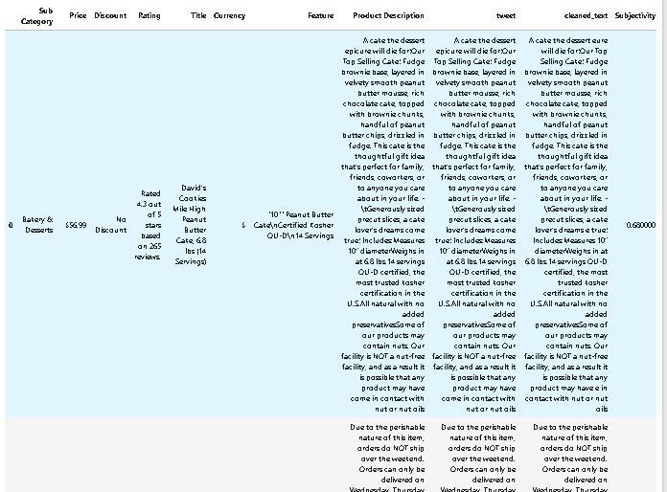
Sample of Analytical File

Slide 9
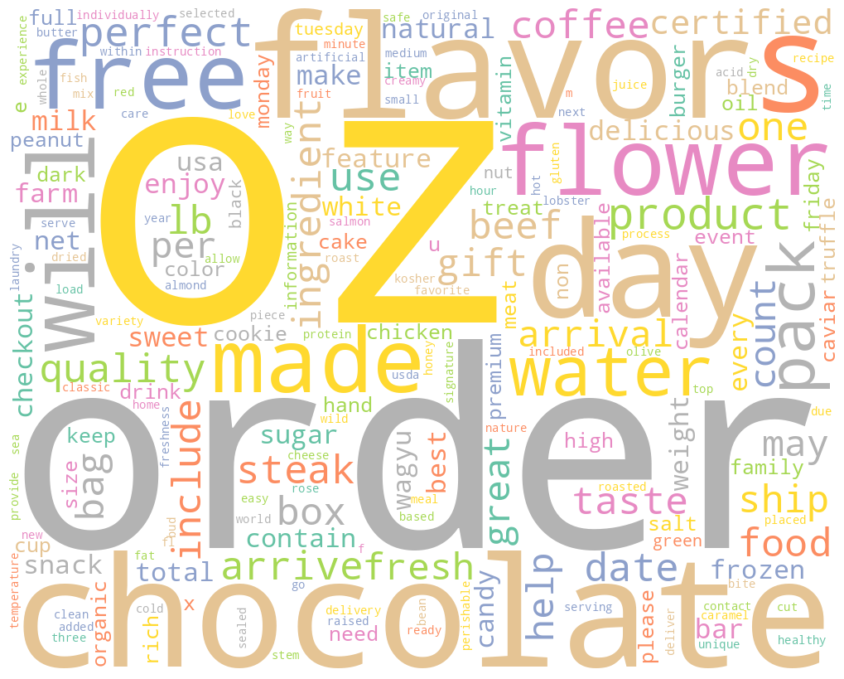
Word Cloud on Text Data

Slide 10
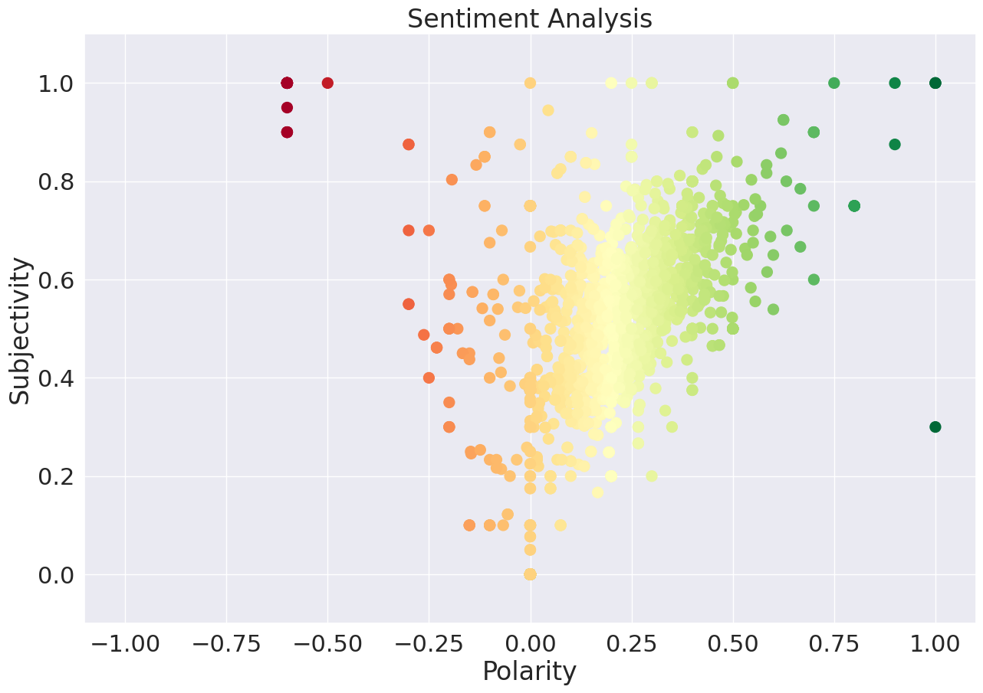
Sentiment Analysis

Slide 11
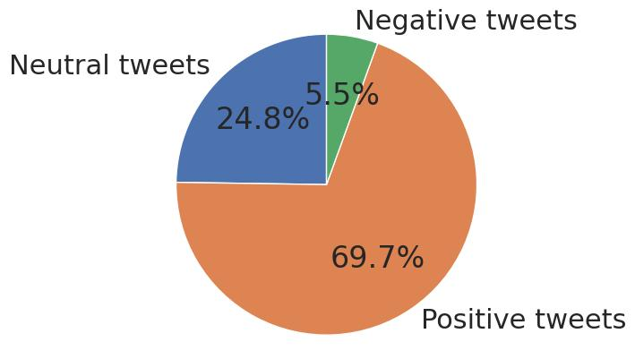
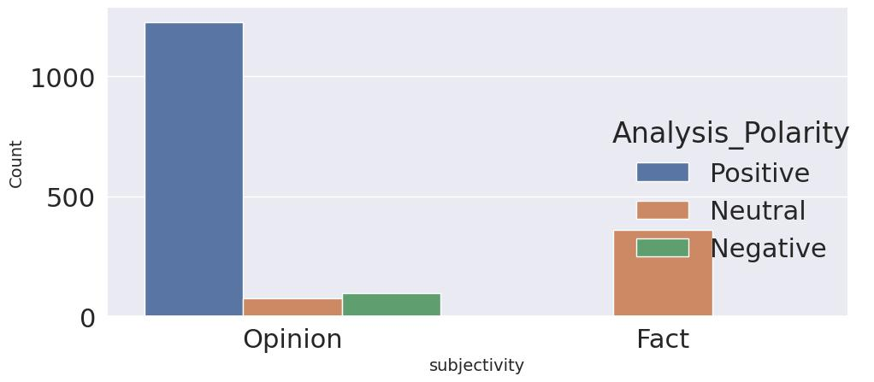
Subjectivity and Polarity analysis

Slide 12
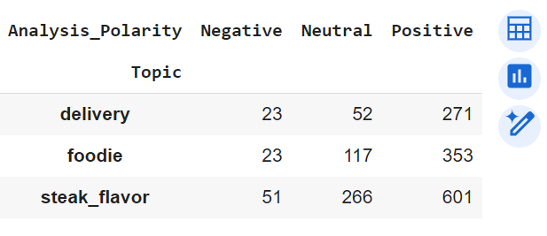
Topic Theme by Sentiment

Slide 13
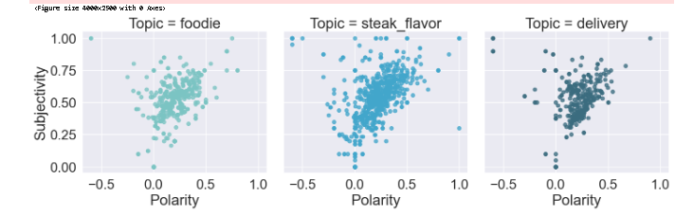
Theme polarity Sentiment Analysis

Slide 14
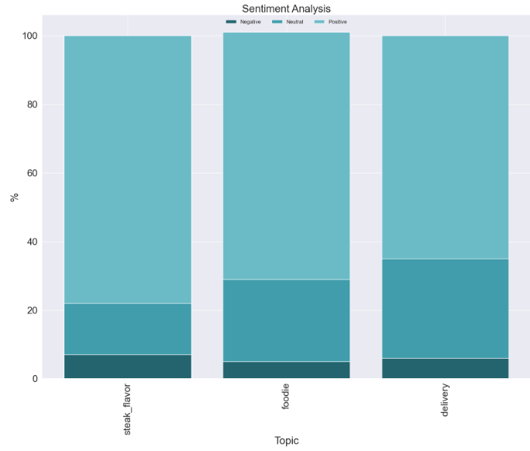
Theme polarity Sentiment Analysis

Slide 15
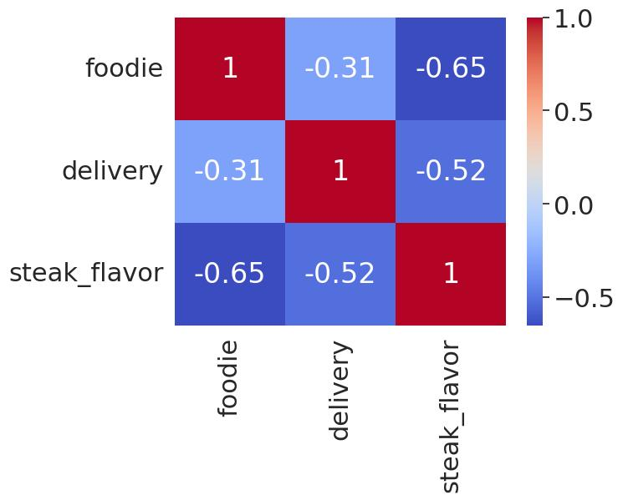
Correlation Analysis by Themes

Slide 16
Conclusions & Findings
The analysis reveals significant trends and correlations within the grocery industry.
Key findings include the importance of e-commerce, consumer sentiment towards product features, and the impact of sustainability practices on purchasing decisions.
Future research should focus on further exploring these areas to provide deeper insights into the industry's evolution.

Slide 17
Thank you

