Slide 1
Online Retail Performance Analysis & Forecasting
Data-Driven Insights for Strategic Decision Making
By Ali Hamza Shaikh
Tools: Microsoft Excel | Tableau

Slide 2
Project Overview
Objectives
Identify revenue trends and seasonal patterns across time periods
Analyze customer concentration and revenue dependency risks
Evaluate geographic demand distribution for market expansion
Forecast future revenue using historical time-series data
Highlight expansion opportunities in high-potential international markets
Project Scope
This analysis combines Excel-based data validation and cleaning with Tableau visual analytics to transform raw retail transaction data into actionable business intelligence for executive-level decision-making.

Slide 3
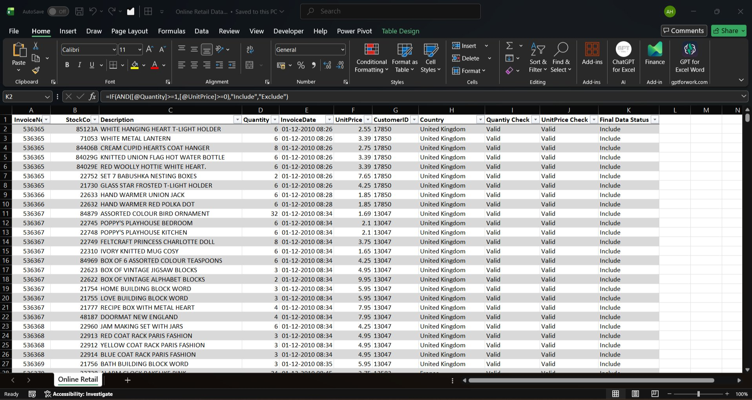
Data Cleaning & Preparation
Cleaning Methodology
Excel Data Validation
Created validation check columns using IF-based logic
Removed transactions with negative quantities
Eliminated records with negative unit prices
Excluded entries with missing customer IDs
Applied formula: =IF(AND([@Quantity]>=1, [@UnitPrice]>=0), "Include", "Exclude")
Filtered and exported clean dataset for analysis

Slide 4
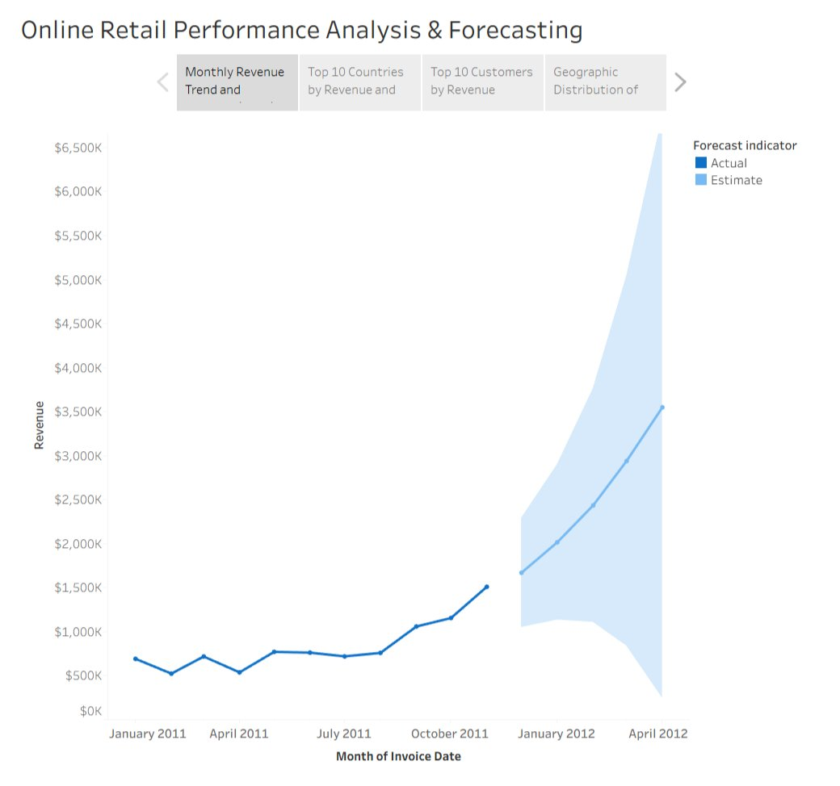
Monthly Revenue Trend & Forecast
Key Insights
• Revenue remains stable in early months with noticeable growth starting mid-year
• Strong seasonal peak in Q4 (October-November) indicates holiday shopping demand
• Forecast projects continued upward trend with sustained growth momentum

Slide 5
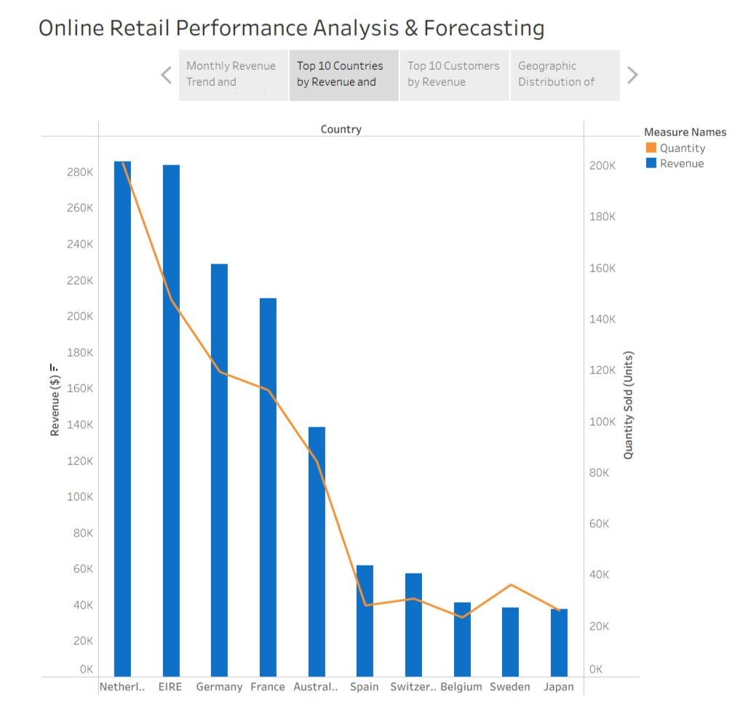
Top 10 Countries by Revenue & Quantity
(Excluding UK for clearer visualization)
Key Insights
• Netherlands, Ireland, Germany, and France show strong dual metrics (high revenue + high quantity)
• Some markets generate high revenue with lower quantity, suggesting premium purchases
• These regions are prime candidates for targeted marketing and distribution expansion

Slide 6
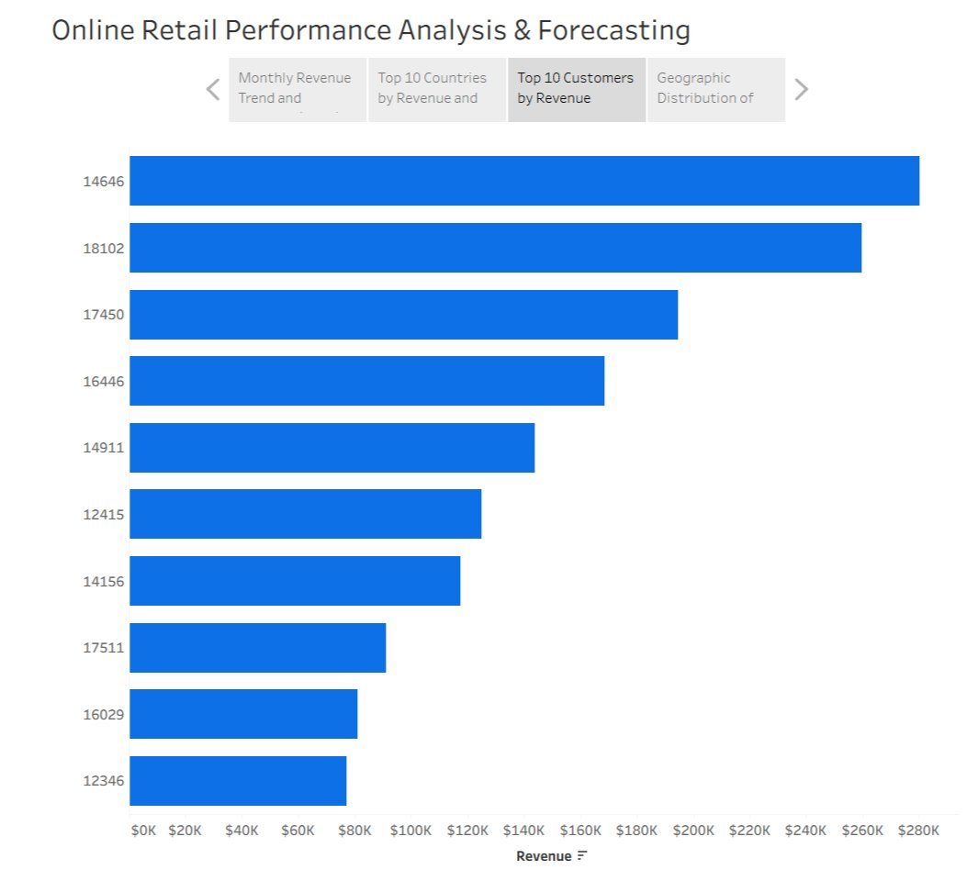
Top 10 Customers by Revenue
Key Insights
• Revenue is well distributed across top customers with no extreme concentration
• Low dependency on any single customer reduces business risk
• Balanced customer portfolio indicates stable revenue stream and lower bargaining power

Slide 7
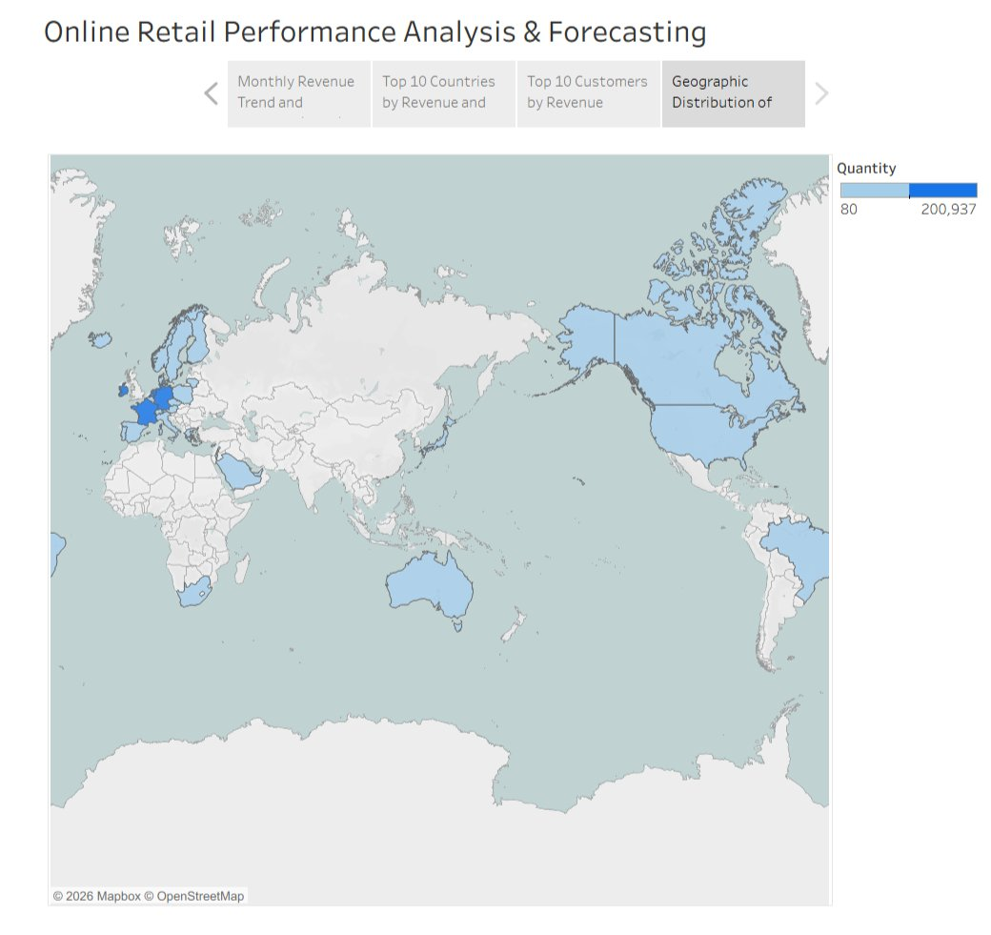
Geographic Distribution of Demand
Key Insights
• Strong demand concentration in Western Europe (Ireland, Netherlands, Germany)
• Significant presence in North America and Australia markets
• Visual heat map enables quick identification of expansion priorities and supply chain planning

Slide 8
Strategic Recommendations
Seasonal Planning
Market Expansion
Leverage Q4 revenue peaks for inventory planning, staffing decisions, and targeted marketing campaigns during peak shopping seasons.
Prioritize Netherlands, Ireland, Germany, and France for localized promotions, enhanced distribution, and market-specific strategies.
Customer Retention
Supply Chain Optimization
Maintain balanced customer portfolio through loyalty programs and relationship management to sustain stable revenue streams.
Use geographic demand insights to optimize logistics, warehouse locations, and regional fulfillment for faster delivery.

Slide 9
Conclusion
This analysis successfully transformed raw retail data into actionable insights through:
• Rigorous data cleaning and validation in Excel
• Interactive visual analytics in Tableau
• Identification of seasonal trends and growth patterns
• Strategic recommendations for market expansion
The insights generated support data-driven decision-making for sustainable growth.

