Slide 1
Character Recognition using Deep Learning
By Team 2
Prajakta Pawar
Dhanshri More
Rutuja Magar

Slide 2
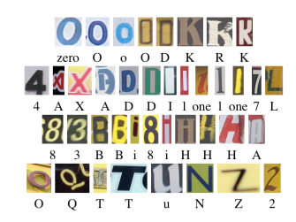
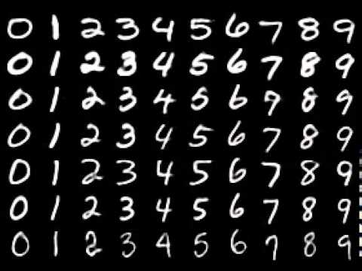
Introduction
We address the problem of recognizing arbitrary single characters from Street View images
Street View Character images recognition using Convolutional Neural Networks
Handwritten digit recognition
using Deeplearning neural net of ‘h2o’
Web service using Azure and Shiny App

Slide 3
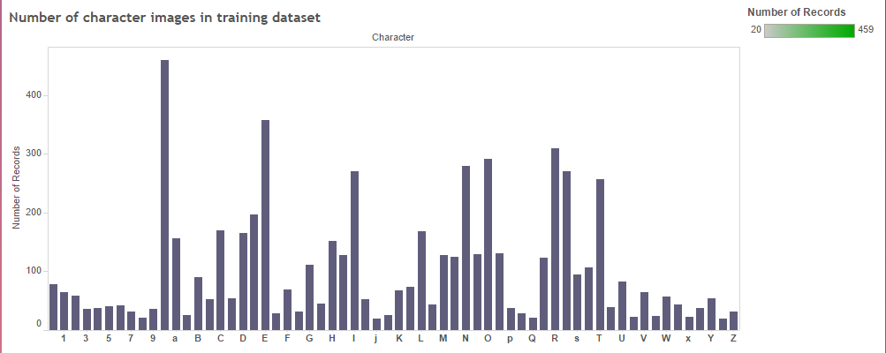
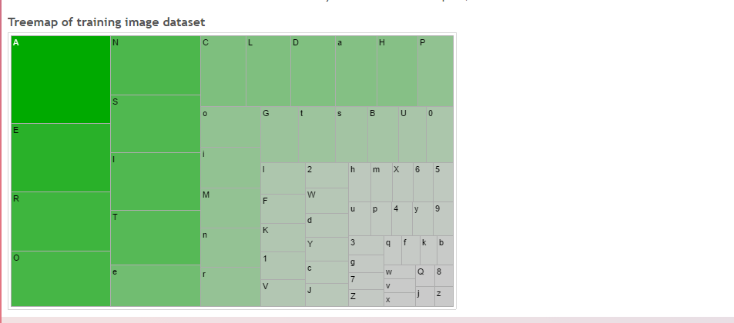
Tableau analysis
Distribution of Training images

Slide 4
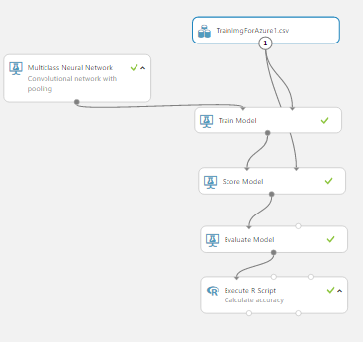
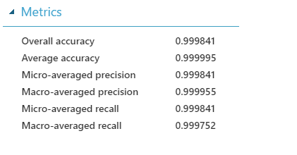
Character Recognition – H2O
Number of learning iterations :1000
Number of hidden layers : 500

Slide 5
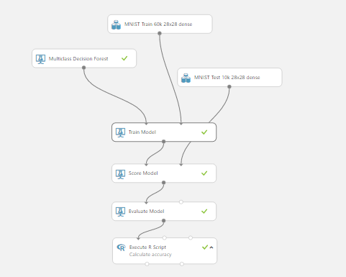
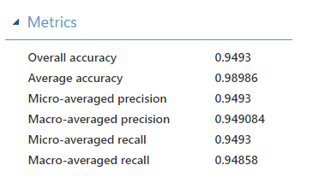
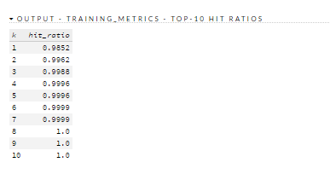
Handwritten Digit Recognition

Slide 6
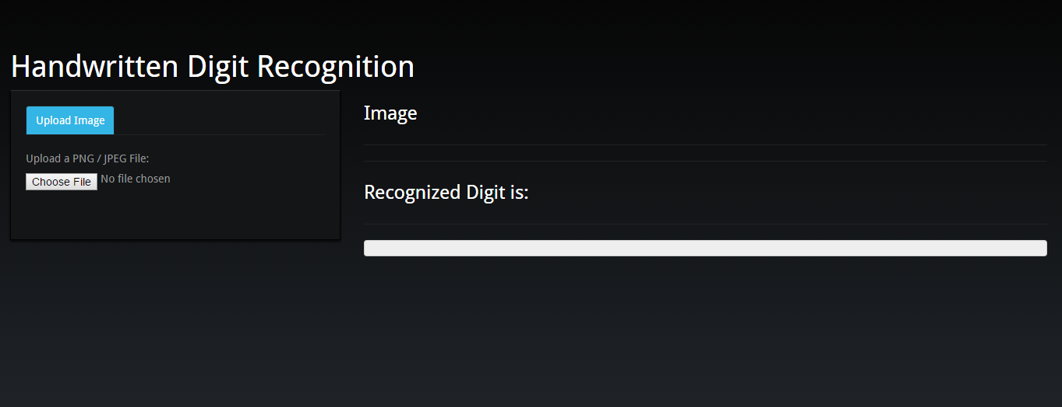
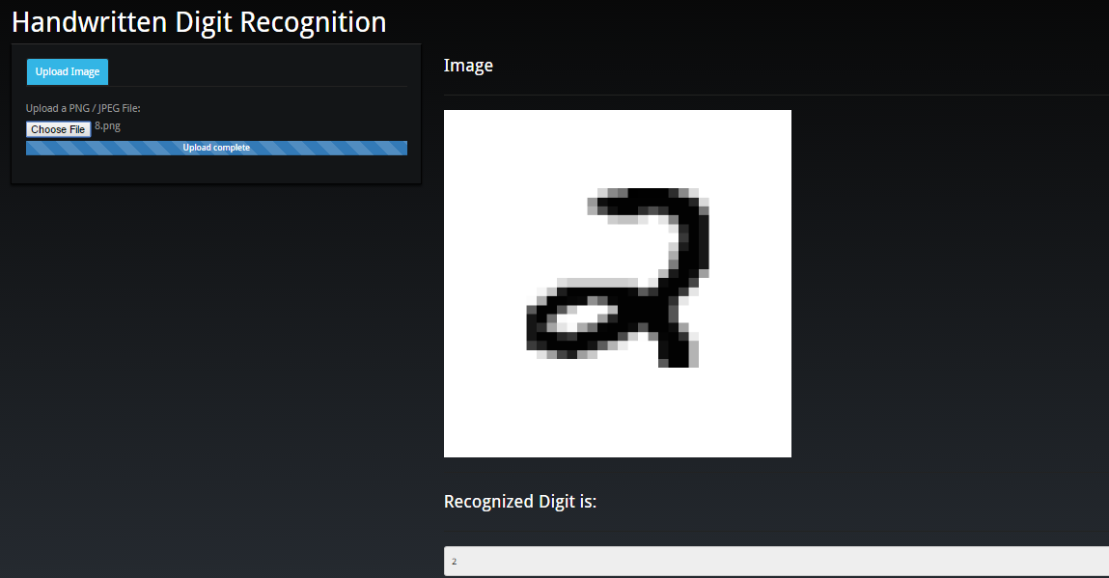

Slide 7
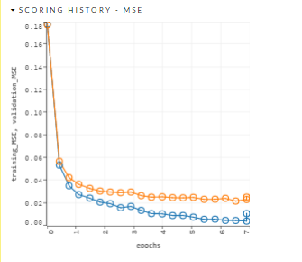
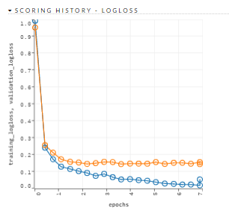
Evaluation Results – H2O

