Slide 1
Team 10 : Energy Analytics
-Suhas Pirankar, Zalak Shah

Slide 2
Executive Summary
Forecast the net power generation for different plants which can play an important role in their current and future power generation.
We have selected a dataset provided by U.S Energy Information Administration. We have all the details related to each and every power plant that is been running in each State. Details of each plant has been provided in detail. We have merged data file of each year from 2012 till 2016 and used that data file.

Slide 3
Boosted Decision Tree Regression
Predict net Fuel generation for a given plant.
Boosted Decision Tree Regression module used to create an ensemble of regression trees using boosting.
Boosting means that each tree is dependent on prior trees, and learns by fitting the residual of the trees that preceded it.
Boosting in a decision tree ensemble tends to improve accuracy with some small risk of less coverage.

Slide 4
Two Class Boosted Decision Tree Classification
Classify “yes” or “No” if the power plant uses the generated power and utilizes its own energy for its working.
Co-generator is using the energy for its own use.

Slide 5
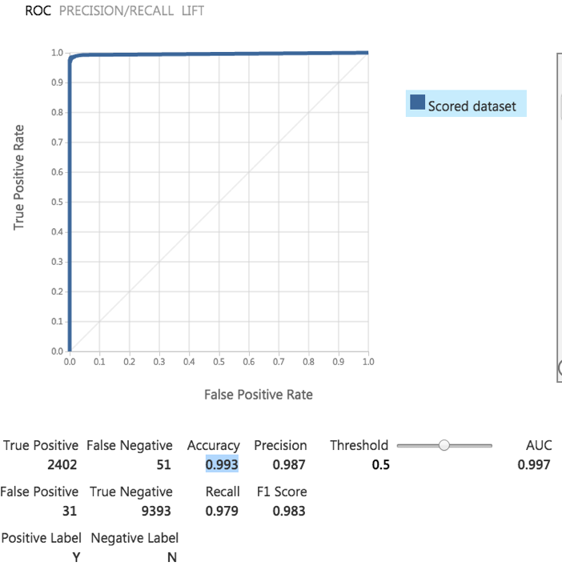
Model Accuracy

Slide 6
Questions ?

Slide 7
Thank you

