Slide 1


Smart Bike Systems
Team 10 : Suhas Pirankar & Zalak Shah

Slide 2
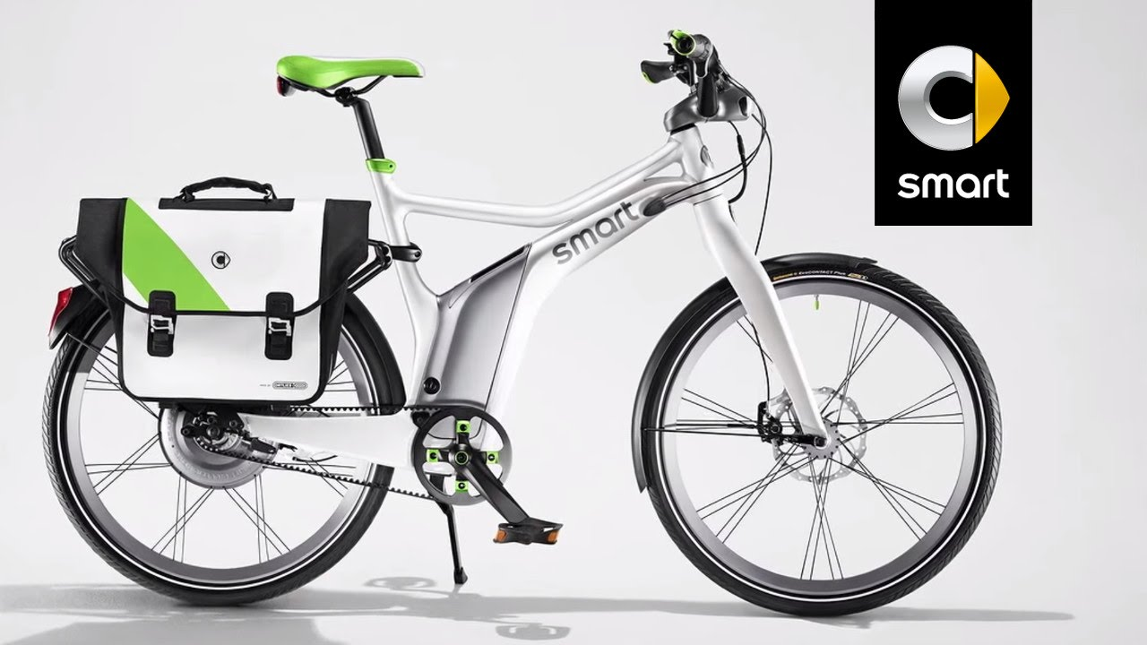
Overview
Process of obtaining membership, rental, and bike return is automated in a city.
People are able rent a bike from a one location and return it to a different place.
Currently there are 500 bike-sharing programs around the world.
Data can be used for studying mobility in a city.
Data Set : Smart Bike Systems

Slide 3

Problem Statement
In this dataset we have to combine historical usage patterns with weather data in order to forecast bike rental demand.
We are predicting the number of bikes that will be required by the Bike Sharing system on a given date timestamp.
We are predicting count of bike required by casual bikers and count of bikes required by registered bikers

Slide 4
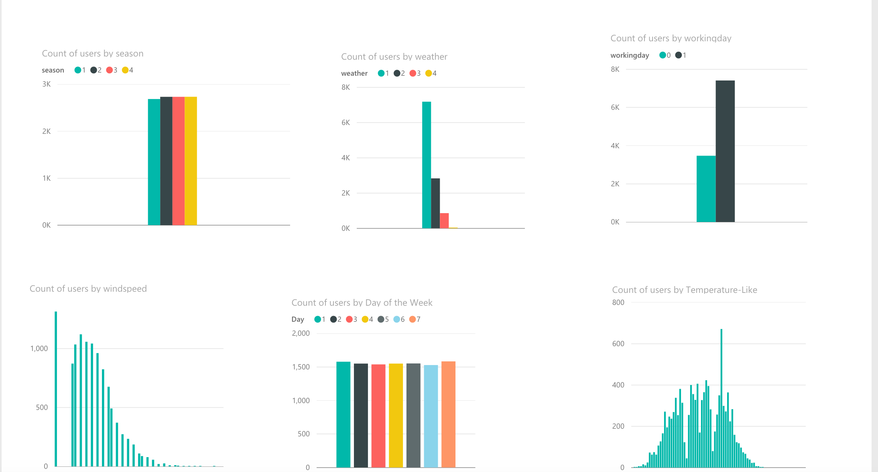
Data Exploration

Slide 5
Feature Engineering
Created new variables to improve the prediction power of model.
New variables like hour, month, day and year .
Different hour bucket for registered/Casual users.
Different temperature bucket for registered/Casual users.
New Variable for weekend identification

Slide 6
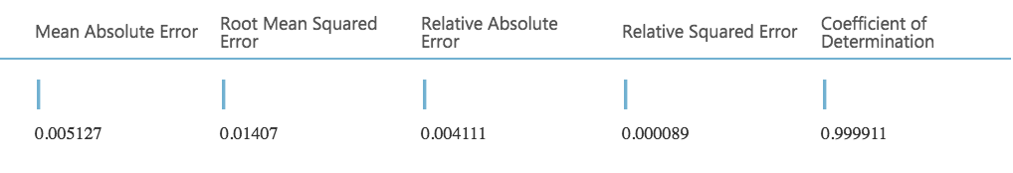
Algorithms
We have used Decision Forest Regression for building our model based on the performance of our algorithm.
Other Algorithms that were used are Bayesian Linear Regression, Neural Network Regression, Boosted Decision Tree.

Slide 7
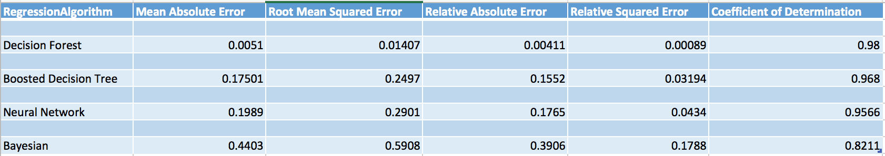
Performance of other Algorithms

Slide 8
Tools
Azure ML, Azure Cloud
Power BI
R
Forecast Weather API, JQuery, Bootstrap, Ajax
Visual Studio
C#
Balasamiq Mockup

Slide 9
Thank you

