Slide 1
Team 10 : Advance Data Science
TEAM Members
Suhas Pirankar
ZalaK SHAH
INFO 7390 Mid-term – Summer 2016

Slide 2
CASE STUDY 2: Advertisement Dataset
Build a model to determine if a given image is Ad or Non Ad:
Perform exploratory data analysis using POWER BI.
Build prediction models to determine if image is and Ad using Logistic regression, Neural Network and Classification trees
Discuss the model and evaluate the model’s performance.

Slide 3
Steps IN Data Cleaning
Replace missing values with NA
Replace NA with Mean of the column
Check for outliers and replace them with mean.
Round values to the nearby integer
Convert columns into factor and prepare them for regression
Manipulate the ‘Ad’ string column and make 1 for Ad and 0 for Non Ad
Split data into Training and Test data set

Slide 4
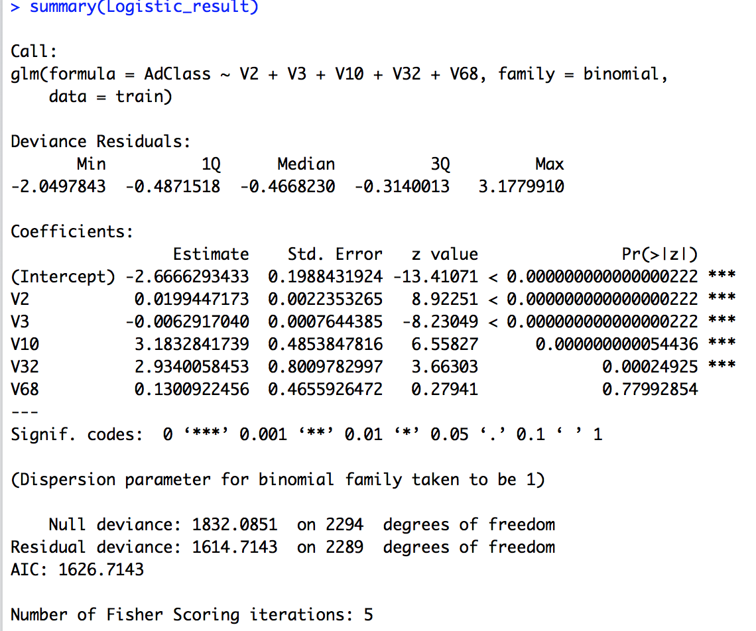
Logistic Regression

Slide 5
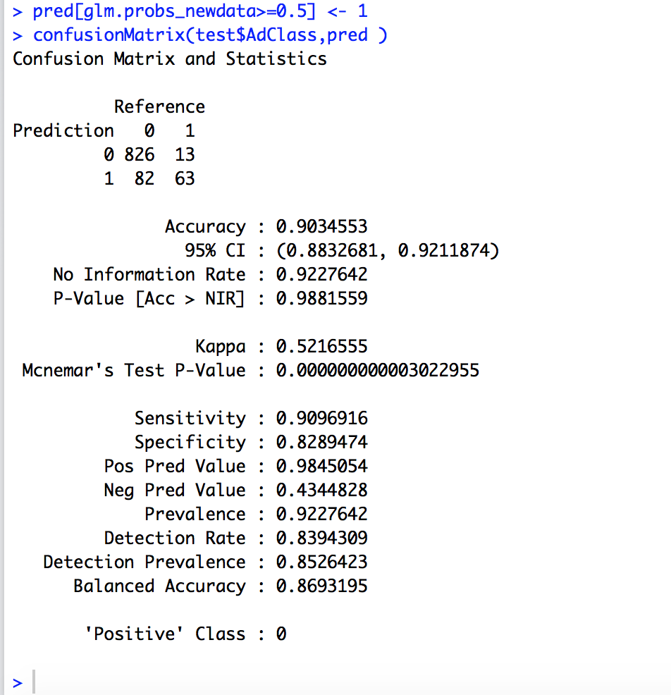
Confusion Matrix
Calculates a cross-tabulation of observed and predicted classes with associated statistics.
The results are dependent on the probability of the prediction.
If we reduce the value of the probability the result of confusion matrix varies

Slide 6
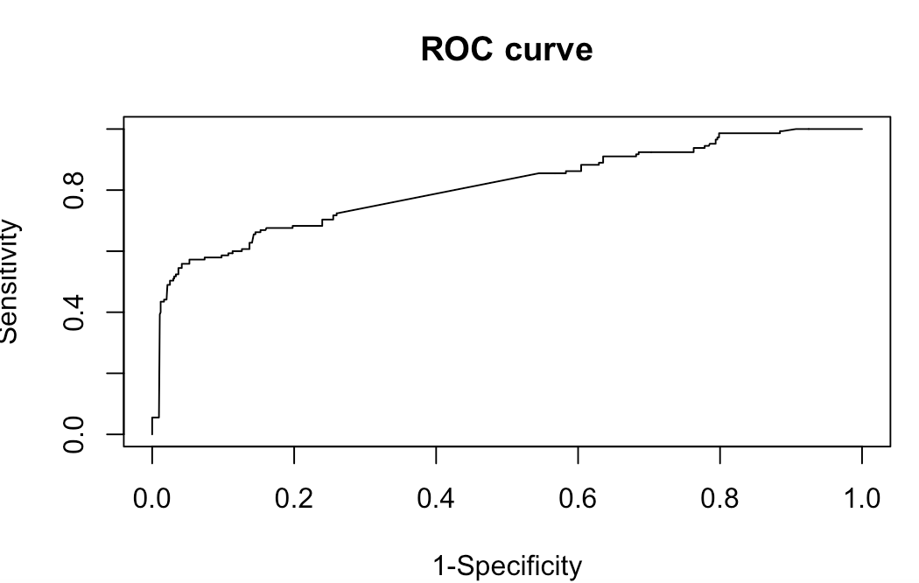
ROC Curve : Ad Data Set ( Receiver operating characteristic)
It shows the true positive rate (Sensitivity) is plotted in function of the false positive rate (100-Specificity) for different cut-off points.
Each point on the ROC curve represents a sensitivity/specificity pair corresponding to a particular decision threshold.
The more area that is coverd by the curve the better is your model

Slide 7
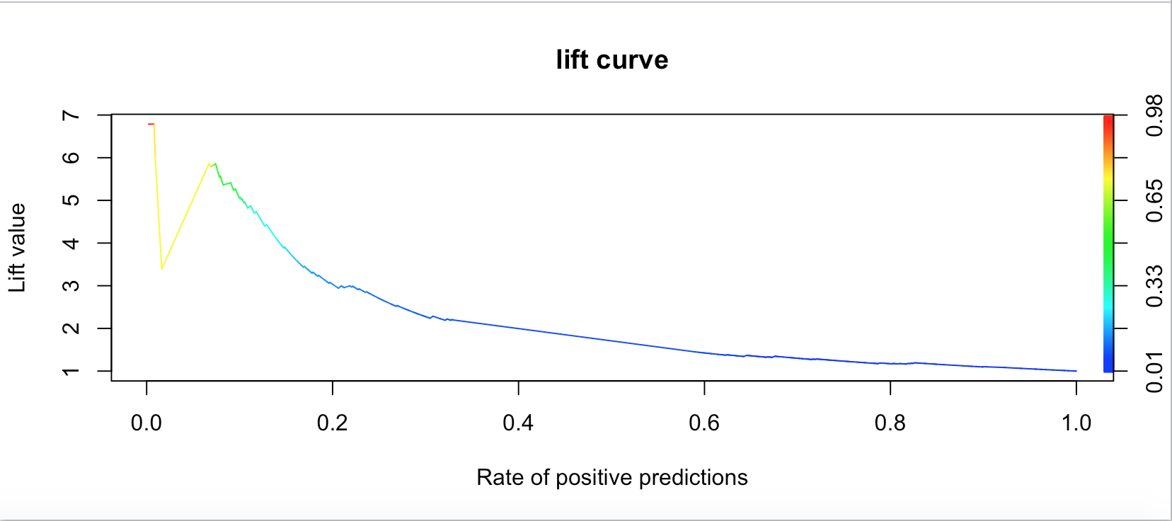
Lift chart
A lift curve is a way of visualizing the performance of a classification model.
Lift is simply the ratio of target response divided by average response.

Slide 8
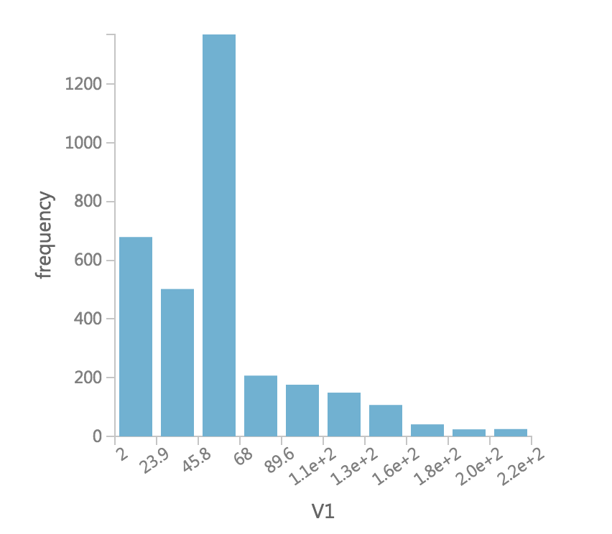
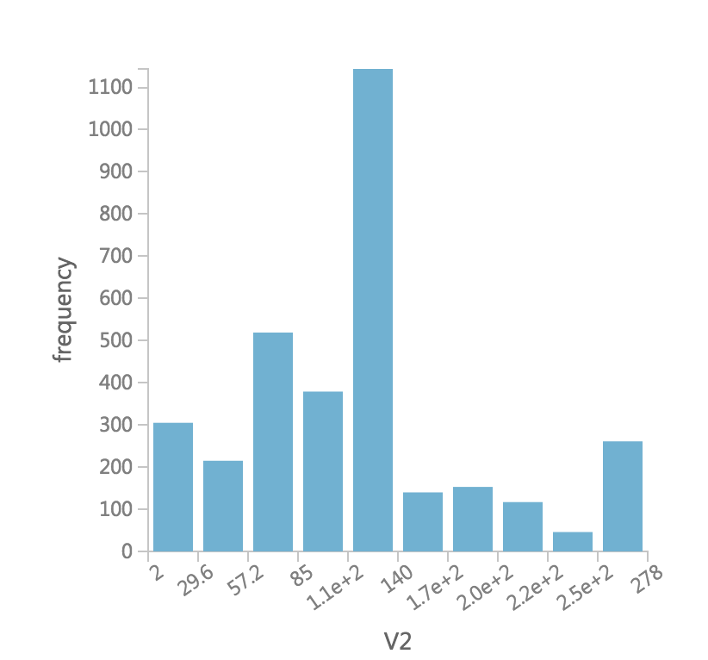
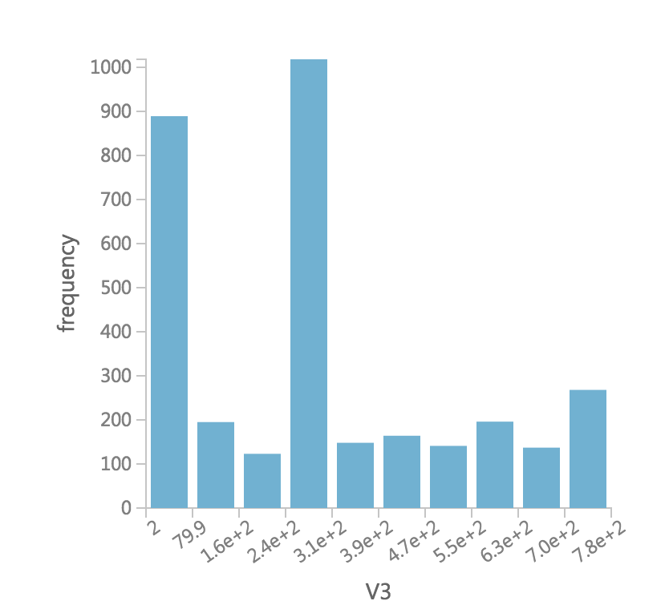
Data visualization

Slide 9
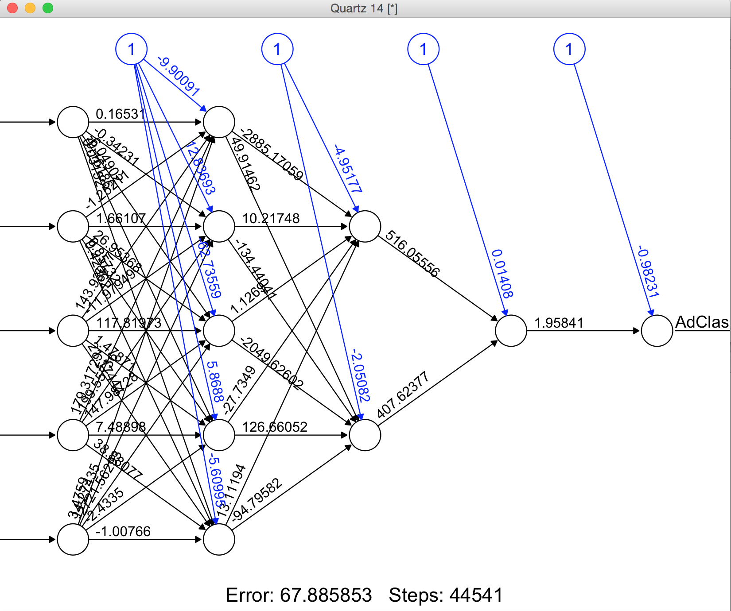
Neural Network

Slide 10
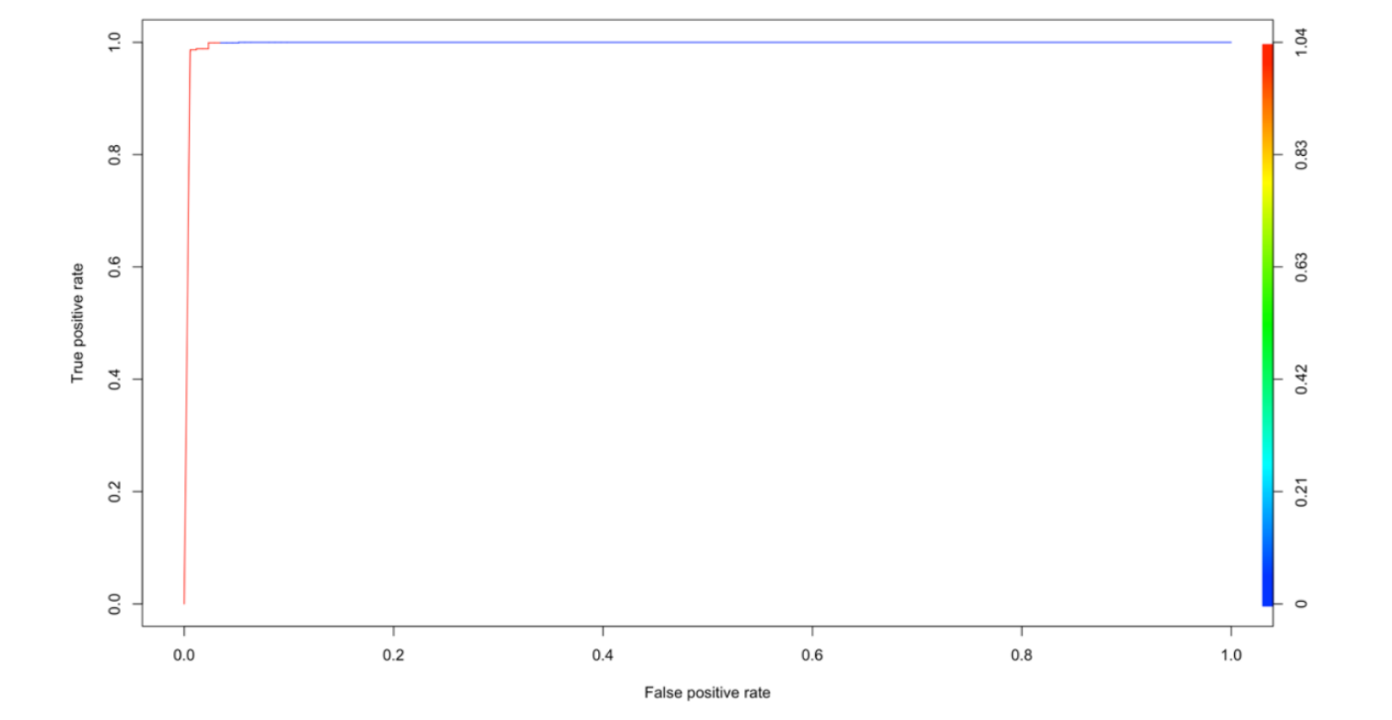
ROC Curve

Slide 11
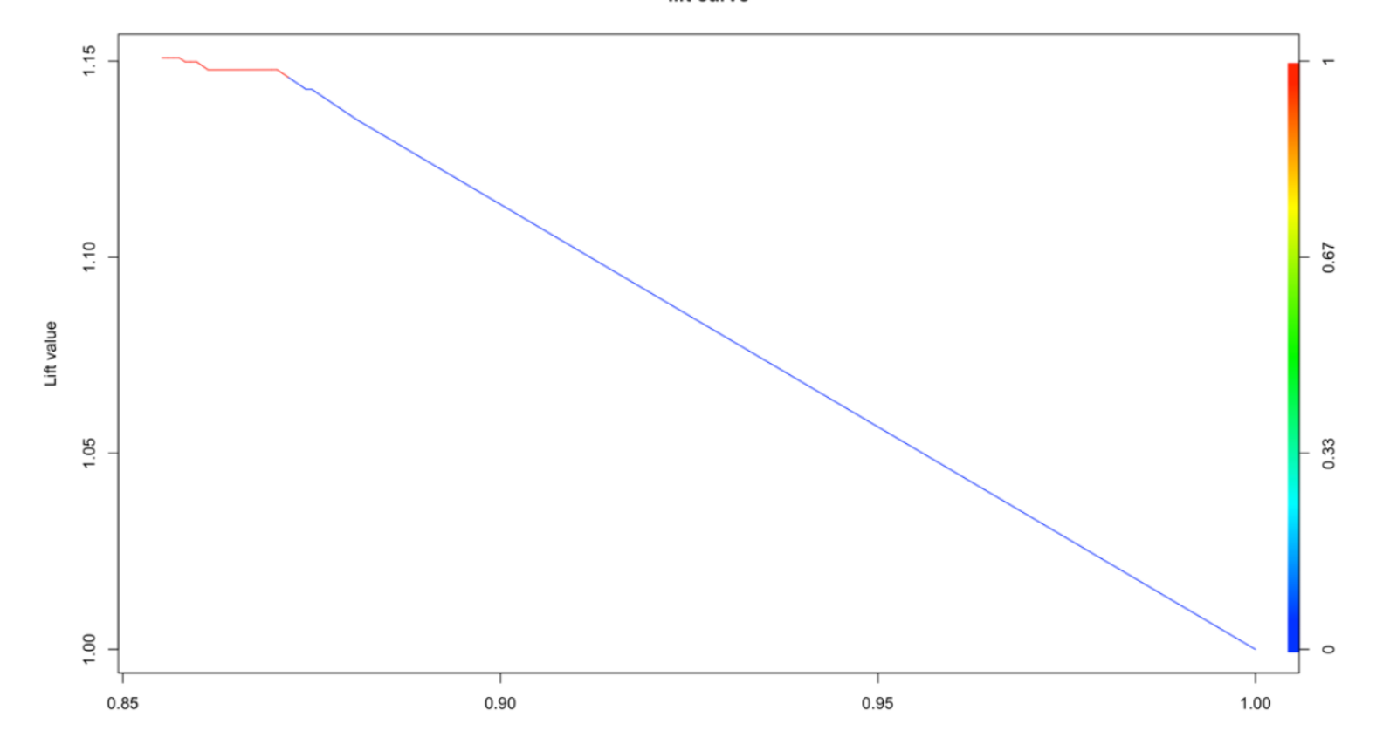
Lift Chart

Slide 12
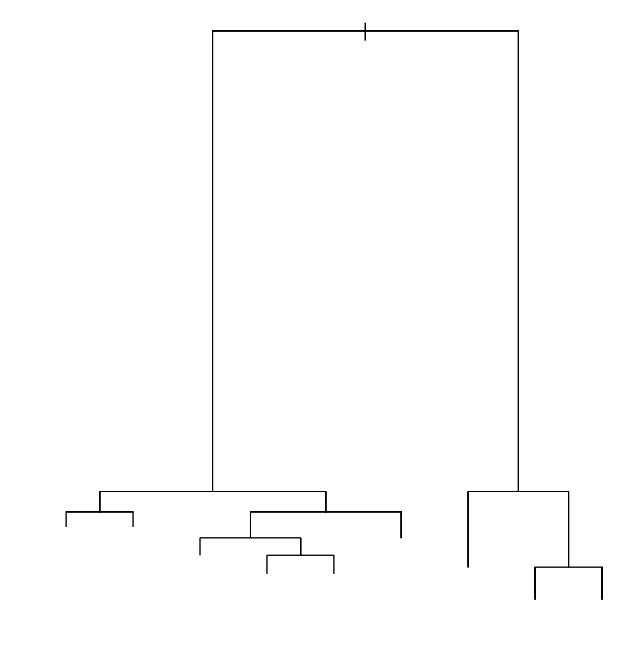
Classification trees
Relatively fast compared to other classification models
Obtain similar and sometimes better accuracy compared to other models
Simple and easy to understand
Can be converted into simple and easy to understand classification rules

Slide 13
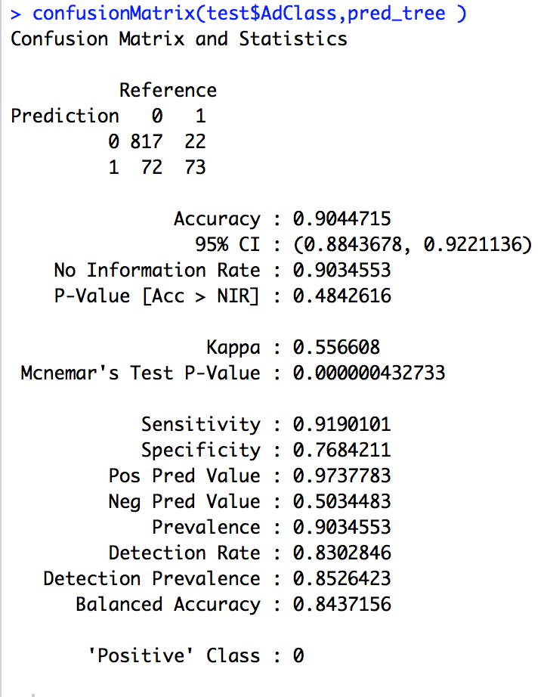
Confusion Matrix
Calculates a cross-tabulation of observed and predicted classes with associated statistics.
The results are dependent on the probability of the prediction.
If we reduce the value of the probability the result of confusion matrix varies

Slide 14
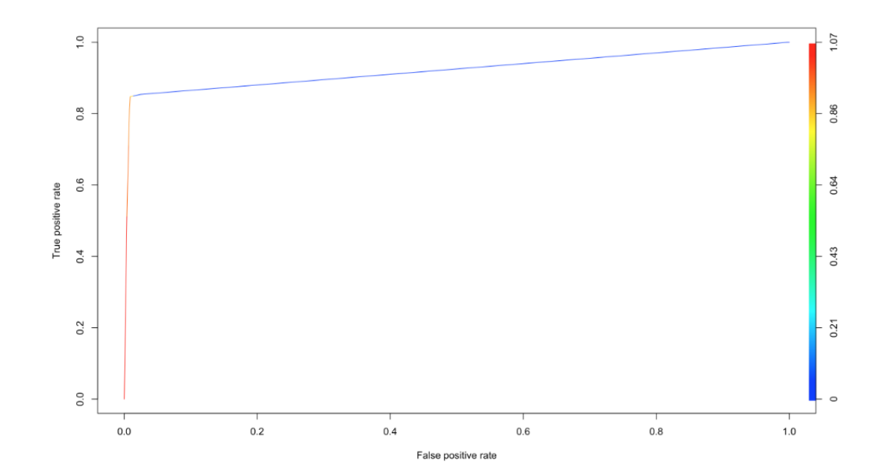
ROC CUrve

Slide 15
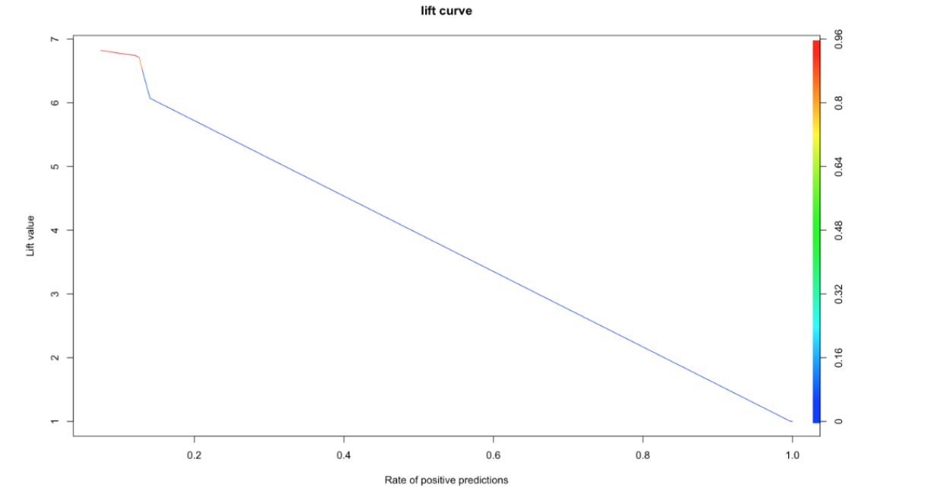
Lift CHart

Slide 16
Best Model
Looking at overall ROC curves and Lift Charts
We select the best model as Classification tree.
Neural network model has average performance

Slide 17
THANK YOU

