Slide 1
Midterm Project
By Zalak & Suhas

Slide 2
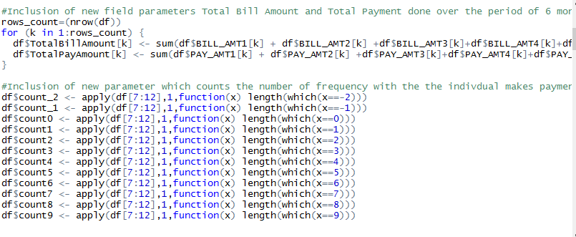
New Data Fields
New Fields Created:
Total Bill Amount
Total Pay Amount
Count for the Pay Status
This are the derived fields used for the predictive analysis for the customer to do the Default or not

Slide 3
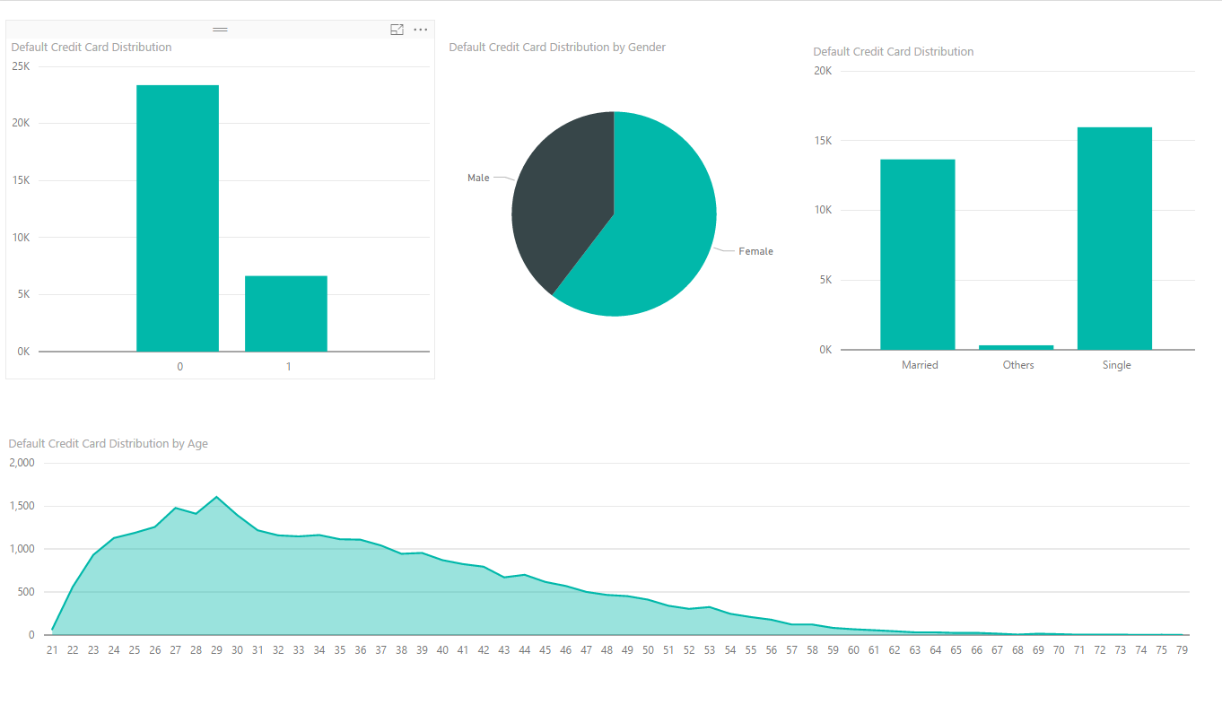
Data Visualization
The data is represented as per its distribution over Age ,Sex and Martial Status.

Slide 4
Logistic Regression
We applied the logistic regression using the new derived fields and the avoiding the pay status of the 6 month credit history.
The accuracy for the model achieved by using the random sampling data to be 81 percent with sensitivity and specificity as 0.82 and 0.61 respectively.
We have considered the 14 derived and 5 original parameters for the creation of predictive model.

Slide 5
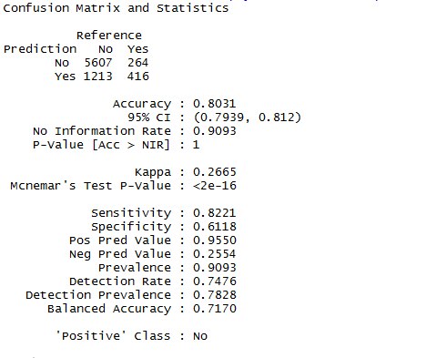
Confusion Matrix
In here the Predictive model suggest that when the Prediction is Yes(i.e Default) then the accuracy is 1213 of (1213+416)
High Sensitivity measures the proportion of positives that are correctly identified and it is quantifying the false negatives.

Slide 6
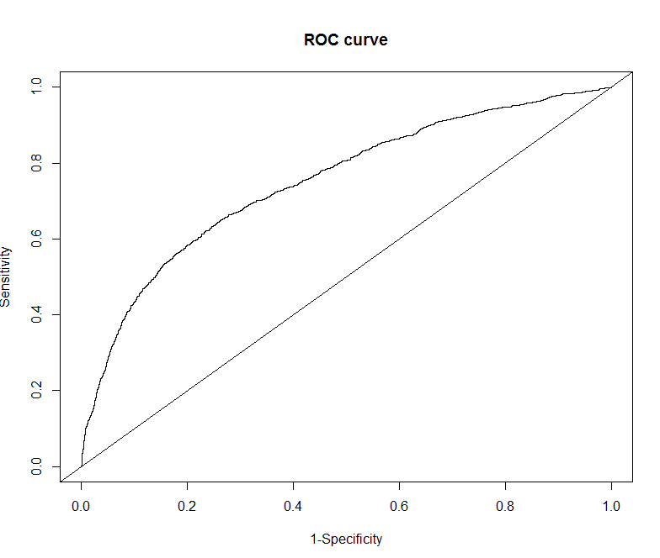
ROC Curve
The ROC Curve which is a graph a trade-off graph between specificity and the Sensitivity.
The area is measure of the prediction accuracy.

Slide 7
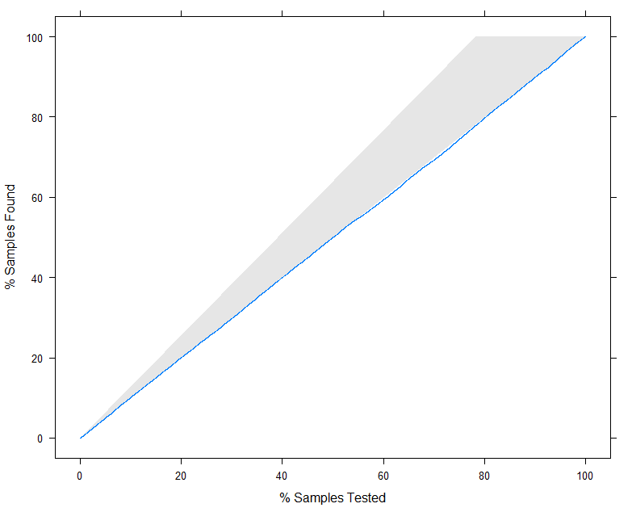
LIFT Curve
Lift curve caters the best fit for the model which is designed .
The purple line represents the expected number of positives we would predict if we did not have a model but simply selected cases at random.

Slide 8
Neural Network
We applied the neural network using the new derived fields and the avoiding the pay status of the 6 month credit history.
The accuracy for the model achieved by using the random sampling data to be 81 percent with sensitivity and specificity as 0.82 and 0.61 respectively.
We have considered the 14 derived and 5 original parameters for the creation of predictive model.

Slide 9
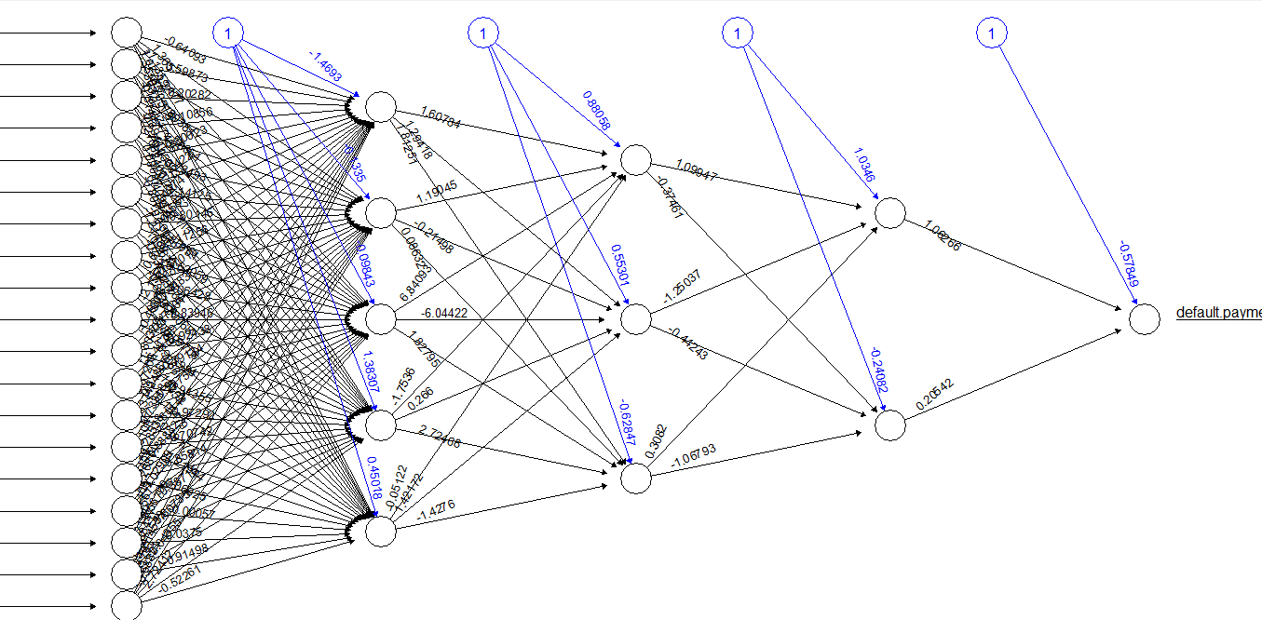
Plot of Neural Network
3 layers with 5 3 and 2 weighing factors.

Slide 10
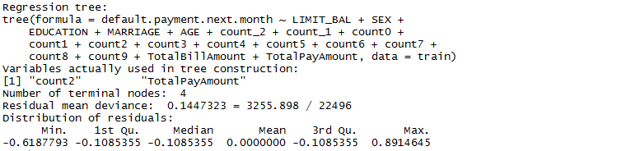
Classification Tree

Slide 11
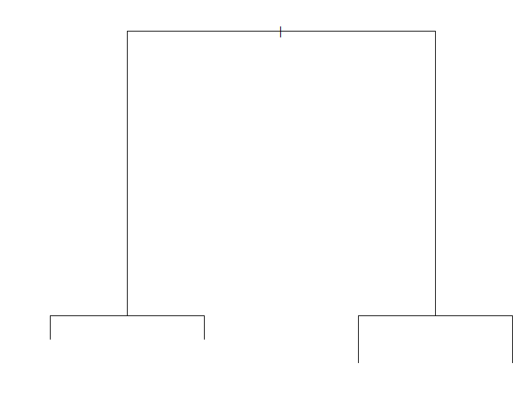
ClassificAtion Tree
The model has propose the following classification Tree.

