Slide 1
YARN /MESOS/VAGRANT/UNIVA Presentation by:
Mubeen
Rashmi
Sandeep

Slide 2
YARN
YARN
YARN – next generation compute framework for Hadoop
Data operating system of Hadoop

Slide 3

1st Generation Hadoop: Batch Focus
HADOOP 1.0 Built for Web-Scale Batch Apps
All other usage patterns MUST leverage same infrastructure
Forces Creation of Silos to Manage Mixed Workloads
Single App
Single App
INTERACTIVE
ONLINE
Single App
Single App
Single App
BATCH
BATCH
BATCH
HDFS
HDFS
HDFS

Slide 4
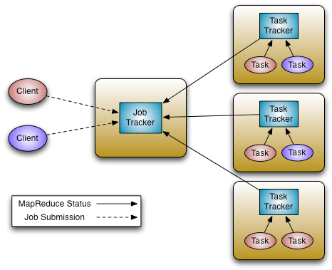
Hadoop 1 Architecture
JobTracker
Manage Cluster Resources & Job Scheduling
TaskTracker
Per-node agent
Manage Tasks

Slide 5
Hadoop 1 Limitations
Lacks Support for Alternate Paradigms and Services
Force everything needs to look like Map Reduce
Iterative applications in MapReduce are 10x slower
Scalability
Max Cluster size ~5,000 nodes
Max concurrent tasks ~40,000
Availability
Failure Kills Queued & Running Jobs
Hard partition of resources into map and reduce slots
Non-optimal Resource Utilization

Slide 6
Hadoop as Next-Gen Platform
Single Use System
Batch Apps
Multi Purpose Platform
Batch, Interactive, Online, Streaming, …
HADOOP 1.0
HADOOP 2.0
MapReduce
(data processing)
Others
MapReduce
(cluster resource management
& data processing)
YARN
(cluster resource management)
HDFS
(redundant, reliable storage)
HDFS2
(redundant, highly-available & reliable storage)

Slide 7
Hadoop 2 - YARN Architecture
ResourceManager (RM)
Central agent - Manages and allocates cluster resources
NodeManager (NM)
Per-Node agent - Manages and enforces node resource allocations
ApplicationMaster (AM)
Per-Application –
Manages application
lifecycle and task scheduling

Slide 8

Hadoop architecture
Interact with that data in multiple ways with predictable performance and quality of service
Applications Run Natively in Hadoop
BATCH
(MapReduce)
INTERACTIVE
(Tez)
ONLINE
(HBase)
STREAMING
(Storm, S4,…)
GRAPH
(Giraph)
IN-MEMORY
(Spark)
HPC MPI
(OpenMPI)
OTHER
(Search)
(Weave…)
YARN (Cluster Resource Management)
HDFS2 (Redundant, Reliable Storage)

Slide 9
Key Benefits of YARN
New Applications & Services
Improved cluster utilization
Scale
Experimental Agility

Slide 10
Key Improvements in YARN
Framework supporting multiple applications
Separate generic resource brokering from application logic
Define protocols/libraries and provide a framework for custom application development
Share same Hadoop Cluster across applications
Cluster Utilization
Generic resource container model replaces fixed Map/Reduce slots. Container allocations based on locality, memory (CPU coming soon)
Sharing cluster among multiple application

Slide 11
Key Improvements in YARN
Scalability
Removed complex app logic from RM, scale further
State machine, message passing based loosely coupled design
Compact scheduling protocol
Application Agility and Innovation
Map Reduce becomes an application in user space unlocking safe innovation
Multiple versions of an app can co-exist leading to experimentation
Easier upgrade of framework and application

Slide 12
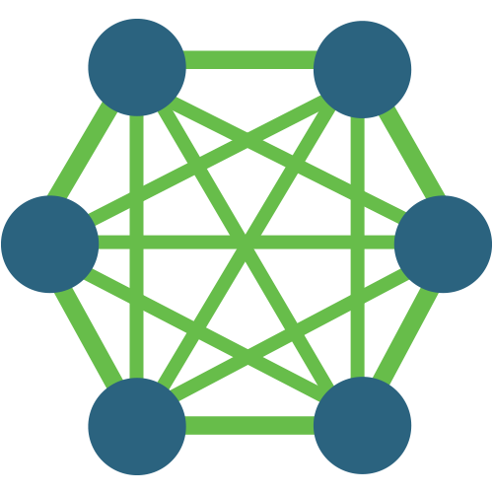


YARN as Cluster Operating System
ResourceManager
Scheduler
NodeManager
NodeManager
NodeManager
NodeManager
map _{1.1}
nimbus₀
vertex_{1.2.2}
vertex_{1.1.1}
NodeManager
NodeManager
NodeManager
NodeManager
map_{1.2}
Batch
Interactive SQL
vertex_{1.1.2}
nimbus₂
NodeManager
NodeManager
NodeManager
NodeManager
nimbus₁
Real-Time
vertex_{1.2.1}
reduce_{1.1}

Slide 13
YARN Application Lifecycle
Application Client
Protocol
Resource
Manager
Application Client
NodeManager
Application Master
Protocol
YarnClient
App
Container
App
Specific API
Application Master
AMRMClient
Container
Management
Protocol
NMClient

Slide 14
Summary
YARN is a platform to build/run Multiple Distributed Applications in Hadoop
YARN is completely Backwards Compatible for existing MapReduce apps
YARN enables Fine Grained Resource Management via Generic Resource Containers.
YARN has built-in support for multi-tenancy to share cluster resources and increase cost efficiency
YARN provides a cluster operating system like abstraction for a modern data architecture

Slide 15

Apache YARN
The Data Operating System for Hadoop 2.0
Flexible Enables other purpose-built data processing models beyond MapReduce (batch), such as interactive and streaming
Efficient Increase processing IN Hadoop on the same hardware while providing predictable performance & quality of service
Shared Provides a stable, reliable, secure foundation and shared operational services across multiple workloads
Data Processing Engines Run Natively IN Hadoop
BATCH
MapReduce
INTERACTIVE
Tez
ONLINE
HBase
STREAMING
Storm, S4, …
GRAPH
Giraph
MICROSOFT
REEF
SAS
LASR, HPA
OTHERS
YARN: Cluster Resource Management
HDFS2: Redundant, Reliable Storage

Slide 16
References
http://hortonworks.com/blog/introducing-apache-hadoop-yarn/
Installation: http://www.alexjf.net/blog/distributed-systems/hadoop-yarn-installation-definitive-guide/
https://issues.apache.org/jira/secure/attachment/12486023/MapReduce_NextGen_Architecture.pdf

Slide 17
Vagrant
Tool for building Virtual Development Enivronment
Higher-Level Wrapper around virtualization software such as VirtualBox, VMware, KVM and Linux Containers (LXC), and around configuration management software such as Ansible, Chef, Salt and Puppet
Works with other virtualization software such as VMWare and KVM
Supports Server Environments like Amazon EC2
Written in Ruby, usable in projects developed in PHP, Python, Java, C#

Slide 18
Why Vagrant
Problems
Installation of Software Manually
Configuration Issues
“Works on my Machine” issue
Difficult to keep Development Environments in Sync
Solution
Vagrant is the Modern Solution
Encourages automation to setup developments environment
Puts development environment into a virtual machine

Slide 19
How it Works?
Install Vagrant and a VirtualBox
Run the following Commands in Terminal
$ vagrant init hashicorp/precise32
$ vagrant up
Fully running Virtual machine with Ubuntu 12.04 LTS 32-bit.
Vagrant SSH – SSH into the machine
Vagrant destroy – Removes all traces of it

Slide 20
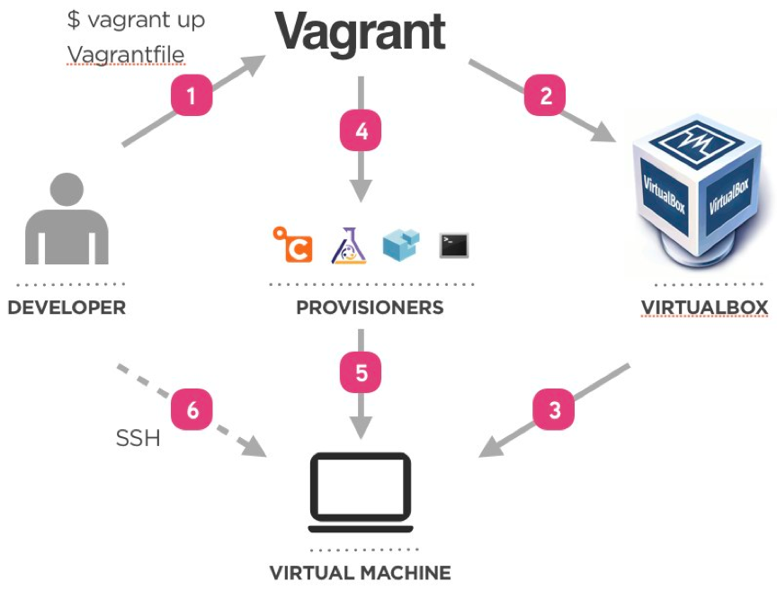
How it Works…

Slide 21
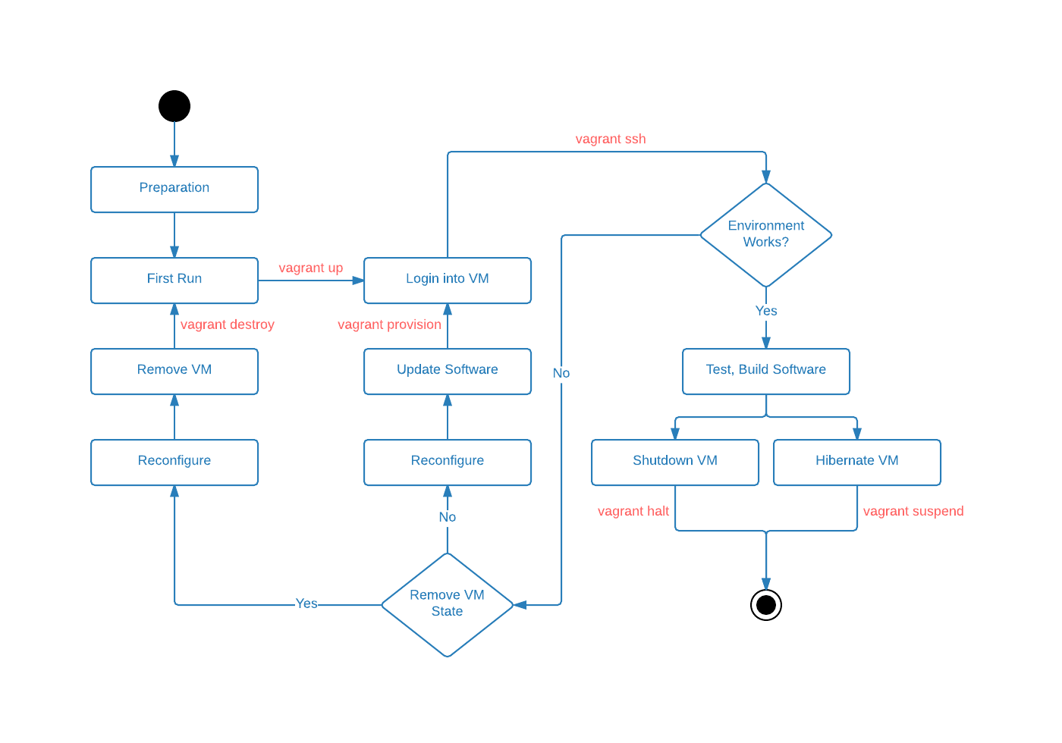
WorkFlow

Slide 22
Bibilography
https://docs.vagrantup.com/v2/
http://cdn.oreillystatic.com/oreilly/booksamplers/9781449335830_sampler.pdf
https://en.wikipedia.org/wiki/Vagrant_(software)
https://www.mapr.com/

Slide 23
Apache Mesos
Open source cluster management tool
It "provides efficient resource isolation and sharing across distributed applications, or frameworks“
Was created in the process of scaling twitter.
Comparable to Google Omega scheduler.
Apache’s top level project.
Frameworks: applications running on top of mesos

Slide 24
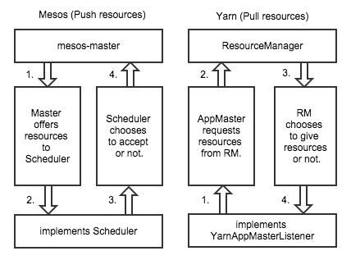
The clusters
YARN / MESOS
Monolithic/Two way
Requests/Offers
Fault tolerance
Request manager/meta-scheduler
Long running services/Batch jobs

Slide 25
How it does?
Two level scheduling mechanism
Resource offers made to frameworks
Master node – decides the resource for each framework
Framework decides what resources it accepts
Framework also decides what applications it will run.

Slide 26
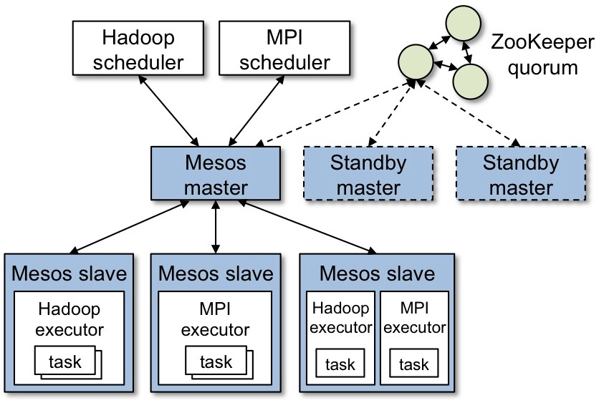
Architecture

Slide 27

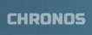





Frameworks
Users

Slide 28

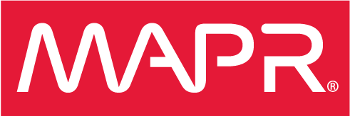
Commercial Usage
Next thing: Myriad

Slide 29
Bibilography
http://radar.oreilly.com/2015/02/a-tale-of-two-clusters-mesos-and-yarn.html
http://mesos.apache.org/
https://mesosphere.com/
https://www.mapr.com/

Slide 30
Univa
UGE is a grid computing system developed
Two types of UGE: an open source version and a production version
Batch Jobs and Interactive Jobs can be executed
user submits a job from a certain computer, UGE submits and executes the job to another computer with lesser load. The execution results are sent back to the user.

Slide 31
Benefits of Using UGE
Multiple programs can be executed at the same time
Automatically handles the scheduling of Jobs
Dynamic Sharing
Support Popular Framework
Maximize Efficiency
Used by Academic Institutions and Government Agencies

