Slide 1

Twitter Spam Detection & Sentimental Analysis
Presented By:
Praneeth Krishna
Sakshi Arora
Prateek Gangwal

Slide 2
Twitter Statistics
645,750,000 registered users
135,000 new users signing up everyday
500 million tweets are generated every day
9100 tweets per second

Slide 3
Business Case
To create a robust platform which can filter spam users in real-time and reveal top trending information with its sentiments

Slide 4
Data Set
Spark Streaming is used to collect tweets as the dataset. The tweets are written out in JSON format, one tweet per line
TwitterUtils in the Spark Streaming Twitter library to get a DStream of tweets

Slide 5
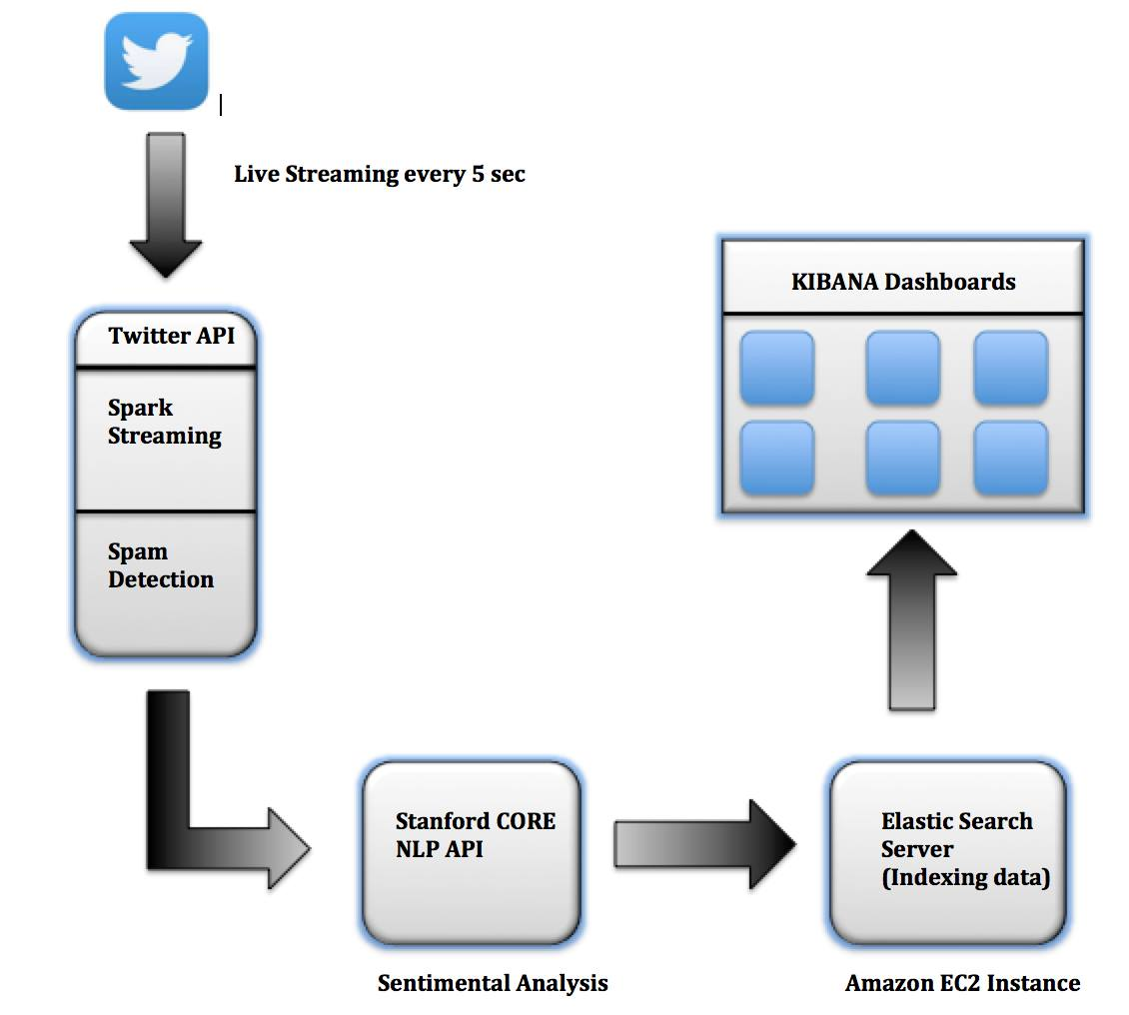




Workflow Architecture

Slide 6
Why this technology stack?
Why Spark Streaming?
Stateful
RDD based resilience with lineage
Master fault tolerance with checkpoint option
Uses micro batches
Code maintenance and resuability

Slide 7
Spark applications can interact with Elasticsearch just as they would with an HDFS resource, allowing them to index and analyze data transparently, in real-time
Elasticsearch acts as a database to store the tweet information
Kibana is used to explore massive amounts of data in Elasticsearch through easy-to-generate reports in real time

Slide 8
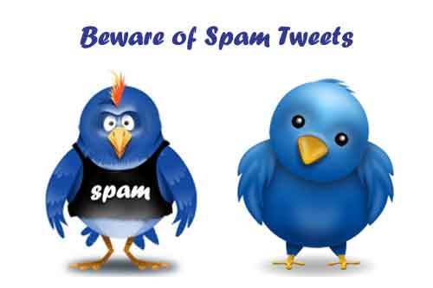
Spam Tweets

Slide 9
Data Preparation
Creating a JSON of user details using json.JSONDSL from streaming data.
Extracting user details such as UserDescription, UserFriendsCount
("UserDescription" -> status.getUser.getDescription)
("UserFriendsCount" -> status.getUser.getFriendsCount)

Slide 10
Spam - Why and What?
Spam is an important issue in social media services such as Twitter, e.g.:
Users inject tweets in trending topics.
Users reply with promotional messages providing a link.
We want to be able to identify these spam tweets in a Twitter stream.

Slide 11
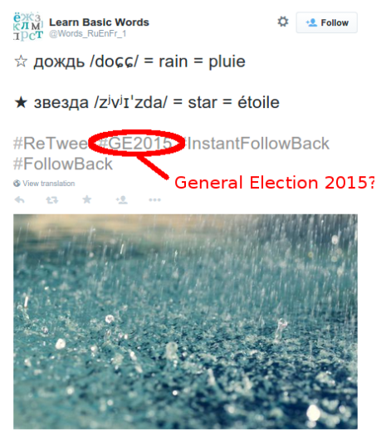
Example

Slide 12
Filtering Twitter SPAM
Recently Created Users
Users That Create Little Content
Users With Few Followers vs Friends ratio
Large Numbers Of HashTags
Short Content Length
Content Requesting Retweets & Follows

Slide 13
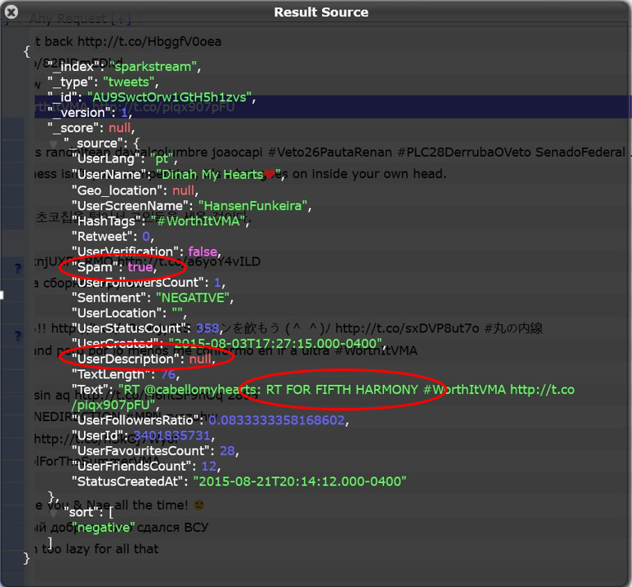

Slide 14
Sentiment Analysis

Slide 15
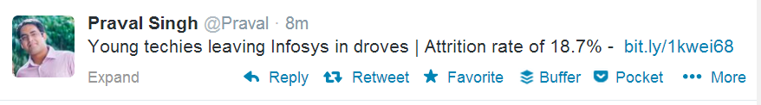
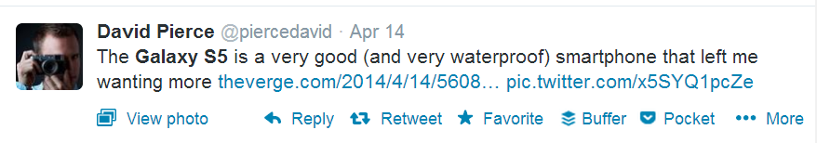
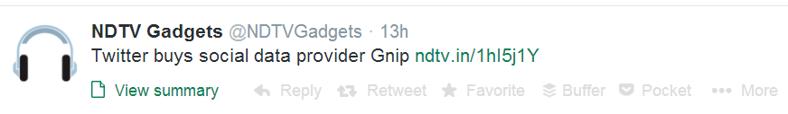
Negative
Positive
Neutral

Slide 16
Why is Sentiment Analysis Important?
Microblogging has become popular communication tool
Opinion of the mass is important
Political party may want to know whether people support their program or not
A company might want find out the reviews of its products

Slide 17
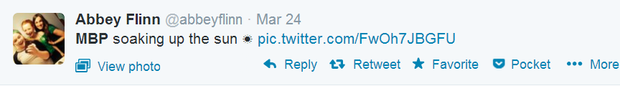
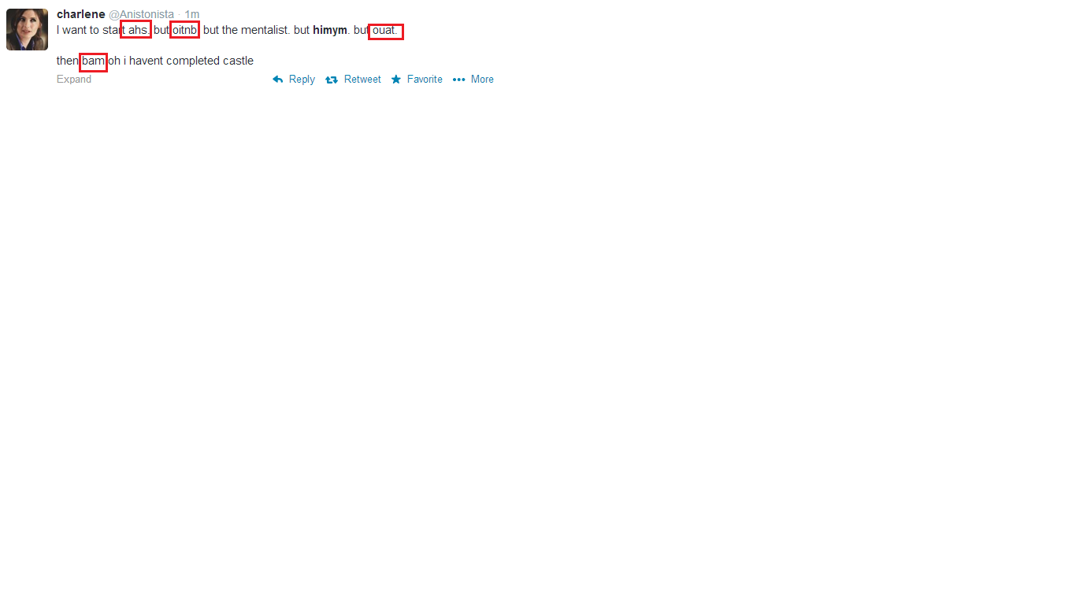
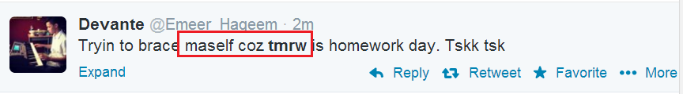
Challenges
Tweets are highly unstructured and also non-grammatical
Out of Vocabulary Words
Lexical Variation
Extensive usage of acronyms like asap, lol, afaik, emoji

Slide 18
What is NLP
The attempt to use programming to read and understand the meaning of text
The use of Natural Language processing, commonly denoted as NLP, with the intention of deriving "sentiment," or subjective information from text

Slide 19
Characterization of Tweets
Binary Classification: It is a two way categorization i.e. positive or negative.
3-Tier: In this, Tweets are categorized as Positive, Negative and Neutral.
5-Tier: Tweets are bucketed in 5 Classes namely: Extremely Positive, Positive, Neutral, Negative and Extremely Neutral.

Slide 20
Approach–Stanford coreNLP
Sentence Splitting (ssplit)
Part- Of - Speech Tagging (pos)
Morphological Analysis (lemma)
Syntactic Parsing (parse)
Tolenization
Annotation Object
Raw Text
Annotated Text
val props = new Properties()
props.setProperty("annotators", "tokenize, ssplit, pos, lemma, parse, sentiment”)

Slide 21

Detecting Sentiment
Collect the Tweet
For each sentence in the tweet, we calculate the following:
Tree
Sentiment
Text size

Slide 22
Predicting Results
val averageSentiment:Double = {
if(sentiments.size > 0) sentiments.sum / sentiments.size
else -1
}
averageSentiment match {
case s if s <= 0.0 => NOT_UNDERSTOOD
case s if s < 1.0 => VERY_NEGATIVE
case s if s < 1.5 => NEGATIVE
case s if s < 2.5 => NEUTRAL
case s if s < 3.3 => POSITIVE
case s if s < 5.0 => VERY_POSITIVE
case s if s > 5.0 => NOT_UNDERSTOOD

Slide 23
References
Evaluation of the Effect of Spam on Twitter
http://homepages.gac.edu/~lyu/Grant_paper.pdf
Detecting malicious tweets in trending topics http://nlp.uned.es/~lurdes/araujo/eswa13_malicious_tweets.pdf
http://mashable.com/2013/11/08/twitter-spambots/
http://dev.datasift.com/docs/csdl/csdl-examples/filtering-twitter-spam
http://nlp.stanford.edu/pubs/StanfordCoreNlp2014.pdf

