Slide 1
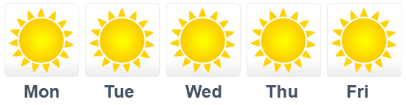
Weather Data Analytics
Final Project: INFO 7374 Big Data & Intelligent Analytics
Group 10: Shweta Anchan & Srinath Sridhar

Slide 2
Introduction
Obtained from http://data.gov.uk/ which is government website for searchable data.
It is provided by the MET Office.
The interface gives access to three datasets.
We picked the observational hourly weather forecast data.
Location: UK; approximately 150 UK observing stations.
Data uploaded on website on an hourly basis.

Slide 3
Dataset
The dataset is a CSV file.
Contains site specific information:
Site Code, Site Name, Longitude & Latitude of Site, Region that site belongs to.
Contains weather factors like:
Wind Direction, Wind Speed, Wind Gust, Visibility, Screen Temperature, Pressure, Pressure Tendency.
Final column “Significant Weather” provides the weather type
Sunny, Heavy Rain, Clear Sky etc.

Slide 4
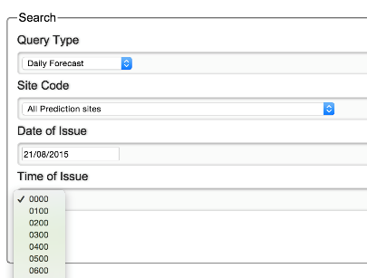
Data Preparation
Main issue: Data had to be downloaded individually for each date and each hour of a day.

Slide 5
Data Preparation II
Solution: An automation script in python
It performs the downloads for each hour on each day and integrates it into a single CSV file.
Package: mechanize; inbuilt functions that finds forms on any HTML page
The form for this data can be found at:
http://datagovuk.cloudapp.net/query

Slide 6
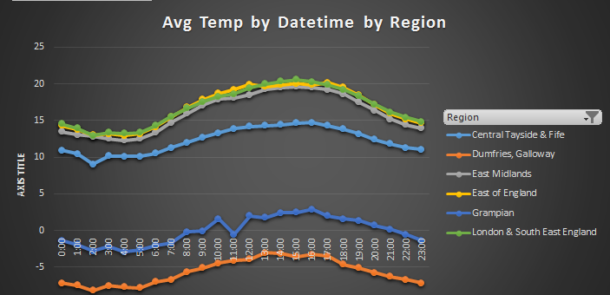
Summary I: Average Temperature

Slide 7
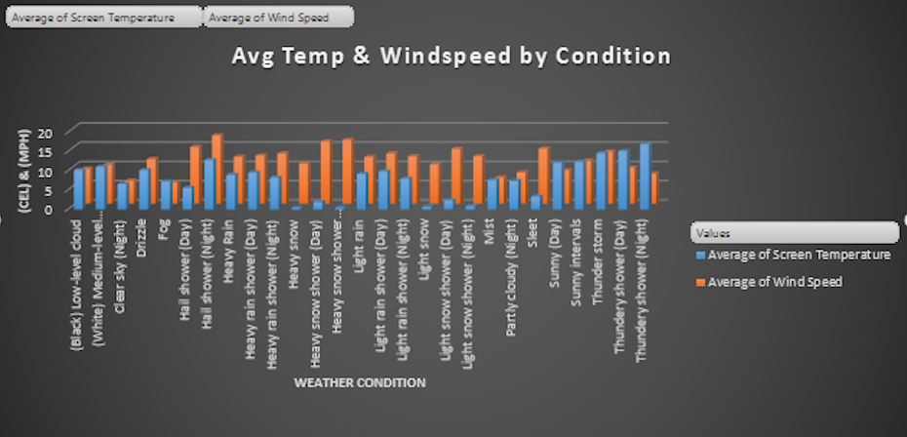
Summary II: Wind Speed & Avg Temp

Slide 8
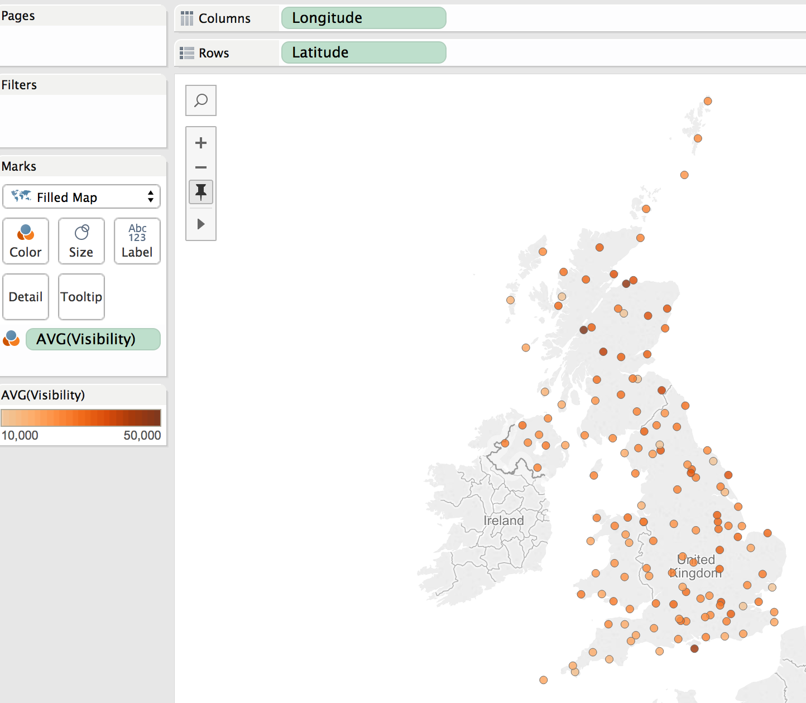
Summary III: Visibility over region

Slide 9
Data Preprocessing
Biggest challenge: Data cleansing into suitable format
Different areas of preprocessing:
Handling bad data
Converting categorical into numerical values
Handling bad data:
“Significant Weather” column has N/A values and also other columns have missing values
We filter out rows that match these criteria.

Slide 10
Data Preprocessing II
Categorical to Numerical:
“Wind Direction” column represented as a 16 pt. compass covering directions
“Significant Weather” contains 27 different categories which is split into binary values based on the occurrence of each category.
“Observation Time” is a string; key value pairs created to assign numerical values
“Observation Date” and split it into 2 columns; Date and Month

Slide 11
Machine Learning
Multi-class classification – One vs Rest
Creating a list with the available unique categories and iterating over the contents one by one
Creating a list of weight matrix for each model and doing a matrix multiplication with the test data
Each model gives out a [1*9] weight matrix. Take one row from the test data. The features of the test data will be a [1*9] matrix.
Transpose the matrix to [9*1] and multiply that with the [1*9] weight matrix inside a for loop. This gives one value
Reducing the number of output categories to four and doing the same thing again

Slide 12
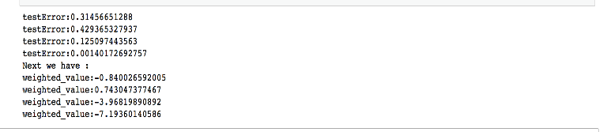
Results
Model Name | Avg Test Error [27 categories] | Avg Test Error [4 cateogires]
LogisticRegressionwithLBFGS | 0.032 | 0.217
SVMwithSGD | 0.036 | 0.317
Actual: Cloudy weather & Predicted : Cloudy weather

Slide 13
Q & A
Thank you!

