Slide 1
I.P.A.D.S
Innovative Precision Agriculture Decision-support System
Group 2: Yue Li, Mingxuan Li, Xingdi Li

Slide 2
Agenda
Problem Definition
Design
Implementation
Demo

Slide 3
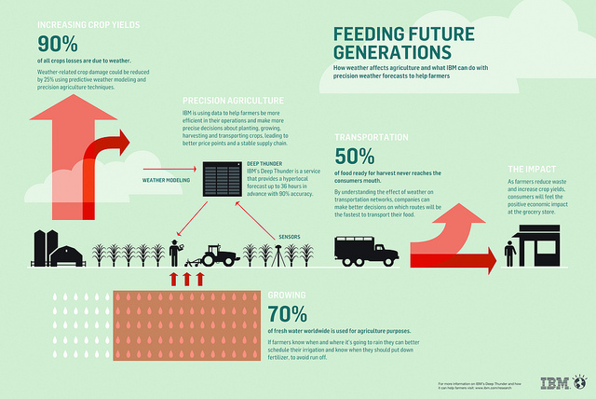
Why Agriculture?
Sustainable pressure
Population increase
Climate change
Economic change
Precision-Ag motivation
Cost of human labor growth
Quick response to climate
Tech is the king in modern Agriculture
Source: IBM

Slide 4
Challenge of getting information
Volume
Historical data
Missing and inaccurate is common
Speed
Up to date
Responsive
Integration
Visual
Interactive
Presentation
Various source
Different aspect for same data

Slide 5
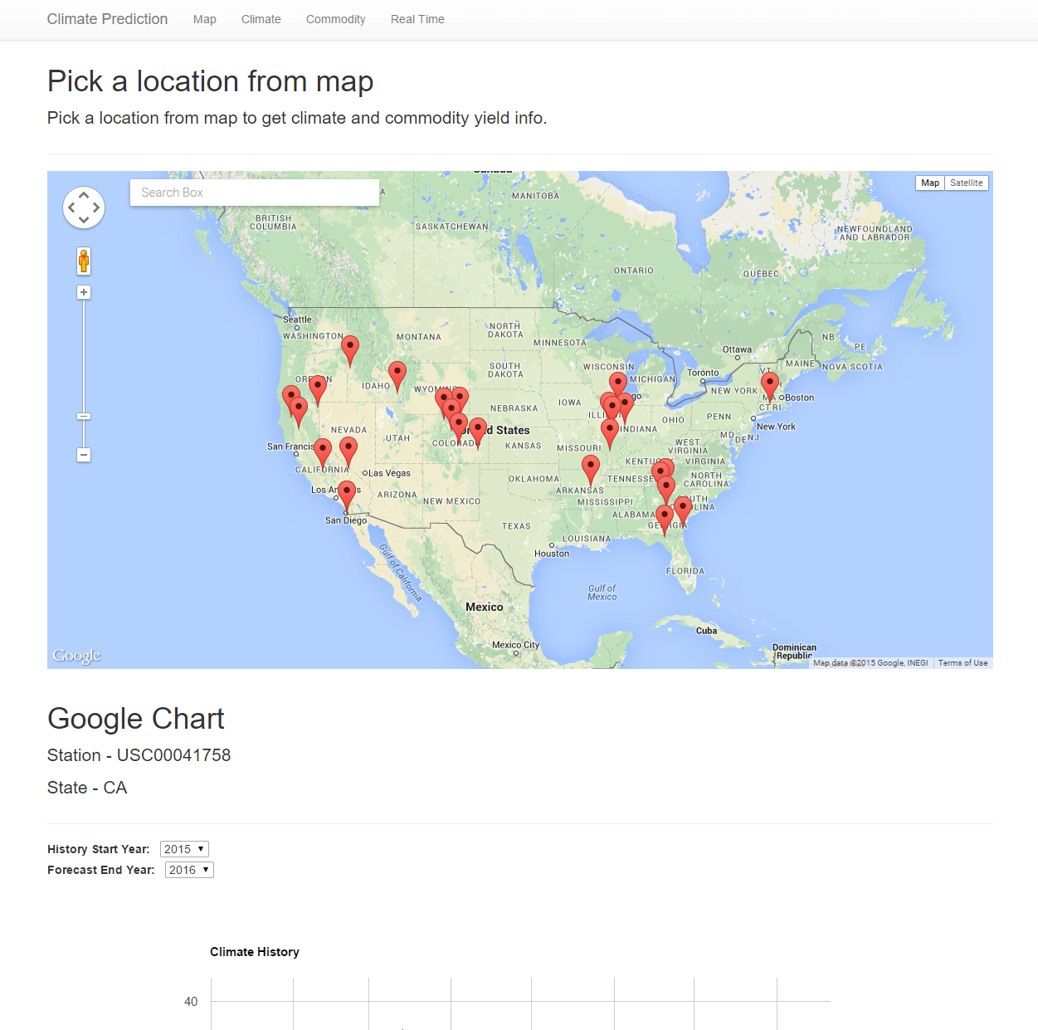
Our solution
Real-time, comprehensive data integration
Advanced analytic algorithm
Unified access portal
Interactive and customizable Data Visualization

Slide 6
Design

Slide 7
Goal – U2U
Useful
Usable
Comprehensive Information
Intuitive Interface
Obscure complexity
Complex Analysis

Slide 8
Use Case
Climate in my location?
Query climate data by location
Agriculture Yield in my state?
Query crop yield by state of station
Show historical and prediction data
Other location with similar climate?
Show crop yield and market index
List location with similar climate
Query Anything with these location

Slide 9
Data Flow
Ingestion
NASS Quickstat
Analysis
Visual Chart
Presentation
ERS ARMSNASS
NWS Climate Service
WeatherMap
Climate Prediction
Climate Locality
Yield Aggregation
Interactive Map

Slide 10
Ingestion (1/2)
Historical Data
Query API
Batch Reduce
Bulk store
Real-time Data
Crawler
Streaming process
Incremental update
“Big Data”
Get and persist
“Small data”
JIT query

Slide 11
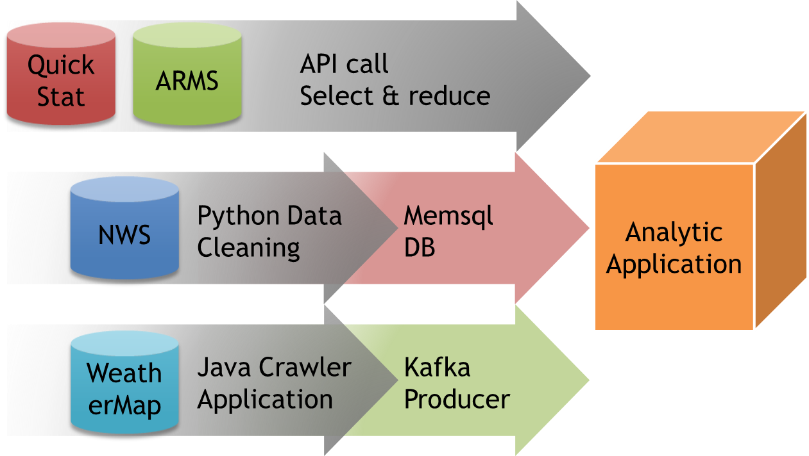
Ingestion (2/2)

Slide 12
Analysis (1/2)
Aggregation
Map reduce
Locality
K-means
DBSCAN
Prediction
ARIMA
Distributed Algorithm: reason

Slide 13
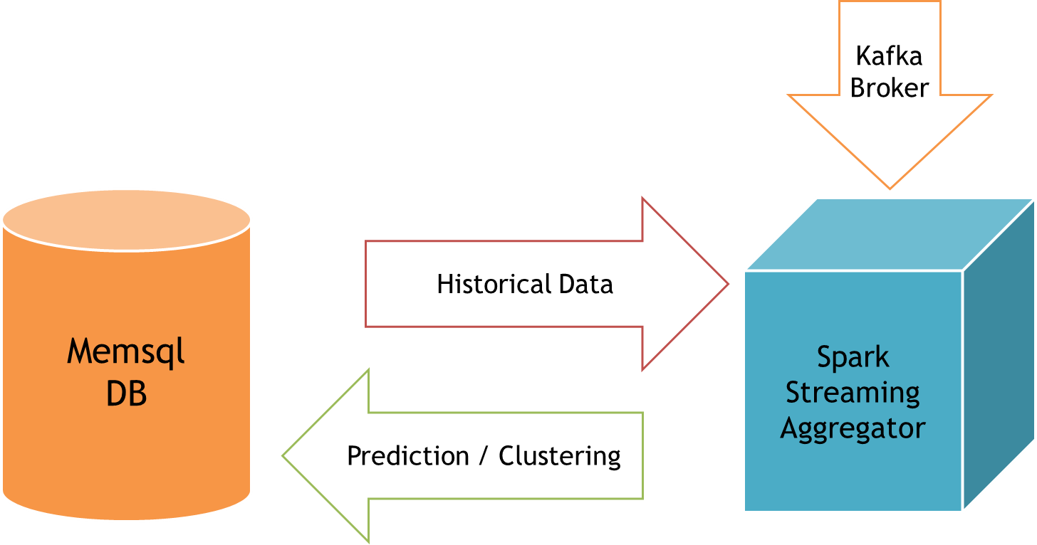
Analysis (2/2)

Slide 14
Presentation (1/2)
Visual
User: everyone, not only data scientist
Intuitive
Interactive
Data up to date
Present content on demand

Slide 15
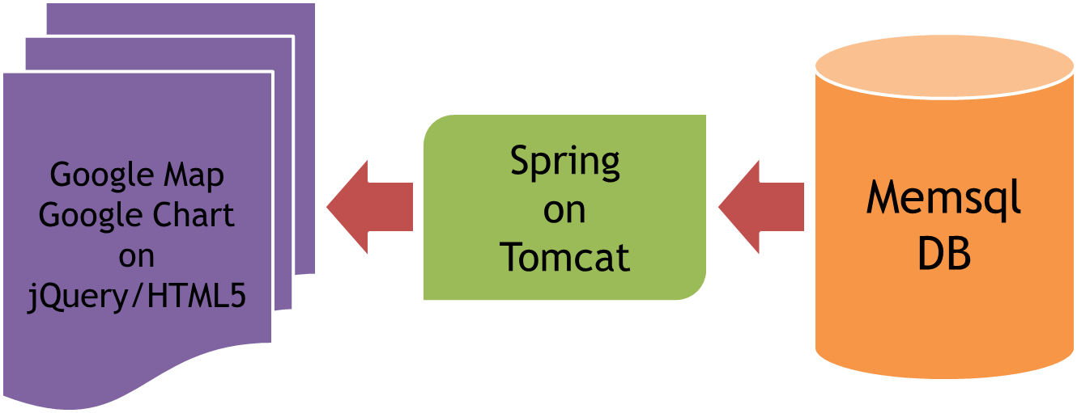
Presentation (2/2)

Slide 16
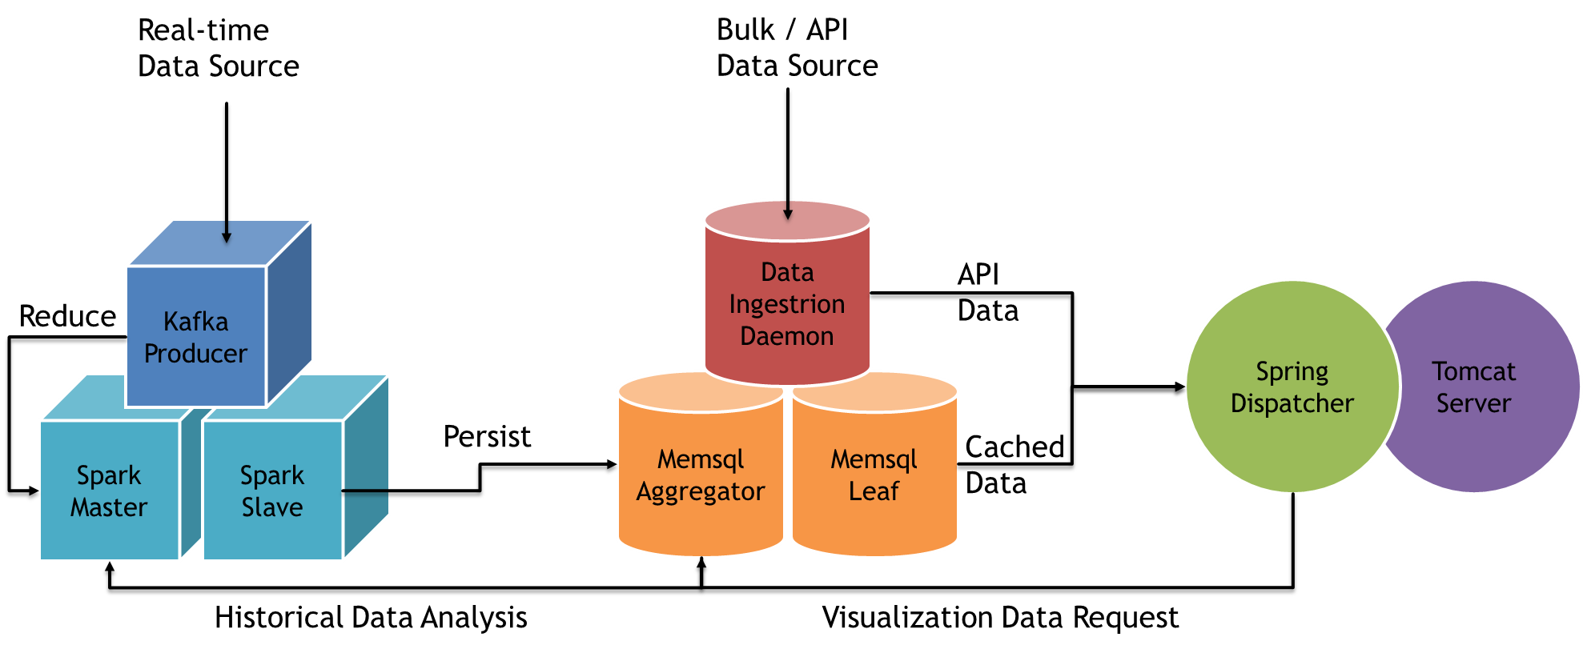
Full stack

Slide 17
Quick
Stat
ARMS
API call
Select & reduce
Analytic
Application
NWS
Python Data Cleaning
Memsql DB
WeatherMap
Java Crawler
Application
Kafka
Producer

Slide 18
Real-time
Data Source
Bulk / API
Data Source
Data
Ingestion
Daemon
Kafka
Producer
API
Data
Reduce
Spring
Dispatcher
Tomcat
Server
Spark
Master
Spark
Slave
Memsql
Aggregator
Memsql
Leaf
Persist
Cached
Data
Historical Data Analysis
Visualization Data Request

Slide 19
Kafka
Broker
Memsql
DB
Historical Data
Spark
Streaming
Aggregator
Prediction / Clustering

Slide 20
Google Map
Google Chart
on
jQuery/HTML5
Memsql
DB
Spring
on
Tomcat

Slide 21
Implementation

Slide 22
Data Cleaning
Batch API call / FTP Download
Substitute missing value
Persist into Memsql
Same date -> same month -> average value
Maintain Index & shard key
Evict invalid record
Too many missing value beyond fixing

Slide 23
Real-time Weather Data
Crawler
Kafka Producer
Spark Dstream
Memsql
5s / call
~2h update per station
Single node
No replication
Direct Kafka connection
Map / Reduce
Spark connector
Persist RDD directly

Slide 24
Analysis Algorithm
ARIMA
Distributed version by Cloudera
Final model: ARIMA(2,0,0) * (0,1,1) [365]
DBSCAN
Open sourced package, but with serious performance issue
Clustering result align with Kmeans
Kmeans
Spark MLLIB Implementation, fast and robust
Ensure every location to be categorized
Unfortunately it’s non-seasonal, we implemented seasonal version
Some location marked as “noise”, does not fit domain knowledge
We choose to use Kmeans

Slide 25
Data Storage
Lvl1: Cached
Fully cached in memory
Lvl2: Persisted
Lvl3: Outsourced
JSON received from API call
API level aggregation
Too large for storage
Memsql snapshot
Transaction log
Provide same durability as SQLDB
Better scalability than SQLDB
Design for high throughput
High data locality

Slide 26
Data Presentation
Back-end: Spring framework
Full MVC structure, with MySQL JDBC driver (compatibly with Memsql)
Run on Tomcat, WAR deployment
Front-end: jQuery, Google Map API, Google Chart
Single page application, fully utilized AJAX, asynchronized update from multiple data source
Dynamic and device-independent UI build on Bootstrap CSS

Slide 27
DEMO

Slide 28
Thank you!

