Slide 1

Team 4
Twitter Sentiment Analysis
Wenjin Cao
Jianxing Lu
Qiaomin Ling

Slide 2
Project Description
Topic: Social media Analytics
Project: Twitter sentiment analysis
Our web app is designed to get attitudes towards an key word by using it to search tweets and making sentiment analysis using these tweets.
Business case: Business popularity analysis; market prediction; targeted promotion…
Notes:
We used a key word to get tweets and find out how people are reacting to it.

Slide 3
Dataset
For training experiment in Azure ML Studio, we used a labeled dataset “Sentiment140” which comprises approximately 1,600,000 automatically annotated tweets. We preprocessed the data in Azure.
For our web application, we got the real-time twitter data in java code(twitter4j.jar) and used it as the web service input.
Notes:
We had 2 dataset sources, one is sentiment140 dataset, it has labled tweets, so we can use it for supervised learning in Azure. Another is directly from twitter api, we get raw tweets in java code for our web application as the Azure web service input.

Slide 4
Train Model
We compared two models in Azure: 1. Two-class Support Vector Machines (SVM √ better) 2. Two-Class Logistic Regression
We used SVM to create an experiment and deployed the web service for our web application.

Slide 5
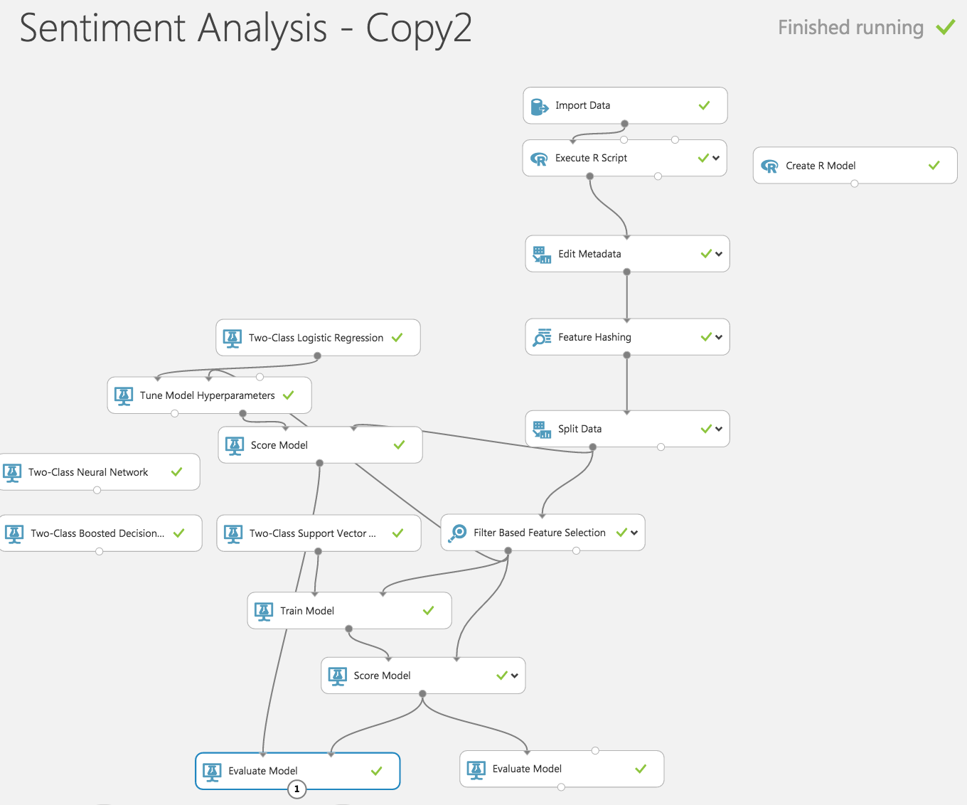

Slide 6
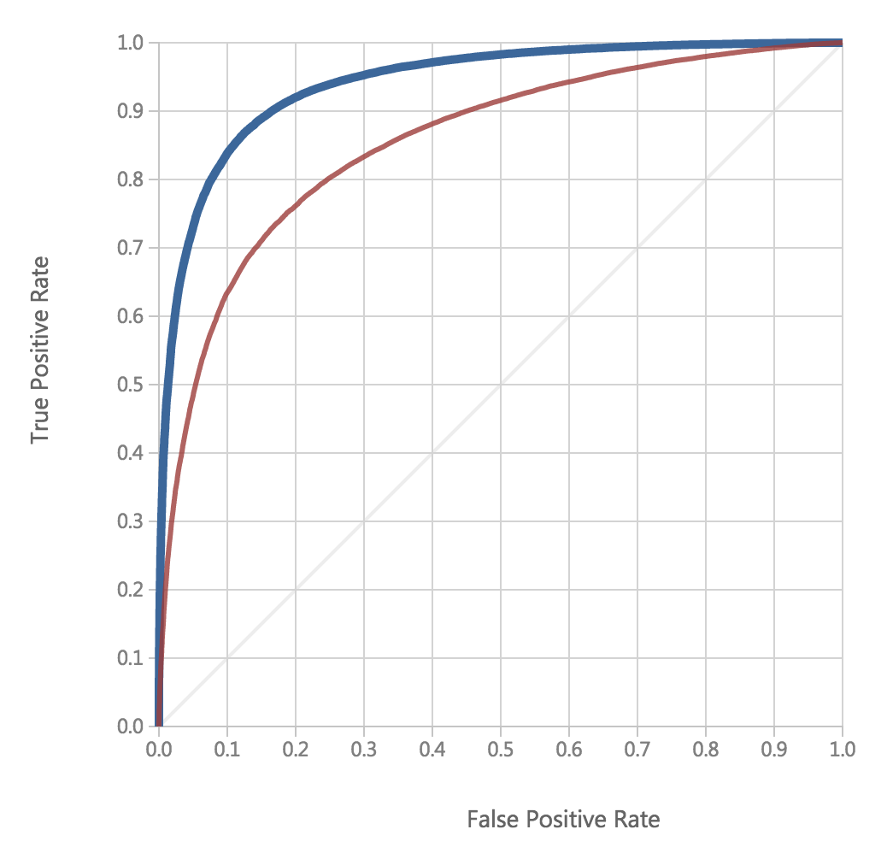

Slide 7
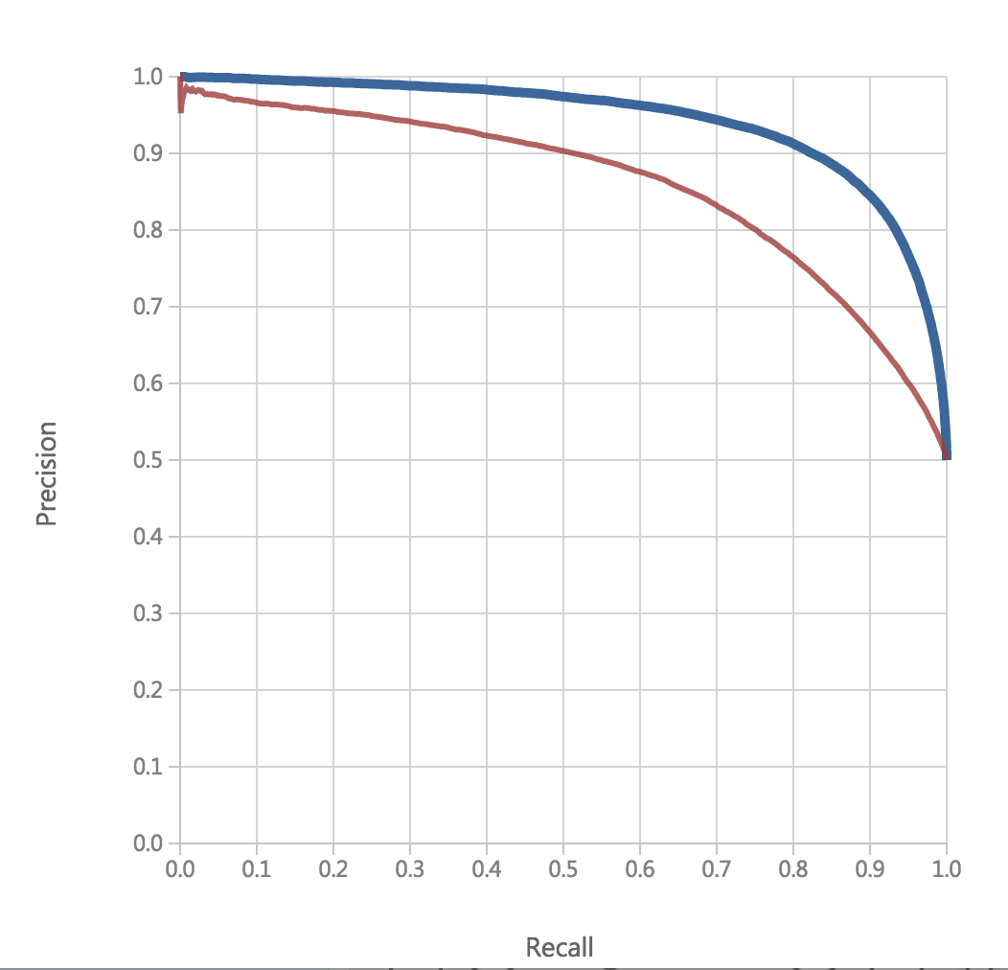

Slide 8
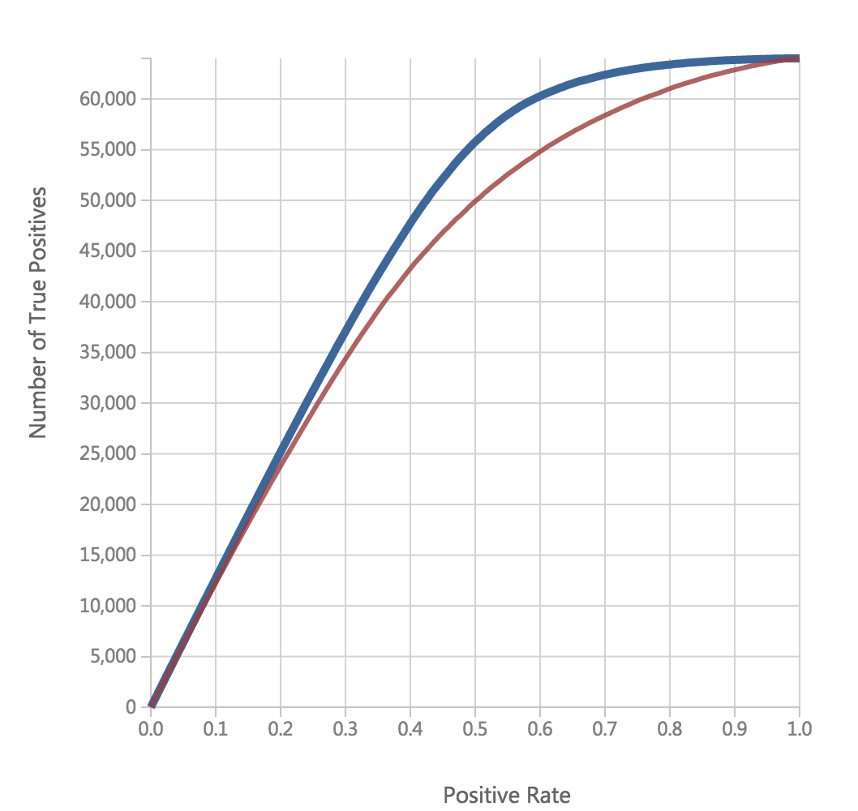

Slide 9
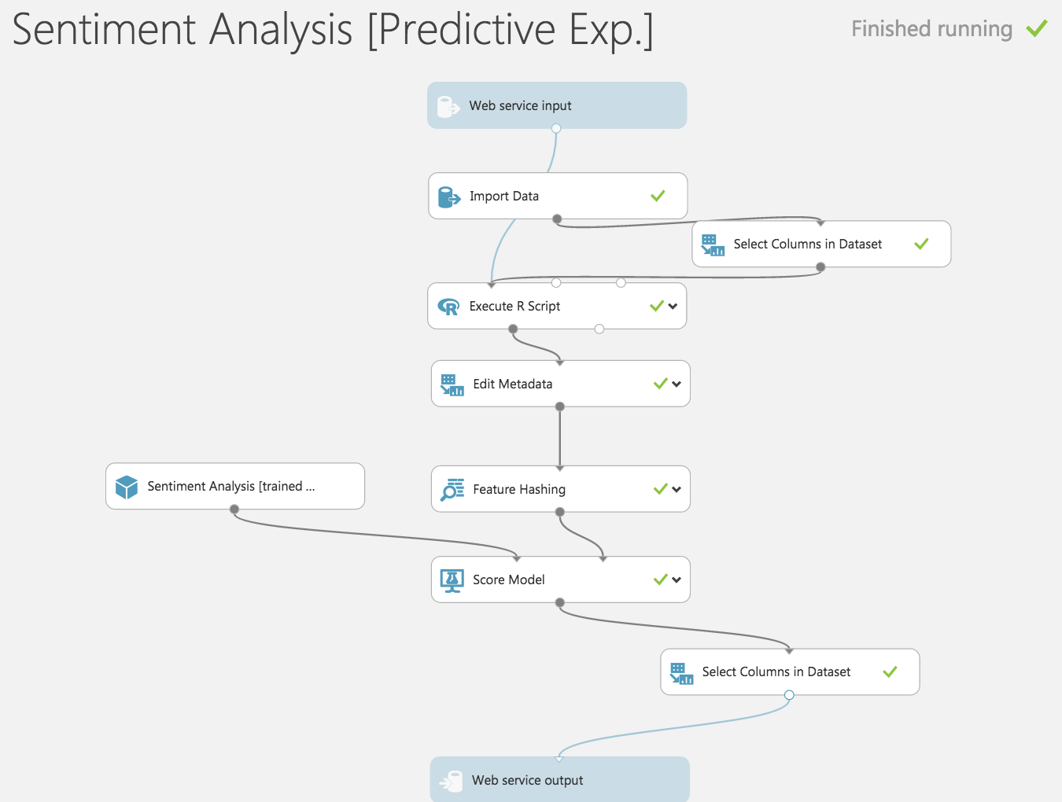

Slide 10
Web application
Maven project using STS.
http://adsa3final.kmftggpm5e.us-east-1.elasticbeanstalk.com/
We offer two ways for users to search by keyword:
Search for a time period. We will summary a total attitude, and a line chart which illustrates the trend of the sentiment by day.
Search for a specific day. We will summary a total attitude, a pie chart which shows the percentage of each attitude( positive, negative, neutral) (counting tweets), and a bar chart which counts tweets with different sentiment scores(between 0-1)(we set the interval to be 0.1)

