Slide 1

Team 4
Twitter Sentiment Analysis
Wenjin Cao
Jianxing Lu
Qiaomin Ling

Slide 2
Project Description
Topic: Social media Analytics
Project: Twitter sentiment analysis
Our web app is designed to get attitudes towards an key word by using it to search tweets and making sentiment analysis using these tweets.
Business case: Business popularity analysis; market prediction; targeted promotion…

Slide 3
Dataset
For training experiment in Azure ML Studio, we used a labeled dataset “Sentiment140” which comprises approximately 1,600,000 automatically annotated tweets. We preprocessed the data in Azure.
For our web application, we got the real-time twitter data in java code(twitter4j.jar) and used it as the web service input.

Slide 4
Train Model
We compared two models in Azure: 1. Two-class Support Vector Machines (SVM √ better) 2. Two-Class Logistic Regression
We used SVM to create an experiment and deployed the web service for our web application.

Slide 5
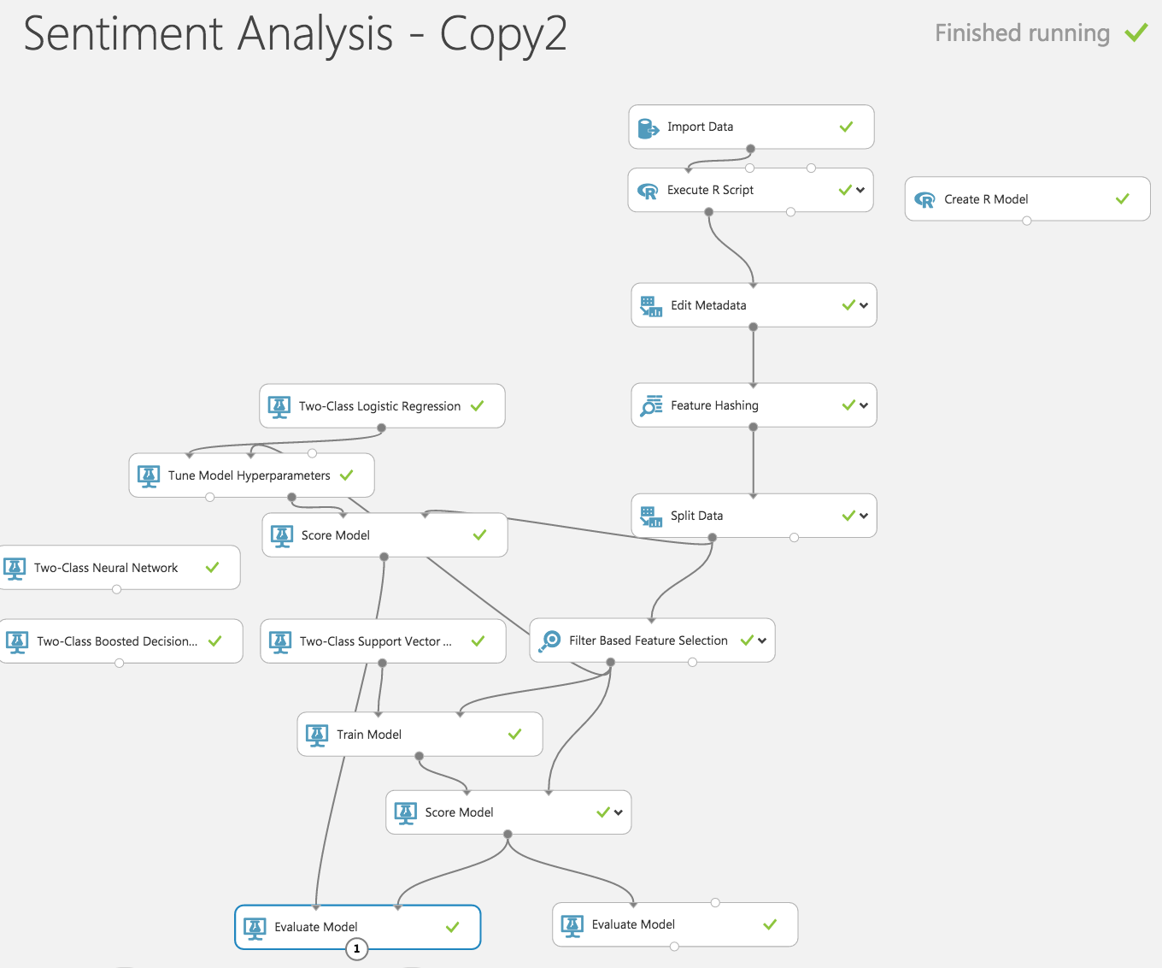

Slide 6
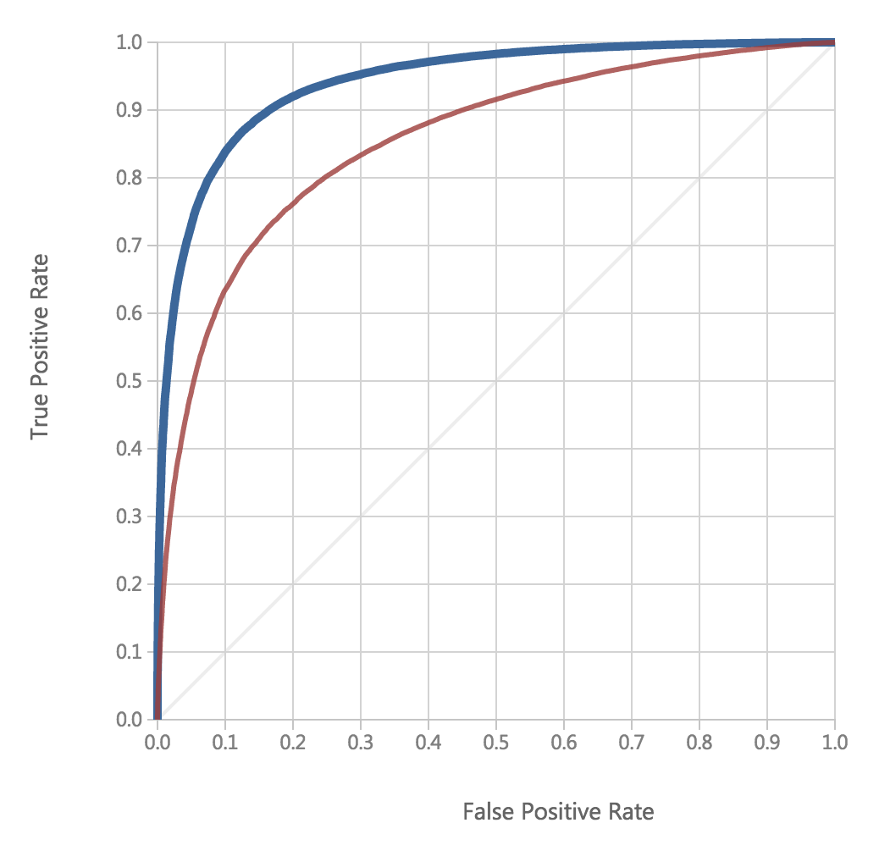

Slide 7
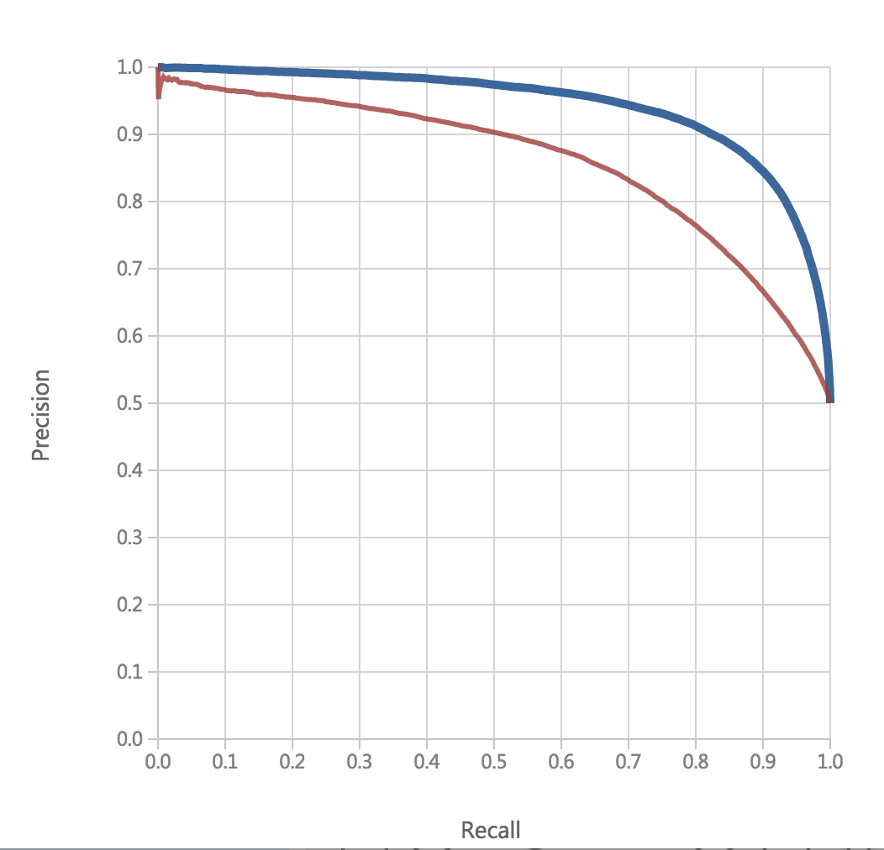

Slide 8
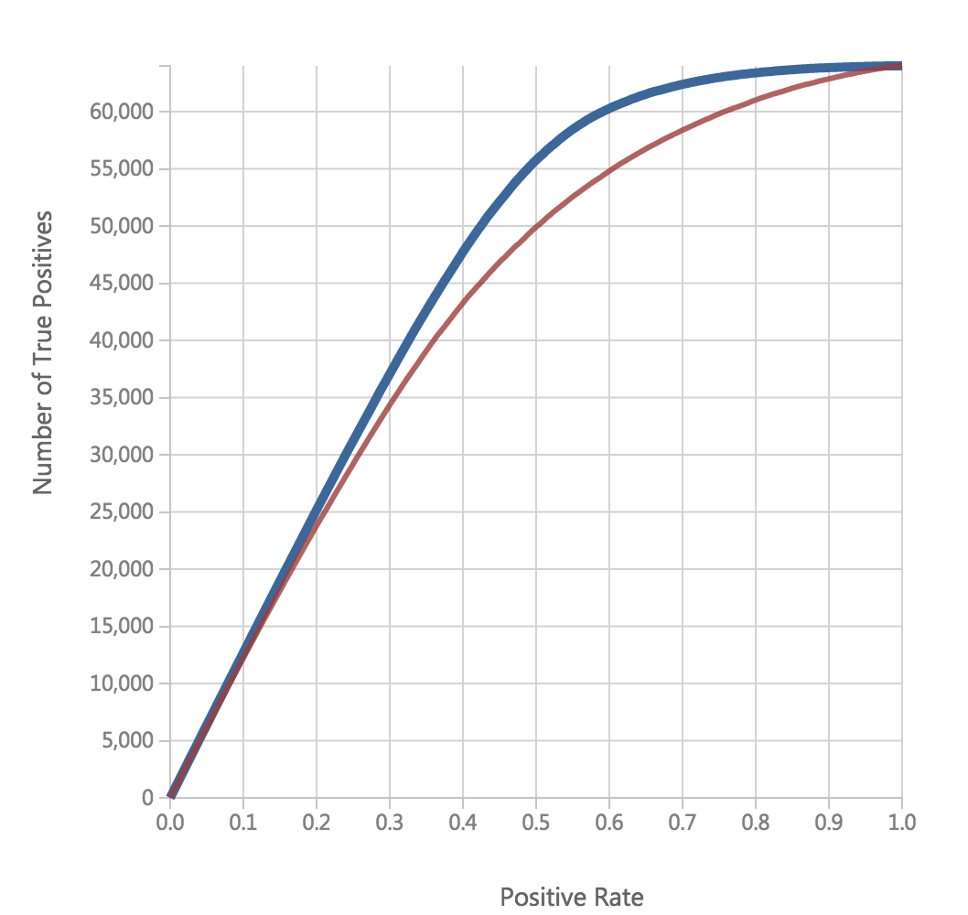

Slide 9
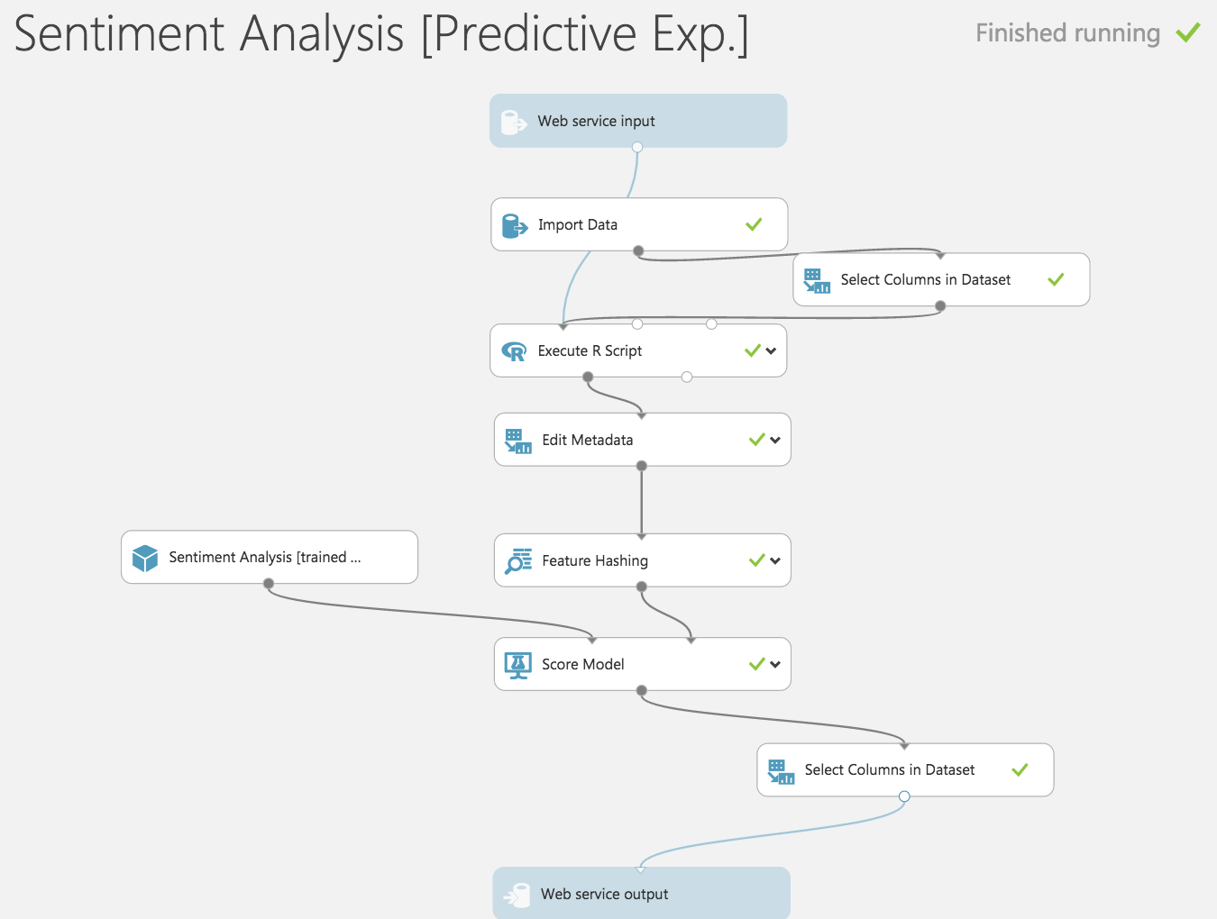

Slide 10
Web application
Maven project using STS. http://testtest.bytqddt2ej.us-east-1.elasticbeanstalk.com/
We offer two ways for users to search by keyword:
Search for a time period. We will summary a total attitude, and a line chart which illustrates the trend of the sentiment by day.
Search for a specific day. We will summary a total attitude, a pie chart which shows the percentage of each attitude( positive, negative, neutral) (counting tweets), and a bar chart which counts tweets with different sentiment scores(between 0-1)(we set the interval to be 0.1)

