Slide 1
NEXUSSUPPORT
Multi-Tenant AI Customer
Support Platform
Serverless AWS deployment · App Runner + DynamoDB + CloudFront
https://d2q0x1hrkokxho.cloudfront.net

Slide 2
OVERVIEW
What NexusSupport Is
› Multi-tenant customer support platform demo: chat, voice, and AI-agent workflows
› 3 sample tenants — ShopNow (E-Commerce), CloudStack (SaaS), MedCare (Healthcare)
› Role-based access: admin, agent, and super-admin across tenants
› Dashboards for conversation volume, CSAT, sentiment, and channel breakdown
› Built to run entirely on pay-per-use AWS services — no idle infrastructure cost
STACK AT A GLANCE
Frontend
React 18 + Vite
Backend
Node.js / Express
Database
DynamoDB
Compute
AWS App Runner
Delivery
CloudFront + S3
CI/CD
AWS CodeBuild
NexusSupport — AWS Serverless Deployment
2

Slide 3
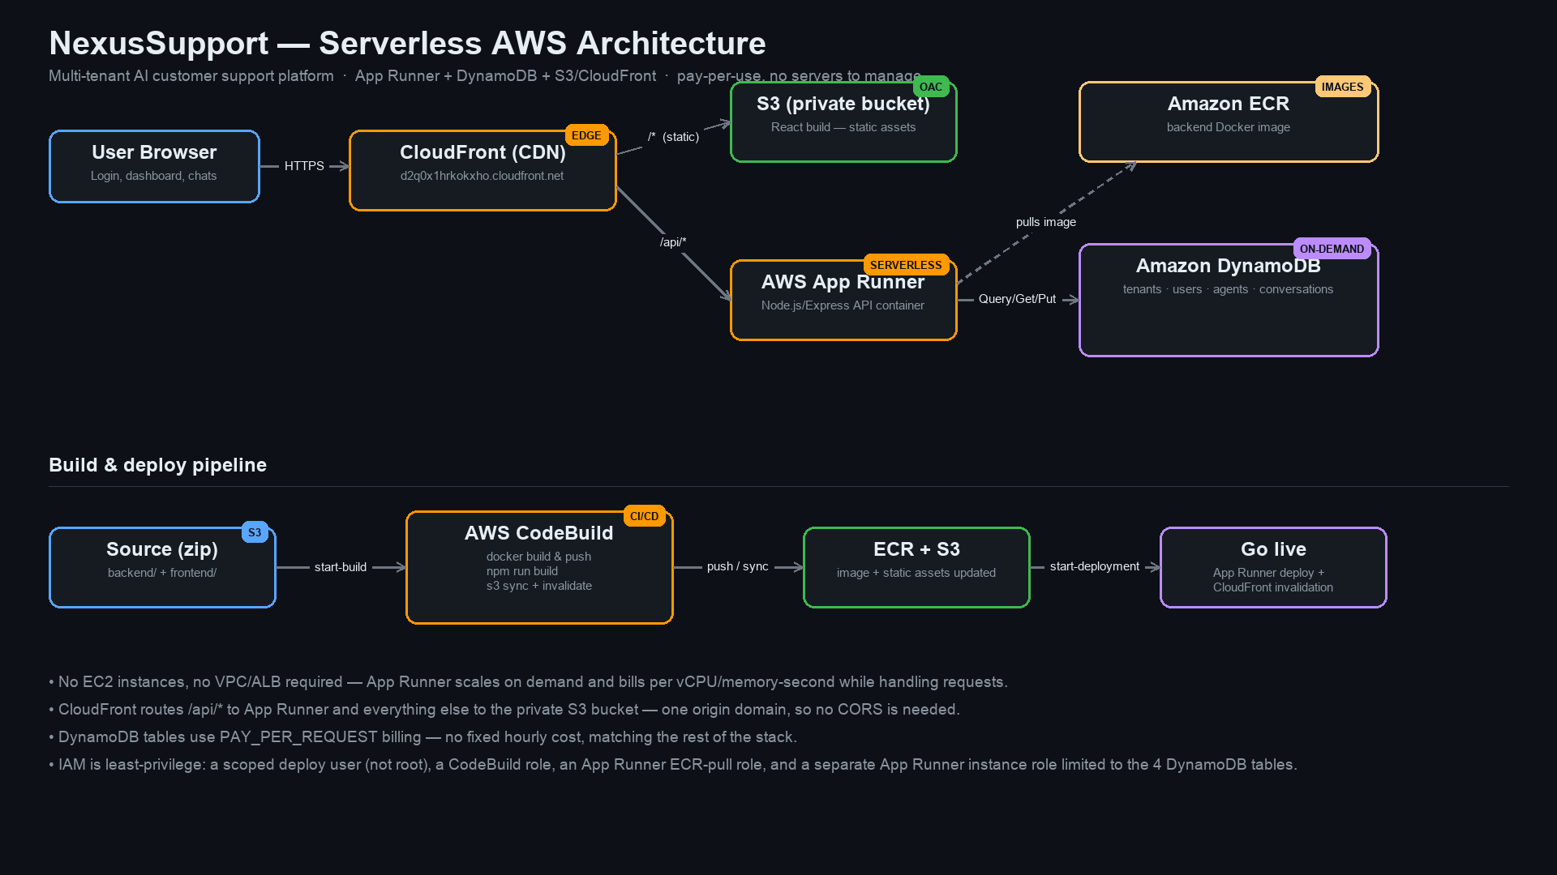
ARCHITECTURE
Serverless Architecture on AWS
NexusSupport — AWS Serverless Deployment
3

Slide 4
ARCHITECTURE
How a Request Flows
1
Browser → CloudFront
Single public entry point at d2q0x1hrkokxho.cloudfront.net
2
Static routes → private S3
React build served via Origin Access Control — bucket has no public access
3
/api/* routes → App Runner
Serverless container runs the Express API, no VPC/ALB needed
4
App Runner → DynamoDB
Reads/writes tenants, users, agents, conversations
Same CloudFront domain serves both → no CORS configuration needed.
NexusSupport — AWS Serverless Deployment
4

Slide 5
DESIGN DECISION
Why App Runner Instead of ECS + ALB
ECS FARGATE + ALB (rejected)
APP RUNNER (chosen)
› Requires a VPC, subnets, security groups
› Application Load Balancer has a fixed hourly cost (~$16-20/mo) even at zero traffic
› More moving parts to secure and maintain
› No VPC, no load balancer to provision or pay for
› Bills per vCPU/memory-second only while handling requests
› Eligibility verified directly against this AWS account before committing
NexusSupport — AWS Serverless Deployment
5

Slide 6
DATA LAYER
DynamoDB Schema
All tables use PAY_PER_REQUEST billing — no capacity planning, no fixed cost.
Table
Partition Key
GSI
Purpose
nexussupport-tenants
id
—
Tenant profile + per-tenant settings
nexussupport-users
id
email-index (email)
Login lookup by email
nexussupport-agents
id
tenantId-index (tenantId)
AI agent roster per tenant
nexussupport-conversations
id
tenantId-index (tenantId, updatedAt)
Support conversations per tenant
Messages are generated deterministically per conversation at read time — no message-create endpoint exists yet.
NexusSupport — AWS Serverless Deployment
6

Slide 7
DEPLOYMENT
Build & Deploy Pipeline
Source
CodeBuild
ECR + S3
Go Live
backend/ + frontend/ zipped
and uploaded to S3
Docker build & push to ECR
npm run build + s3 sync
CloudFront invalidation
New image and static
assets are now live
apprunner start-deployment
rolls out the new image
→
→
→
Auto-deploy-on-push is intentionally disabled — every rollout is an explicit, reviewable step.
NexusSupport — AWS Serverless Deployment
7

Slide 8
SECURITY
Security & IAM
› Dedicated nexussupport-deployer IAM user for all deployments — the AWS root account is never used day-to-day
› CodeBuild role scoped only to this project's ECR repo, its two S3 buckets, and CloudFront invalidation
› App Runner ECR-access role — pull-only access, separate from application permissions
› App Runner instance role — scoped to just the 4 DynamoDB tables this app owns (Get/Put/Update/Delete/Query/Scan)
› Frontend S3 bucket is fully private — CloudFront reaches it only via Origin Access Control (OAC)
› Secrets (JWT secret, Anthropic API key) passed as CloudFormation NoEcho parameters — never committed to git
NexusSupport — AWS Serverless Deployment
8

Slide 9
ECONOMICS
Pay-Per-Use Cost Model
App Runner
Per vCPU-second / GB-second while handling requests
DynamoDB
Per request (on-demand) + storage
S3 + CloudFront
Per GB stored / transferred + per request
ECR
Per GB of image storage
CodeBuild
Per build-minute — only runs on deploy
No idle fixed cost: no ALB, no NAT gateway, no provisioned database capacity.
NexusSupport — AWS Serverless Deployment
9

Slide 10
ROADMAP
Known Limitations & Next Steps
CURRENT LIMITATIONS
SUGGESTED NEXT STEPS
› AI is not wired up — Anthropic API key exists but is unused by the backend today
› Conversation messages are generated, not stored, per conversation
› Voice pipeline (Twilio/Deepgram/ElevenLabs) is UI/demo only
› Wire the backend to Claude for real AI-generated responses
› Add a message-create endpoint + persist messages in DynamoDB
› Add a custom domain + ACM certificate in front of CloudFront
NexusSupport — AWS Serverless Deployment
10

Slide 11
Live Now
https://d2q0x1hrkokxho.cloudfront.net
admin@shopnow.com / demo1234

