Slide 1
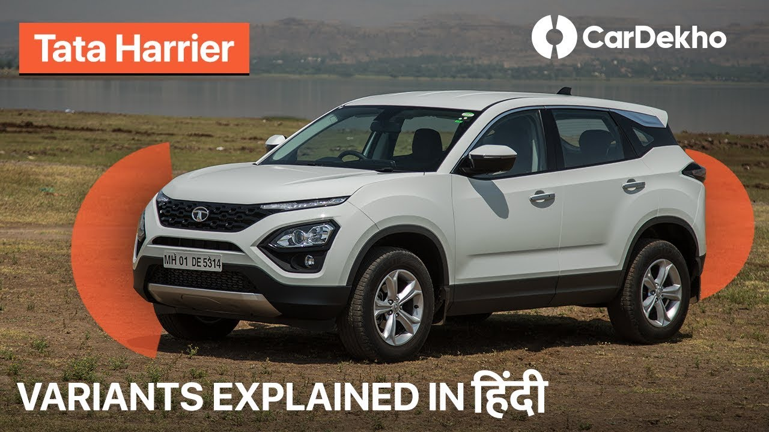
MY SQL Project: Second Hand Car Dealer

Slide 2

CarDekho.com is India's leading car search venture that helps users buy cars that are right for them. Its website and app carry rich automotive content such as expert reviews, detailed specs and prices, comparisons as well as videos and pictures of all car brands and models available in India. The company has tie-ups with many auto manufacturers, more than 4000 car dealers.

Slide 3
QUESTIONS BASED ON DATASET
Read car data
Total cars: To get a count of Total Car
.The manager asked the employee .How many car wii be available in 2023?
The manager asked the employee .How many car is available in 2022,2021,2022?
client asked me to print total of all cars by year. I don’t see all the details
Client asked to a Car dealer agent How many diesel Car will there be in 2020?
. Client asked to a Car dealer agent How many Petrol Car will there be in 2020?
The manager told the employee to give a print All fuel cars (petrol, Diesel, CNG) come by all year
Manager said there were more than 100 cars in a given year , Which year had more than 100 cars ?
.The manager said to the employee all car count details between 2015 and 2023; we need a complete list .
The manager said to the employee all car details between 2015 to 2023; we need a complete list .

Slide 4
THIS COMPLETE PROJECT IS ABOUT THE SALES OF THE COMPANY NAME AS BIGMART AND USING THE DATA, CAME UP WITH THE VALUEABLE INSIGHTS IN A DASHBOARD tHIS COMPLETE DATA SET HAS 7927 records 12 COLUMNS AND THE FIELDS OR TERMS WHICH THIS DATASET HAS ARE AS FOLLOWS: name, year, selling_price, km_driven, fuel, seller_type, transmission, Owner, mileage, engine, max_power,torque, ETC.

Slide 5
Read Car Dataset Total records -7927 column -12 Query: SELECT * FROM Car_dekho;

Slide 6
Total cars: To get a count of Total Car >Total no of car is 7927 Query : select count(*) from car_dekho

Slide 7
The manager asked the employee .How many car is available in 2023? Ans: - 6 query :SELECT COUNT(*) FROM Car_dekho WHERE year = 2023;

Slide 8
The manager asked the employee .How many car is available in 2022,2021,2022? Ans; in 2020: 74 car in 2021 : 7 cars in 2022 : 7 cars SELECT COUNT(*) FROM Car_dekho WHERE year = 2020; SELECT COUNT(*) FROM Car_dekho WHERE year = 2021; SELECT COUNT(*) FROM Car_dekho WHERE year = 2022;

Slide 9
client asked me to print total of all cars by year. I don’t see all the details SELECT year, count(*) FROM Car_dekho GROUP BY year;

Slide 10
Client asked to a Car dealer agent How many diesel Car will there be in 2020? Answer: 20 SELECT count(*) FROM Car_dekho WHERE year = 2020 AND fuel = "Diesel";

Slide 11
Client asked to a Car dealer agent How many Petrol Car will there be in 2020? Answer : 21 SELECT count(*) AS NO_of_Petrol_car FROM Car_dekho WHERE year = 2020 AND fuel = "petrol";

Slide 12
The manager told the employee to give a print All fuel cars (petrol, diesel,CNG) come by all year SELECT year, count(*) FROM Car_dekho WHERE fuel = "petrol" GROUP BY year; SELECT year, count(*) FROM Car_dekho WHERE fuel = "diesel" GROUP BY year; SELECT year, count(*) FROM Car_dekho WHERE fuel = "CNG" GROUP BY year;

Slide 13
Manager said there were more than 100 cars in a given year , Which year had more than 100 cars ? Answer :2019, 2017,2016, 2015,2014,2013,2012,2011,2010,2009,2008,2007,2007 SELECT year, count(*) FROM Car_dekho GROUP BY year HAVING count(*)>100;

Slide 14
The manager said to the employee all car count details between 2015 and 2023; we need a complete list . Answer : 4124 Cars SELECT count(*) FROM Car_dekho WHERE Year BETWEEN 2015 AND 2023;

Slide 15
The manager said to the employee all car details betweeb 2015 to 2023; we need a complete list . SELECT * FROM Car_dekho WHERE year BETWEEN 2015 AND 2023;

Slide 16
Thank You

