Slide 1
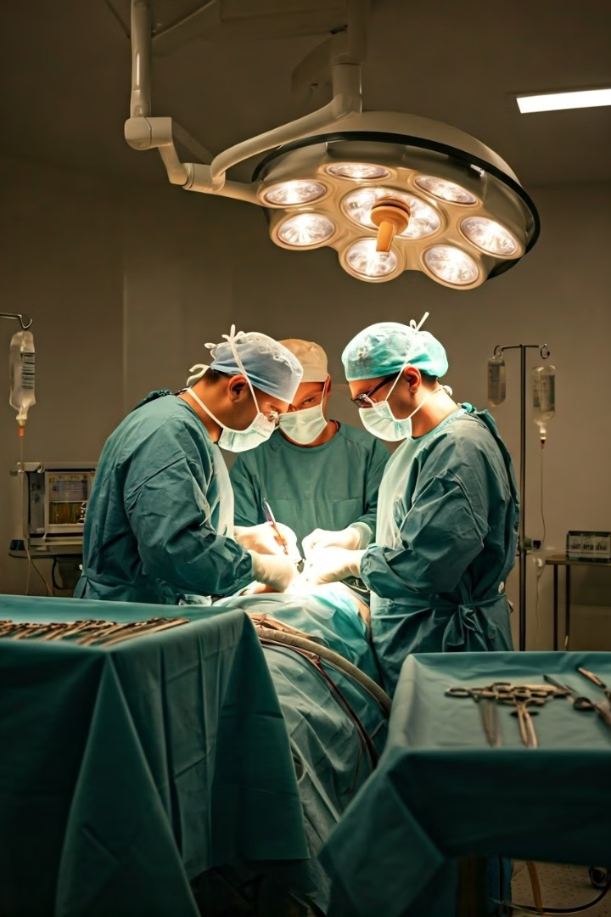
ICUTrack: Patient ICU Experience Timeline
“Empowering Patients Through Data Visualization and Connection”

Slide 2
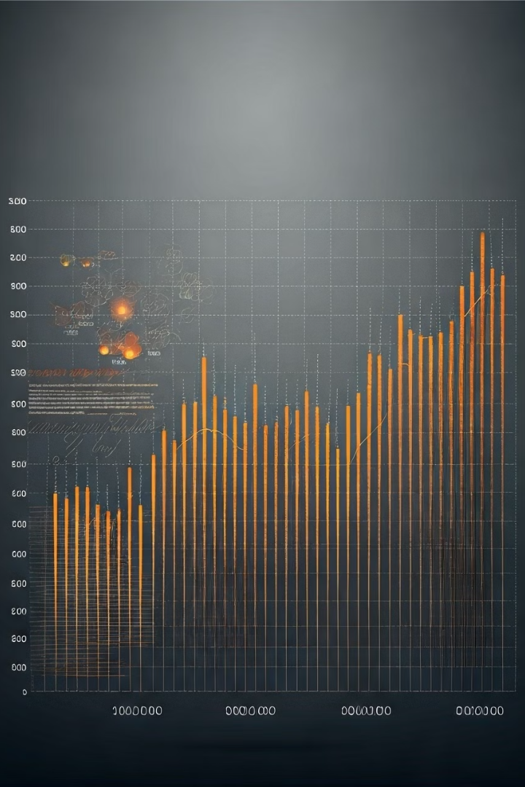
Problem Statement
ICU experiences can be complex and overwhelming.
Patients often struggle to understand the full scope of their treatments and surgeries.
There is limited ability for patients to find and connect with others who have had similar experiences.

Slide 3
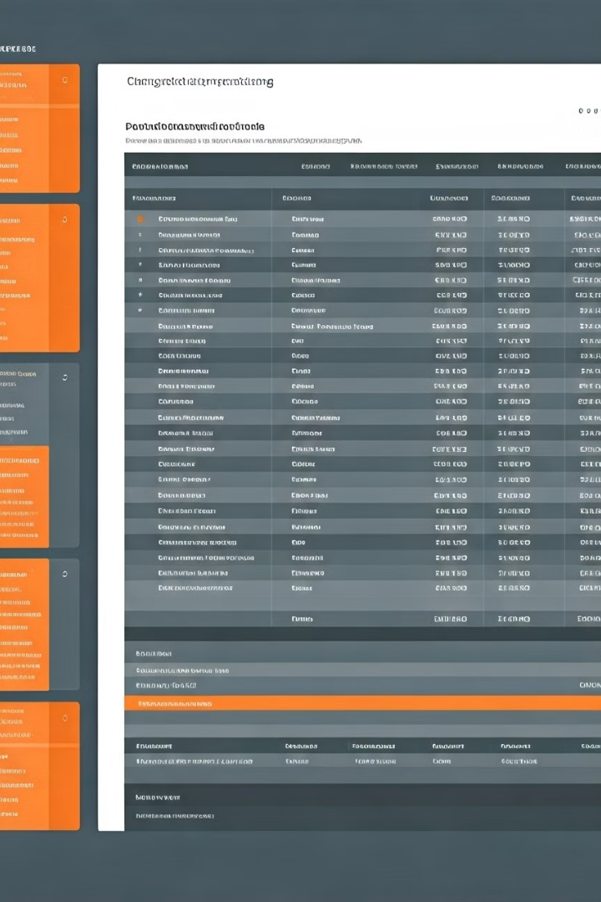
Our Solution: ICU Experience Timeline App
An app that generates a timeline of patient ICU experiences, including:
Medications (e.g., drugs, dosages, administration times)
Surgeries
Medical Procedures
Helps patients find similar experiences by comparing their timeline with others.
Enables patients to connect with those who have gone through the same procedures.

Slide 4
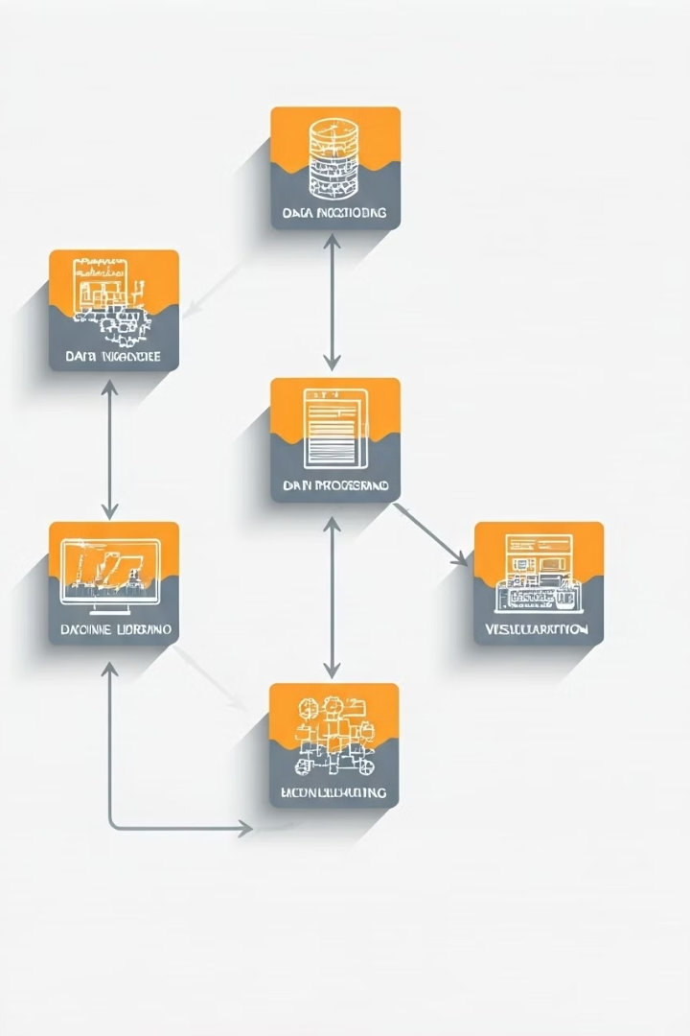




App Features
Timeline Generation:
Automatically creates a visual timeline of ICU treatments.
Similar Patient Matching:
Uses Jamba agent LLM to find patients with similar ICU experiences.
Patient Interaction:
Enables patients to communicate with others who have had similar treatments.
Data Privacy:
Ensures secure and private interaction between patients.

Slide 5
Impact and Results
Empathy & Emotional Support:
Connecting with others who have undergone similar ICU experiences can provide emotional reassurance and reduce feelings of isolation.
Shared Knowledge & Insights:
Patients can exchange practical advice, such as coping mechanisms, recovery tips, and personal experiences with treatments or medications.
Improved Recovery & Outcomes:
Patients who feel supported and connected are often more optimistic and engaged in their recovery, which can lead to better health outcomes and faster recovery times.

Slide 6
THANK YOU!

