Slide 1
Hoisting Nested Functions
Program Testing and Analysis – Winter 2017/18
Mentor
Marina Billes
Presented By
Chaitra Hegde (2917308)
Anam Dodhy (2618089)
27.02.18 |Technische Universitat Darmstadt | PTA | Prof Dr. Michael Pradel
Notes:
|
| <number>

Slide 2
What is Hoisting?
Hoisting is the JavaScript interpreter’s action of moving all variable and function declarations to the top of the current scope
Rules for Hoisting Nested Functions:
  Rule 1: the nested function must not depend on the local variables of it’s parent function.
  Rule 2: there should be no other function definition at the same level of the parent function that has the same name as the nested function.
27.02.18 |Technische Universitat Darmstadt | PTA | Prof Dr. Michael Pradel
Notes:
Rule 1- These variables include both local variables defined in outer function and parameters of outer function
Motivation behind Hoisting - Nested functions are created inside parent function's environment every time the parent function is called. This could decreases performance if parent function is called frequently.

Slide 3
Jalangi Callbacks used
functionEnter()
  Triggered before starting the execution of a function
functionExit()
  Triggered when the execution of a function is completed
read()
  Triggered after reading a variable
write()
  Triggered before writing a variable
declare()
  Triggered when the scope of a local variable starts
27.02.18 |Technische Universitat Darmstadt | PTA | Prof Dr. Michael Pradel
Notes:
functionEnter – This callback is called before the execution of a function body starts.
functionExit – This callback is called when the execution of a function body completes
Read() – This callback is called after a variable is read.
Write() – This callback is called before a variable is written.
Declare() - This callback is triggered at the beginning of a scope for every local variable declared in the scope, for every formal parameter, for every function defined using a function statement, for <tt>arguments</tt> variable, and for the formal parameter passed in a catch statement.
FunctionEnter and FunctionExit are the two major callbacks for our approach.

Slide 4
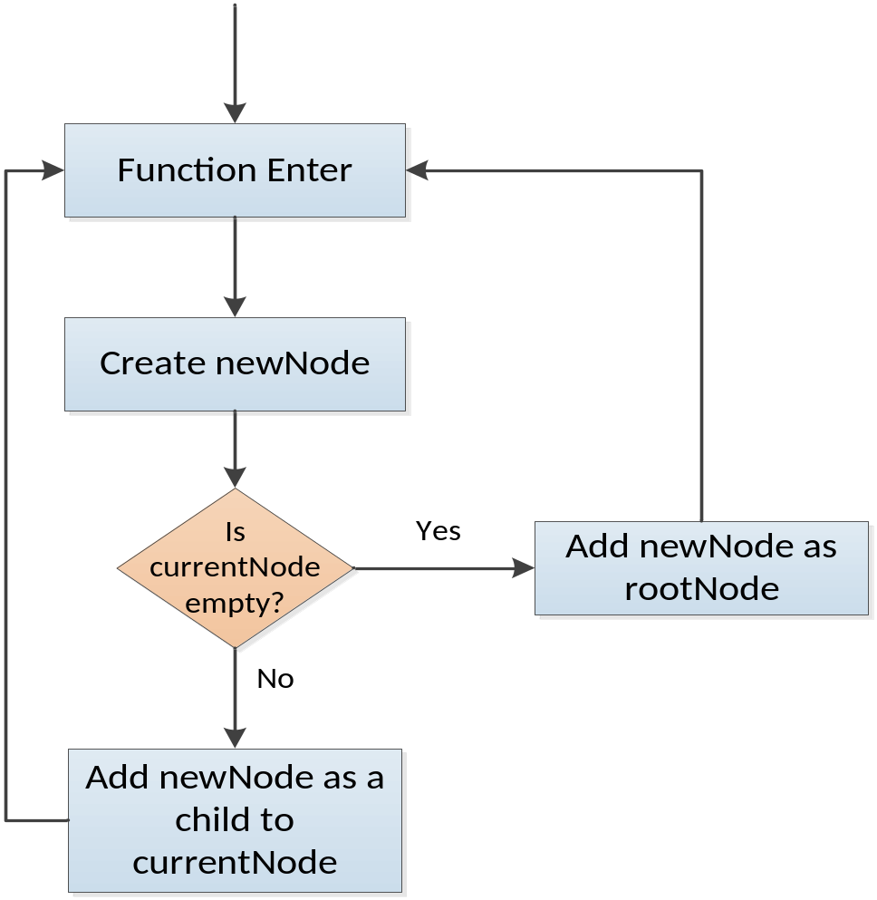
Approach
27.02.18 |Technische Universitat Darmstadt | PTA | Prof Dr. Michael Pradel
Notes:
We are building a tree for each function being called
Anonymous Function expression checked while “Creat a newNode”
We check for recursive functions at the “Add childNode to currentNode” stage
Indirect eval() is checked when the write() callback is called
Each Node in the tree represents a function.

Slide 5
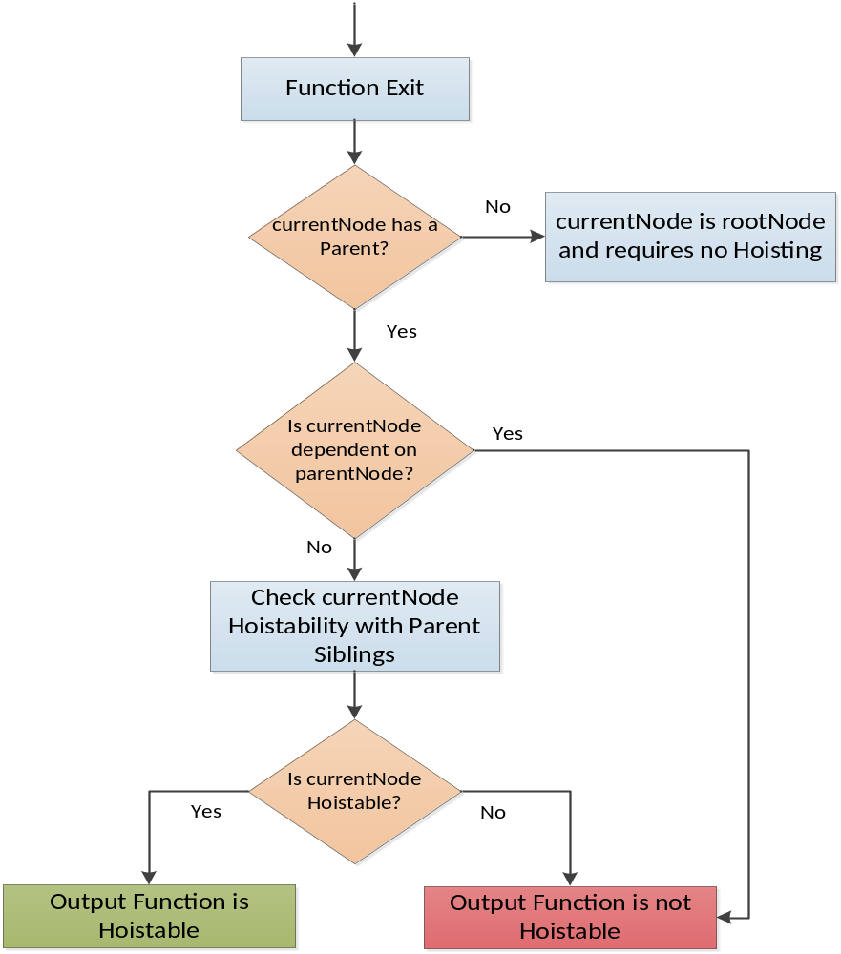
Approach - Continued
27.02.18 |Technische Universitat Darmstadt | PTA | Prof Dr. Michael Pradel
Notes:
- “Check Hoistability with Parent Siblings” is a recursive process to check the whole hierarchy of the currentNode

Slide 6
Handling Corner Cases
Function Expressions
eval
  Direct eval
  Indirect eval
Recursive Functions
27.02.18 |Technische Universitat Darmstadt | PTA | Prof Dr. Michael Pradel
Notes:
Function Declaration – are handled by first checking whether is dependent upon its parent’s variables and second my checking whether its parent has any other child function with the same function definition
Function Expressions - While “creating a new node” we check whether the function has a name or not. If not then we name it as “anonymous” function and rest of the working is same as in Function Declaration
Recursive Functions – while “adding a child node” we check if the function name is same as its parent function’s name. if yes, then it is identified as a recursive function by our analysis and is not added again to our tree.
Eval() –
Indirect Eval() we check this in this write() callback. It is basically a variable with a function assigned to it as a value and it is already compiled at a global scope by javascript therefore, it doesn’t need any further hoisting. In our analysis, it would be treated as a normal function only at a global scope.
Direct Eval() is treated as a normal function where hoistability is checked with its current parent as being doing for function declaration.

Slide 7
Evaluation
We are still working on this.
27.02.18 |Technische Universitat Darmstadt | PTA | Prof Dr. Michael Pradel

Slide 8
Thank You!
27.02.18 |Technische Universitat Darmstadt | PTA | Prof Dr. Michael Pradel

Slide 9
References
Flanagan. JavaScript: The Definitive Guide. O’Reilly Media, 2011.
https://github.com/Samsung/jalangi2
27.02.18 |Technische Universitat Darmstadt | PTA | Prof Dr. Michael Pradel

