Slide 1
Dynamically Detecting Uncaught Errors in Asynchronous Functions
Program Testing and Analysis – Winter 2017/18

Slide 2
Goals
Identify asynchronous callback functions
Check for uncaught error in callback
Provide stack trace for error

Slide 3
Asynchronous functions
setTimeout (callback, delay);
setInterval (callback, delay);
target.addEventListener (event, callback);
var xhttp = new XMLHttpRequest ();
xhttp.onreadystatechange = callback
xhttp.open (method, url);
xhttp.send ();
Notes:
setTimeout & setInterval both timers, execute function after a number of miliseconds.
addEventListener- which exeute the callack function for a certain target whnever a specific event occur.
In XMLHttpRequest
If XMLHttpRequest2 the onload is used instead of onreadystatechange

Slide 4
Motivation
 | Yahoo | MSN | BBC | Gmail
Total functions | 2349 | 148985 | 47780 | 35092
XMLHttpRequest | 0 | 19 | 2 | 0
setTimeout/ setInterval | 9 | 877 | 1015 | 12
addEventListener | 3 | 327 | 91 | 37
Notes:
This showa that these functions are heavily used

Slide 5
Approach
Identify asynchronous function
Identify callback id & location
Check for error before the
callback finish execution
Print stack trace
Notes:
// identify asynchronous function : depend on the type of the function
First,second :For example : setTimeout , check for each function invocation and if the function name equal to setTimeout
1.Store function name , location , global id
2. Extract the callback function from the first argument of this function .
Store callback id, location, name .
Third : each time the function enter : check if the function id equal callback -> recored it (“callback start execution ”)
Fourth : check for each function exit : if the global id equal to stored global id and the state isrecorded
Check for wrappedExceptionVal != undefined , there is an error → print stack trace

Slide 6
Evaluation
Tested on five simple examples, and the following three Github projects:
News API, using Ajax https://github.com/MantasJakevicius/news-api
Moment.js plugin using timers https://github.com/Alxmerino/moment-timer
Open source social network
https://github.com/phongdong/sjsuossn
Notes:
1. Display news from different resources using AJAX XMLHttpRequest

Slide 7
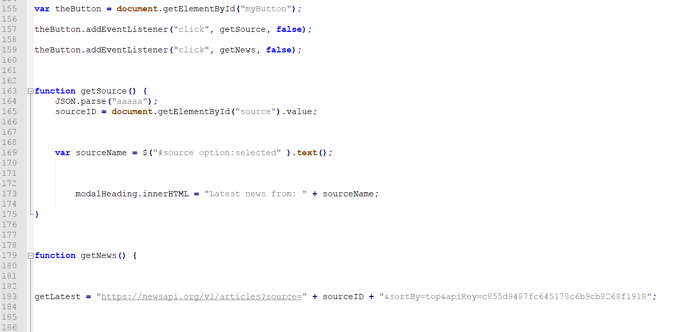
1- News API
https://github.com/MantasJakevicius/news-api

Slide 8
1- News API (cont.)
******************* Trace **************************
addEventListener function addEventListener from line 157 column 1 till line 157 column 54 and the callback function getSource from line 163 column 1 till line 175 column 2 with error
******************* Error details *******************
JSON.parse: unexpected character at line 1 column 1 of the JSON data
******************* End ****************************
******************* Trace **************************
addEventListener function addEventListener from line 159 column 1 till line 159 column 52 and the callback function getNews from line 179 column 1 till line 307 column 2 with error
******************* Error details *******************
sourceID is not defined
******************* End ****************************

Slide 9
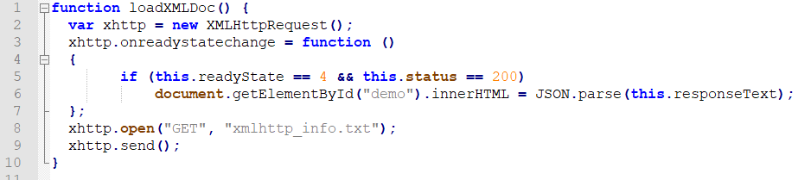
2- XMLHttpRequest

Slide 10
2- XMLHttpRequest (cont.)
******************* Trace **************************
index.htm:9801:29
Declare XMlHttpRequest object xhttp from line 2 column 15 till line 2 column 35
call back function anonymous from line 3 column 30 till line 7 column 4
send function from line 9 column 3 till line 9 column 15
******************* Error details *******************
index.htm:9803:29
JSON.parse: expected ',' or '}' after property value in object at line 1 column 16 of the JSON data
******************* End ****************************

Slide 11
Thank you :)

