Slide 1
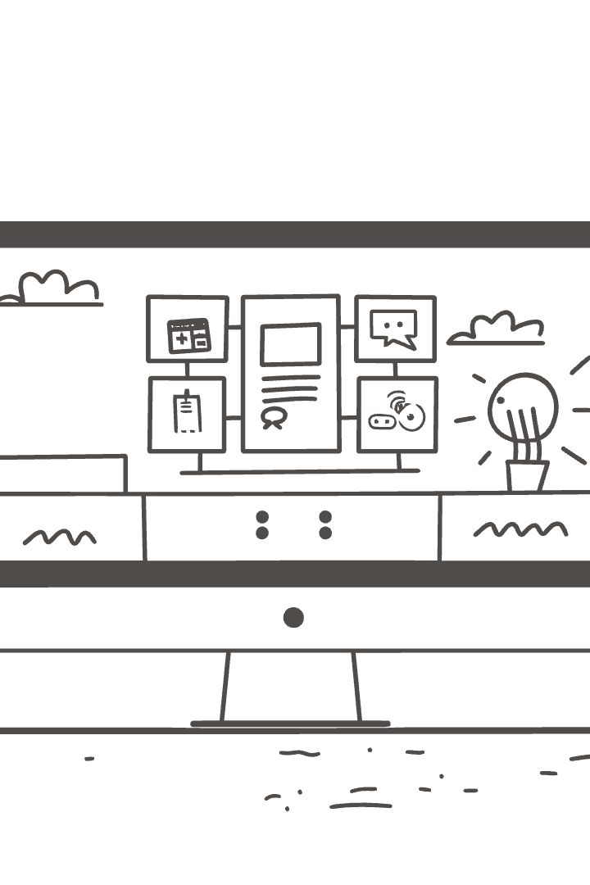
Medicure Clinic Management System
This presentation summarizes the unit testing strategy and application overview for the Medicure Clinic Management System. It highlights key modules, development strategies, and testing tools used to ensure the reliability of this desktop healthcare app.
By ___________

Slide 2
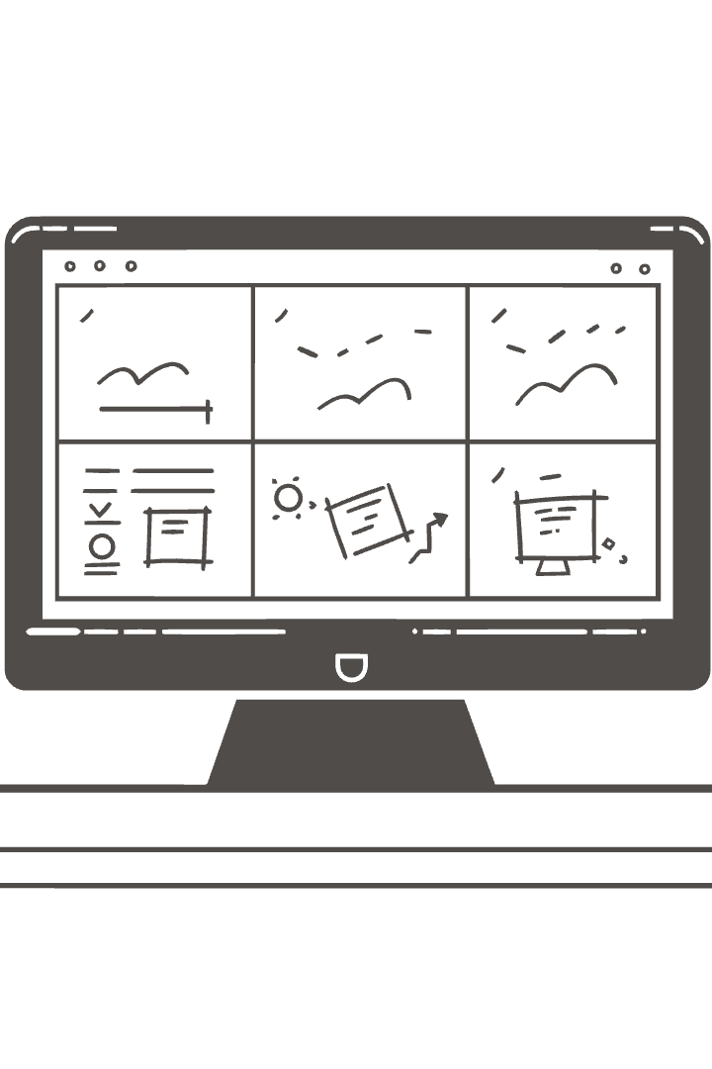




Project Overview
Desktop App
Developed using WinForms and .NET 8.
Key Modules
Patient, Appointment, Reports, Users.
File-Based Data
No database required for data persistence.
Role-Based Access
Built-in access control for Admin and Doctor roles.

Slide 3





Development Strategy
Modular Design
Defensive Programming
Iterative Development
Maintainability
The development strategy includes modular design, defensive programming, iterative development, and maintainability.

Slide 4




Role of Unit Testing
Reliability
Ensures reliability in healthcare apps.
Early Bug Detection
Catches bugs early (e.g., double bookings, data loss).
Safe Updates
Enables safe updates and better maintainability.

Slide 5
Testing Tools & Frameworks
MSTest
Moq (Planned)
Test Explorer
File-Based Testing
Native to Visual Studio.
For mocking external components.
Manage and view results.
Simulates CRUD without DB.

Slide 6

Key Unit Testing Concepts
Test Class/Method
Assertions
Mocking & Stubbing
Structure for organizing tests.
AreEqual, ThrowsException.
Simulate I/O, user auth.

Slide 7

Case Study Learnings
Isolated Logic Tests
Testing logic independently.
RBAC Enforcement
Role-based access control.
CRUD via Mock Files
Simulating data operations.

Slide 8
What’s Working & What’s Next
What’s Working
Improvements Planned
Clean, testable code
Integrate Moq for simulation
Role-based access tests
Automate regression tests
Test suite coverage with MSTest
Explore UI testing

Slide 9

Conclusion
The Medicure Clinic Management System uses unit testing to ensure reliability and maintainability. Key components are tested using MSTest, and future plans include integrating Moq for enhanced testing capabilities.

