Slide 1

The Modeling of Magnetic Fields in Electromagnetic Microgenerators Using the Finite Element Method
Project realized by Anamaria Bobos

Slide 2
Table of contents
1
Introduction
2
Materials and methods
3
Results
4
Discussion and conclusions

Slide 3


Xia makes the statement:
The development of electronics and the continuous miniaturization of systems causes an increase in the demand for electricity.
John makes the following plan:
Wait a second…I know!!
We need to recover electrical energy from renewable sources
John knows that:
Electromagnetic microgenerators make it possible to obtain useful electrical energy from the environment (wind energy, kinetic energy).

Slide 4

Kevin seems upset he’s not familiar with the subject.
Let’s tell him about the phenomenon of electromagnetic induction
One more important thing:
Each such microgenerator has coils and magnets
This phenomenon consists of the induction of the current in the coils as a result of changes in the magnetic field

Slide 5

It might be useful to analyze the parts of the microgenerator, says Dennis.
  is the structure of a multilayer, spiral ceramic microspring on which a silver layer has been deposited. Therefore, a planar spiral coil was made.
Vibrating element
  The second part of the structure contains neodymium magnets. As the coil vibrates against the magnetic field generated by the magnets, a current is induced in it. The direction of its flow depends on the direction in which the coil moves.
Magnets

Slide 6

Kevin says: Now I get it!
Electromagnetic microgenerators are a current research topic and are still being developed in various microelectronic technologies
COMSOL Multiphysics software was used for the simulation.
So what is the aim of the project?
By modeling based on the finite element method, we sought
to determine a shape and arrangement of the magnets on the disc that will ensure the
highest magnetic flux density above the disc

Slide 7
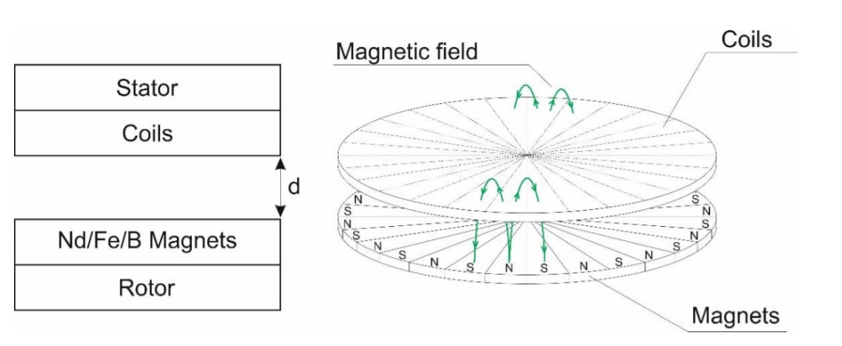
Moving on to materials and methods…
Let’s dive in!
The construction scheme of the electromagnetic microgenerator.
The coils were made of silver paste by the screen printing technique on several layers of LTCC tapes, which made it possible to realize a multilayer planar coil structure.
The drawing shows the lines of the magnetic field penetrating both the air gap between the stator and rotor, as well as the non-magnetic LTCC ceramics and the coil material.

Slide 8
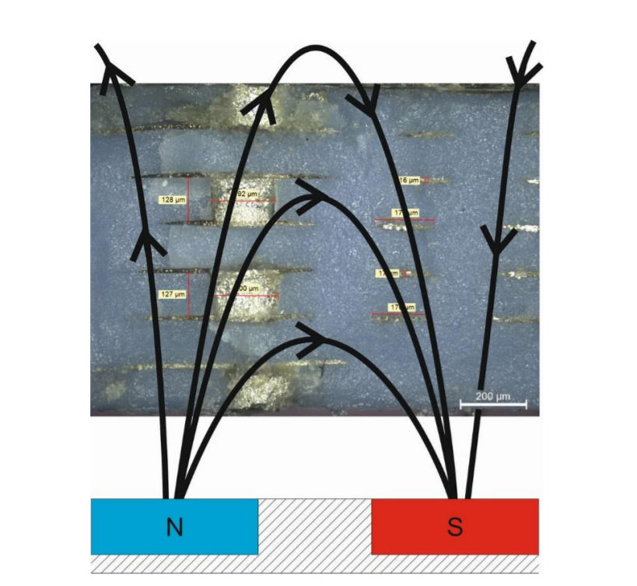
Still materials and methods
. The cross-section through the electromagnetic microgenerator.
At constant disc speed, the rate of change of the magnetic field depends on the number of magnets on the disc. The more magnets used on the disc, the more magnetic field changes can be observed, and thus, the higher the value of electromagnetic induction.
Various discs with permanent magnets were designed and fabricated. The influence of their positioning, dimensions, and magnetization on the alternating magnetic field was measured in the system for the characterization of electromagnetic microgenerators.

Slide 9
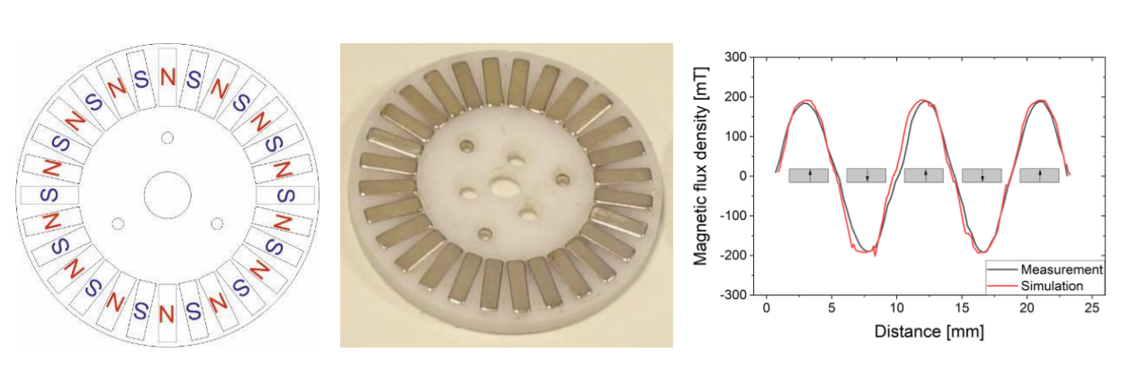
More materials and methods because who doesn’t love pictures
This paper presents the simulation results of the magnetic flux density generated by four configurations of magnets on the disc, differing in their shape and dimensions.

Slide 10

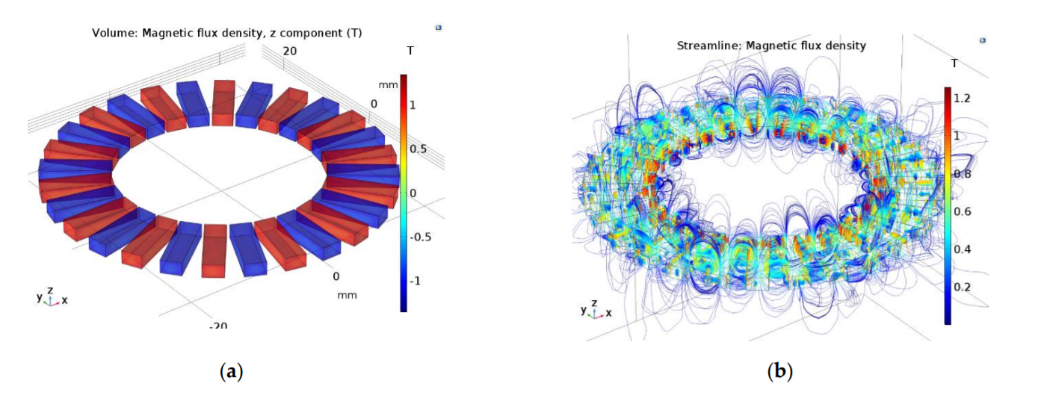
Please be done with materials and methods
Not yet! But wait… Who are you? Anyways
Figure a shows a magnetic configuration in which the magnetic flux density propagates through the magnet’s volume in only one direction (z component).
Figure b presents magnetic flux density lines in the close surroundings of the magnets.

Slide 11

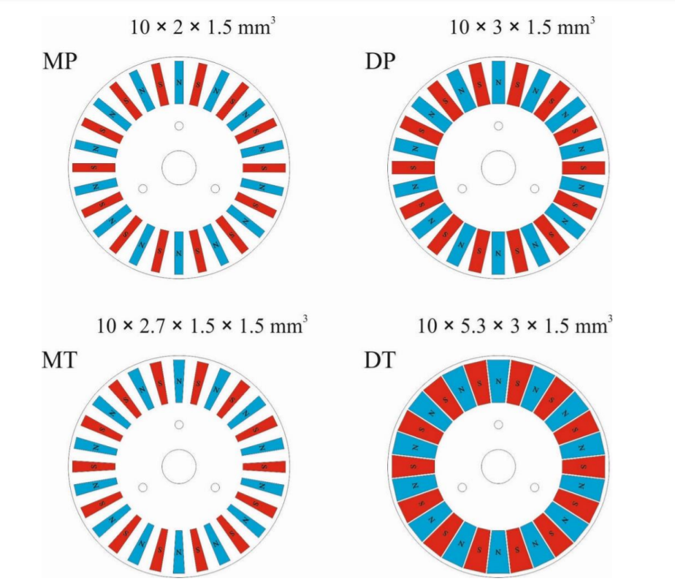
Time to see some results…
Remember a COMSOL multipysics software was used
COMSOL Multiphysics software allows simulation of physical phenomena using finite element analysis. Due to high level of sophistication and ability to simulate magnetic fields, it was chosen as the main tool for the following study.
Four-disc configurations were used in the simulation:
*MP-small magnets in the shape of rectangular prisms
*DP-large magnets in the shape of rectangular prisms
*MT-small magnets in the shape of trapezoidal prisms
*DT-large magnets in the shape of trapezoidal prisms

Slide 12

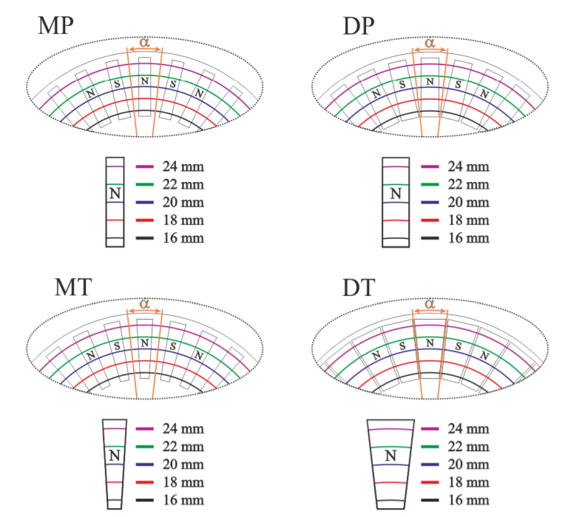
Let’s help Kevin understand the results by showing the magnetic field simulation points

Slide 13
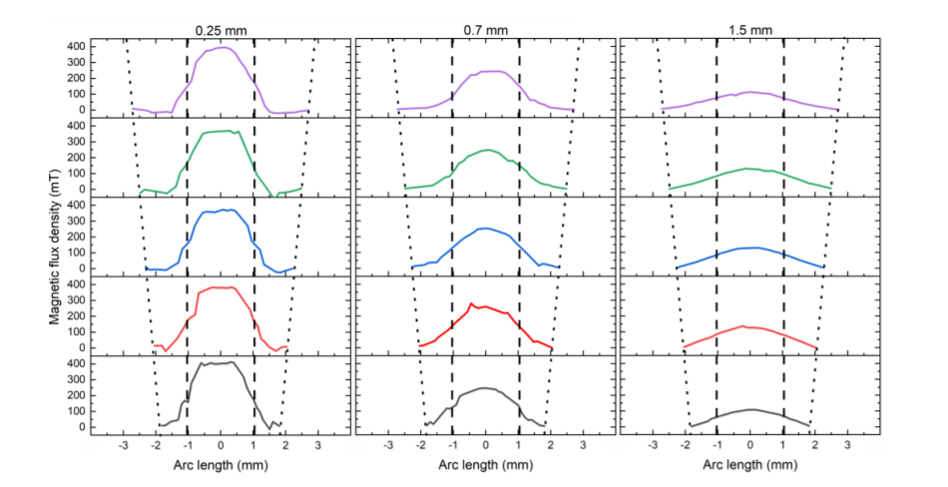
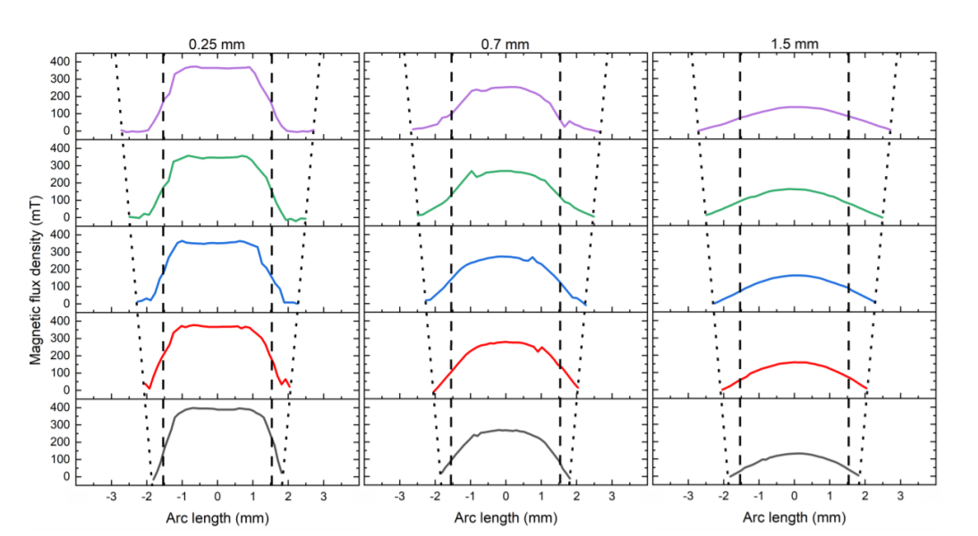
Yes, I know it looks bad before reading the explanations…
Magnetic flux density as a function of arc length for MP configuration
Magnetic flux density as a function of arc length for DP configuration
-> magnets (black—16 mm, red—18 mm, blue—20 mm, green—22 mm, and violet—24 mm, from the center of the target).

Slide 14
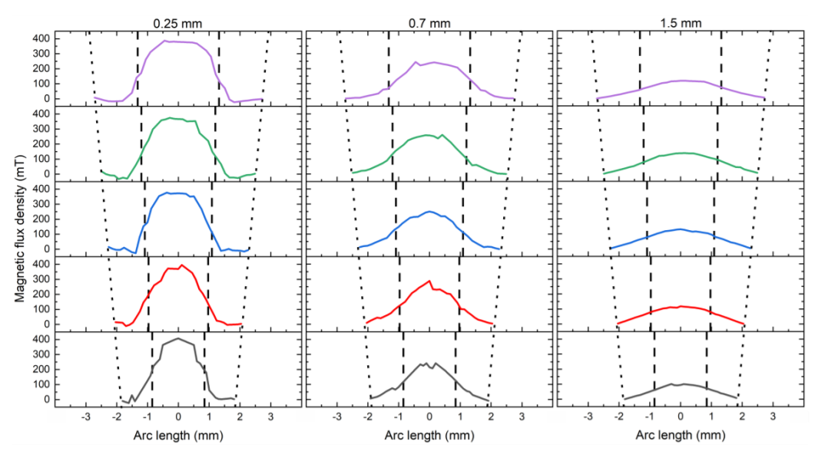
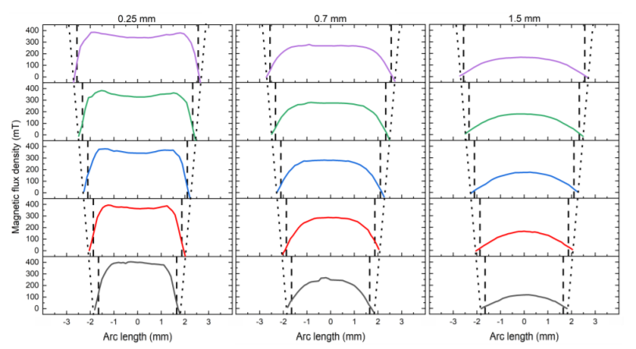
We handled MP and DP configurations, so…
Magnetic flux density as a function of arc length for MT configuration
Magnetic flux density as a function of arc length for DT configuration
*The value of magnetic flux density over the area defined by the angle of 12.85◦ is greater than that over the area defined only by the shape of the magnets
* In both cases, the smallest value is presented by the MP and MT configurations.
*On the other hand, the highest value of the magnetic flux density over the given area is represented by the DT configuration, for which the values determined for both areas are also very similar.

Slide 15
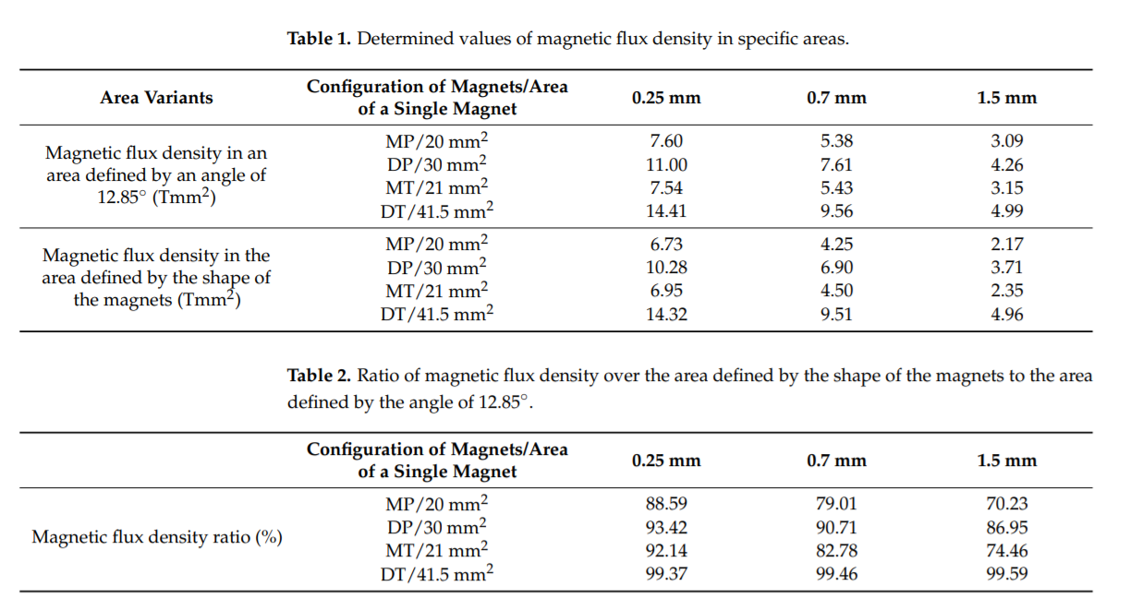
->As can be observed from the simulations, the configuration of the magnets has a great influence on the shape and value of the magnetic field over the surface of the magnets, in addition to greatly affecting the area surrounding the magnets.
->In the case of a multilayer coil, the magnetic induction in the various layers of the coil depends on the distance of this layer from the surface of the magnetic disc.

Slide 16

Time for discussions and conclusions

Slide 17
Briefly recap first…
A magnetic disc is one of the basic components of an electromagnetic microgenerator.
When optimizing the device, both components—the coil structure and the magnetic disk—must be considered.
The COMSOL Multiphysics program allowed simulation of the magnetic field surrounding the selected magnetic disks.

Slide 18
Conclusions based on the simulation results:
The total magnetic field in a single segment with a magnet is proportional to the area of the magnet;
For magnets in the shape of a rectangular prism, the distances between adjacent magnets increase along with the distance of the analysed point from the center of the target.
For large magnets in the shape of a rectangular prism, the zero level of magnetic flux density is maintained for about 0–1 mm. There are no sections with zero magnetic induction for magnets in the shape of a trapezoidal prism;
The magnetic flux density decreases non-linearly with increasing distance from the disc with magnets.

Slide 19

John seems pretty happy now…and definitely smarter
Final remark:
The presented results of magnetic field distribution are very useful because they show how quickly the magnetic field density in an electromagnetic microgenerator is changed, both depending on the magnetic configuration and the distance from the disc with magnets
References:
https://www.mdpi.com/1996-1073/15/3/1014

Slide 20
Thank you for watching ☺
Project realized by Anamaria Bobos

