Slide 1
PWM GENERATOR
Anamaria Bobos
Faculty of Electronics, Telecommunications and Information Technology
Grupa 2021

Slide 2

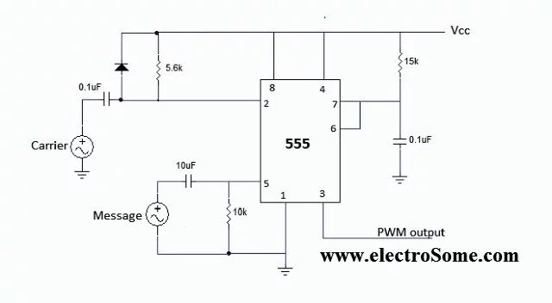

Slide 3
Functioning mode
The modulation of the pulse width is based on changing the pulse width to control the output voltage and to control the output frequency by changing the circuit. The output frequency can be modified by changing the modulation period of the impulse.

Slide 4
Functioning mode
The 555 timer circuit is in monostable mode. In this way, the output is 0V without tripping and Vcc with tripping. When the value of the sawtooth signal’s amplitude is less then the value of the input signal, the output is 1 ,and in other cases, 0.

Slide 5
Equations
T=1.11*R*C; - The period of the signal for the 555 timer in monostable mode.
s1=Ain*sin(w1.*t); - generating a sinusoidal signal
s2=Ad.*sawtooth(w2*t); -generating a sawtooth signal

Slide 6
Equations
for i = 1:n if (s1(i)>=s2(i))
pwm(i) = 1;
else
pwm(i) = 0;
end
end
Generating the PWM signal

Slide 7
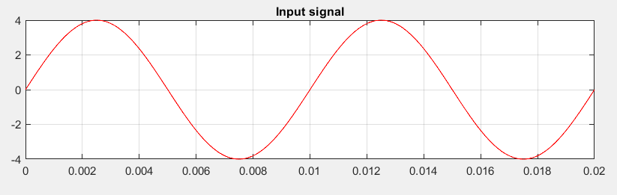
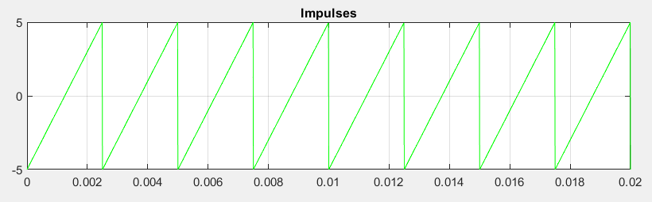
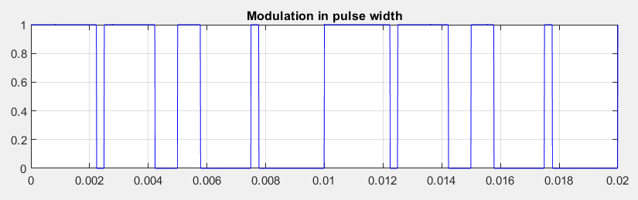
1. Input signal
2. Sawtooth signal
3. PWM signal

Slide 8
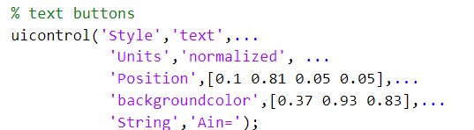
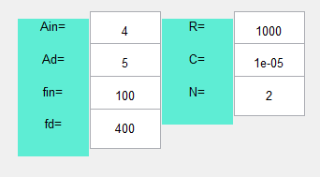
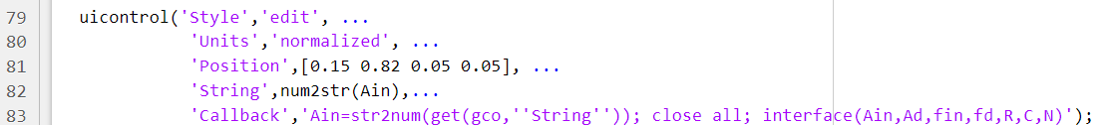
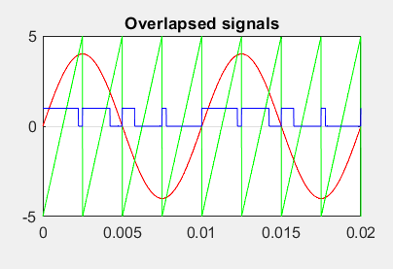
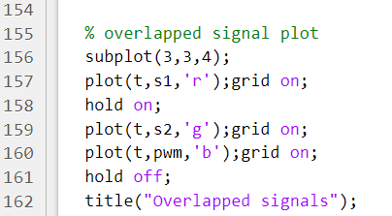

Slide 9
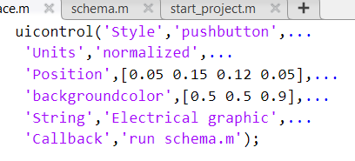
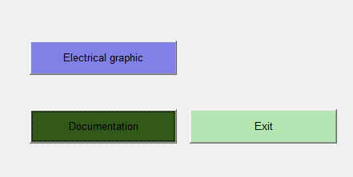
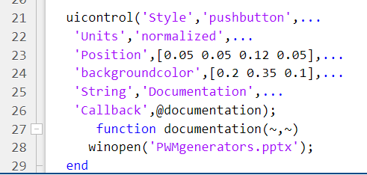
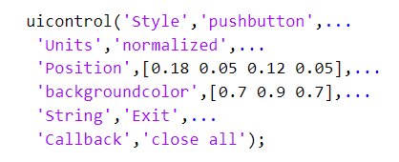
Electrical graphic– pushbutton that shows an image of .png type.
Documentation– pushbutton that opens an external file of type .pdf;
Exit – pushbutton that can close the project.

Slide 10
Bibliografie
http://www.bel.utcluj.ro/dce/didactic/fec/
https://www.mathworks.com/help/physmod/sps/ug/pwm-circuit-using-555-timer.html
https://www.electronicsforu.com/electronics-projects/software-projects-ideas/555-timer-design-using-matlab
https://didatec.sharepoint.com/:b:/r/sites/DICCAG2122/Shared%20Documents/General/CAG_Laboratory/CAG_Lab10.pdf?csf=1&web=1&e=cehVfk
https://ro.answersexpress.com/555-monostable-multivibrator-73527

