Slide 1


MicroK8s and Quarkus
Best things come in small packages

Slide 2


Agenda
Quarkus
Kubernetes
IoT lightweight K8s

Slide 3


$whoami
anamarija.talijanac@true-north.hr
https://github.com/anamarija

Slide 4
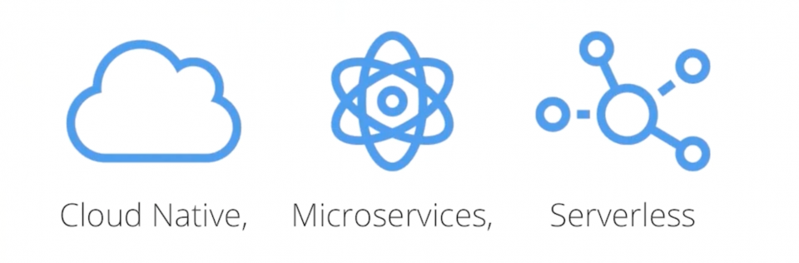


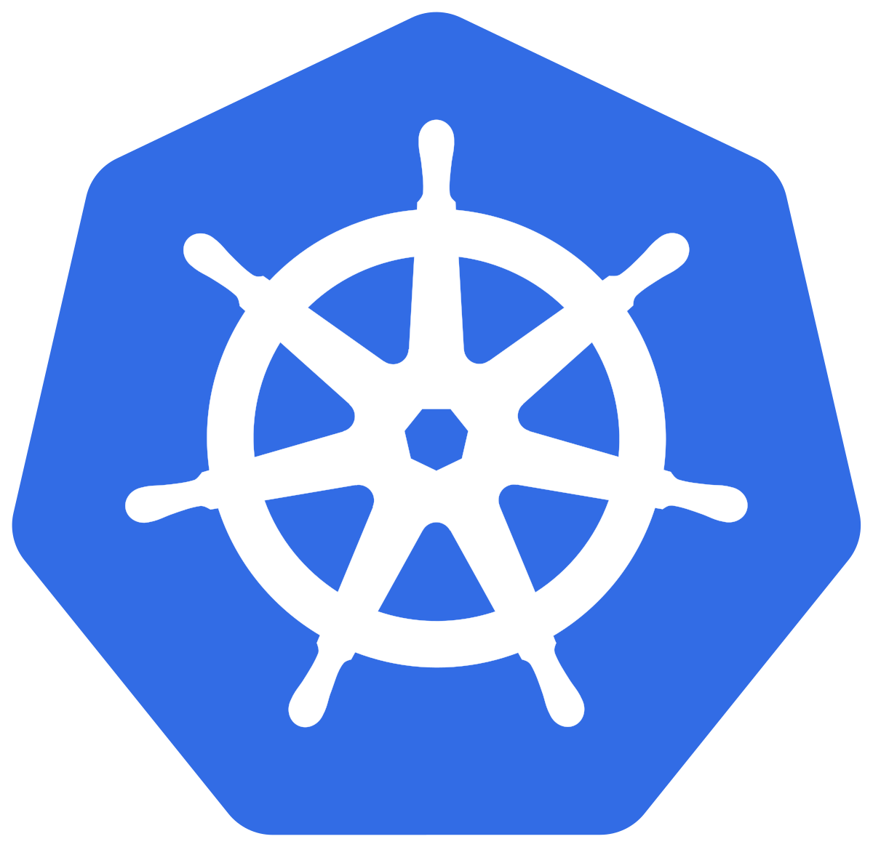
Quarkus – Supersonic Subatomic Java

Slide 5
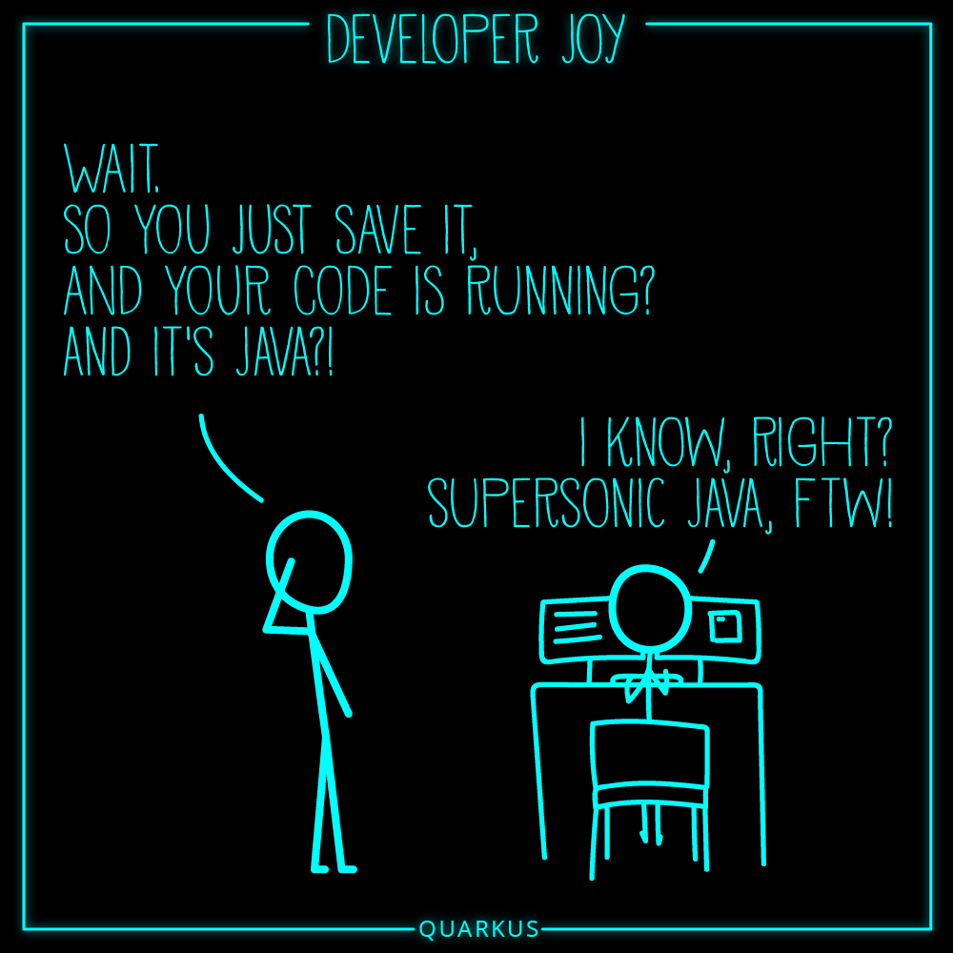
Quarkus Developer Joy
Based on standards, but not limited
Unified configuration
Super fast live reload
Easy native executable generation

Slide 6
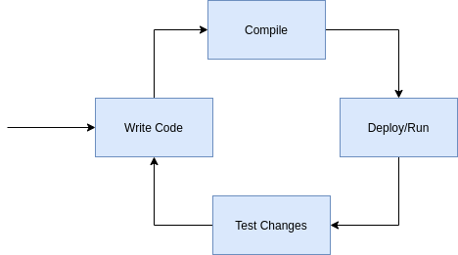
Quarkus Developer Joy

Slide 7
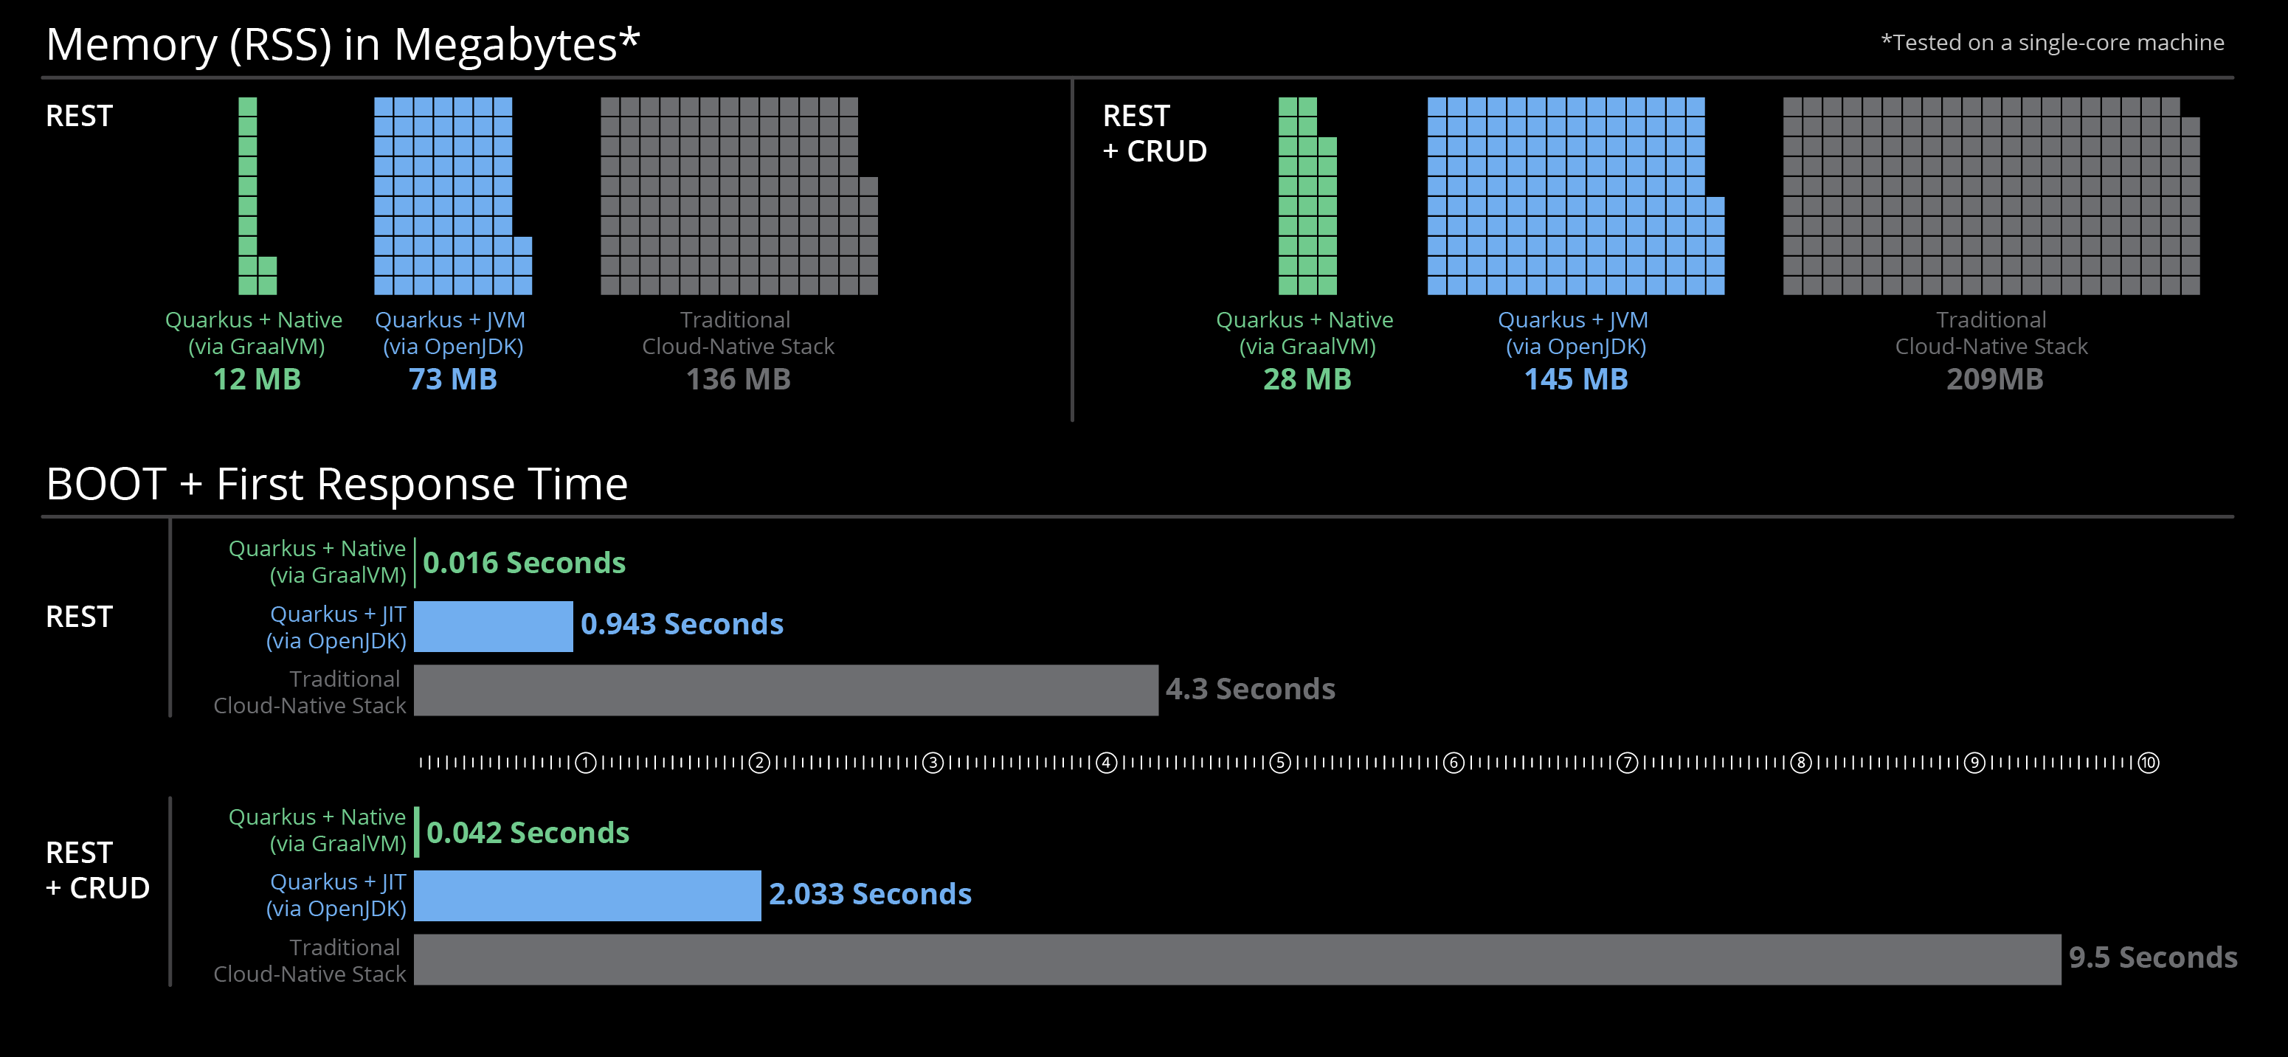
Quarkus – Supersonic Subatomic Java

Slide 8
Quarkus Unifies Imperative and Reactive
Combine imperative and reactive development in the same application
Inject the EventBus or the Vertx context
Use the technology that fits your use case

Slide 9

DEMO

Slide 10
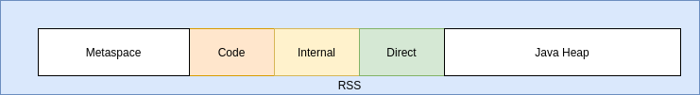
Quarkus
Startup overhead # of classes, bytecode, JIT
Memory overhead # of classes, metadata, compilation

Slide 11
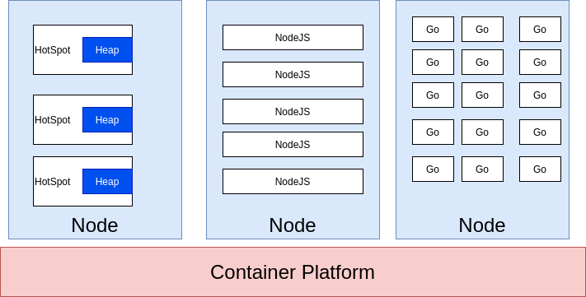
Quarkus

Slide 12
Quarkus – How does it work Move Startup time to Build time
Parse Configs
Classpath & class scaning
Build framework meta model objects
Prepare reflections and build proxies

Slide 13
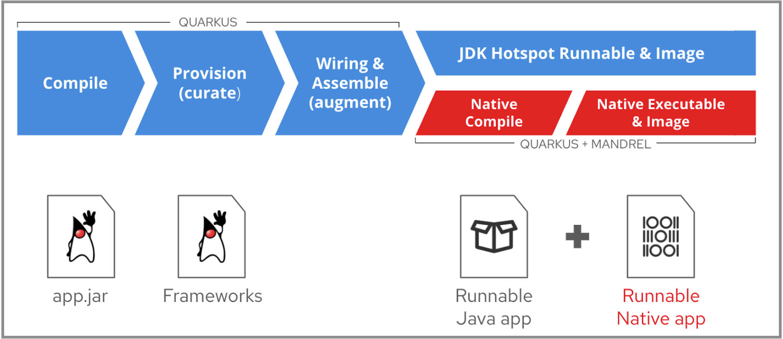
Quarkus

Slide 14

Quarkus Best of Breed Frameworks & Standards

Slide 15

Quarkus Spring API Compatibility

Slide 16
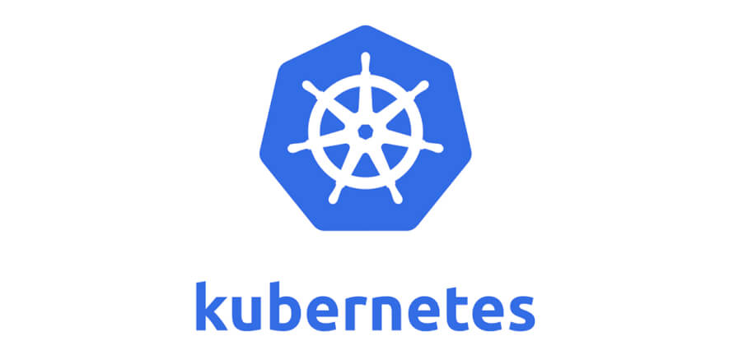
Kubernetes
Kubernetes is a portable, extensible, open-source platform for managing containerized workloads and services, that facilitates both declarative configuration and automation. It has a large, rapidly growing ecosystem. Kubernetes services, support, and tools are widely available.

Slide 17
Kubernetes
Self-healing
Manual & Auto scaling
Automatic scheduling
Automatic restarting
Cross-host managed deployments
Build-in load balancing
Container livecycle management

Slide 18
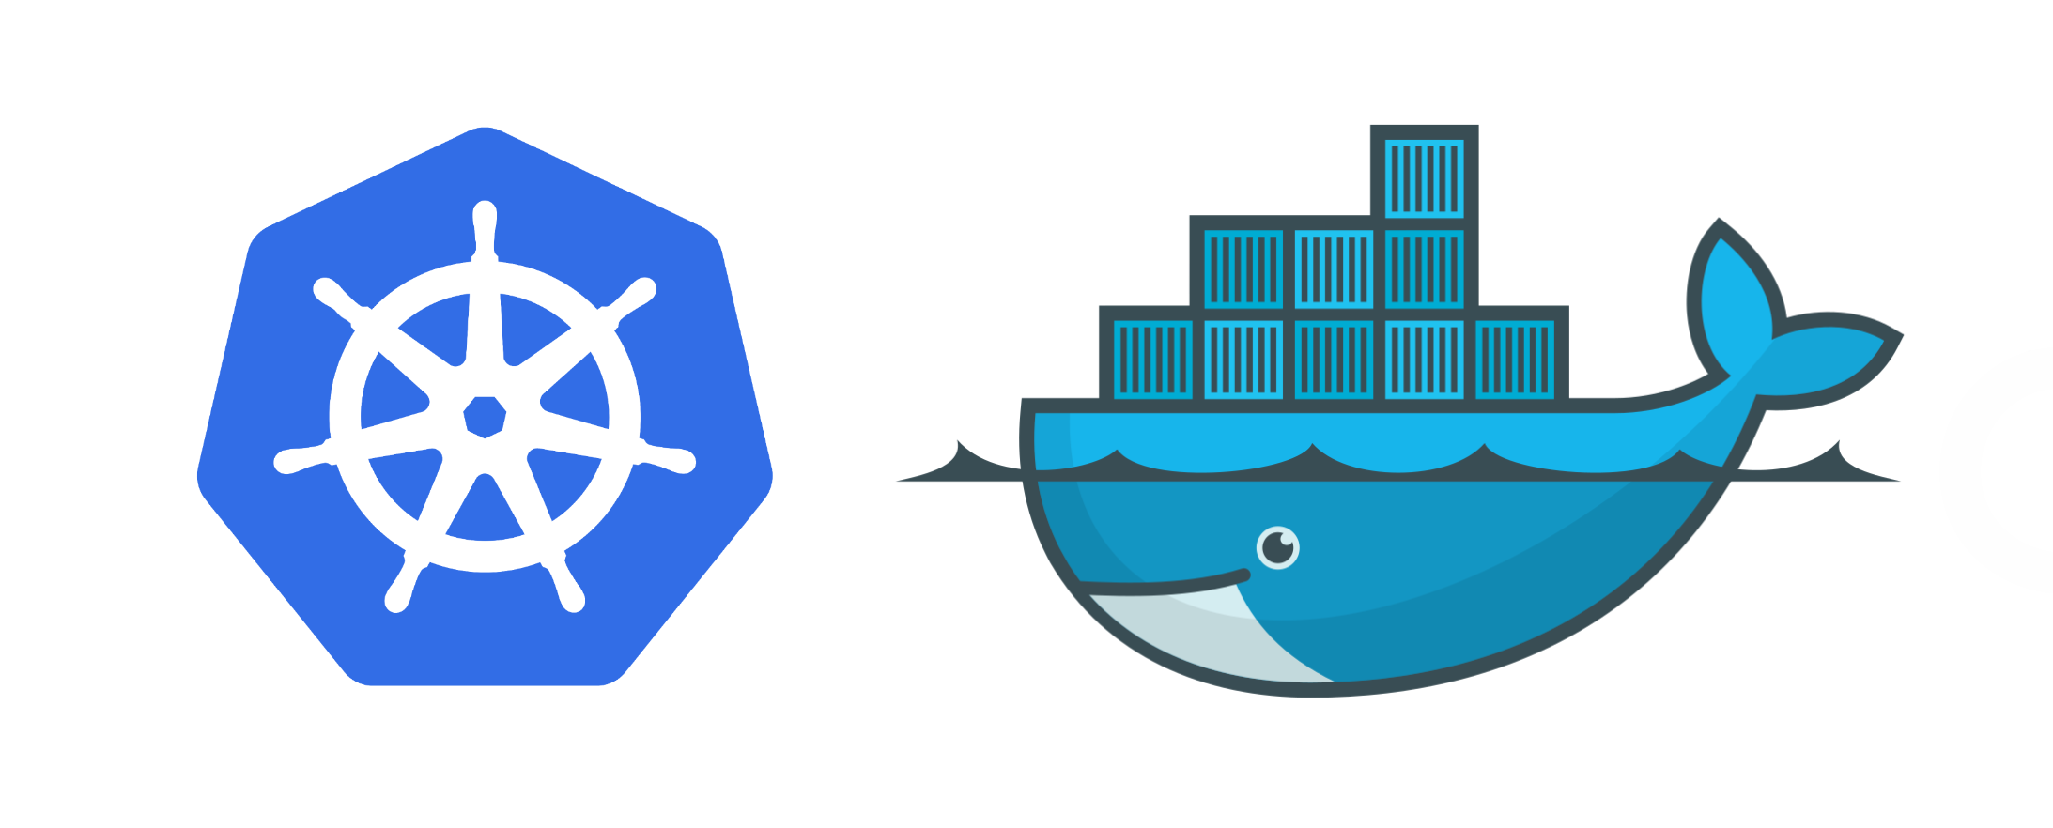

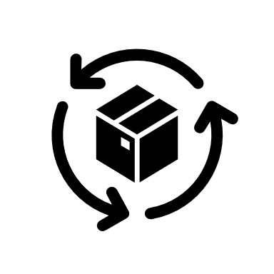

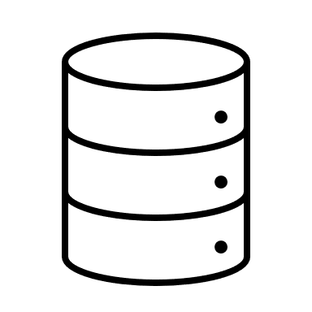
Kubernetes Terms
Pod
1* container
Shared IP
Shared storage
Shared resources
Shared livecycle
Replication Set
Deployment
Desired state
replicas
Pod template
Health checks
Resources
Images
Services
Grouping of pods
with stable VirtualIP
and DNS name
Persistent volume
Network available storage
Persisten volume
Persistent volume claims
Persistent volume classes

Slide 19

Kubernetes Terms
Label
Key value pair
Associated with an object (app=hello-world)
Enables easy selection of resources
Deamon Set
Pod runs on all nodes even unscheduleable
Each node runs exactly one pod
infrastructure-related pods
Job/ CronJob
A taks that terminates after completing task
Not continous
Jobs can ge repeated using the CronJob resource
ConfigMap and Secrets
Encapsulates pod configuration with different representation based on dana sensitivity

Slide 20
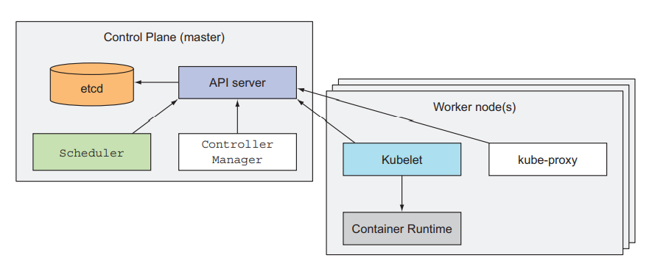
Kubernetes

Slide 21
DEMO

Slide 22
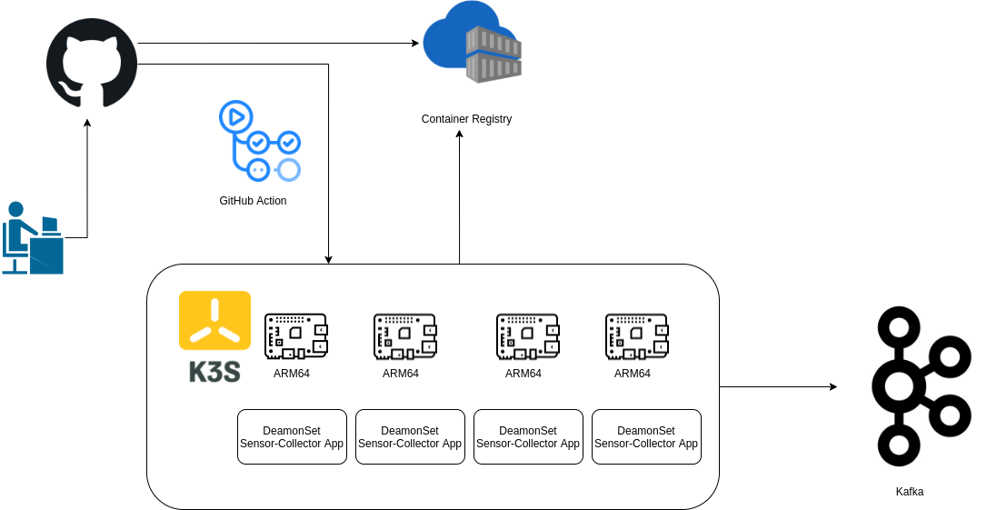
Simple Temperature Sensor Collector

Slide 23
Q&A
THANK YOU

