Slide 1


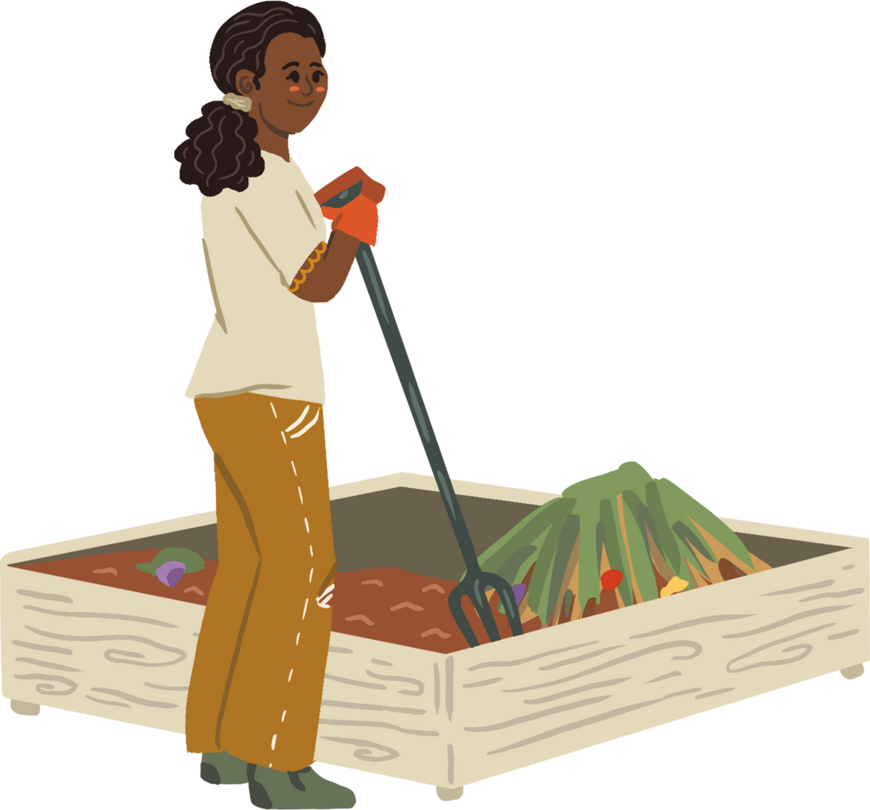



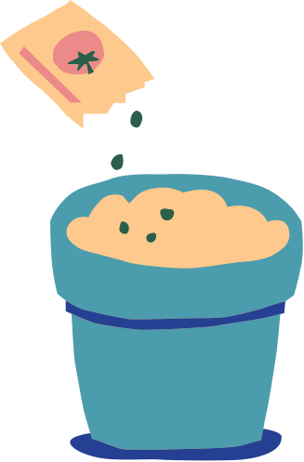

BotanIQ
Ana
Johannes

Slide 2

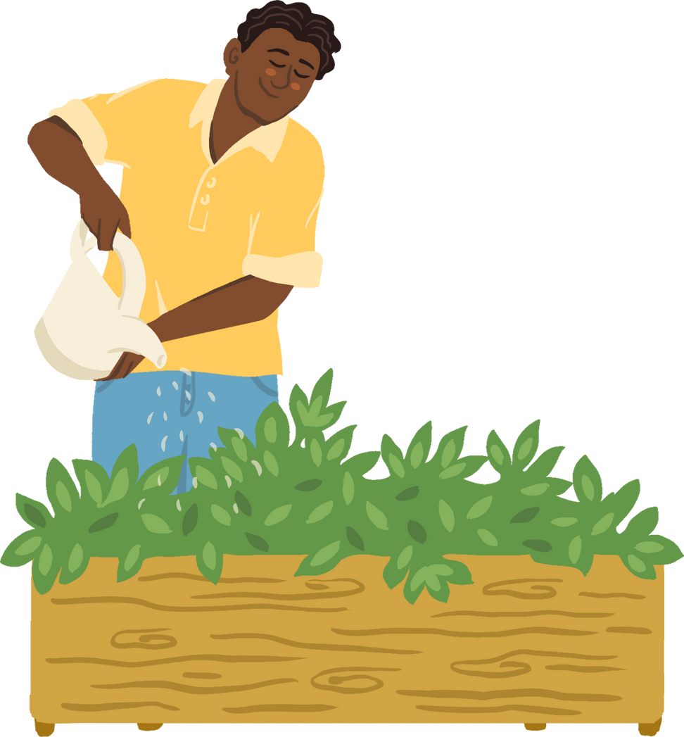

What is BotanIQ
It is an application to recognise what kind of plants you have and what disease they have.
Identifies plant diseases quickly
Promotes targeted treatment, reduces the use of pesticides and promotes environmental friendliness
Enhances understanding of plant health

Slide 3





DETECT DISEASED PLANTS
Take a photo of your plant
Using machine learning to recognise plants and diseases
Visualise the results of the plant and disease
Give recommendations for the treatment of the plant

Slide 4
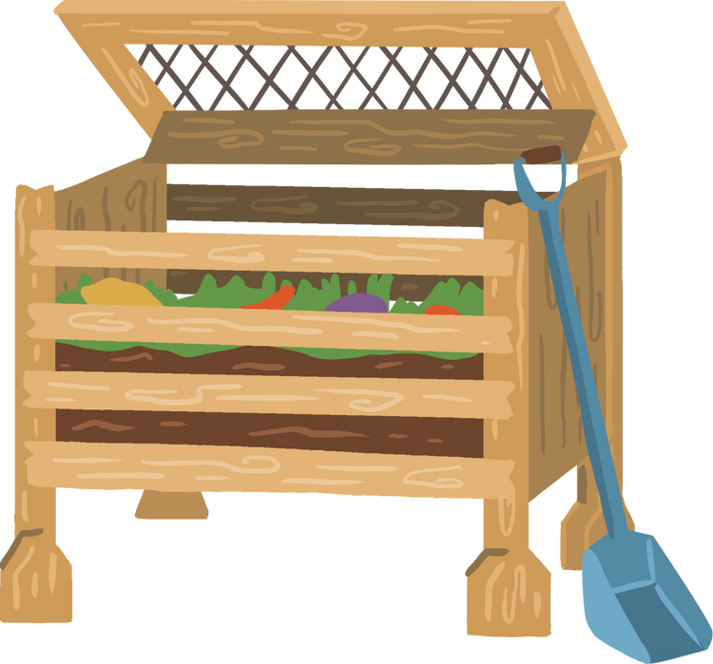
THANK YOU!

