Slide 1
Website Mockup
Spring 2018
csi 145 midterm project

Slide 2
Research
1
Find a subject you would like to use as content for a website you will build. I want you to look specifically on Wikipedia for that content or another open source resource.
I want you to look for enough content on a subject to fill at least four pages and have a handful of images.
You can do the project on the subject of your choice. I looked up “cuttlefish”, and I found a treasure trove of content. Wikipedia has different sections that I could use as pages, along with images and videos.
Collect the information you would like to use for your website
Compile the information to fill 4 webpages

Slide 3

Details
2
Create a mock up of your website
Mock up: a working sample for reviewing format, layout, or content.
The text, images and videos are to be organized for a website
4 pages are required
Home Page
Videos
Images
Content of your choice
You may use Word, PowerPoint or software of your choice.
See next slide for an example of a homepage mock up…

Slide 4
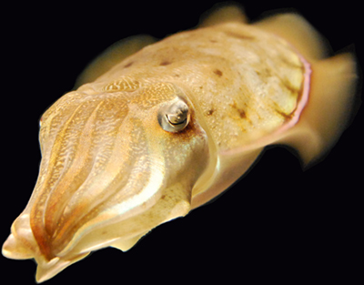
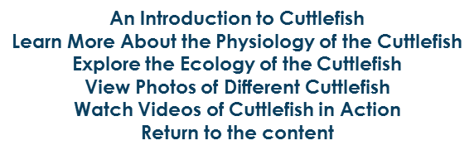

The Fascinating Cuttlefish
Cuttlefish are marine animals of the order Sepiida. They belong to the class Cephalopoda, which also includes squid, octopuses, and nautiluses. Cuttlefish have a unique internal shell, the cuttlebone. Despite their name, cuttlefish are not fish but mollusks.
Cuttlefish have large, W-shaped pupils, eight arms, and two tentacles furnished with denticulated suckers, with which they secure their prey. They generally range in size from 15 to 25 cm (5.9 to 9.8 in), with the largest species, Sepia apama, reaching 50 cm (20 in) in mantle length and over 10.5 kg (23 lb) in weight.
Cuttlefish eat small mollusks, crabs, shrimp, fish, octopuses, worms, and other cuttlefish. Their predators include dolphins, sharks, fish, seals, seabirds, and other cuttlefish. Their life expectancy is about one to two years. Recent studies indicate cuttlefish are among the most intelligent invertebrates. Cuttlefish also have one of the largest brain-to-body size ratios of all invertebrates.
The “cuttle” in “cuttlefish” comes from the Old English word cudele, meaning “cuttlefish,” which may be cognate with the Old Norse koddi (“cushion”) and the Middle Low German küdel (“pouch”). The Greco-Roman world valued the cephalopod as a source of the unique brown pigment the creature releases from its siphon when it is alarmed. The word for it in both Greek and Latin, sepia, is now used to refer to a brown pigment in English.
Want more Cuttlefish? Look No Further:
The text content of this site was lovingly borrowed from on 15 April 2018 under the. Licensing terms of content
from other sources (photos, etc.) is noted along with each respective resource.

Slide 5
Requirements
4
Home Page (slide 6)
Navigation
Banner
Brief description
Footer
Give credit where credit is due
Videos page (slide 7)
Minimum of 4 videos
Images page (slide 8)
Minimum of 10 images
Each image must have a short description
Content of your choice (slide 9)
Mix of text and video or images

Slide 6


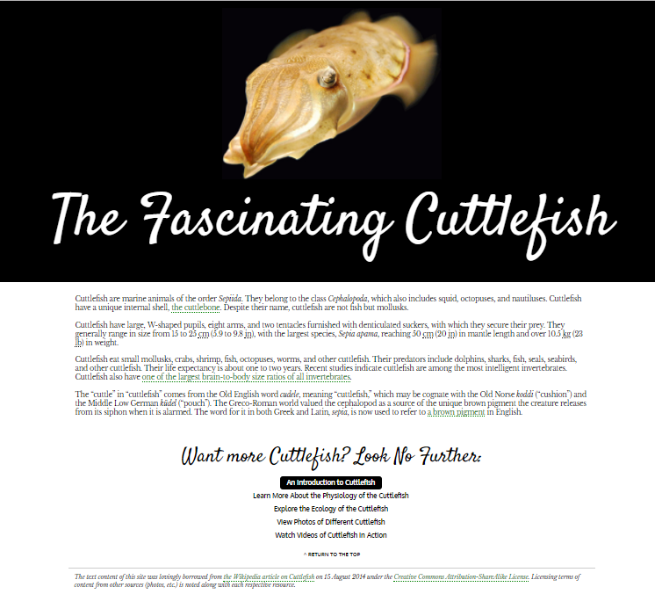



Home Page
Navigation
Banner
Brief description
Footer
Give credit where credit is due

Slide 7
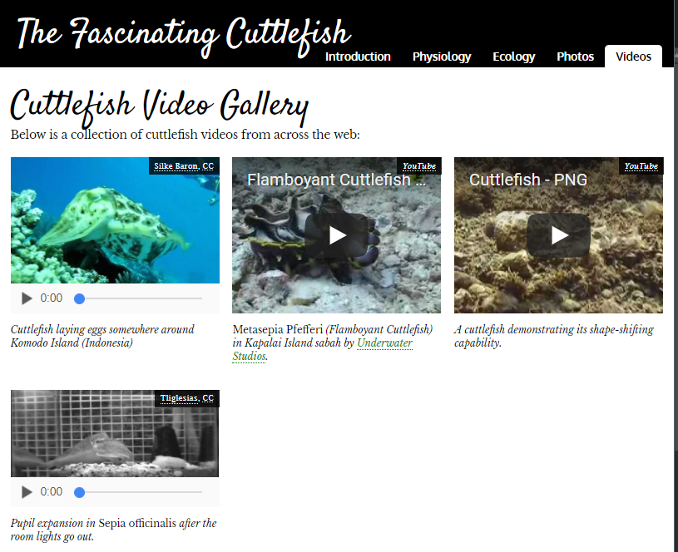
Videos
6
Minimum of 4 videos

Slide 8
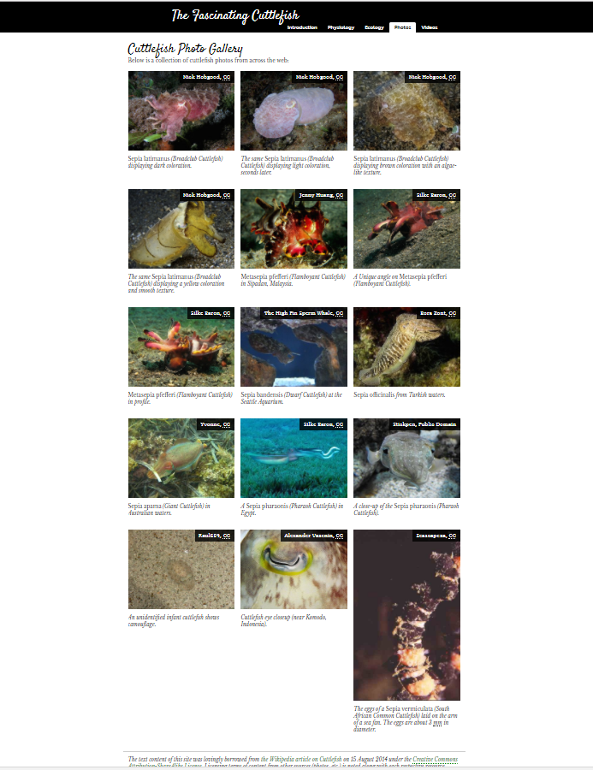
Images
Minimum of 10 images
Each image must have a
short description

Slide 9
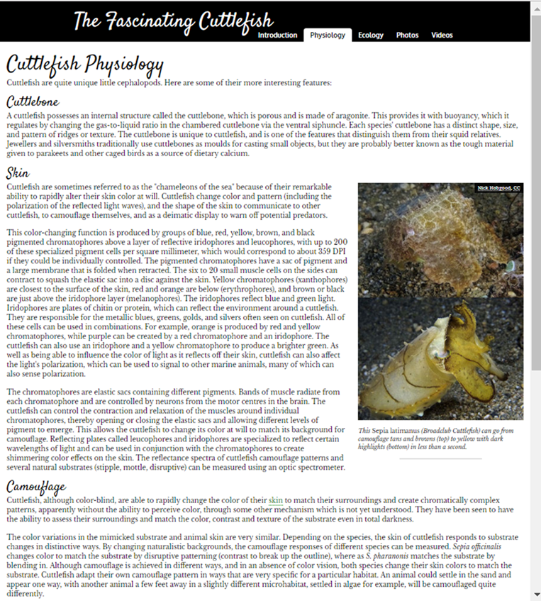
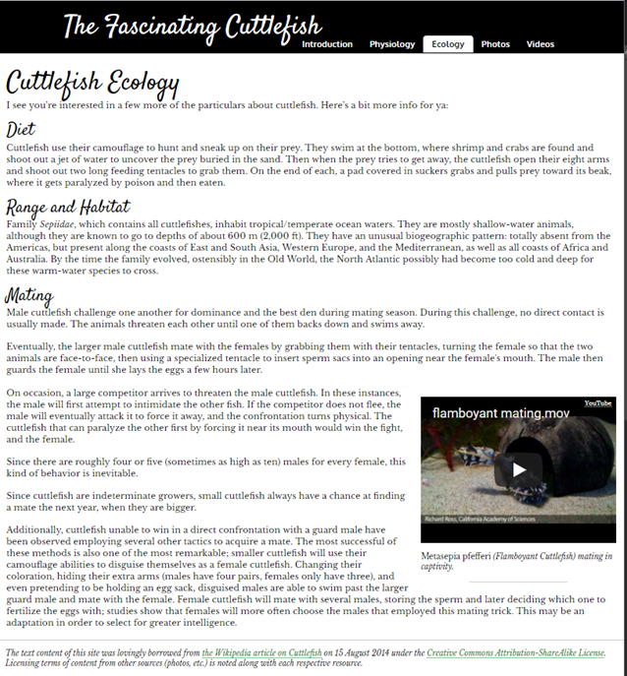
8
Content page of your choice
Example 2:
Example 1:

Slide 10
Submission Details
Create a Mock up of the following
Home Page
Navigation
Banner
Brief description
Footer
Give credit where credit is due
Videos page
Minimum of 4 videos
Images page
Minimum of 10 images
Each image must have a short description
Content page of your choice
Mix of text and video or images
Submit all four pages
You may use PowerPoint, Word or another software to create your mockups.
If you use a non-Microsoft software please convert to PDF for submission
This is only a mockup of your website

