Slide 1
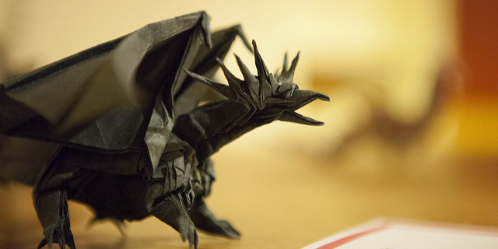
The Art of Origami
Introduction
Origami (折り紙, from ori meaning "folding", and kami meaning "paper" (kami changes to gami due to rendaku)) is the art of paper folding, which is often associated with Japanese culture. In modern usage, the word "origami" is used as an inclusive term for all folding practices, regardless of their culture of origin. The goal is to transform a flat square sheet of paper into a finished sculpture through folding and sculpting techniques. Modern origami practitioners generally discourage the use of cuts, glue, or markings on the paper. Origami folders often use the Japanese word kirigami to refer to designs which use cuts, although cutting is more characteristic of Chinese papercrafts.
The small number of basic origami folds can be combined in a variety of ways to make intricate designs. The best-known origami model is the Japanese paper crane. In general, these designs begin with a square sheet of paper whose sides may be of different colors, prints, or patterns. Traditional Japanese origami, which has been practiced since the Edo period (1603–1867), has often been less strict about these conventions, sometimes cutting the paper or using nonsquare shapes to start with. The principles of origami are also used in stents, packaging and other engineering applications.
Top | Photos >
The text content of this site was lovingly borrowed from the Wikipedia article on Origami on May 6 2018 under the Creative Commons Attribution-ShareAlike License. Licensing terms of content from other sources (photos, etc) is noted along with each respective resource.

Slide 2
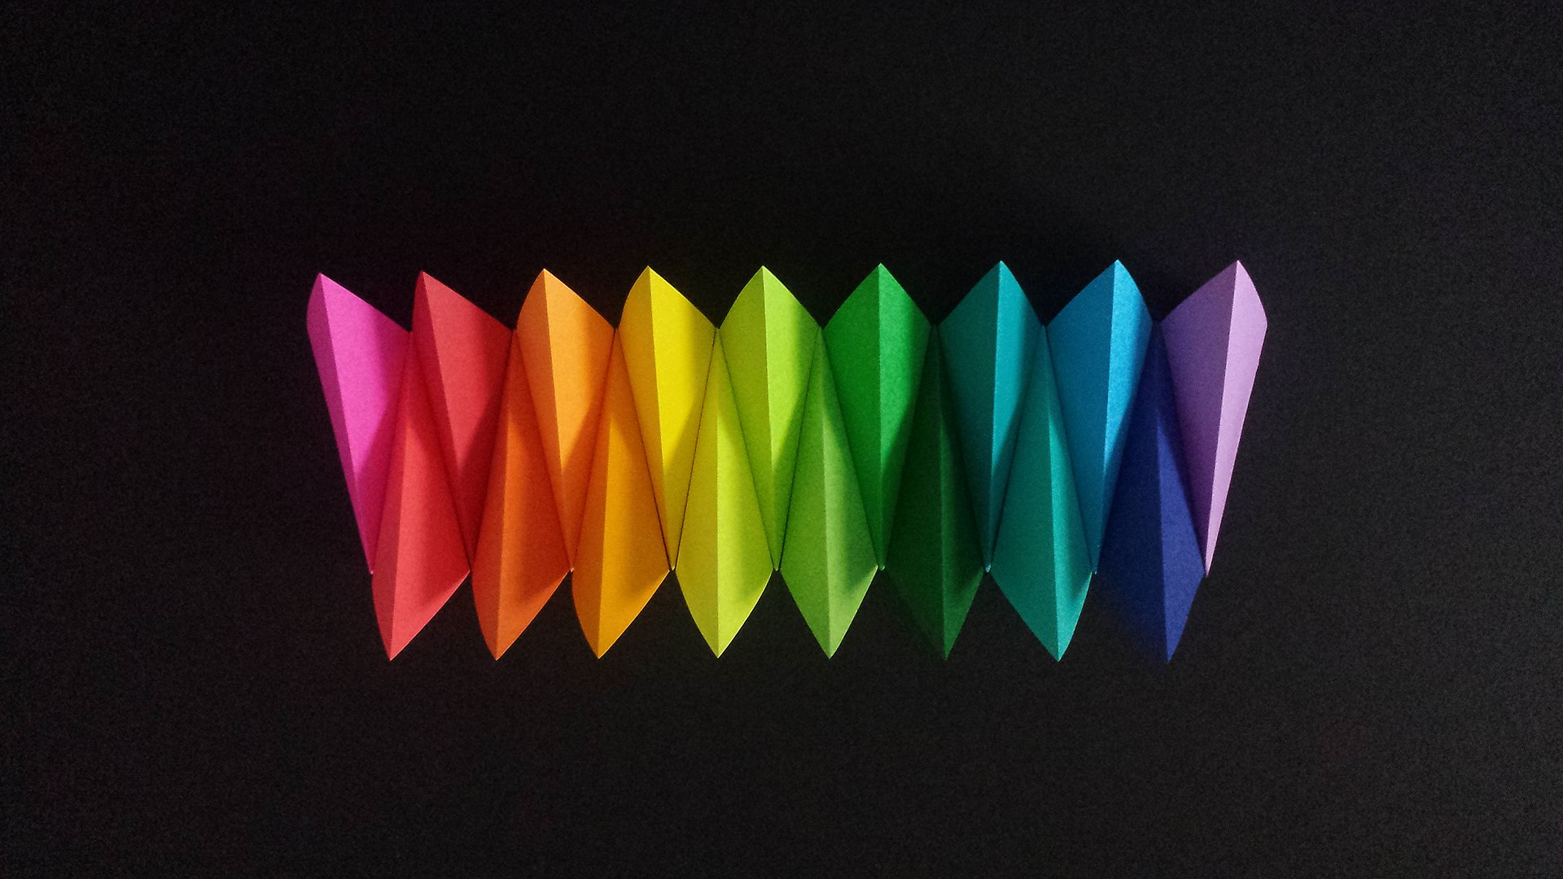
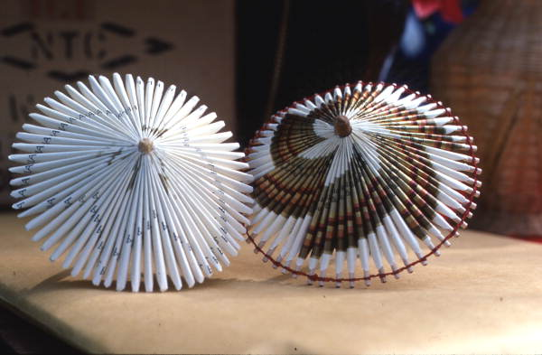
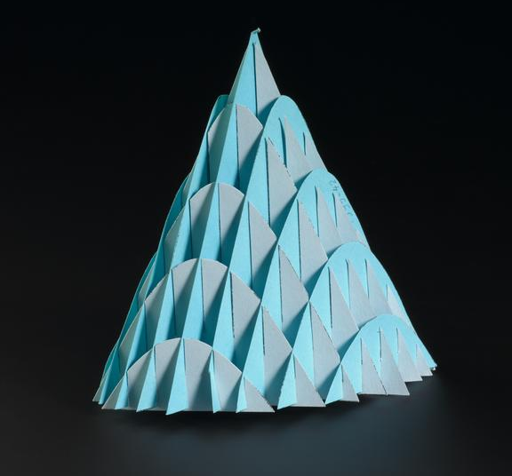
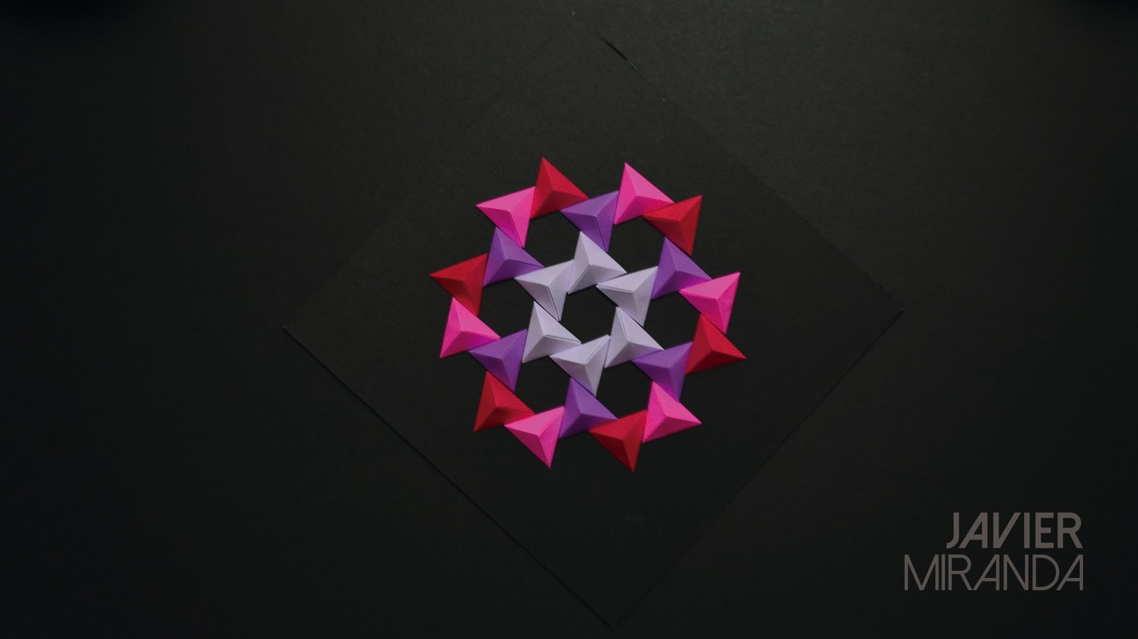
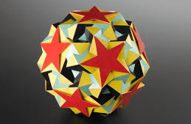
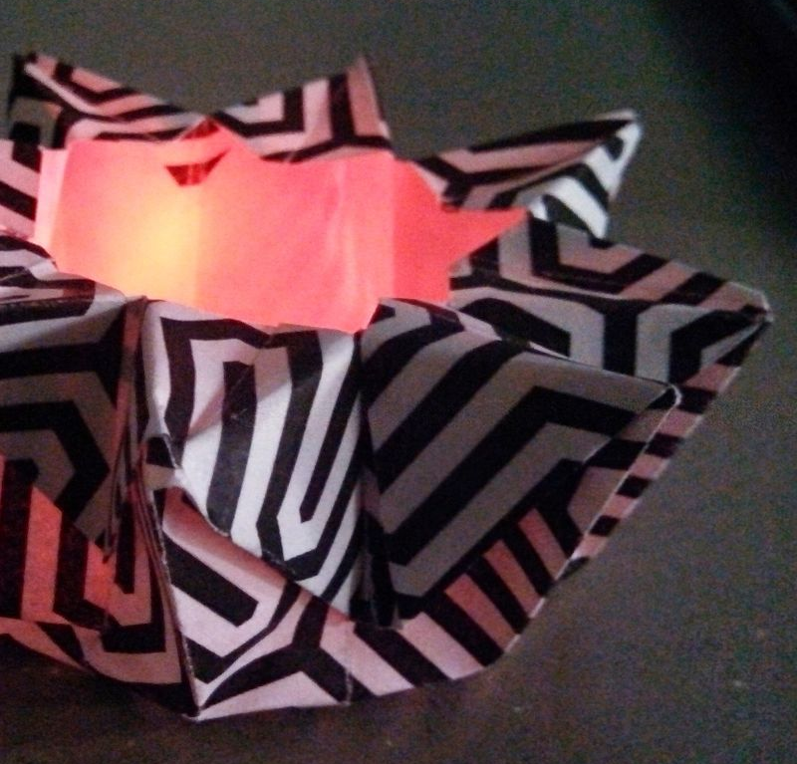
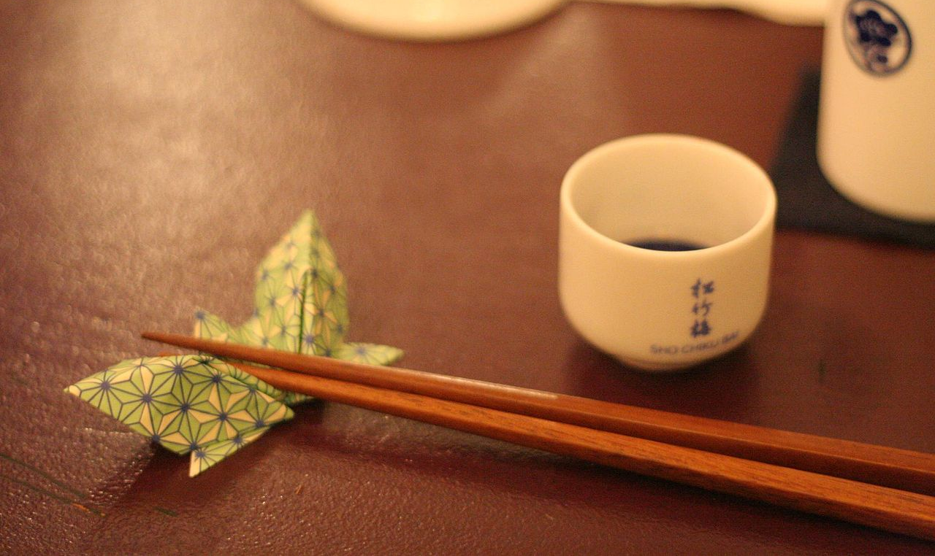
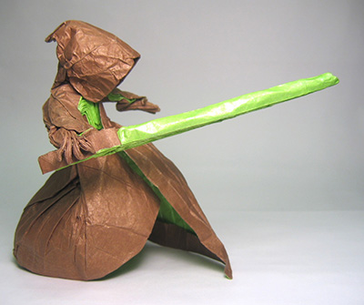
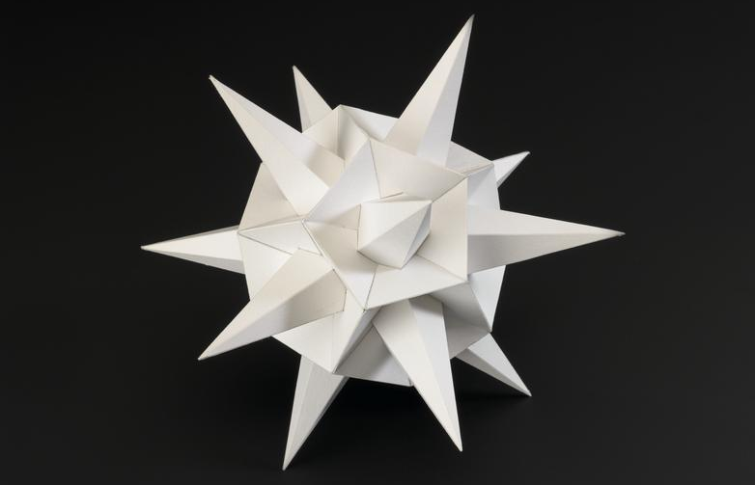
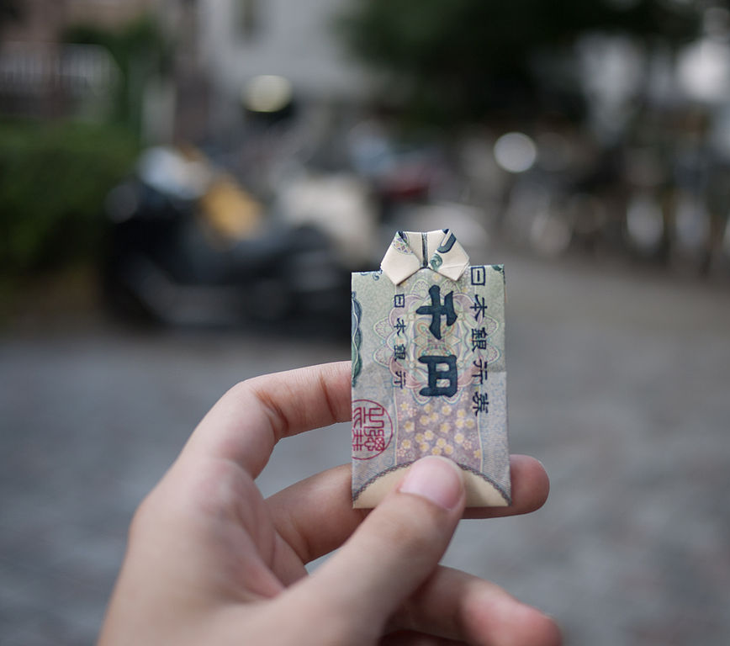
The Art of Origami
Home
Photos
Videos
Techniques
Photo Gallery
Origami art Javier Miranda - Venezuela
Origami made by Kazuko Law Pensacola, Florida
Sliceform of a cone © The Science Museum
Topología en invierno by Javier Miranda
Snub Icosidodecadodecahedron © The Science Museum
Origami led tea light Author: Susan Barnum
Sake, Chopsticks, Paper Rest Author: Orin Zebest
Jedi - Folded by Phillip West
Polyhedron model © The Science Museum
Remember Summer Author: Hajime Nagahata
The text content of this site was lovingly borrowed from the Wikipedia article on Origami on May 6 2018 under the Creative Commons Attribution-ShareAlike License. Licensing terms of content from other sources (photos, etc) is noted along with each respective resource.

Slide 3

The Art of Origami
Home
Photos
Videos
Techniques
Video Gallery
How to fold an Origami Crane, an easy and classic origami
Video tutorial for making an origami lily
How to make an origami Rose (Nakashima Rose)
How to fold the origami Fireworks by Yami Yamauchi
How to make a spiral of DNA origami
How to make Origami Magic Ball
The text content of this site was lovingly borrowed from the Wikipedia article on Origami on May 6 2018 under the Creative Commons Attribution-ShareAlike License. Licensing terms of content from other sources (photos, etc) is noted along with each respective resource.

Slide 4
The Art of Origami
Home
Photos
Videos
Techniques
Techniques
Many origami books begin with a description of basic origami techniques which are used to construct the models. This includes simple diagrams of basic folds like valley and mountain folds, pleats, reverse folds, squash folds, and sinks. There are also standard named bases which are used in a wide variety of models, for instance the bird base is an intermediate stage in the construction of the flapping bird. Additional bases are the preliminary base (square base), fish base, waterbomb base, and the frog base.
Origami Paper
Origami paper, often referred to as "kami" (Japanese for paper), is sold in prepackaged squares of various sizes ranging from 2.5 cm (1 in) to 25 cm (10 in) or more. It is commonly colored on one side and white on the other; however, dual coloured and patterned versions exist and can be used effectively for color-changed models. Origami paper weighs slightly less than copy paper, making it suitable for a wider range of models.
Normal copy paper with weights of 70–90 g/m2 can be used for simple folds, such as the crane and waterbomb. Heavier weight papers of (19–24&nb 100 g/m2 (approx. 25 lb) or more can be wet-folded. This technique allows for a more rounded sculpting of the model, which becomes rigid and sturdy when it is dry.
Foil-backed paper, as its name implies, is a sheet of thin foil glued to a sheet of thin paper. Related to this is tissue foil, which is made by gluing a thin piece of tissue paper to kitchen aluminum foil. A second piece of tissue can be glued onto the reverse side to produce a tissue/foil/tissue sandwich. Foil-backed paper is available commercially, but not tissue foil; it must be handmade. Both types of foil materials are suitable for complex models.
Washi (和紙) is the traditional origami paper used in Japan. Washi is generally tougher than ordinary paper made from wood pulp, and is used in many traditional arts. Washi is commonly made using fibres from the bark of the gampi tree, the mitsumata shrub (Edgeworthia papyrifera), or the paper mulberry but can also be made using bamboo, hemp, rice, and wheat.
Top | Home >
The text content of this site was lovingly borrowed from the Wikipedia article on Origami on May 6 2018 under the Creative Commons Attribution-ShareAlike License. Licensing terms of content from other sources (photos, etc) is noted along with each respective resource.

