Slide 1

Local Government
Digital Democracy
Notes:
Hi everybody! My name is Trina Sarkar and my group and I decided to focus the overarching theme of digital democracy to local governemnts -- because we see it as an area rife with potential to grow. Now, when we began, we only had vague ideas of issues and problems we wanted to solve and even vaguer solutions to those issues/problems. Through intervieweing a variety of participants, we discovered that interest in and knowledge of local government could be a great avenue for our needfinding project.

Slide 2
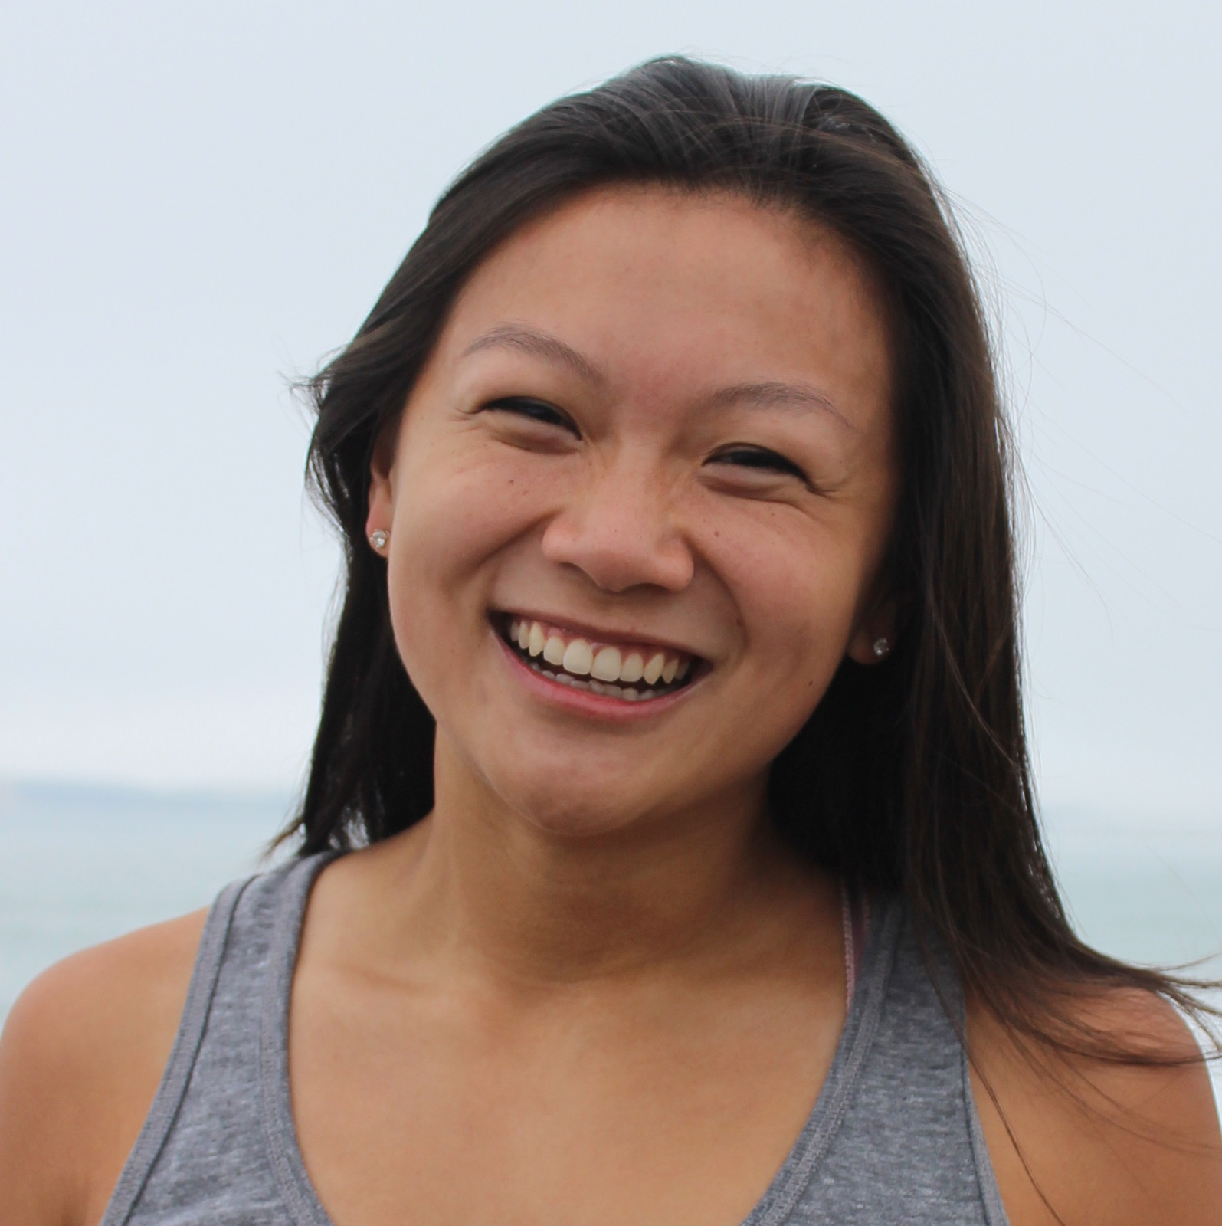
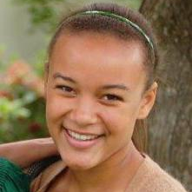
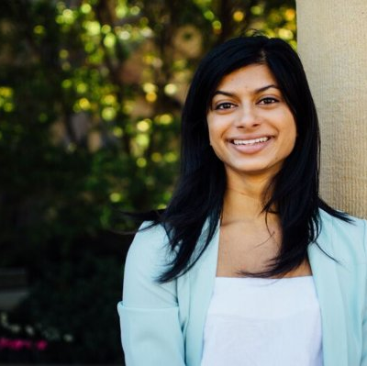
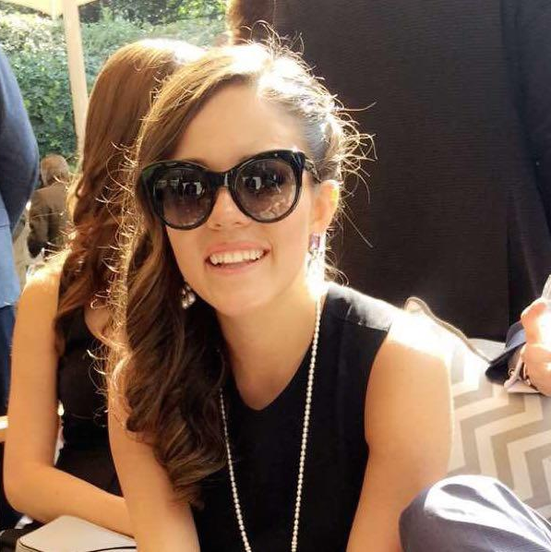
The team
Answer the question, “Why are we the ones to solve the problem we identified?”
Katy Shi
Alex Gill
Trina Sarkar
Ana Carolina Mexia
TEAM
Columbia, MO
Junior
Computer Science
Portland, OR
Junior
Symbolic Systems
Irvine, CA
Junior
Computer Science
Mexico City
Junior
Computer Science

Slide 3
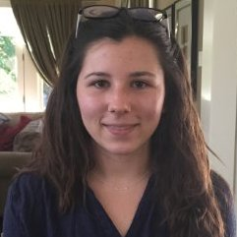

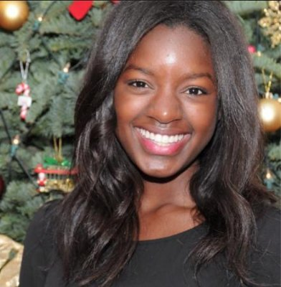
The team
Answer the question, “Why are we the ones to solve the problem we identified?”
Auden Ehringer
Lewis Kaneshiro
Ashley Akinola
PARTICIPANTS
Electrical Engineer
20
Orinda California
EXPERT
Entrepreneur
45
Native Hawaiian
ADULT
Economics
20
Irvine California
YOUNG ADULT
Notes:
In our interviewees, we looked for a variety of demographics, because we didn't want a single opinion dominating our data -- because in actuality, local government affects everyone! We scouted for and eventually successfully inteviewd a sample with a range of ages, genders, and ethnicities.
First, we interviewed Auden Ehringer , a friend of Caro's, in French House, a house on the row. Auden is a Stanford student, EE major, 20 yrs old, from Orinda California. We chose Auden because she is an extreme user, in that she is an expert on the workings of local government and could give us sound insight on how to improve this system that she knows so well.
SEcond, we interviewed Lewis Kaneshiro. We interviewed him because we wanted an older demographic to impart on how they view local government and if they are any less apathetic than the young. We asked him if we could interview him and then interview took place at the Stanford Bookstore.
Next, we interviewed Ashley Akhinola, at Tressider (bio). We wanted another young adult, but one who is not an extreme user -- and is more representative of the young adult population. We wanted to get insight on how to make local government more enticing to younger generations.

Slide 4

The team
Answer the question, “Why are we the ones to solve the problem we identified?”
Kojo
Toby
PARTICIPANTS
Mechanical Engineer
25
Chicago
RECENT INTEREST IN POLITICS
Software Engineer
24
New York
EXTREME (NOT US CITIZEN)
Notes:
To round of our participant panel, we have Kojo and Toby. Due to privacy reasons, they did not want their age or pictures to be displayed publicly but we interviewed them outside the Stanford bookstore. Kojo was interesting because he was a frequent mover and had only recently taken an interest in politics. We wanted to see how changing zip codes affected his interest in local government and were curious on how he was recently inspired.
Toby, was our final interviewee and another extreme user because he was actually not a US citizen but had seen the effects of local government from an outside perspective and had perspectives to share on his own experiences.

Slide 5
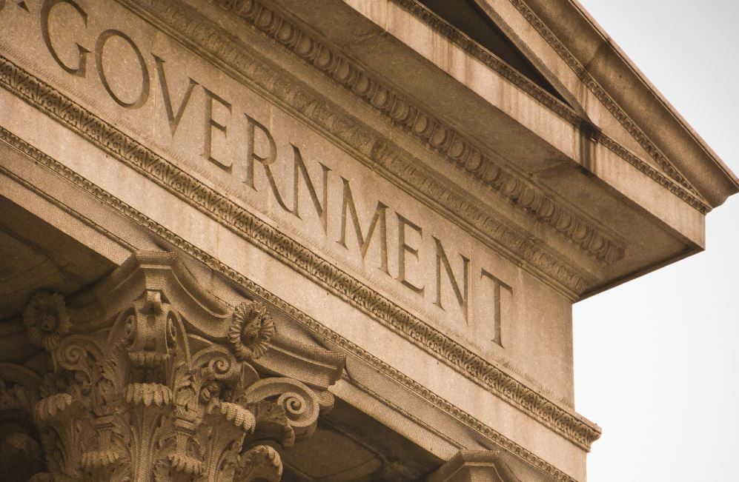
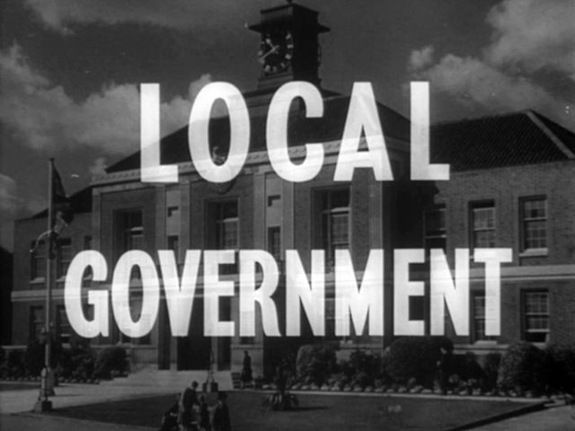

INITIAL QUESTIONS
Notes:
What do you know about government?
What do you know about local government?
What local government issues(if any) do you care about?
When was the last time you voted on local government issues?

Slide 6
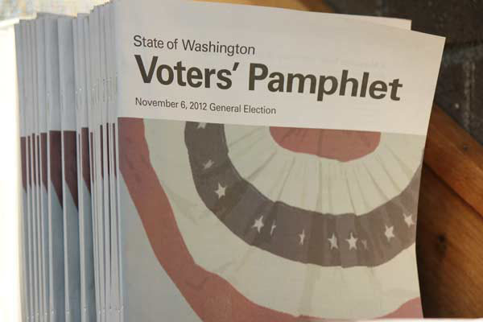

FOLLOW-UP QUESTIONS
Notes:
How do you prepare for voting in local government elections?
What social media sites have been helpful in this process?
What do you wish you knew about ballot measures previously?
What would incentivize you to vote in a local government election?

Slide 7
Empathy Map
SAY | THINK
DO | FEEL

Slide 8
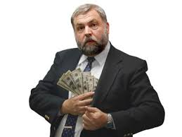
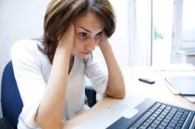
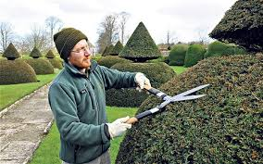

SAY
Notes:
Quotes:
"Local government is about trimming hedges. I don't care about that"
"It doesn't directly impact me."
"I'm not exactly sure what local government employees do."
"Most local politicians are only interested in making money."
"I move too much to vote in a local election."
Picture Links:
http://14831-presscdn-0-78.pagely.netdna-cdn.com/wp-content/uploads/2016/02/Corruption-Inc.jpg
http://www.catholicmatch.com/institute/wp-content/uploads/2013/08/frustrated-e1375796924733.jpg
http://visioncarebenefits.com/21805/how-to-trim-hedges/how-to-trim-hedges-entrancing-with-hedge-trimming-tips-for-keeping-your-hedge-in-perfect-shape
https://media.licdn.com/mpr/mpr/AAEAAQAAAAAAAAESAAAAJDdiMGRhZmY3LWRiMDEtNDgyNS1hMmY2LTEwMGEwZTRiMDU0Mw.jpg

Slide 9


THINK
Notes:
Quotes:
“It takes too much work to be informed”
“I should be more informed”
“What does my government actually do?”
“Why should I care about the local government?”
“I don’t really care”
“The local government doesn’t do anything that matters to me”
“My vote doesn’t matter”
“The local government doesn’t actually have any power”
“Does it really matter whether I know who the mayor is?”
Links:
https://images-mm.s3.amazonaws.com/Garfield_Whatever_New_Orange_Shirt.jpg
http://www.cityoflafayette.com/ImageRepository/Document?documentID=9295

Slide 10




DO
Notes:
Visit city council website / google the issue they are interested in
Social Media and News Digest
Don’t actively prepared to vote
Read Local Newspaper
Attends Townhall
https://upload.wikimedia.org/wikipedia/commons/thumb/c/c2/F_icon.svg/2000px-F_icon.svg.png

Slide 11

FEEL
Obligated vs. Insignificant
Passionate vs. Lazy
Inspired vs. Uninformed
Notes:
Contradictions!

Slide 12
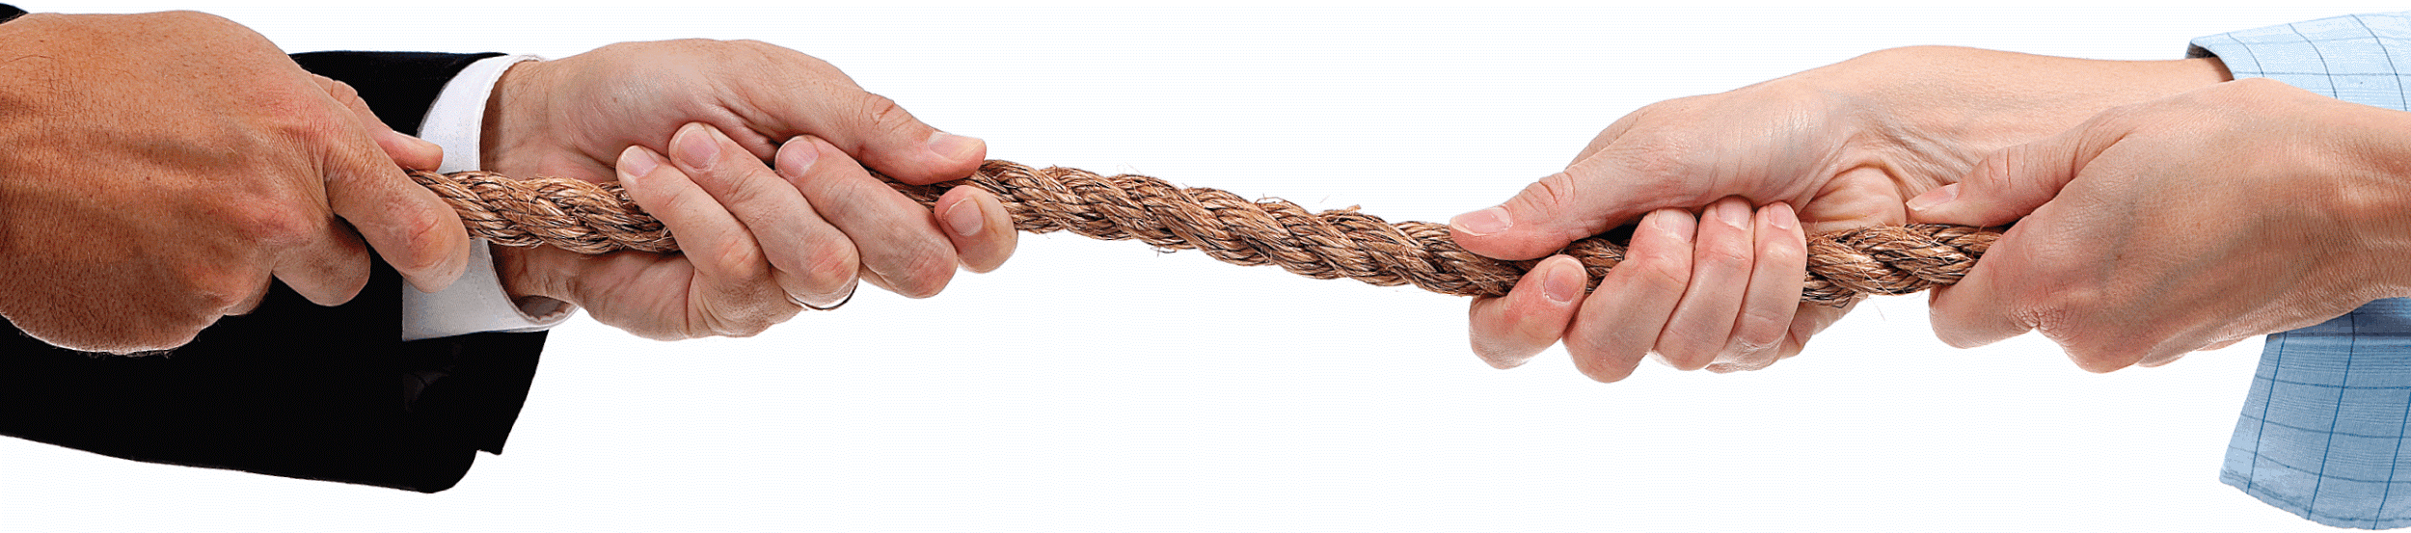
Tensions
“I know I should know more, and it’s embarrassing that I don’t.”

Slide 13
Tensions
“Sometimes I don’t vote because my vote doesn’t matter, and if I do want to vote, it takes too long to dig around to find information and become an informed voter”

Slide 14
Tensions
Tensions
“Local governments care about stuff like trimming hedges. I don’t care about stuff like that.”

Slide 15

Surprises
Different Interests
Based on Background
Wants something that summarizes each issue while waiting in line.
Notes:
Ashley cared about education and infrastructure
Lewis vocalized zero interest in education and infrastructure; cares about Native Hawaiian issues and sexual assault
Kojo cared about health care

Slide 16
Needs
To be an informed voter
To learn about issues quickly
To hear about issues that matter to them
Insights
Everyone wants to be an informed voter, but few have the time/energy/inspiration to learn
Voters are very particular about which issues they want to hear about
Questions
How can we balance high information with minimal to low user effort?

Slide 17
Summary
SUMMARY
Most people know nothing about their local government, but are curious about the issues that matter to them
A large hindrance in being informed about local issues is the lack of a centralized resource, aside from the actual ballot
Information on the ballot may not be factually accurate - need a way to present info concisely and factually

