Slide 1

BallotBox

Slide 2
OVERVIEW
Value Proposition
Know your ballot before you vote
Problem/Solution
Many young voters know nothing about their local government and have no desire to learn. Our app mocks up a ballot such that you can click on individual issues and learn more about each one. The app is designed such that you could use it in line while waiting to vote and be sufficiently informed by the time you vote.

Slide 3
TASKS
Simple
Acquainting users with the ballot
Medium
Learning more about the specific measures on the ballot
Complex
Ranking Issues/Measures/Positions that are important to you

Slide 4
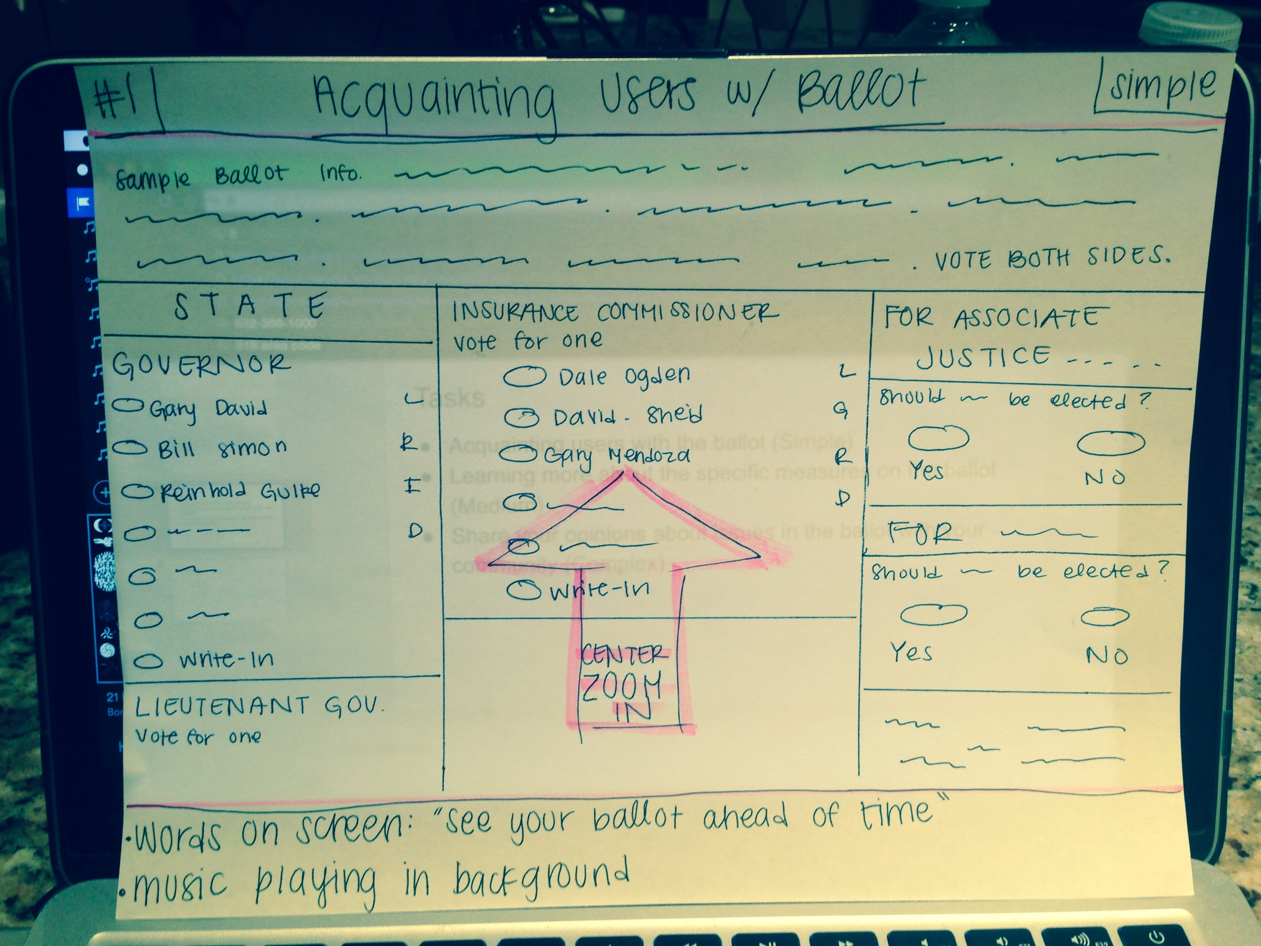
STORY BOARDS

Slide 5
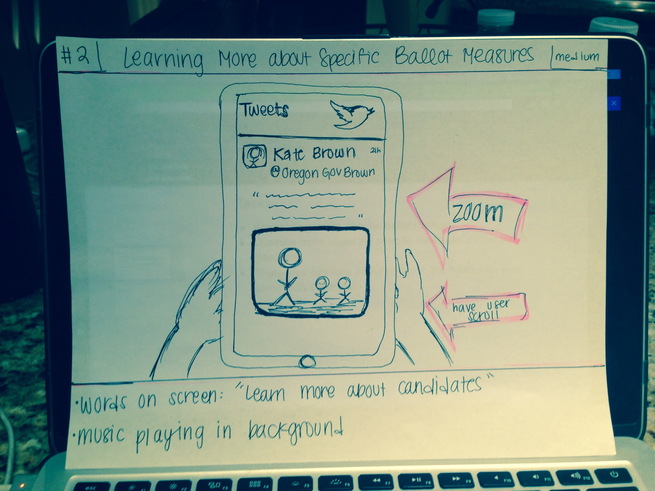
STORY BOARDS

Slide 6
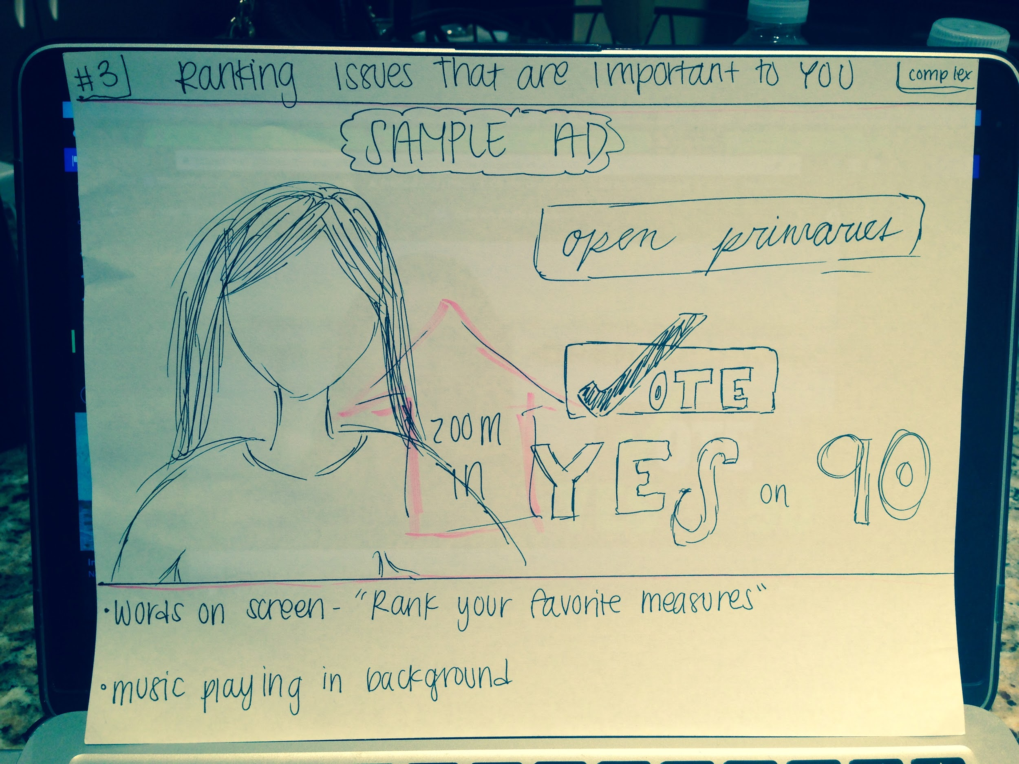
STORY BOARDS

Slide 7
https://youtu.be/XDU4O9CbdSM

