Slide 1

BallotBox
Know your vote.

Slide 2
Hello!
Ana, Alex, Katy, and Trina
Updates on our medium-fi prototype
Notes:
I’m Alex and working on team with Ana, Katy, and Trina, and I’m here to give an update on our medium-fi prototype

Slide 3
1.
Problem and Solution Overview
Notes:
Local government --> needfinding pattern of folks who knew nearly nothing about local government --> obligated to vote but incredibly uninformed while doing so

Slide 4
Many new voters find the ballot and the issues proposed by their local government very hard to navigate. Our app mocks up a ballot such that you can click on individual issues/candidates and learn more about each one. The app is designed such that you could use it in line while waiting to vote and be sufficiently informed by the time you vote.
Notes:
So we set out to address the problem that new voters in particular had a hard time navigating ballot issues and understanding what each candidate stood for and what each measure meant. Our solution was to mock up and interactive ballot that allowed voters to learn more. Since most people didn’t have time or motivation to go out of their way, we designed the app such that users could explore while waiting in line to vote -- which would likely be otherwise spent wasting time on phones.

Slide 5
Three Tasks
Updates and Improvements
Notes:
Started out with acquainting users with ballot, learning more about measures/candidates, and suggesting potentially relevant measures to users. However, we realized these three tasks were too simple, so we updated from there to provide a more interactive and fulfilling experience.

Slide 6
Acquaint with ballot
Learn and save issues
Quiz to find measures
Simple
*Improved* Medium
*New* Complex
Notes:
Retained original simple task of acquainting with ballot. Our medium task has now updates so users can save issues. Complex task now provides a user quiz to suggest measures relevant to them.

Slide 7
Improved task: Voter Summary
“Vote” for preferred candidates and measures
Summary of votes to remind you of your votes
Inspired by classmate’s suggestion -- thanks!
Notes:
Inspired by classmate’s suggestion we now allow users to vote on app for preferred candidates. Then at any time, user can check on their voting summary to see who they liked and their opinions on various measures

Slide 8
New task: User Quiz/Survey
Take quiz at start of app about lifestyle
We’ll suggest measures relevant to you
Have kids? Learn about education reform
Use public transit? Learn about transportation funding
Do you smoke? Learn about cigarette tax
User survey now acts as the bridge between ballot and issue finder
Notes:
Our new task came from our user testing last week, when a user suggested a quiz for finding issues that matter to them. Now, at startup users take a quiz about their lifestyle, and we will suggest relevant measures. Before, issue finder relied on users to choose their own, but now more integrated and we do the work for you

Slide 9
We made some changes
Voter Summary
User Quiz
Android
Notes:
As you can see, those were two of our major three changes this week. Now we’ll look at changes in design of prototypes

Slide 10
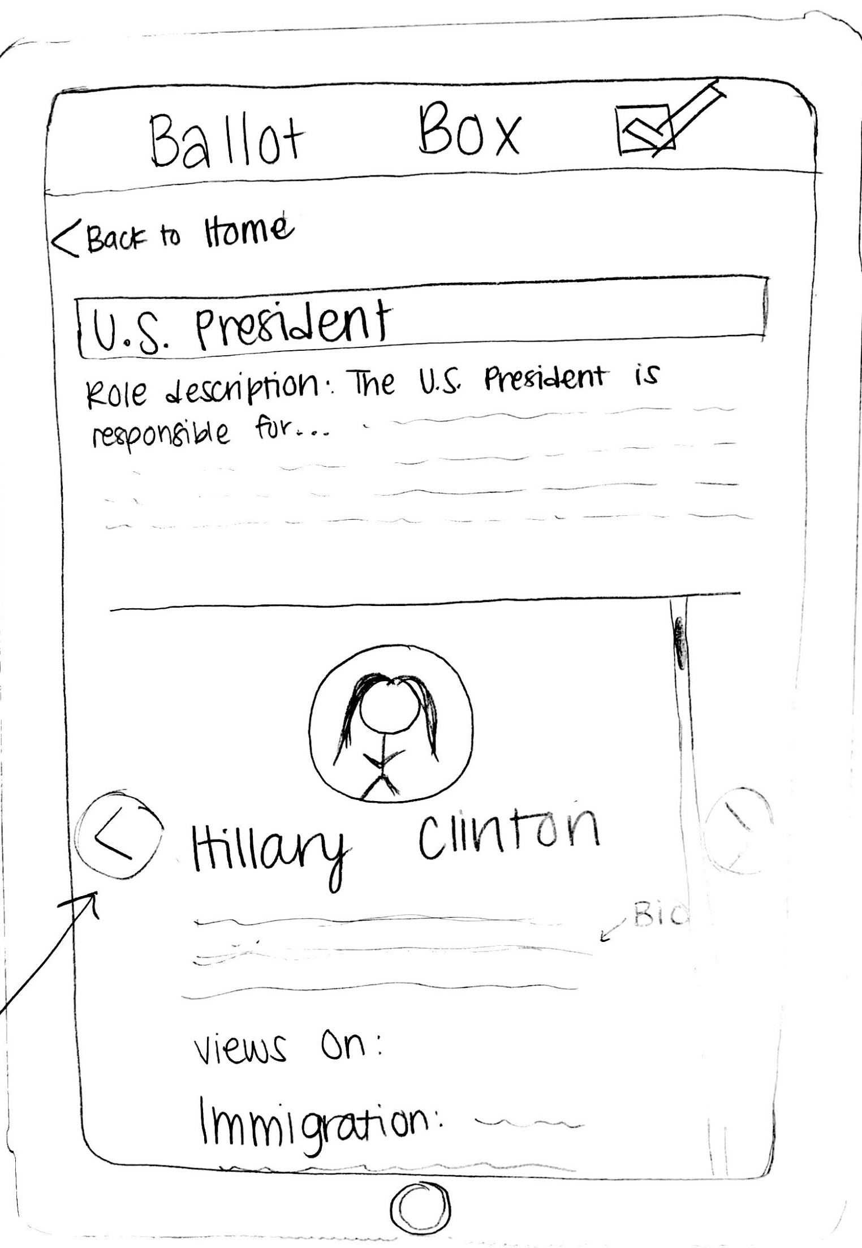
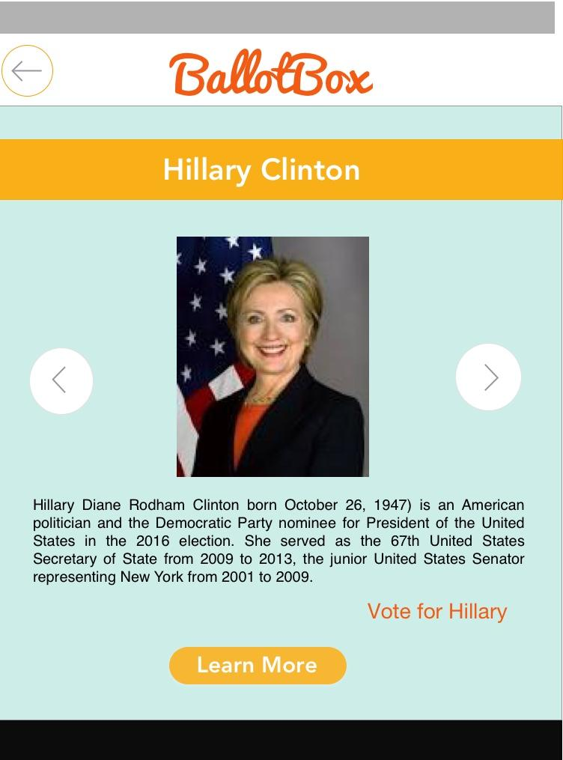
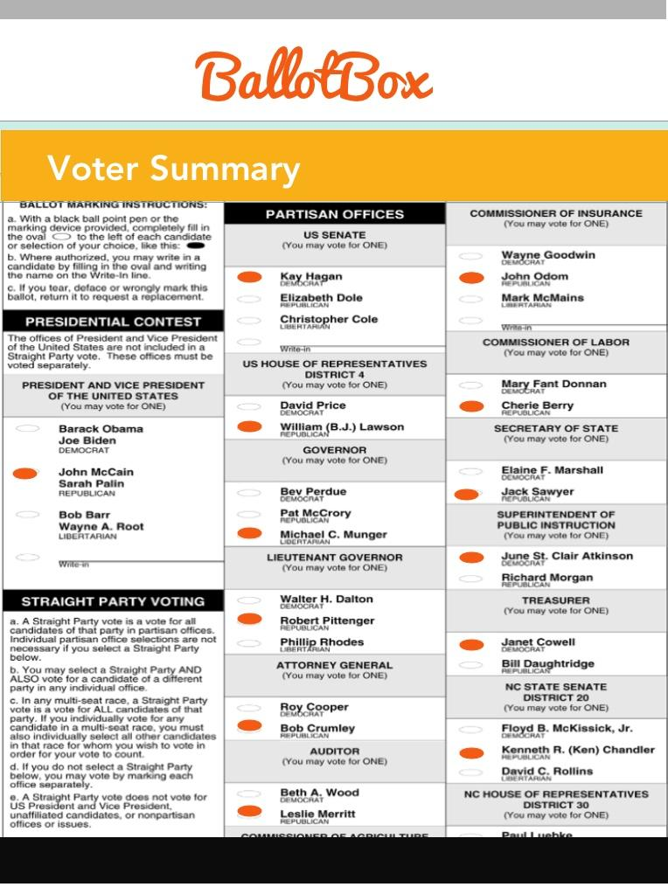
Simple Explore → Active voting
Before
After
Why?
Keep track of opinions
Active voting decisions more useful than simple learning
Practice act of voting

Slide 11
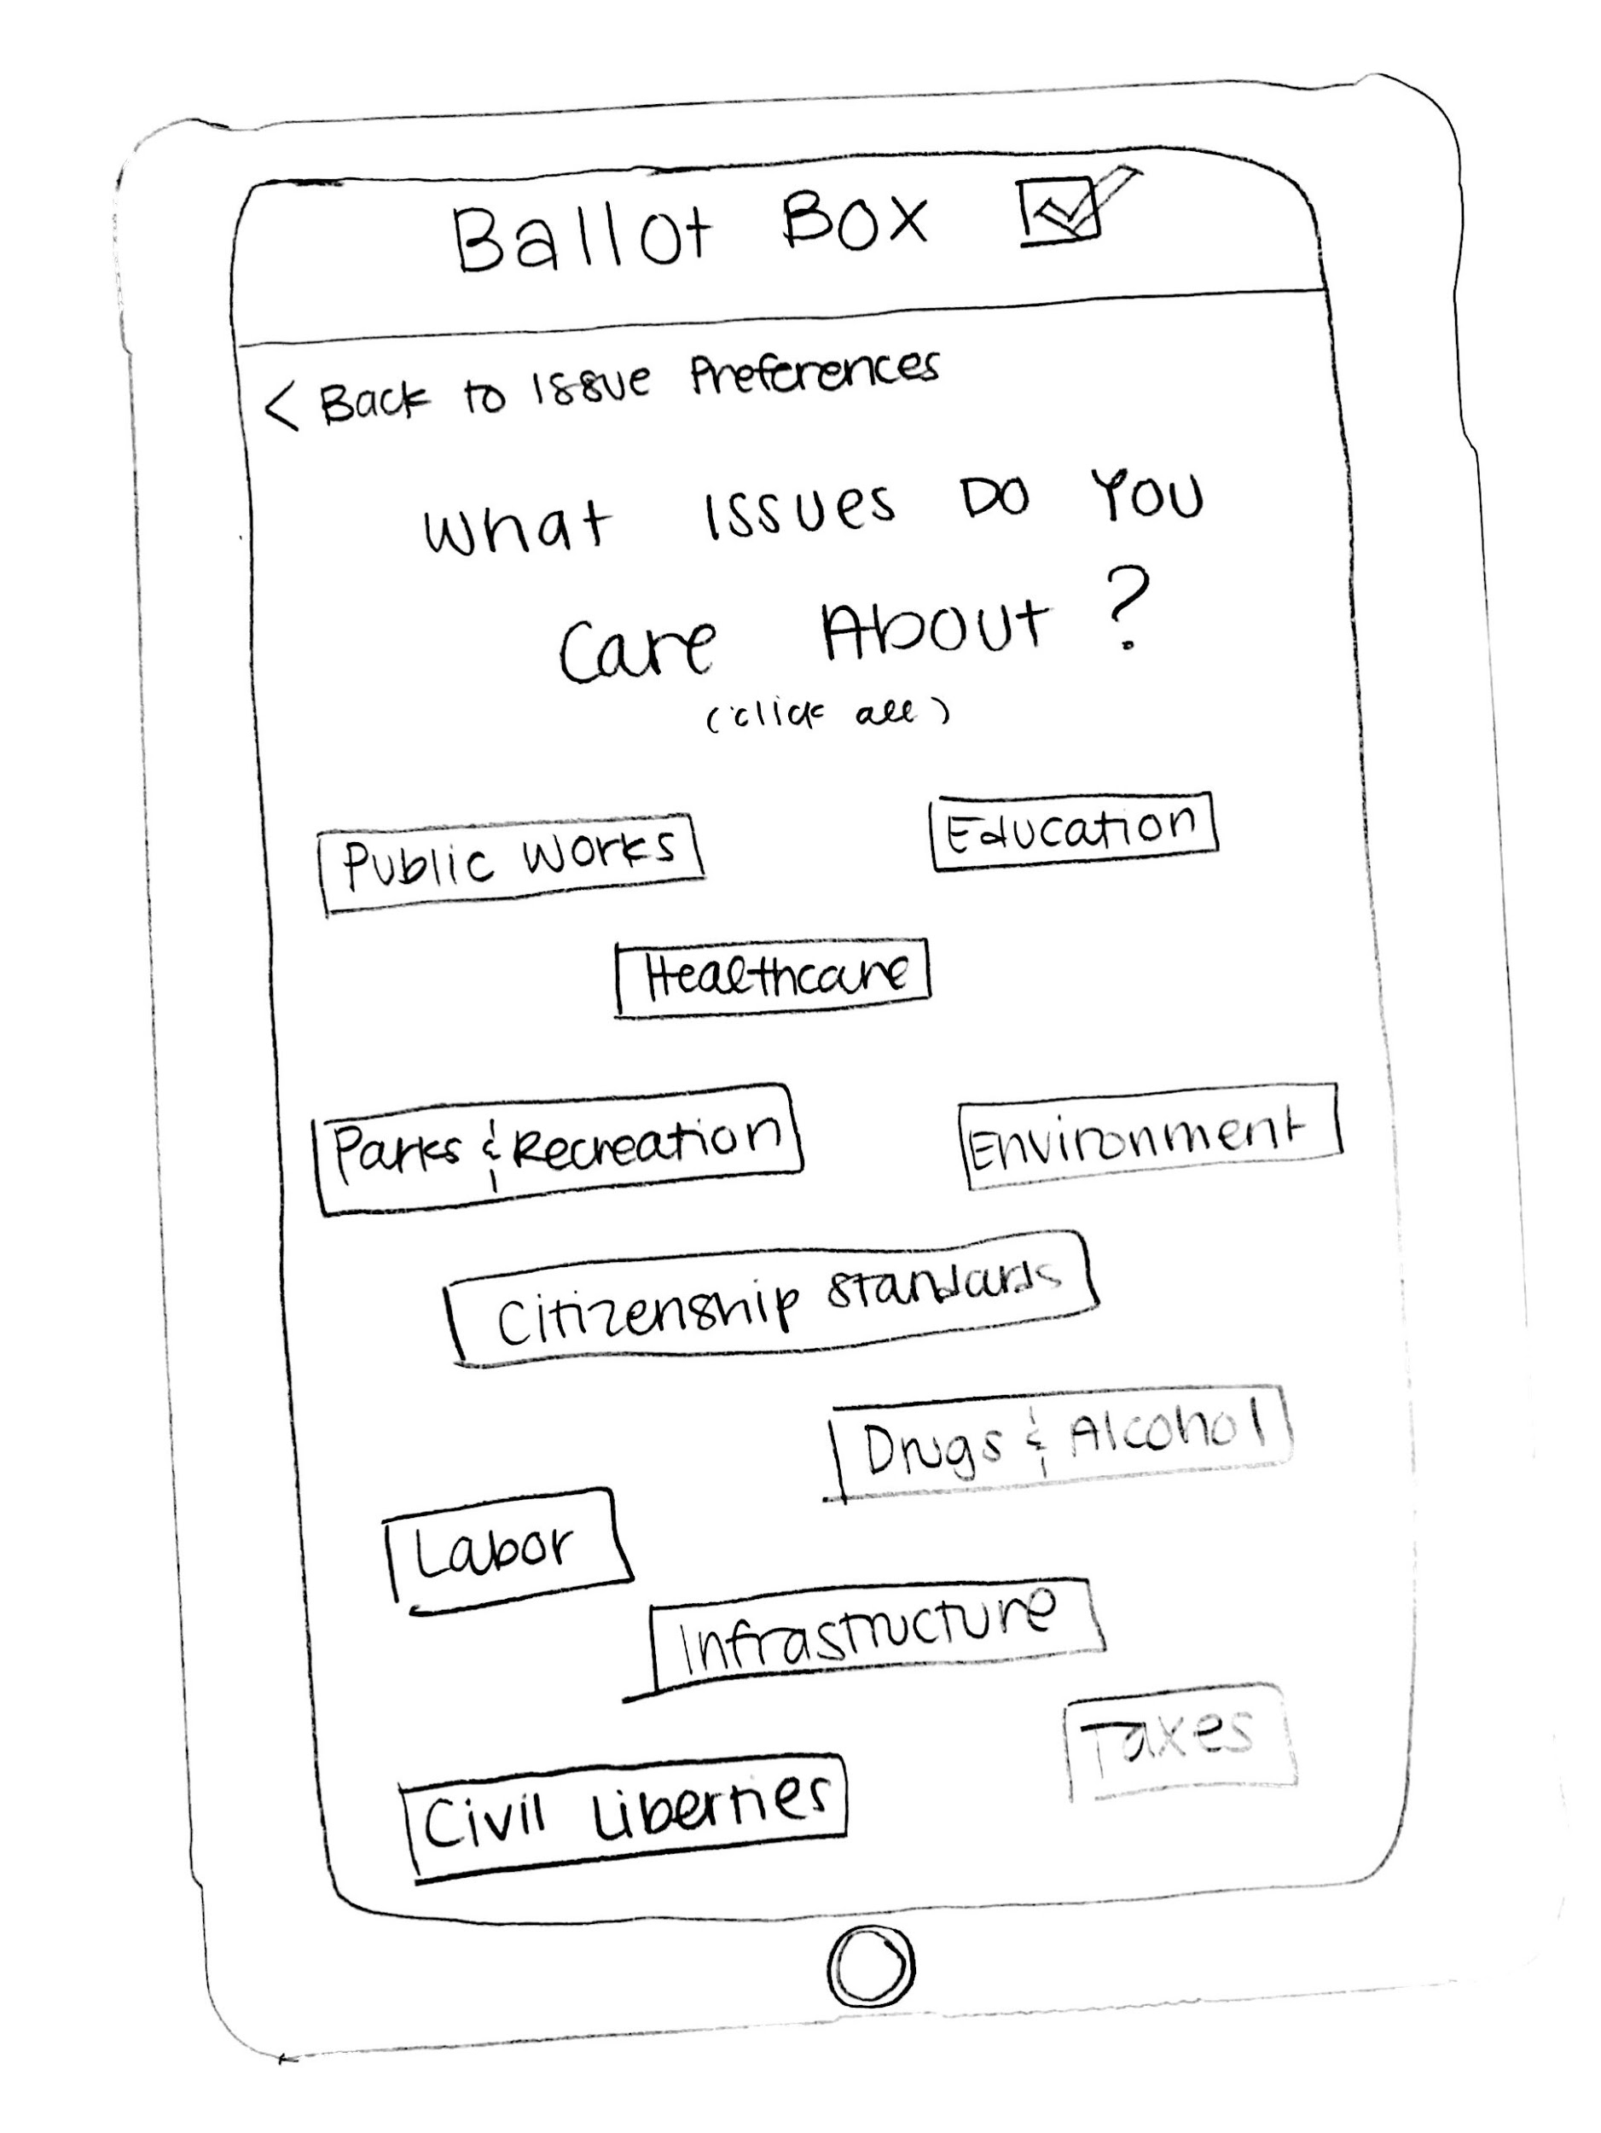
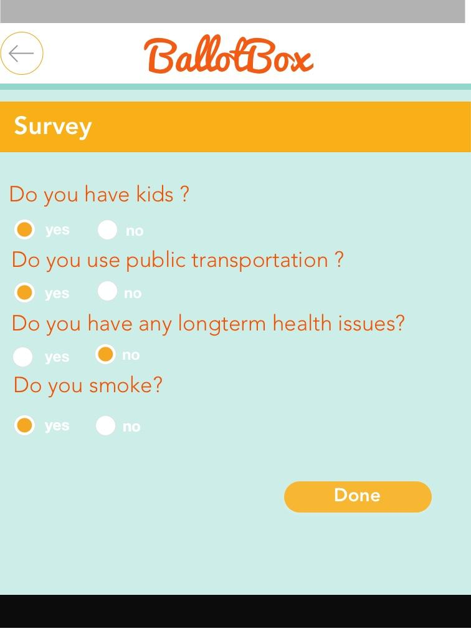
Issue Finder → Quiz
Before
After
Why?
More interactive interface
Brings up issues voters may not have considered
App makes connections between issues and measures for you

Slide 12
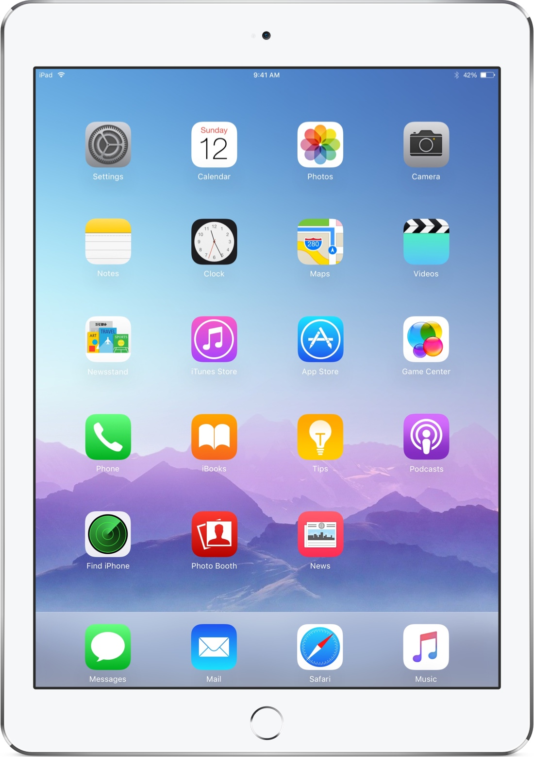
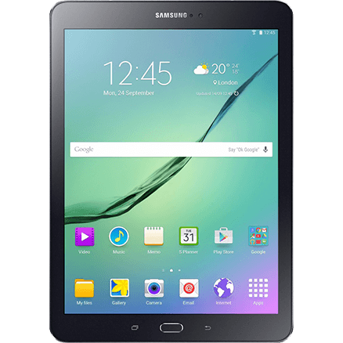
iOS → Andriod
Before
After
Why?
More affordable for widespread use
Java
More variety in size

Slide 13
Prototype Taskflows

Slide 14
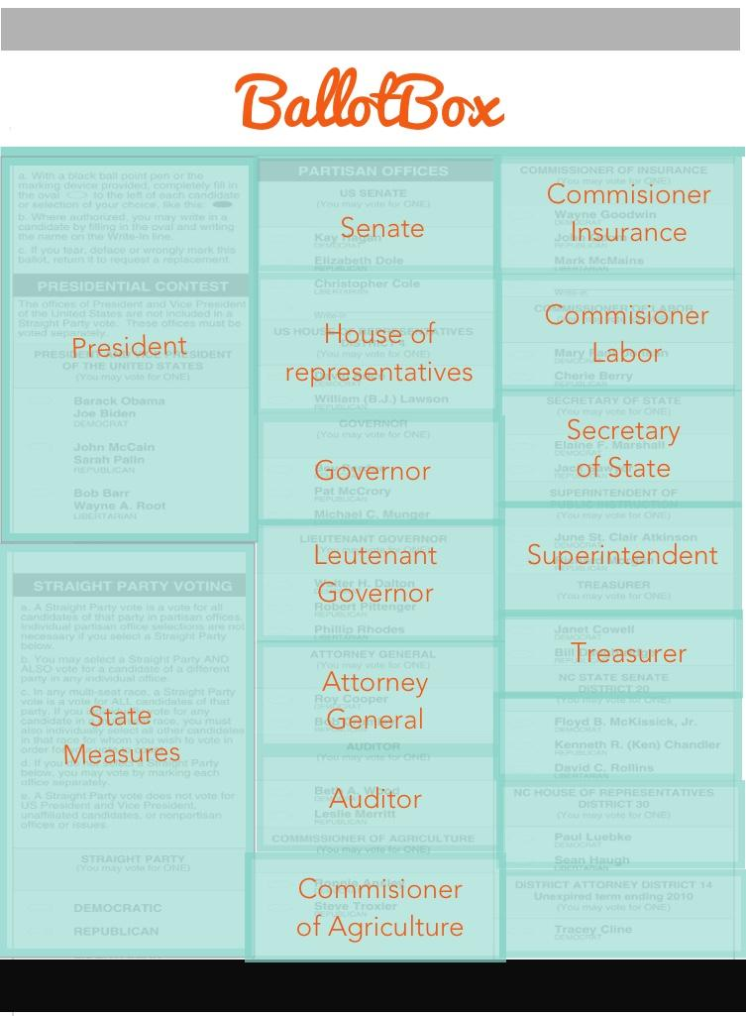
Simple Task
Acquaint users with ballot

Slide 15
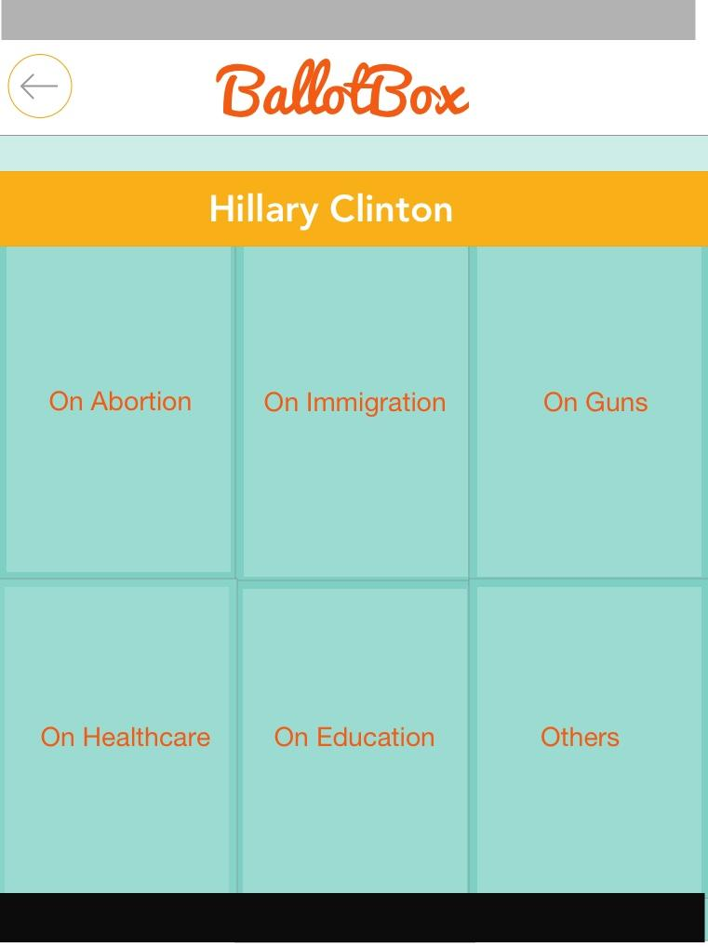
Medium Task
Learn about candidates/issues and star the ones you like

Slide 16
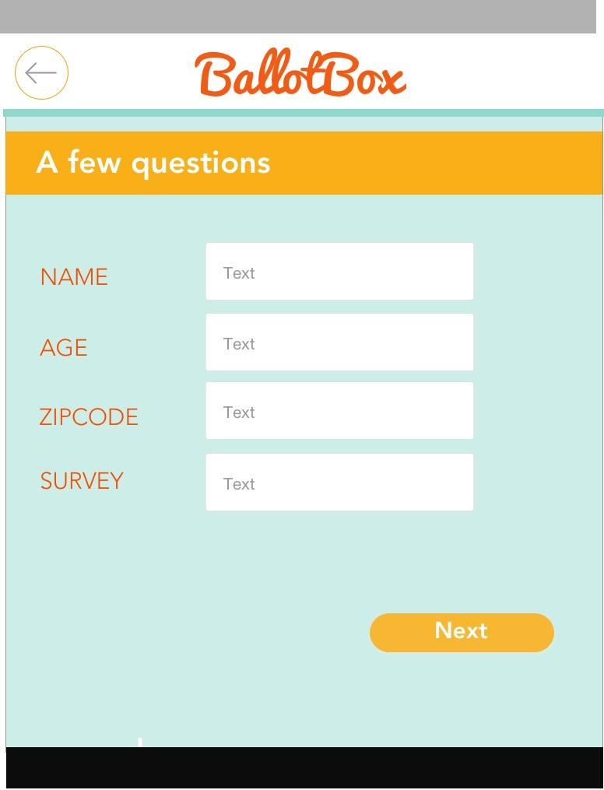
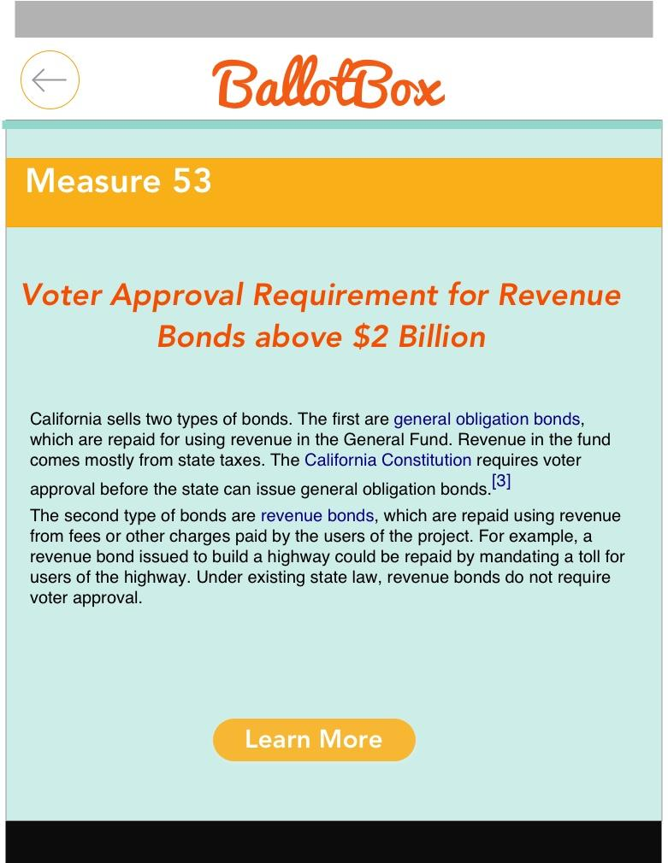
Complex Task
Take a quiz, and see suggested measures based on answers

Slide 17
Prototype Tools
What we used & how it helped

Slide 18

Sketch.
Helped with:
Creating UI
Easy export to Invision
Didn’t help with:
Dynamic mockups
Transitions

Slide 19

Invision.
Helped with:
Ordering task flow
Making sure flow made sense
Didn’t help with:
Backend functionality
Doing everything in one app

Slide 20
Current Limitations
Limitations:
Doesn’t account for weight of tablet
No real backend functionality
Wizard of Oz:
Hard-coded user survey results, votes
Ballot for just one county

Slide 21
Thanks!
Any questions?

